Slide 1
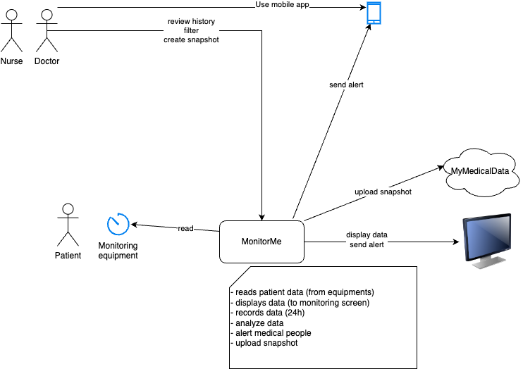

Slide 2

personel
doctor
MyMedicalData
MonitorMe Dashboard
(GUI)
MonitorMe App
snapshot creator
Patient DB
Notification creator
Analyse rule builder
Signal DB
displays
patient
sign analyzer
(per type but using all signals)
store
vital sign input device
vital sign
collector
(per patient and type)
Analyse Data Dispatcher
MonitorThem
send signal

Slide 4
