Slide 1
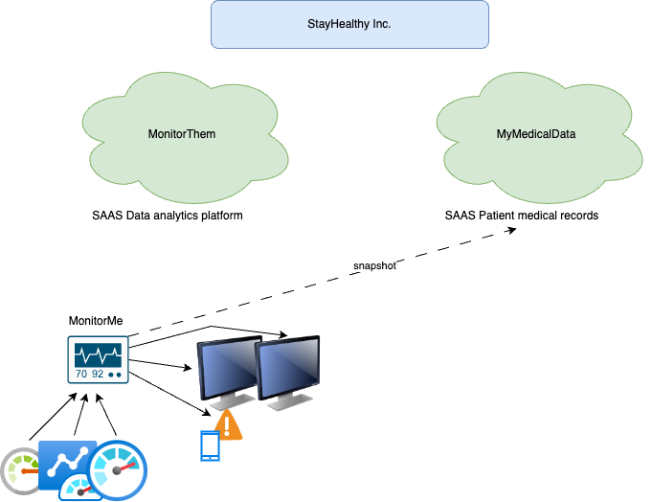

Slide 2
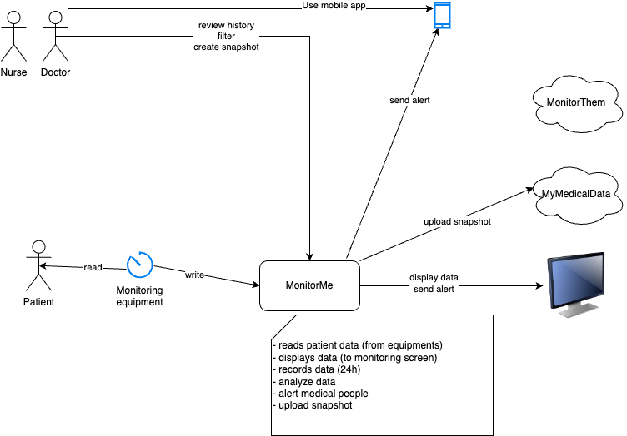

Slide 3

personel
doctor
Component View
MyMedicalData
MonitorMe Dashboard
(GUI)
MonitorMe App
snapshot creator
Patient DB
Notification creator
Analyse rule builder
Signal DB
displays
patient
sign analyzer
(per type but using all signals)
store
vital sign input device
vital sign
collector
(per patient and type)
Analyse Data Dispatcher
MonitorThem
send signal

Slide 4
personel
doctor
Event Driven
Component View
MonitorMe Dashboard
(GUI)
MyMedicalData
MonitorMe App
External Data APIs
MonitorThem
Patient DB
Analyse Rule Builder
Notification Event Channel
Raw Signal Persister
Signal DB
patient
Signal Analyzer
Vital Signal
Event Channels
(One Topic per Signal type)
Patient Signal
Collector
(all Signals per patient)
vital signal input device
Event producer
Event Channel/Queue
Event Consumer
Microservice

Slide 5
Roles & Responsibilities
5 | Snapshot Creator
5.1 | Enable to create Snapshot from Signal DB
5.2 | Access Consolidated Data from Signal DB
5.3 | Capable to upload Snapshot to MyMedical Data ( 10 )
5.4 | HTTPS API
6 | Signal Analyzer
 | Adjust Thresolds dependant on Patient A/S
 | Calculate A/S and VS threshold to patient record
6.1 | If Trend on Blood Presure drops -->Patient S
6.2 | (A/S) Blood Pressure Threshold calculated and SET
6.3 | if Patient S Alarms Adjusted.
6.4 | If Patient A Alarms Adjusted
6.5 | If Trend heart rate drops -->Patient S
6.6 | (A/S) Heart Rate Threshold calculated and SET
6.7 | if Patient S Alarms Adjusted.
6.8 | If Patient A Alarms Adjusted
6.9 | If Respiration Rate drops -->Patient S
6.1 | (A/S) Respiration Rate Threshold calculated and SET
6.11 | if Patient S Alarms Adjusted.
6.12 | If Patient A Alarms Adjusted
7 | Notification Event Channel
7.1 | Monitor thresholds per patient (per record)
7.2 | Analize and Triggers Alerts (Notifications) to users
7.3 | Manage users who should recieve Notifications
7.4 | Build and Manages notifications to be sent to APP
7.5 | Build Consolidate Data to be sent to MonitorMe Dashboard
7.6 | Sent data to APP
7.7 | Send data to MonitorMe dashboard ( 3 )
8 | Analyze Rule Builder
8.1 | Collects Data from Signal Analyzer ( 5 )
8.2 | Send data to MonitorMe ( 9 )
1 | Vital Sign input device
 | Collects raw data:
1.1 | heart rate
1.2 | blood pressure
1.3 | oxygen levels
1.4 | blood sugar
1.5 | respiration rate
1.6 | ECG
1.7 | body temperature
1.8 | sleep (awake/sleep)
2 | Patient Signal Collector
2.1 | Collects raw data 1.1-1.8 per patient
2.2 | Process raw data per patient (1 record)
2.3 | 20 records available for 1 Nurse Station
2.4 | 20 Records available every < 1s
2.5 | Every Record on Screen every 5s
2.6 | 100 s (20 x 5s) time to show 20 Records
2.7 | Data recorded and Stored for 24hrs (history)
2.8 | Receive and Record 6.5 Data (Consolidated Data)
2.9 | Receive and Record 6.6 Data (APP Data)
3 | Signal Persister
3.1 | Collects and stores Vital Signals
4 | MonitorMe Dashboard
4.1 | Collects data from Patient Signal Collector
4.2 | 20 Records (20 patients data) and Store in Patient DB
4.3 | Display the data (Dashboard)
4.4 | filters by time and vital signal
4.5 | Through a GUI a user can access history data

Slide 6
Architecture Characteristics
The Solution design is based on an Event-Driven Architecture, as this provide:
Scalability.- The solution is deployed in premises but based on a private cloud and designed to be scalable (initially up to 500 patients), this is achieved by a combination of proprietary devices, software and cloud native technologies.
Security.- Based on premises all data is secure and governed by the required medical standards according to the regional area where it is deployed; exposed APIs externally to integrate with SaaS is through a single point of integration by using an API Gateway. All communications are encoded.
Reliability.- Services and DBs decomposition allows to have high availability in the solution end to end. It is expected that 8 of the vital signals are monitored separately per specific sensors and data collected independently, see component ( 3 ) is de-coupled for this specific purposed.
Performance.-By priorizing Event Driven architecture for NFRs data collection (periodicity) per each of the 8 vital signals, see component 1, the aim is to allow the overall solution to adjust to the dimensioned capacity performance.
Elasticity.- The Design is dimensioned based on the core initial Requirements; the deployment of microservices (see roles & responsibilities) allow the solution to cope with traffic peaks driven by users (doctors, nurses and other medical staff).
Atomicity.- Due to requirements to manage and process critital information as vital signals, we proposed decoupling of services and DBs-Intent in order to enable atomicity per transaction . (see Use Cases).

Slide 7
Use Case 03: alert

Slide 8
Use Case 03: alert

Slide 9
Use Case 03: alert

Slide 10
Use Case 03: alert

Slide 11
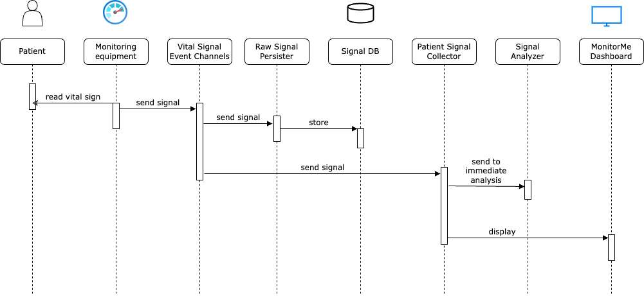
Use Case 01, 02: collect and display signals

Slide 12
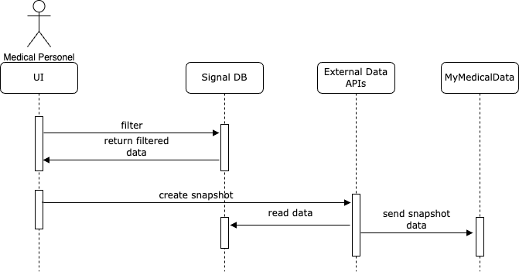
Use Case 05: create snapshot

Slide 13
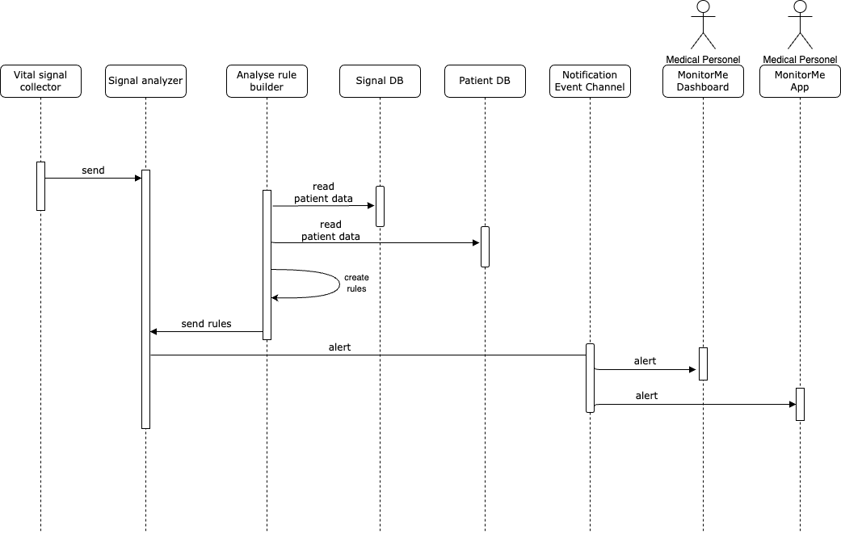
Use Case 03, 04: analyse signals and alert

