Slide 1
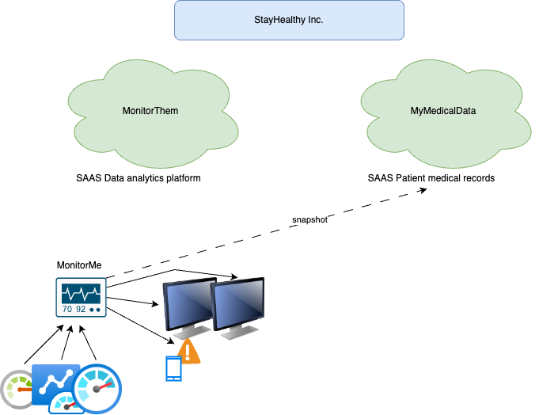

Slide 2
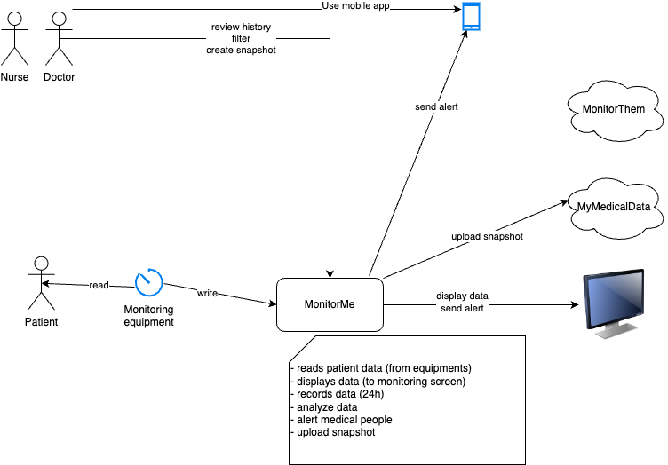

Slide 3

personel
doctor
Event Driven
Component View
MonitorMe Dashboard
(GUI)
MyMedicalData
MonitorMe App
External Data APIs
MonitorThem
Patient DB
Analyse Rule Builder
Notification Event Channel
Raw Signal Persister
Signal DB
patient
Signal Analyzer
Vital Signal
Event Channels
(One Topic per Signal type)
Patient Signal
Collector
(all Signals per patient)
vital signal input device
Event producer
Event Channel/Queue
Event Consumer
Microservice

Slide 4
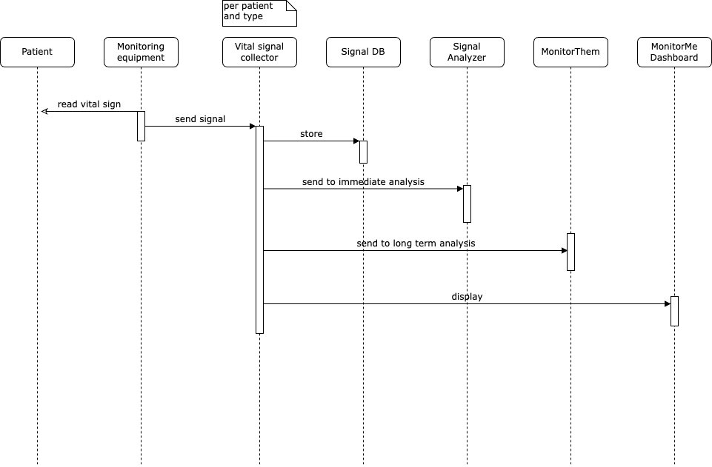
Use Case 01: collect signal

Slide 5
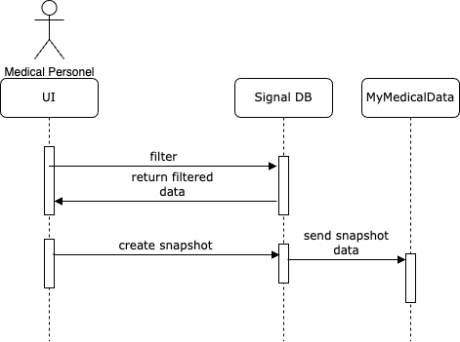
Use Case 02: create snapshot

Slide 6
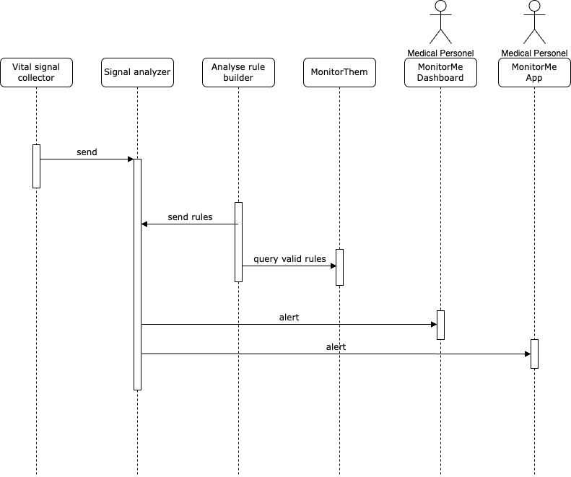
Use Case 03: alert

Slide 7
personel
doctor
Component View
MyMedicalData
MonitorMe Dashboard
(GUI)
MonitorMe App
snapshot creator
Patient DB
Notification creator
Analyse rule builder
Signal DB
displays
patient
sign analyzer
(per type but using all signals)
store
vital sign input device
vital sign
collector
(per patient and type)
Analyse Data Dispatcher
MonitorThem
send signal

