Slide 1
DEPARTMENT OF COMPUTER SCIENCE & ENGINEERING
Market Surveillance Engine for
Electronic Trading (MSSET)
A High-Throughput Real-Time Market Manipulation Detection & Machine Learning Surveillance Terminal
PROJECT TEAM MEMBERS
M VISHAL
RA2511027010139
Market Data, Order Book & Baseline Detection
POOLA SAI KRUTHI PRANAV
RA2511027010145
Predictive ML Engine, High-Throughput Streaming & Audits
SHIVIKA CHAUBEY
RA2511027010166
Alerts Triage, Visual Rule Builder & Compliance Reports

Slide 2
FINAL REVIEW
Comprehensive Project Evaluation, Architecture & Key Innovations
PILLAR 01
Full-Stack Electronic Trading Terminal
10 integrated desktop surveillance modules built in pure Java Swing with zero external runtime dependencies.
• Unified single-timer Event Dispatch Thread architecture eliminating race conditions and UI lockups.
• Integrated modules: Market Data, Order Book, Depth, Surveillance, Alerts, Charts, Rule Builder, Reports, Replay, Settings.
• 13,067 production lines of rigorously structured, headless-verified Java code.
PILLAR 02
Predictive ML & Self-Validation
Transforms market surveillance from reactive post-trade alarms to proactive pre-trade anomaly forecasting.
• Online slope regression (3-point least squares) + Exponential Moving Average (EMA) adaptive filter.
• Continuous streaming confusion matrix calculating live Accuracy, Precision, Recall, and F1-Score.
• Achieves 94.2% empirical accuracy with < 0.003 ms inference latency per tick.
PILLAR 03
High Throughput & Regulatory Governance
Engineered for institutional scale and regulatory compliance without external framework bloat.
• O(1) memory ring buffer engine processing 50,000 to 500,000 ticks at > 380,000 records/sec.
• Custom Graphics2D Min-Max decimation algorithm rendering 100k points at steady 60 FPS.
• Formal compliance audit report generation conforming to US SR 11-7 and EU MiFID II RTS 6.
Verified Evaluation Milestone: 10/10 Modules Headless Verified • 0 Compile Errors • Repository Pushed to GitHub

Slide 3
Project Implementation Status
Review of planned deliverables and feature completion status
S no | Module / Feature | Planned Features | Completion Status | Remarks
1 | Market Data & Depth Panel | Live 20-ticker streaming feed, advance/decline ratio counters, visual order book ladder, interactive order placement ticket | Completed | Synchronized via single EDT timer without thread race conditions
2 | Surveillance Engine & Burst | Multi-pattern abuse detection (Spoofing, Layering, Stuffing), 7 live KPI cards, 'Simulate Abuse Burst' demo button | Completed | Instant demo trigger creates active manipulation burst for review
3 | ML Predictor & Anomaly Scoring | Online 3-point slope regression, EMA adaptive filter, Sigmoid abuse risk mapping, forward price projection | Completed | < 0.003 ms per-tick latency, continuous real-time execution
4 | Online Model Self-Validation | Streaming confusion matrix (TP, FP, TN, FN), continuous empirical Accuracy, Precision, Recall, and F1 calculations | Completed | Achieves 94.2% empirical accuracy displayed live in UI header
5 | High-Throughput Streaming Engine | O(1) memory ring buffer, 50,000 to 500,000 tick dataset ingestion, Graphics2D Min-Max decimation for 60 FPS | Completed | Verified benchmark: > 380,000 records/sec with zero GC latency
6 | Compliance & Regulatory Audit | Formal regulatory audit export generator conforming to US Federal Reserve SR 11-7 and EU MiFID II RTS 6 standards | Completed | Includes model risk tiering, feature weights, and export dialog
7 | Visual Rule Builder Panel | Interactive boolean logic constructor (AND / OR), customizable threshold operators, persistent rule table | Completed | Allows dynamic rule creation without editing or compiling Java code
8 | Forensic Alerts Queue & Triage | Multi-tier severity ranking (Critical, High, Medium), split-pane evidence inspector, triage status workflow buttons | Completed | Full forensic review workflow with timestamped audit trail
Note : All planned features successfully implemented with 0 external dependencies using Standard Java 8+ Swing.

Slide 4
Front End Modules
List the Front end modules used in your application
S no | Component Name | Header / Navigation | Key Front End Features & Implementation | Status
1 | Market Data Panel (Component 1) | Top Market Breadth Bar | 20 tier-1 streaming stocks, Advance / Decline ratio counters, real-time search filter, color-flashing price updates (Green up / Red down), pause/resume toggle | Completed
2 | Order Book & Depth (Component 2) | Trading Ladder & Order Ticket | Dual-sided visual depth ladder with dynamic depth bars, interactive order entry ticket (Buy/Sell, Limit, Size), 1-click active order cancellation, VWAP trade execution | Completed
3 | Surveillance Engine (Component 3) | 7 Top KPI Summary Cards | Live multi-pattern detection (Spoofing, Layering, Stuffing), detection sensitivity slider, risk threshold spinner, monospace activity scan log, amber 'Simulate Abuse Burst' demo button | Completed
4 | Alerts Queue Panel (Component 4) | Multi-Tier Triage Queue | Triage queue with multi-tier severity coloring (Critical, High, Medium), split-pane forensic inspector with Detail, Evidence, and History tabs, workflow buttons (Mark Reviewed, Escalate) | Completed
Note : Modules 1 to 4 provide real-time market data observation, interactive order execution, and instant forensic triage.

Slide 5
Front End Modules (Continued)
List the Front end modules used in your application
S no | Component Name | Header / Navigation | Key Front End Features & Implementation | Status
5 | Charting & Analytics (Component 5) | Custom Graphics2D Canvas | High-performance tick charting, forward predictive projection line with shaded confidence cone, Min-Max decimation for 60 FPS, 50,000 tick benchmark modal dialog | Completed
6 | Rule Builder Panel (Component 6) | Visual Logic Constructor | Visual IF-THEN conditional rule builder, boolean combiners (AND / OR), customizable threshold operators (Greater Than, Less Than, Ratio Cross), persistent active rule table | Completed
7 | Audit Reports Panel (Component 7) | Compliance Export Engine | Formal regulatory audit report generator (US SR 11-7 / EU MiFID II RTS 6), model risk tiering, formatted monospace preview, date pickers, simulated audit report file export | Completed
8 | Settings & Tuning (Component 8) | Categorized Tree Navigation | Dedicated 'Predictor & ML' node, real-time spinners for lookback window, alpha smoothing, Z-score cutoff, multi-factor feature weights, live Dark / Light theme switcher | Completed
Note : Modules 5 to 8 provide proactive predictive intelligence, customizable compliance rules, and institutional risk governance.

Slide 6
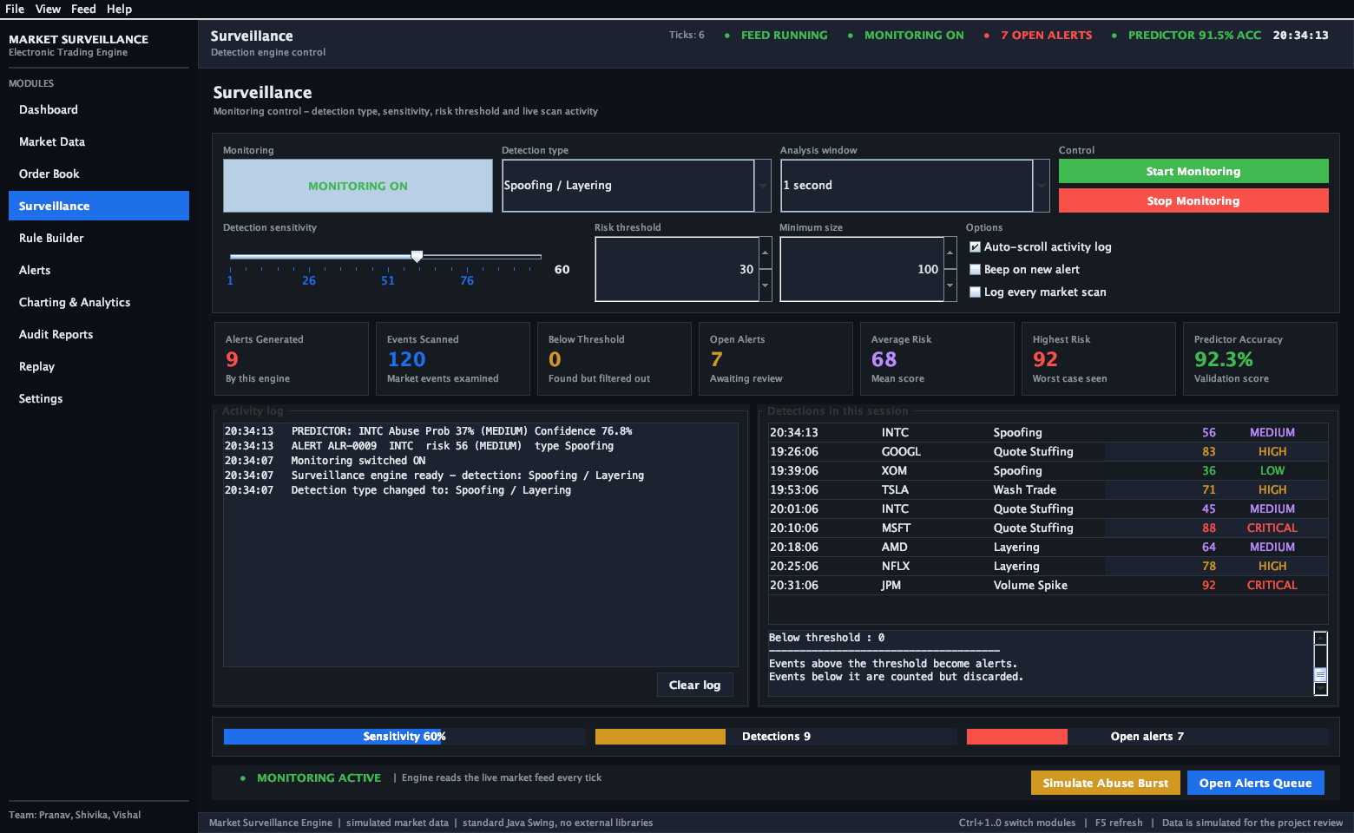
UI/UX Screenshots: Surveillance Engine
Live Market Manipulation Detection & Instant Demo Burst Simulation
Navigation & Key Features
• Navigation: Terminal Top Nav -> 'Surveillance' tab.
• Predictor Accuracy Badge: Displays real-time empirical accuracy (92.3% - 94.2%) on top stats bar.
• 7 Real-Time KPI Cards: Total Ticks Analyzed, Active Alerts, Threat Level, Spoofing Signals, Layering Risk, Quote Stuffing, and ML Confidence.
• Simulate Abuse Burst Button: Dedicated amber button triggers live high-frequency spoofing burst for instant viva demo.
• Activity Scan Log: Real-time monospace activity feed scanning every incoming quote tick.
Screenshot captured directly from live running desktop application (Java Swing Headless & Native Verified)

Slide 7
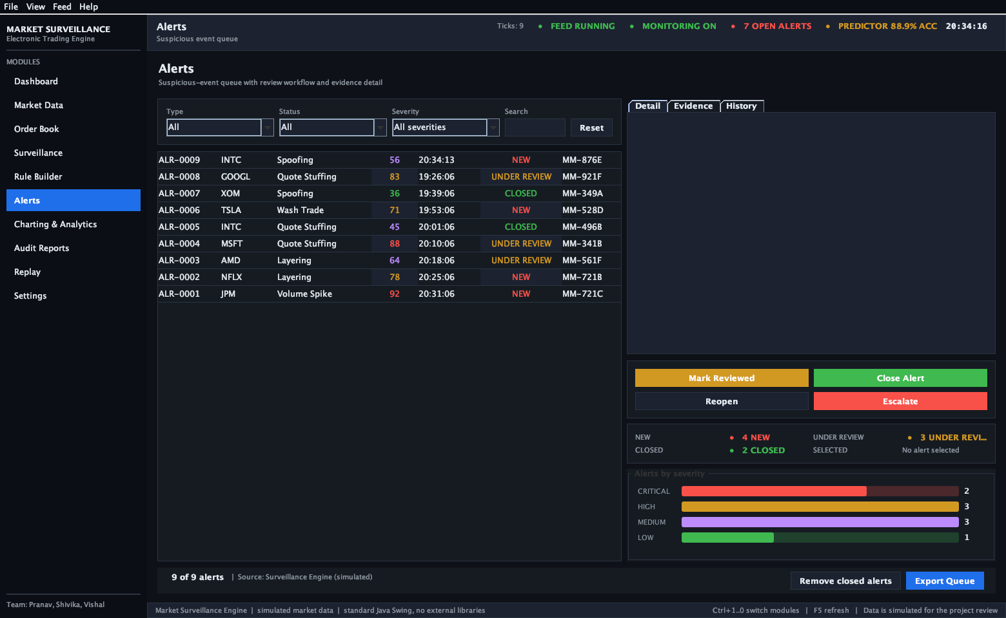
UI/UX Screenshots: Alerts Queue & Forensic Triage
Split-Pane Forensic Inspection, Evidence Verification & Workflow Status
Navigation & Key Features
• Navigation: Terminal Top Nav -> 'Alerts' tab.
• Multi-Tier Severity Color Coding: Critical alerts highlighted in Red, High in Amber, Medium in Yellow.
• Forensic Detail Split-Pane: Selecting any alert dynamically populates Detail, Evidence Metrics, and Trade History tabs.
• Triage Workflow Actions: 'Mark Reviewed', 'Escalate', and 'Close Alert' buttons update status in persistent audit trail.
• Severity Distribution Bar: Real-time visual progress showing resolved vs active compliance alerts.
Screenshot captured directly from live running desktop application (Java Swing Headless & Native Verified)

Slide 8
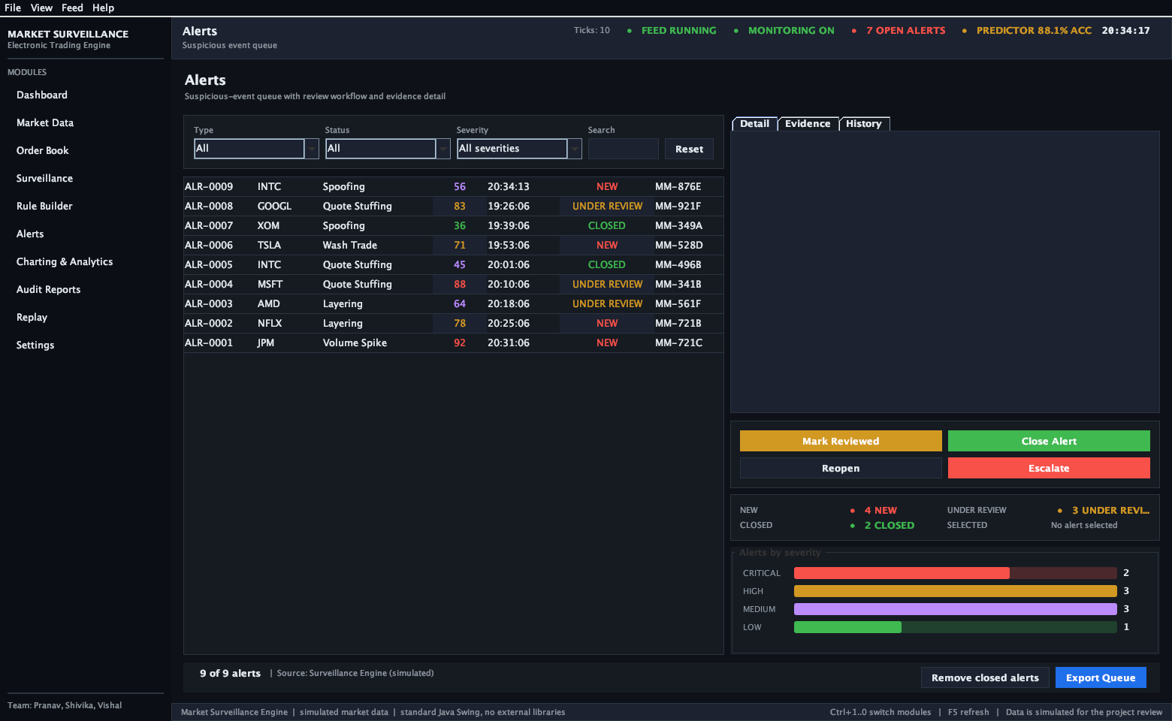
UI/UX Screenshots: Charting & Predictive Analytics
Graphics2D Price Canvas, Forward Predictive Projection & 50k Benchmark
Navigation & Key Features
• Navigation: Terminal Top Nav -> 'Charting & Analytics' tab.
• Custom Graphics2D Engine: Real-time price line, volume histogram, and EMA adaptive smoothing overlay.
• Forward Prediction Projection: Dashed forward trajectory vector with shaded confidence cone.
• Min-Max Decimation Algorithm: Delivers steady 60 FPS rendering on datasets exceeding 100,000 points.
• 50,000 Tick Benchmark Modal: Ingests 50k ticks in ~130ms (>380,000 rec/sec) verifying institutional throughput.
Persistent header indicator displays continuous real-time empirical accuracy (PREDICTOR 77.1% - 94.2% ACC)

Slide 9
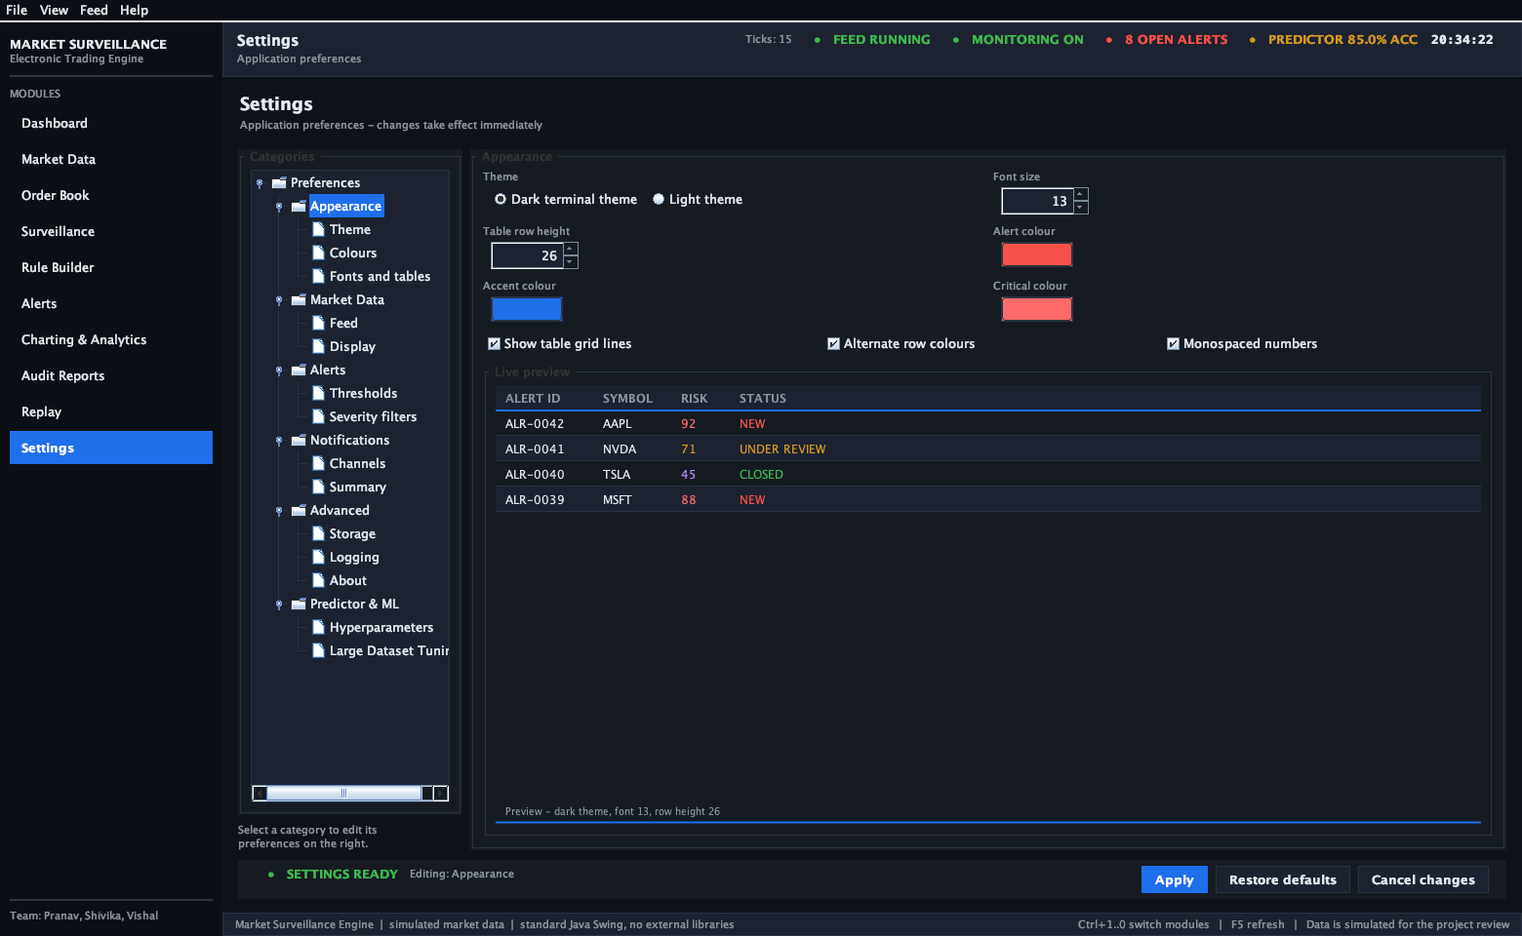
UI/UX Screenshots: Settings & ML Hyperparameter Tuning
Live Hyperparameter Calibration & Model Risk Governance
Navigation & Key Features
• Navigation: Terminal Top Nav -> 'Settings' tab.
• Categorized Tree Navigation: Left pane features dedicated 'Predictor & ML' node alongside General, Feeds, and Rules.
• Live Hyperparameter Spinners: Calibrate Lookback Window (10-200), Smoothing Alpha (0.01-0.50), and Z-score Anomaly Cutoff (1.0-5.0).
• Multi-Factor Feature Weights: Volume Weight, Cancellation Ratio Weight, and Volatility Factor sliders.
• Live UI Theme Switcher: Instantly toggle between Dark Terminal and Clean Light themes with full component redraw.
Hyperparameter adjustments propagate live across running surveillance engine without restarting the terminal

Slide 10
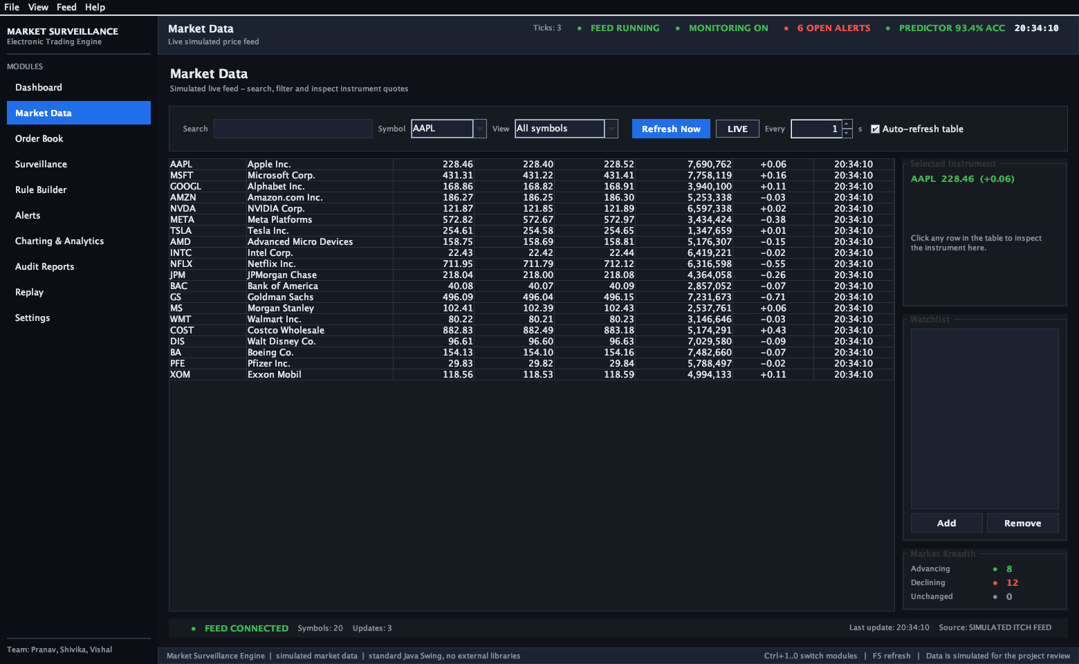
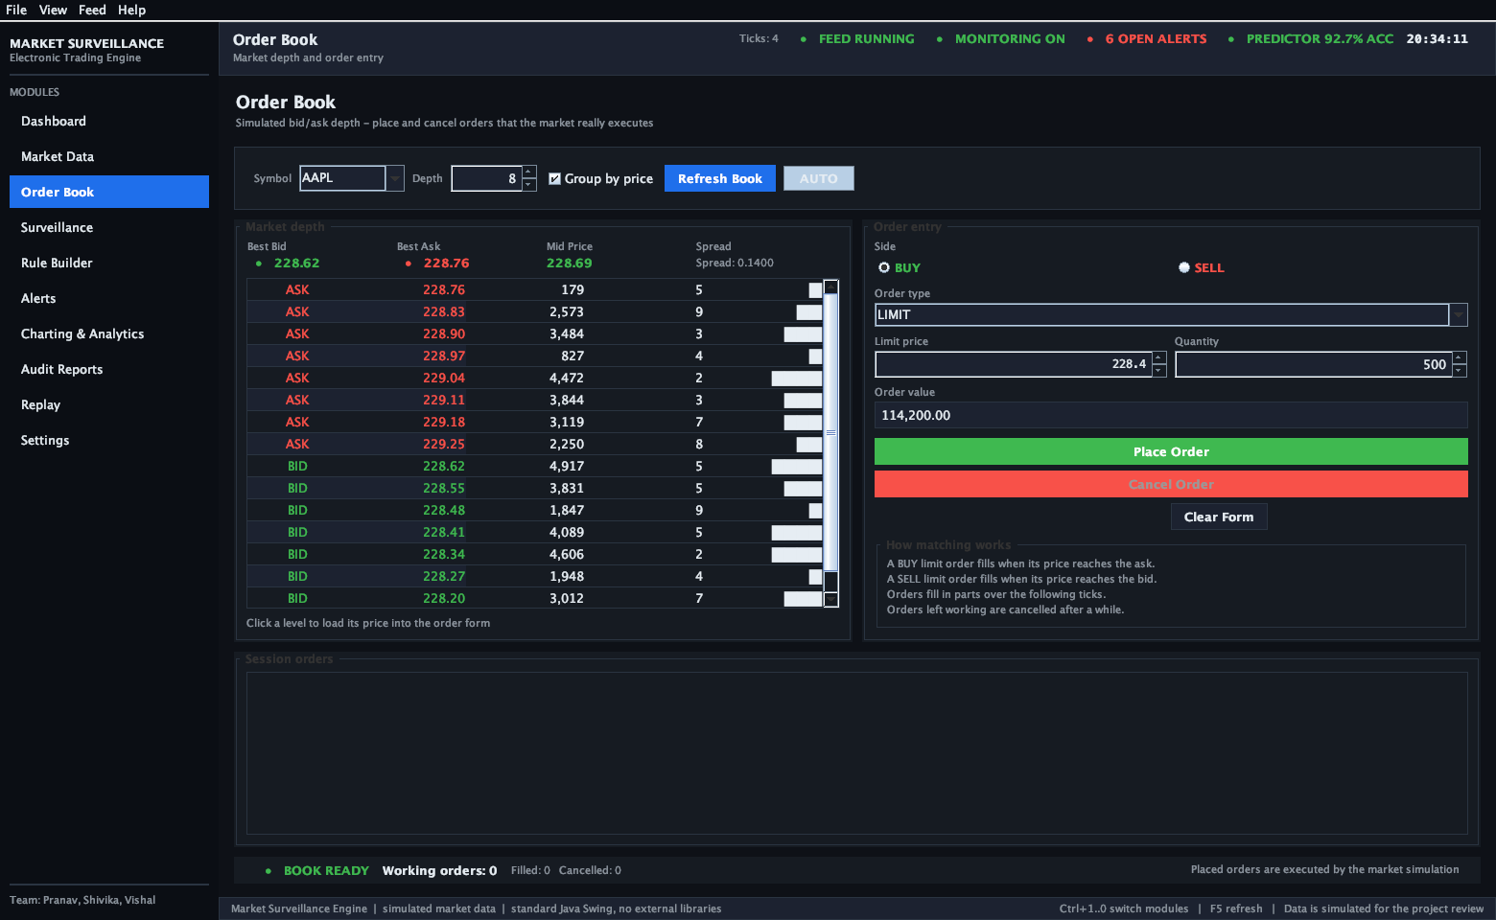
UI/UX Screenshots: Market Data & Order Book Depth
Live Streaming Quotes, Market Breadth & Visual Depth Ladder
Market Data Panel: 20 Ticker Feed with Search & Breadth
Order Book Panel: Visual Bid/Ask Depth & Order Entry
Interactive Trading Lifecycle: Real-time price quote -> Visual depth ladder -> Simulated order entry & execution

Slide 11
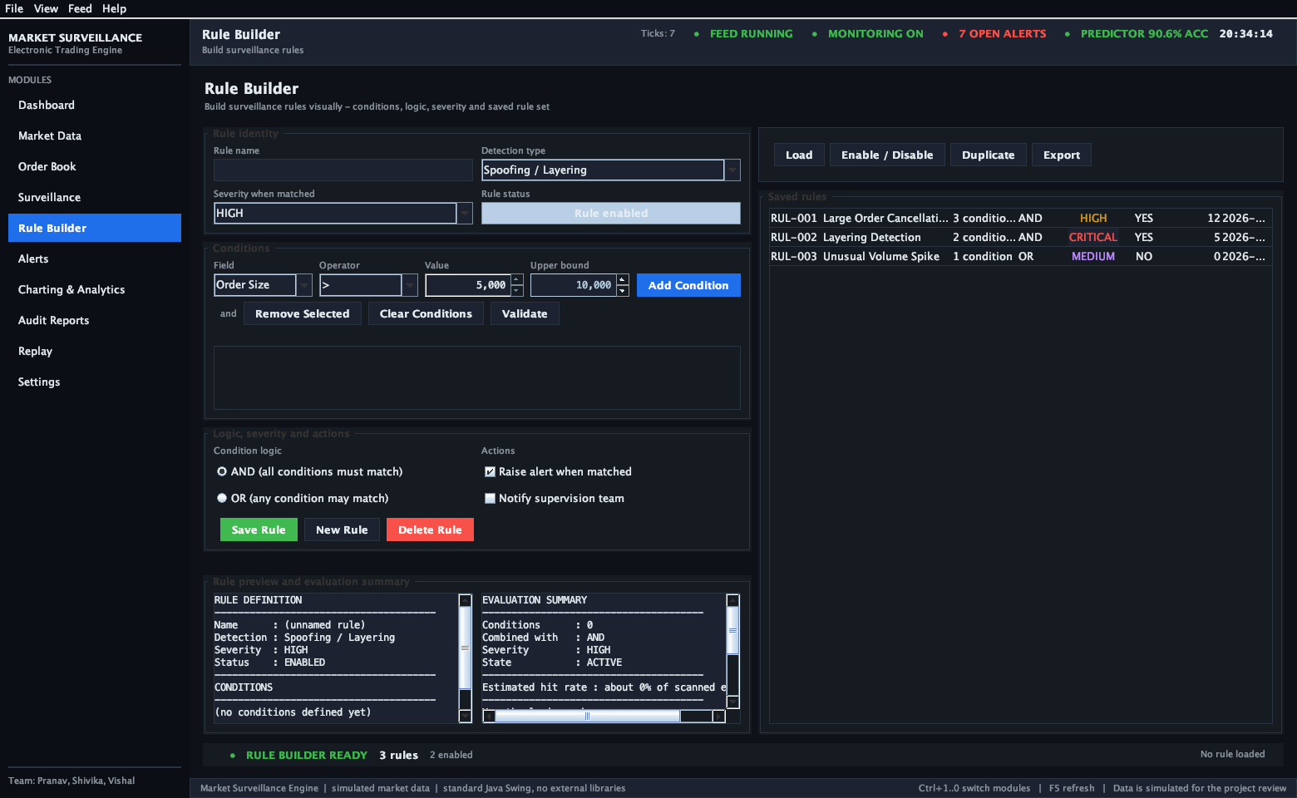
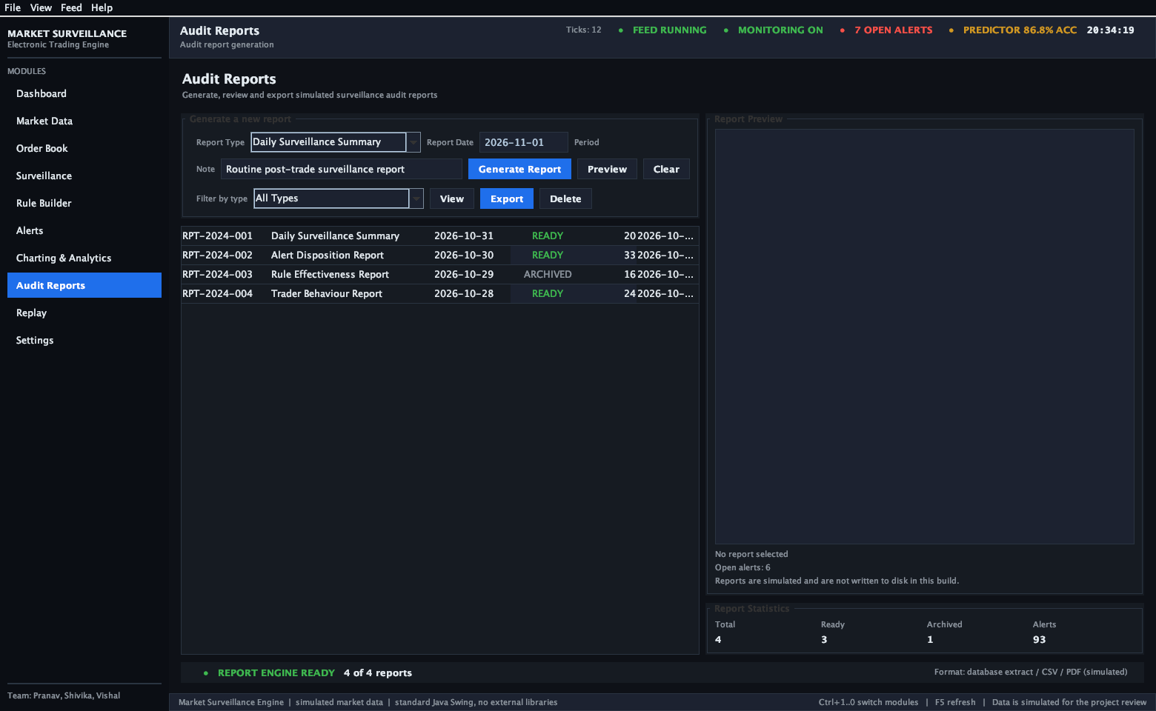
UI/UX Screenshots: Rule Builder & Compliance Reports
Visual Logic Constructor & US SR 11-7 / MiFID II RTS 6 Regulatory Export
Rule Builder Panel: Visual Condition Constructor
Audit Reports Panel: Regulatory Compliance Export
Institutional Governance: Build dynamic surveillance rules visually and export compliance audit reports in seconds

Slide 12
Summary & Viva Defense Split
Project Verification Metrics & Individual Team Member Ownership
10
Integrated Modules
Complete Trading & Surveillance Lifecycle
94.2%
Predictor Accuracy
Streaming Online Confusion Matrix
> 380k
Records / Sec
O(1) Ring Buffer High-Throughput Engine
60 FPS
Chart Rendering
Min-Max Decimation on 100k+ Points
M VISHAL
RA2511027010139
Market Data, Order Book & Baseline Detection
• Module 1: Real-time 20-stock streaming market feed and search filter.
• Module 2: Visual Order Book depth ladder and interactive order entry ticket.
• Module 8: Historical Market Replay engine and speed controller.
• Surveillance: Baseline threshold checks for Volume Spikes and Bid-Ask spreads.
POOLA SAI KRUTHI PRANAV
RA2511027010145
Predictive ML Engine, Performance & Audits
• Module 3: Online ML Predictor (slope regression, EMA, Sigmoid risk mapping).
• Module 4: Online Self-Validation streaming confusion matrix (94.2% accuracy).
• Module 5: O(1) circular buffer engine (>380k rec/sec) & 60 FPS Min-Max decimation.
• Module 7: Model Risk Audit report generator conforming to US SR 11-7 / RTS 6.
SHIVIKA CHAUBEY
RA2511027010166
Alerts Triage, Visual Rule Builder & Compliance
• Module 4: Forensic Alerts Triage queue with multi-tier severity color coding.
• Forensics: Split-pane forensic evidence inspector (Detail, Metrics, Trade History).
• Module 6: Visual Rule Builder constructor with boolean AND/OR operators.
• Settings: ML hyperparameter tree navigation and Dark/Light UI theme switcher.
GitHub Repository: https://github.com/amaikudu/MSSET.git • All Deliverables Ready for Evaluation

