Slide 1




COM4401 · TEAM ORAL PRESENTATION
Four mini-projects, one story
Computing · Software engineering · Networking · Cyber-security
Team 3 · Enrique Manzano Ayala · Chiamaka Eluwa · Toby Mathew · Fatimah Bibi

Slide 2
Meet the team
Enrique Manzano Ayala
Chiamaka Eluwa
Toby Mathew
Fatimah Bibi
Student ID 2518164
Student ID 2505794
Student ID 2600291
Student ID [ID needed]
MP1 · Computing
MP2 · Software
MP3 · Networking
MP4 · Cyber-security
Presents MP1
Presents MP2
Presents MP3
Presents MP4

Slide 3
One story: from the machine to staying safe
MP1 · Computing
MP2 · Software
MP3 · Networking
MP4 · Cyber-security
The machine and its data: PC architecture and SQL
The software that runs on it: designing, building and testing a program
The network that connects it: a studio network
Keeping it all safe: cyber-security awareness
For every project we cover three things: the problem · our solution · one strong proof

Slide 4
MP1
Computing
PC architecture and SQL
PRESENTED BY
Enrique Manzano Ayala
1
2
3
4

Slide 5
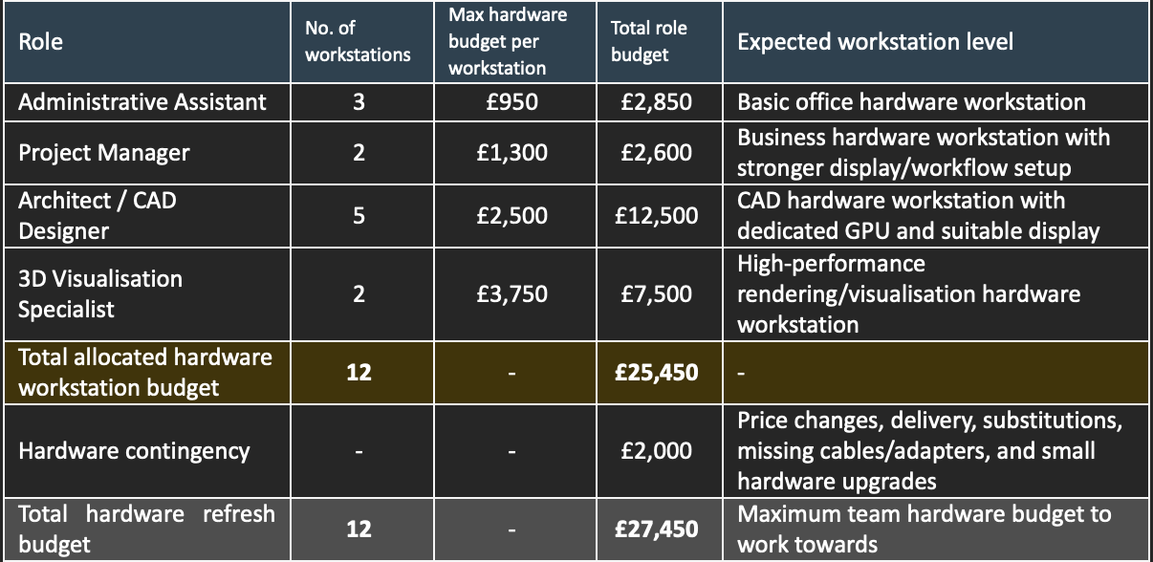



The problem: building PCs for four job roles
The scenario
Our team acted as a small computing advice team for a company changing its computer systems.
The brief
We were given a specification for each department and asked to suggest builds for them.
The budget
4
12
£25,450
£25,450 for 12 workstations, plus a £2,000 contingency, shared across four roles.
job roles
workstations
hardware budget

Slide 6

The solution: five builds, one choice each
Five builds
Every choice explained
Evidence supplied
One build for each area, plus two for the most demanding role. Only one of those two versions was chosen.
Each build explains why it was chosen, and why each part was picked over the other options available.
Screenshots of the specification tables and of the builds are included for every role.
MAXIMUM BUDGET PER WORKSTATION, BY ROLE
Administrative Assistant
Project Manager
Architect / CAD Designer
3D Visualisation Specialist
3 workstations
2 workstations
5 workstations
2 workstations
£950
£1,300
£2,500
£3,750

Slide 7
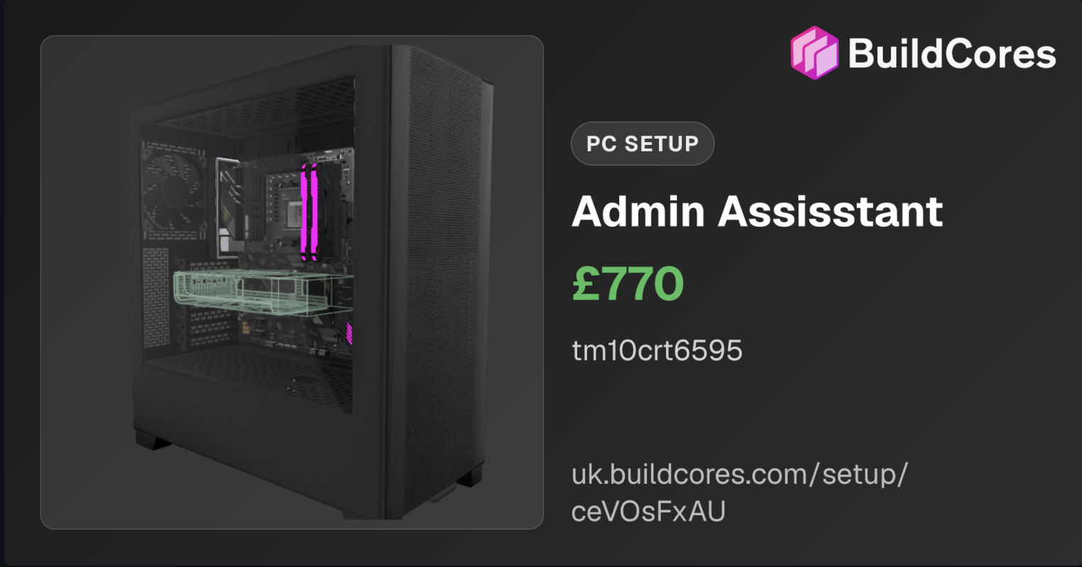
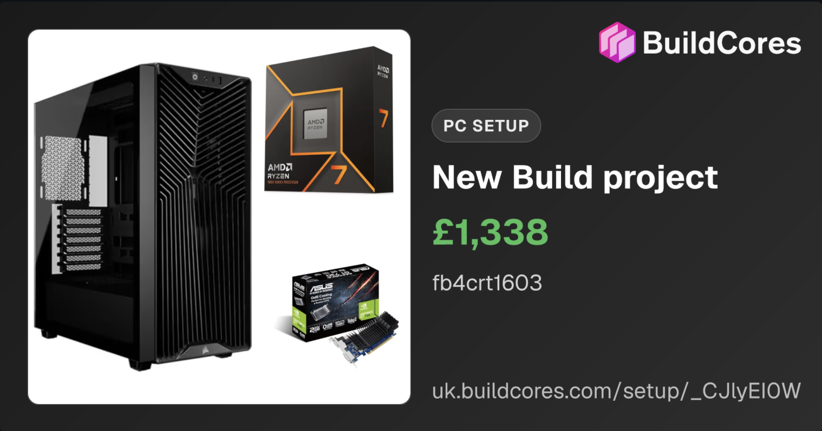
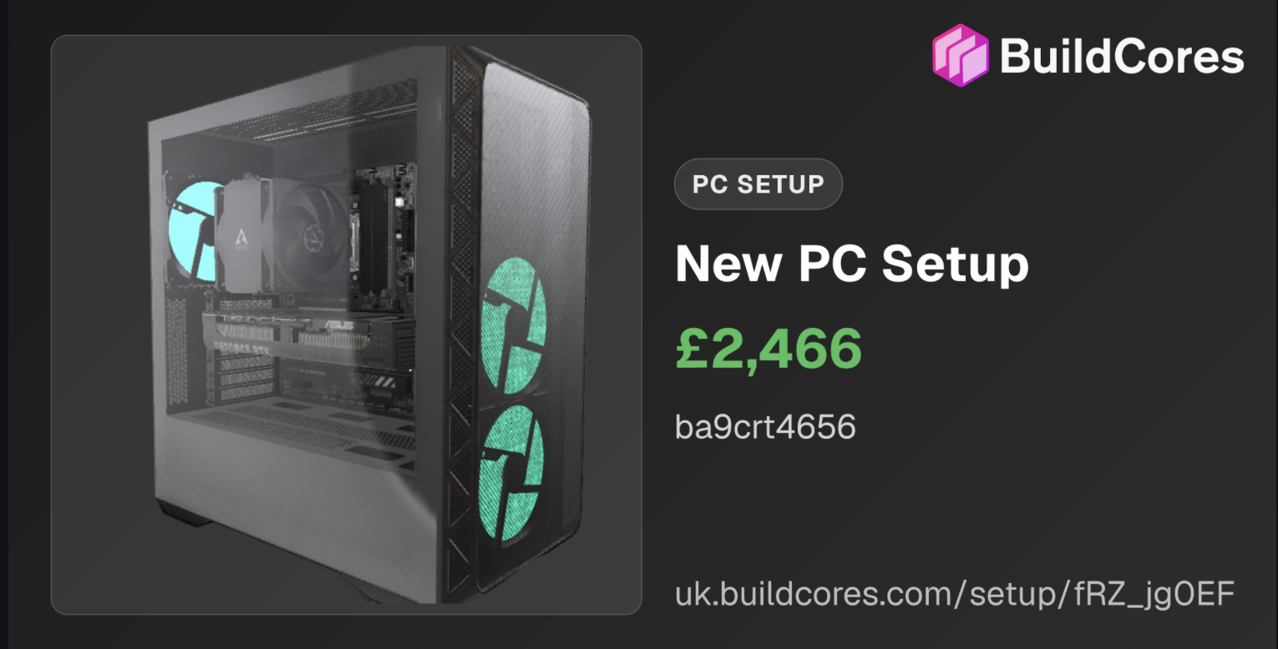
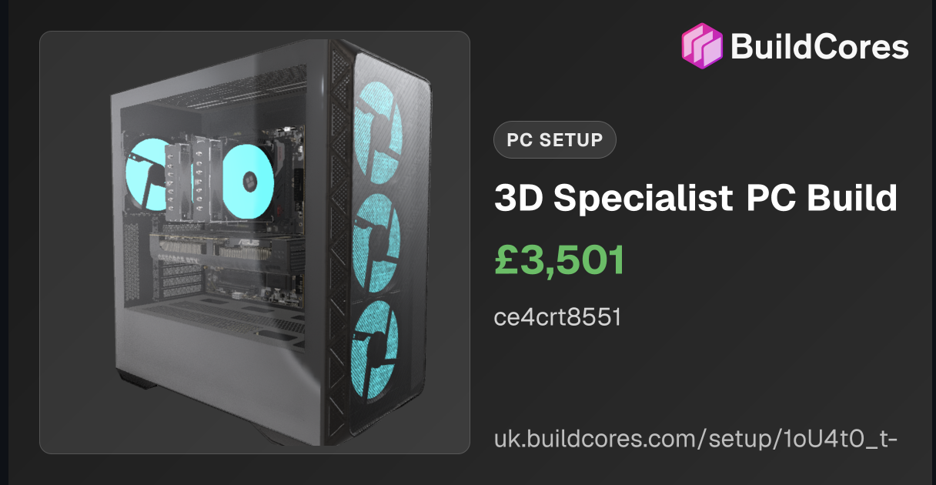
The builds: one proposal for each role
EACH PROPOSAL SHOWS
Every part and its price
A full parts list, built on BuildCores.
Administrative Assistant · £770
Built by Toby Mathew
Project Manager · £1,338
Built by Fatimah Bibi
Why each part was chosen
A justification for each component.
Cost against budget
The total compared with the role's budget.
Architect / CAD Designer · £2,466
Built by Beth Alldred and Enrique Manzano Ayala
3D Visualisation Specialist · £3,501
Built by Chiamaka Eluwa

Slide 8
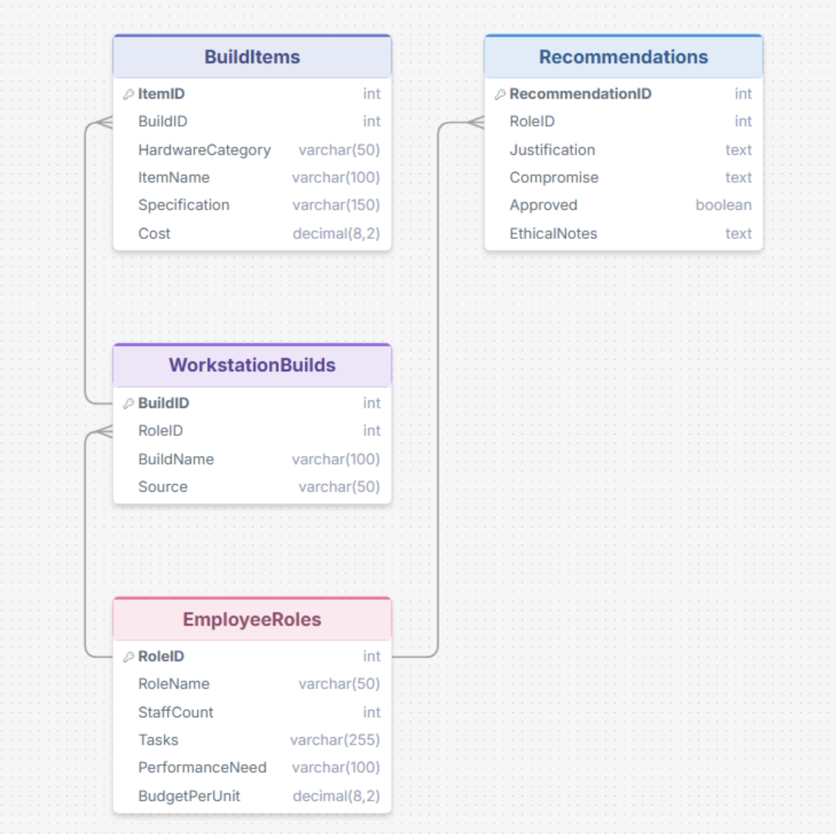
Database design: four linked tables
EmployeeRoles
WorkstationBuilds
Each role, its headcount, tasks and budget per workstation
Each build, linked to the role it is for
BuildItems
Recommendations
Every component in a build, with its cost
Justification, compromise, approval and ethical notes
DATA INTEGRITY
Primary keys keep every record unique. Foreign keys only link to records that exist. Suitable data types reduce invalid entries.

Slide 9
SQL evidence: 11 queries, all tested
Q1–Q4
Select, filter and sort
SELECT RoleName, BudgetPerUnit FROM EmployeeRoles WHERE BudgetPerUnit > 1000;
Roles, budgets over £1,000 and the largest teams first.
Q5–Q8
Filter, count and total
SELECT BuildID, SUM(Cost) AS TotalCost FROM BuildItems GROUP BY BuildID ORDER BY TotalCost DESC;
Items in a build, item counts, and the total cost of each build.
Q9–Q11
Join the tables
SELECT RoleName, SUM(Cost) AS TotalSpend FROM EmployeeRoles JOIN WorkstationBuilds … JOIN BuildItems … GROUP BY RoleName;
Builds with their roles, items with their builds, and spend per role.

Slide 10
Final review: 12 workstations, within budget
12
£23,666.80
£25,450
£1,783.20
workstations proposed
total hardware cost
hardware budget
left in the budget
What the final review covers
The five proposals reviewed together as one plan
Total cost checked against the budget
Professional and ethical notes recorded for every role
Team contribution record kept in the repository

Slide 11
MP2
Software Engineering
Pennine Pizza Works ordering system
PRESENTED BY
Chiamaka Eluwa
1
2
3
4

Slide 12




The problem: pizza orders done by hand
Orders arrive by phone and at the counter
Staff write each order down on paper.
THE CLIENT'S PRICE RULES
Small pizza
£3.25
Totals are worked out on a calculator
Medium pizza
£5.50
Several pizzas, extra toppings, a discount and delivery all change the price.
Large pizza
£7.15
1 extra topping
£0.75
Mistakes are easy to make
2 extra toppings
£1.35
The client needs a simple system that calculates accurately.
3 extra toppings
£2.00
4 or more toppings
£2.50
AUDIENCE CHALLENGE
Pizzas per order
1 to 6
Total this in your head: Large + 3 toppings, Large + 2 toppings, Medium + 1 topping, with delivery. The answer is on the demo slide.
Discount
10% over £20
Delivery charge
£2.50

Slide 13
Our approach: the waterfall model
1
2
3
4
5
Analysis
Design
Implementation
Testing
Deployment
Business rules, 12 requirements (R1–R12) and an input–process–output table.
Structure chart, data plan, 15 subroutines and a main flowchart.
Built in Flowgorithm as 16 functions: Main plus 15 subroutines.
19 tests using normal, extreme and abnormal data. Issues logged.
Final version, GitHub README and instructions for running it.
See the problem →
See the design →
See it run →
See the tests →
Why waterfall? The brief is clear and does not change, and it asks for every stage in this order. Each requirement (R1–R12) can be followed from analysis all the way to testing.

Slide 14
Design: break the problem into small parts
Pizza ordering system
15
Input details
1 · Input
Pizza costs
2 · Process
Order totals
3 · Process
Itemised bill
4 · Output
subroutines, each with one clear job
GetCustomerInfo
R1
GetSizePrice
R6
CalculateSubtotal
R8
DisplayCustomerHeader
R12
R1–R12
GetPizzaCount
R2
GetToppingCharge
R7
CalculateDiscount
R9
DisplayItemisedPizzas
R12
every requirement traced to a box on the chart
GetPizzaChoices
R3, R4
CalculatePizzaCosts
R6, R7
GetDeliveryCharge
R10
DisplayTotals
R12
4
GetDeliveryOption
R5
CalculateFinalTotal
R11
DisplayFinalTotal
R11
modules: input, pizza costs, order totals, itemised bill

Slide 15

Live demo: the program running
1
Open the Flowgorithm file straight from our GitHub repo
PENNINE PIZZA WORKS - ORDER BILL
Pizza 1: Large, 3 extra toppings
Standard £7.15 Toppings £2.00 Pizza cost £9.15
Pizza 2: Large, 2 extra toppings
Standard £7.15 Toppings £1.35 Pizza cost £8.50
Pizza 3: Medium, 1 extra toppings
Standard £5.50 Toppings £0.75 Pizza cost £6.25
-------------------------------------------
Subtotal: £23.90
Discount: -£2.39
Delivery charge: £2.50
-------------------------------------------
FINAL TOTAL: £24.01
2
Run it and enter the challenge order: Large + 3, Large + 2, Medium + 1, delivery Yes
3
Read the itemised bill and check each figure
4
Did it match your total from the opening challenge?
Matches the hand-worked answer: 9.15 + 8.50 + 6.25 = £23.90, minus 10%, plus £2.50 delivery = £24.01
Run live from the repository, not a screenshot

Slide 16



Testing: 19 tests, 3 kinds of data
Normal
Typical orders the program should accept
e.g. 3 pizzas, Medium size, delivery Yes
19
tests
Extreme
Values at and just beyond the limits
e.g. 0 and 7 pizzas, a subtotal of exactly £20.00
Abnormal
BOUNDARY PROOF
Input the program should reject
£20.00 subtotal → discount £0.00
£20.30 subtotal → discount £2.03
e.g. abc, -2, XL, Maybe

Slide 17
Testing found bugs, so we fixed them
FOUND BY
BEFORE
“-” accepted as the number of toppings
AFTER
Rejected: “Invalid. Please enter a whole number, 0 or more”
THE FIX
Read the input as text and check every character is a digit using Len, Char and ToCode. Then convert with ToInteger.
TC011
FOUND BY
BEFORE
“large” (lower case) rejected as an invalid size
AFTER
“large” accepted, the same as “Large”
THE FIX
Read the size as text. Three nested Ifs accept the full word or just S, M or L, in either case.
TC008
FOUND BY
BEFORE
Prices printed as “Standard £5.5 Toppings £0”
AFTER
“Standard £5.50 Toppings £0.00”
THE FIX
Wrap each price in ToFixed(…, 2) inside DisplayItemisedPizzas.
TC014–16

Slide 18
MP3
Networking
Studio network
PRESENTED BY
Toby Mathew
1
2
3
4

Slide 19
The problem: a network for a design studio
The client
NorthWest Architecture Studio Ltd is refreshing its IT infrastructure. Staff PCs cover admin, project management, CAD design and 3D visualisation roles.
The task
Model a working office Local Area Network (LAN), plus a connection to an external cloud network.
BUILT IN
Filius
network simulation software
Also required
Assign IP addresses, set up internal and external services, test the network and explain the principles.

Slide 20
The solution: a routed office LAN
1
2
7
router
switches
computers
OFFICE SIDE
CLOUD SIDE
192.168.10.x
203.0.113.x
The router has two connections, one for each switch. The office switch is connected to 6 of the computers.
The external switch is connected to the cloud. Addresses were assigned so each device matches the switch it connects through.

Slide 21
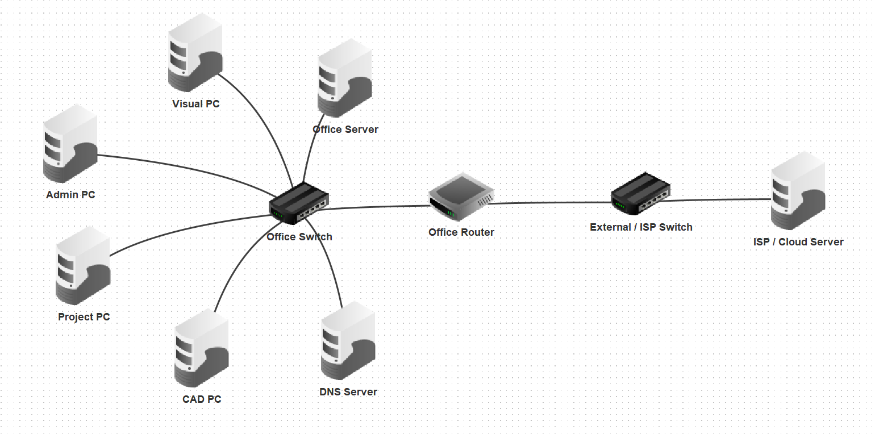
The network diagram
OFFICE · 192.168.10.x
Admin PC, Project PC, CAD PC, Visual PC, Office Server and DNS Server, all on the office switch.
CLOUD · 203.0.113.x
The external switch connects the router to the ISP / Cloud Server.

Slide 22
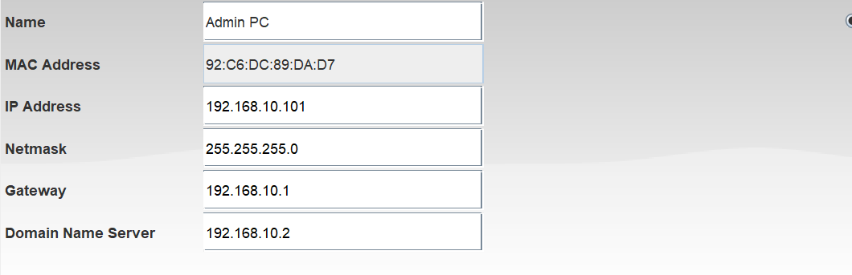
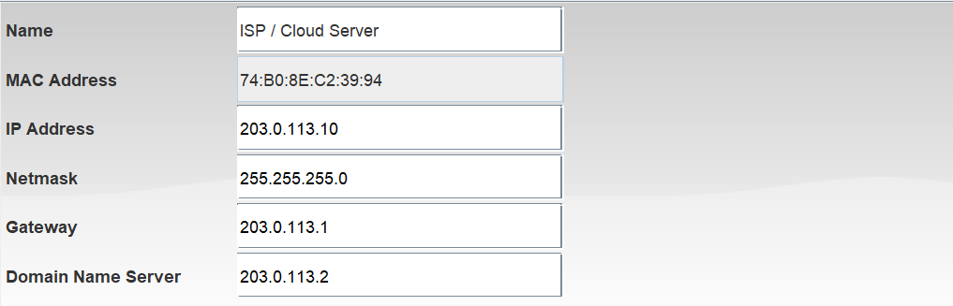
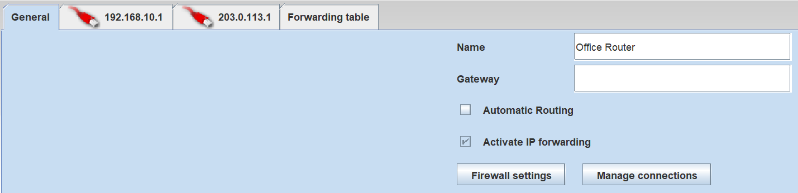
Configuration: addresses and gateways
Admin PC
1
192.168.10.101 on the office side, with the router (192.168.10.1) as its gateway.
ISP / Cloud Server
2
203.0.113.10 on the cloud side, with its gateway at 203.0.113.1.
Office Router
3
One interface for each side, 192.168.10.1 and 203.0.113.1, with IP forwarding switched on.

Slide 23
MP4
Cyber-security
Cyber-security awareness report
PRESENTED BY
Fatimah Bibi
1
2
3
4

Slide 24





Cybersecurity: safer choices online
Practical ways to protect accounts, recognise scams and secure devices.
THE ISSUE
There is little current cyber awareness. Our team addressed this by creating a cyber report for the public with five sections.
THE FIVE SECTIONS
Passwords
MFA
Phishing
Devices
Wi-Fi

Slide 25
Password hygiene and MFA
Make stolen passwords less useful
A
B
C
Use unique passwords
Use a password manager
Enable MFA
Reusing passwords lets attackers try credentials leaked from one service on other accounts.
Generate and store long, unique passwords instead of relying on memory or predictable variations.
A second factor adds protection if a password is stolen. Never approve an unexpected login request.
REMEMBER
MFA FACTORS
Secure your email first, because it may be used to reset other accounts.
Something you know, have or are. Authenticator apps and security keys are alternatives to SMS codes.

Slide 26
Phishing
Pause when a message pressures you
Phishing aims to make people reveal information by impersonating someone or an organisation they may know. It can do this by making you open files or sign in on fake pages. It exploits human trust, such as habit and emotions.
URGENT ACCOUNT NOTICE
“Your account will be locked in 10 minutes. Verify your password now.”
Phone number used starts with 073 or 078
RED FLAGS TO STAY CAUTIOUS OF
Urgency, fear or a threat of account closure or an emergency
Unexpected links or attachments
Spelling mistakes or addressing using all capitals
Requests for passwords, codes or unusual payments
Smishing occurs via text message whereas vishing occurs via phone call, which is more effective as victims cannot stop to think and analyse what is being asked, e.g. a caller could pose as a bank fraud team. Spear phishing is more targeted as it targets one specific group or individuals by using real details which are personal to them, making it more believable.
Take a second to pause → do not click on anything → report to report@phishing.gov.uk

Slide 27

Patching, devices and public Wi-Fi
Reduce common routes into your data
01
Update promptly
02
Lock and encrypt
03
Use trusted apps
Patches fix known weaknesses in operating systems, browsers and apps.
Screen locks and device encryption help protect data if a device is lost.
Install from official stores or verified publishers; avoid unknown USB devices.
ON PUBLIC WI-FI
HTTPS
VPN
Encrypts traffic between your browser and the website.
Encrypts traffic to the VPN provider, but that does not mean every website is trustworthy.

Slide 28
Five fundamentals
01
02
03
04
05
Unique passwords
Enable MFA
Pause before clicking
Update and lock devices
Use Wi-Fi thoughtfully
A password manager reduces phishing risk, as it only auto-fills on the exact domain. It also flags weak passwords and syncs across devices.
Never share sign-in codes. Authentication can be something you know (a password), something you have (an authenticator app) or something you are (a face scan).
Verify unexpected requests separately.
Patch software and protect stored data.
Check the network; use HTTPS and consider mobile data.
Harvard referencing is used throughout to ensure solid evidence.

Slide 29


Reflection: what connects the four projects
Plan, then build
Prove it works
Work as a team
Honest about the journey

Slide 30

Use of generative AI
Where we used it
How we checked it
Generative AI helped refine our slides.
It worked from our own reports, designs and test results.
It was a polishing aid, not a source of evidence.
Every figure and claim was checked against our reports and test results.
AI output was corrected or rewritten where it was wrong.
The live demo runs our real program, not AI output.
The work, decisions and evidence are ours. We take responsibility for every claim in this presentation.

Slide 31
CONCLUSION
Computing
Software
Networking
Security
the foundation
the solution
the connection
the protection

Slide 32

Thank you
Questions?
Team 3 · Enrique Manzano Ayala · Chiamaka Eluwa · Toby Mathew · Fatimah Bibi

