Slide 1
BED AND BREAKFAST PROJECT
Demo: PA2550-Seminar Series in Software Engineering

Slide 2
Team Members
Makarudze, Anna
Mahapatra, Payel
Kotapati, Jammithri
Rokaya, Sanjeeb
Arakkal Sudesh, Meenakshi

Slide 3
Introduction
We have developed a website called Bed and Breakfast (BnB)
The goal of this project is to develop a web application that allows users to make reservations for accommodations.
We have used
Programming Language: Python with Django Framework
Database: SQLite
Live Server: PythonAnywhere
Version Control: GitHub
Scrumboard: Trello

Slide 4
Product Features
Online Booking Platform
Cancel Reservations
This is an online booking platform that allows guests to make reservations for rooms, breakfast and social events like Concerts, Scavenger Hunt.
The website allows modification and cancellation of reservations made
View reports
This website allows manager to view periodic reports on the BnB reservations to determine the business performance.
Search functionality
This website allows searching of available rooms ans social events by providing specific check-in and check-out dates, number of adults and children.

Slide 5
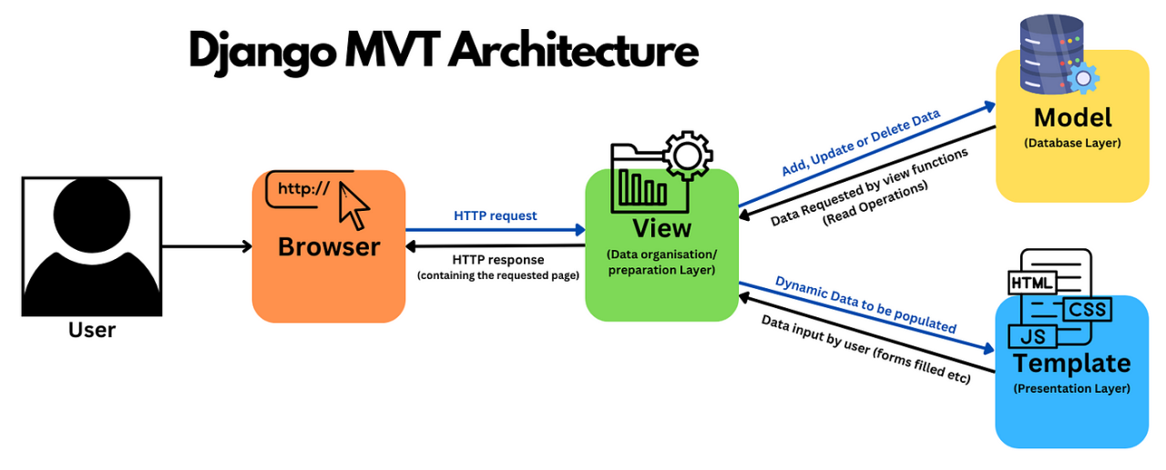
Design pattern
We have used Django MVT Architecture
Source: https://www.linkedin.com/pulse/mastering-django-essential-design-patterns-best-mohammad-fa-alfard-zsg3f/

Slide 6
Use Cases
01
02
03
Sign Up Guest
Make reservation
Cancel reservation
04
05
06
Manage rooms
Manage social events
View performance reports of bnb

Slide 7
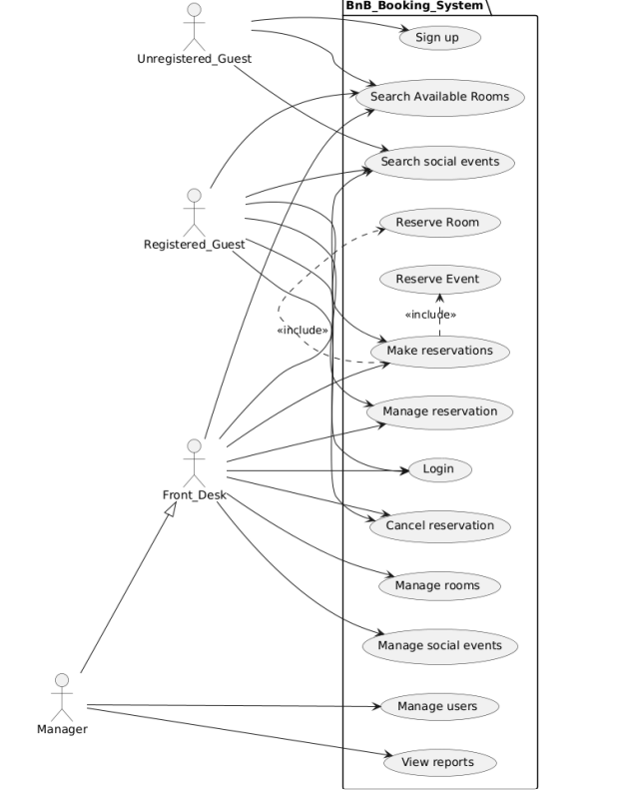
Use case diagram

Slide 8
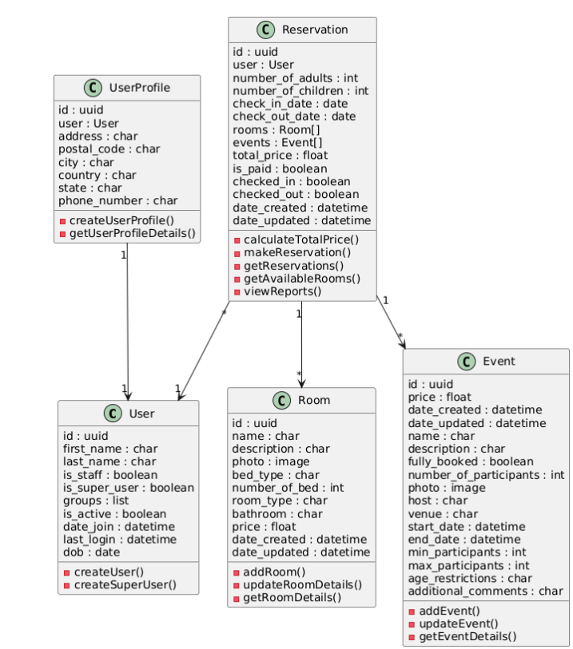
Class Diagram

Slide 9
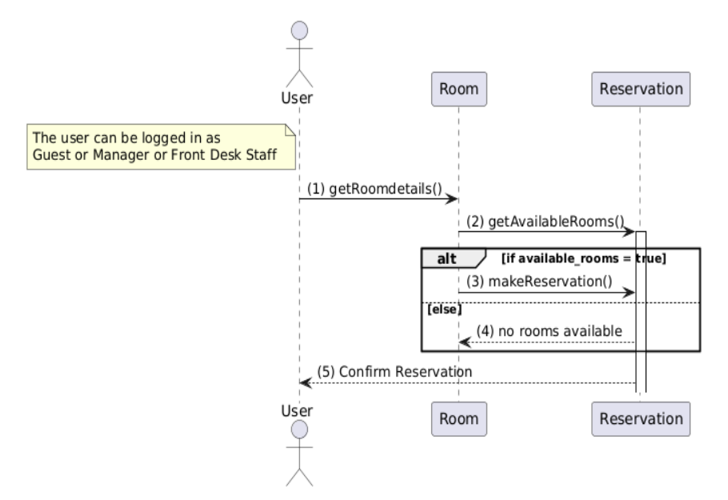
Sequence diagram
Make a room reservation sequence diagram

Slide 10
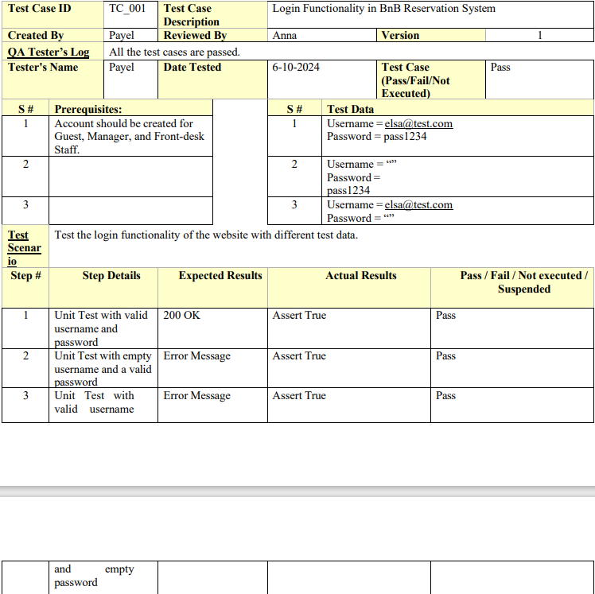
Unit testing

Slide 11
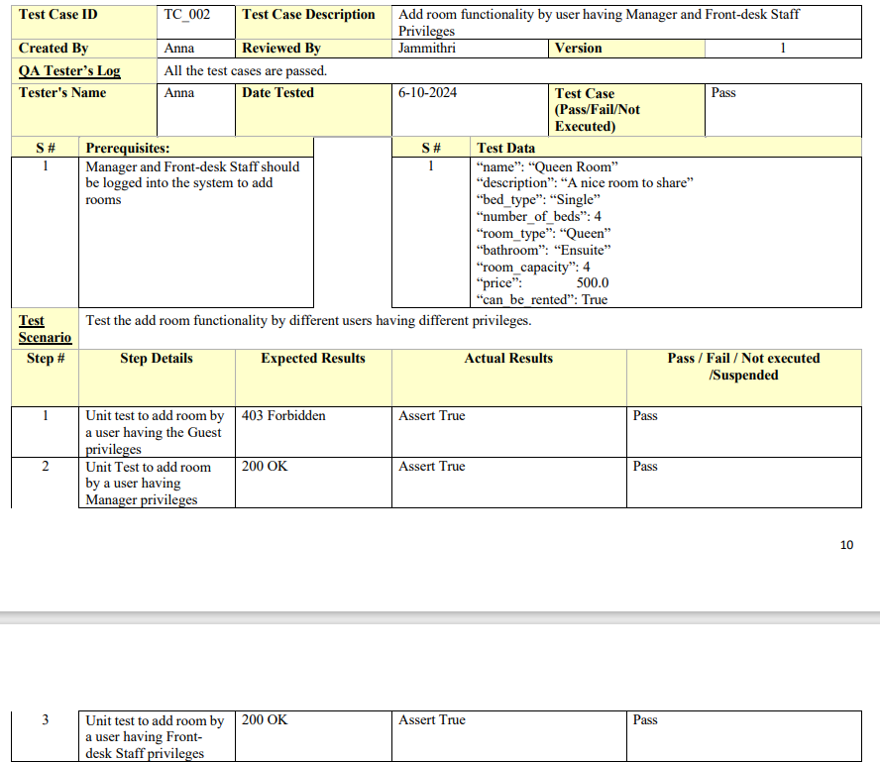
Unit testing

Slide 12
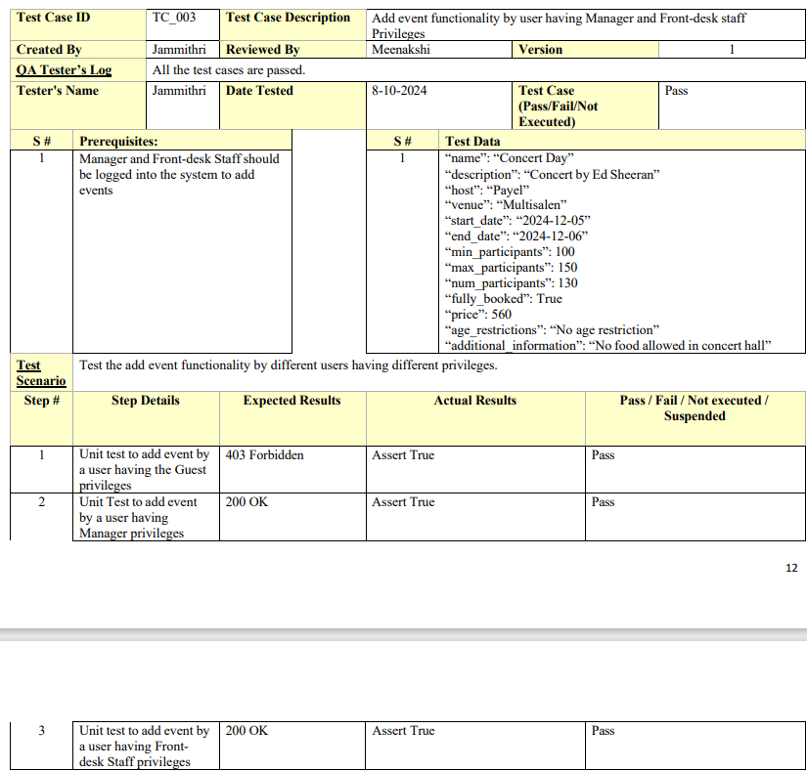
Unit testing

Slide 13
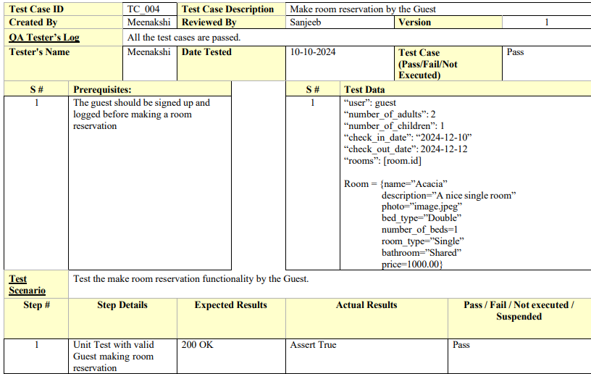
Unit testing

Slide 14
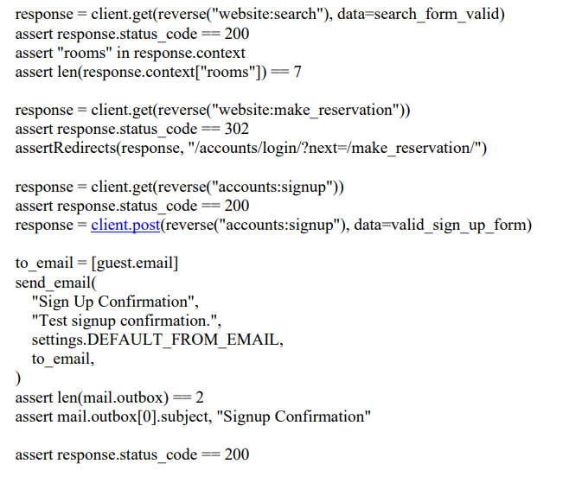
Integration testing

Slide 15
Demo
GitHub: https://github.com/amakarudze/bnb
Live Server: https://annamz.pythonanywhere.com

Slide 16
Thank You
ANY QUESTIONS ?

