Slide 1
RABBITMQ
A Message Broker Implementing AMQP

Slide 2
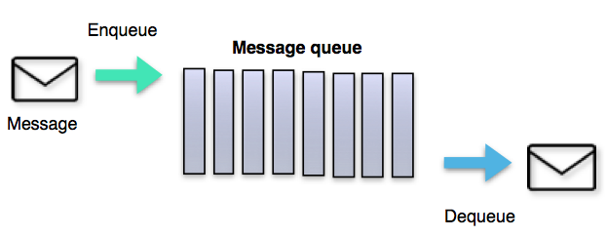
Messaging
Messaging is a way of exchanging messages from point A to point B or many points C.
Messaging enables distributed communication that is loosely coupled.
A message sender sends a message to a destination, and the message recipient can retrieve the message from the destination. However, the sender and the receiver do not have to be available at the same time in order to communicate. eg. Email

Slide 3
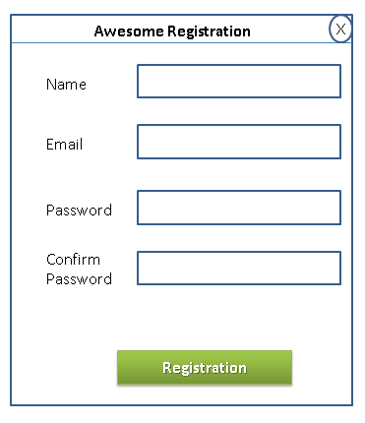
Why Messaging
Registration Process
Send welcome email after successful registration using third party SMTP server
Registration must be made possible through affiliate links and tracking must be made possible for those registrations through third-party APIs to track the performance of the affiliate registration process.
Log audit information of the user like time, location etc.

Slide 4
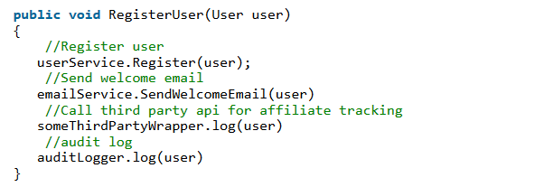
Why Messaging…
Things to Ponder on
Third-party API stops working.
Audit log table gets locked due to high traffic.
User information needs to be send to other internal systems which are written in a different language.
And many more such cases where direct communication is required between applications.

Slide 5
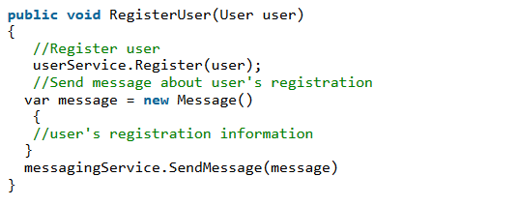
Why Messaging…
Can our code scale to meet new requirements or remove dependencies on third-party APIs?
Assume that RegisterUser will only register the user
Messages are stored in a central place where other applications can access those.
Now email services, third-party APIs, and audit log service can run independently and perform their tasks without impacting the user registration module.

Slide 6
Message Broker/Message–oriented Middleware
Wikipedia says that,
“Message-oriented middleware (MOM) is software or hardware infrastructure supporting sending and receiving messages between distributed systems. MOM allows application modules to be distributed over heterogeneous platforms and reduces the complexity of developing applications that span multiple operating systems and network protocols.”
Message brokers do many things such as:
Decouple message publisher and consumer
Store the messages
Routing of messages
Monitoring and management of messages
Message Brokers
IBM Message Queues ( IMB MQ / Websphere MQ), Apache ActiveMQ, Apache Kafka, Apache Qpid, HornetQ (Red Hat), RabbitMQ, JBoss Messaging, etc.

Slide 7
AMQP
The Advanced Message Queuing Protocol (AMQP) is an open standard application layer protocol for message-oriented middleware.
AMQP defines both the network protocol and the server-side services through:
A defined set of messaging capabilities called the "Advanced Message Queuing Protocol Model" (AMQ model). The AMQ model consists of a set of components that route and store messages within the broker service, plus a set of rules for wiring these components together.
A network wire-level protocol, AMQP, that lets client applications talk to the server and interact with the AMQ model it implements.
A wire-level protocol is a description of the format of the data that is sent across the network as a stream of bytes.
Message Brokers implementing AMQP : RabbitMQ, Apache Qpid, Apache ActiveMQ, etc.

Slide 8
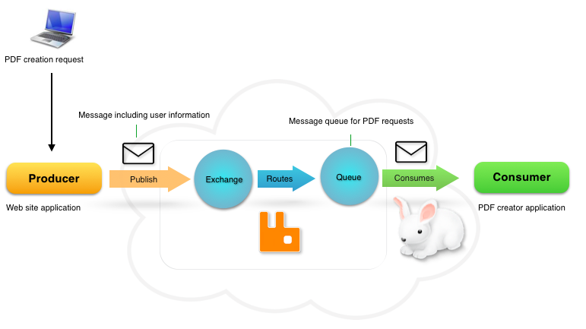
The Advanced Message Queuing Model (AMQ Model)

Slide 9
JMS VS AMQP
JMS is an API specification (part of the Java EE specification) that defines how message producers and consumers are implemented.
We can differentiate JMS from AMQP on following points.
Protocols used by producers and consumers to communicate with the message broker.
Message Routing
JMS ( P -> Q -> C )
AMQP ( P -> E -> B -> Q -> C )
Messaging Models
Message Structure

Slide 10
JMS VS AMQP - Protocols…

Slide 11
JMS VS AMQP - Protocols…

Slide 12
RabbitMQ
RabbitMQ is a message queueing software called a message broker or queue manager. Simply said; It is a software where queues can be defined, applications may connect to the queue and transfer/receive a message onto/from it.
Implements AMQP
Written in Erlang programming language
Interoperable
Polygot

