Slide 1

INTERN PROJECT CONCEPT
LLM Validation
Atlas
A friendly map and memory for planning LLM validations consistently.
Simple example: document summarization with human review
Goal: make validation easier to start, easier to compare, and easier to reuse.
LLM Validation Atlas | 1
Notes:
Open with the core idea: this is not an automation replacement. It is a planning assistant that helps validators reuse what MRM already knows.

Slide 2
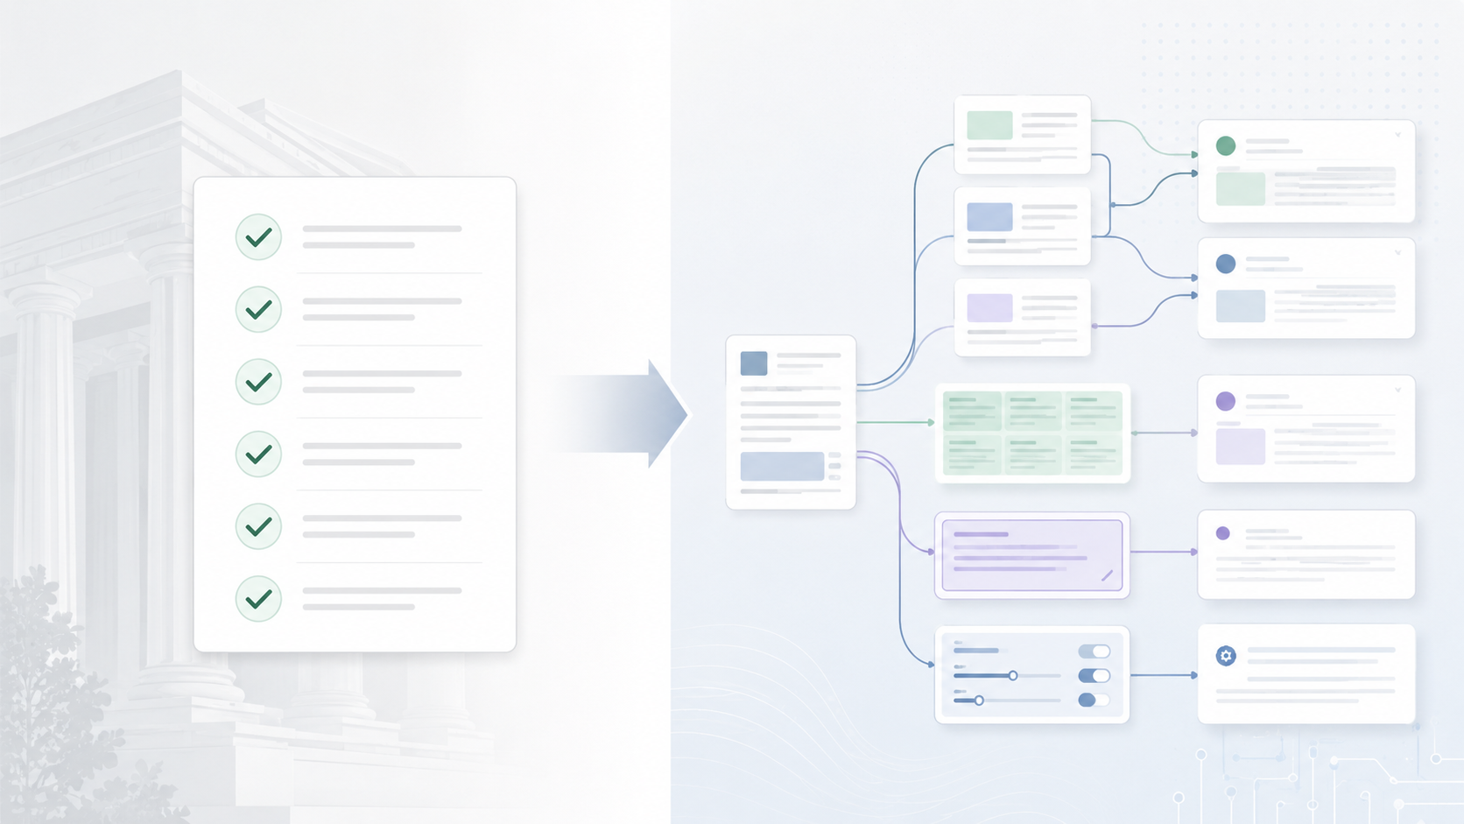
Why this matters now
Before LLMs, the validation playbook was relatively mature.
Data checks, train/test splits, performance metrics, benchmarks, sensitivity, monitoring.
LLM projects are more varied and less standardized.
Summarization, extraction, RAG, chat, OCR plus LLM, agentic flows, human-in-the-loop tools.
The pain: every new project can feel like starting from scratch.
LLM Validation Atlas | 2
Notes:
Make this relatable: the issue is not lack of skill. The issue is that the knowledge is scattered and the problem space is moving fast.

Slide 3

The running example
COMMON-SENSE USE CASE
An internal tool summarizes important documents.
The LLM drafts the summary.
A human reviews it before use.
The final summary supports business work.
Simple enough to explain.
Rich enough to test seriously.
LLM Validation Atlas | 3
Notes:
Use this same example throughout the deck. It keeps the project friendly and concrete.

Slide 4
For LLMs, “accuracy” is not enough
For the summarizer example, we care about several ways the output can fail.
Omission risk
Does it miss key facts or risk language?
Validation question
Unsupported facts
Does it invent details not in the source?
Is this summary
correct, grounded,
complete, stable,
and useful?
Meaning drift
Does it change the document’s intent?
Inconsistency
Does it summarize similar documents differently?
The framework should help us remember all of these - not just the easiest metric.
Review burden
Does the human spend too much time correcting it?
LLM Validation Atlas | 4
Notes:
This slide motivates why a validation map is needed. The goal is not more bureaucracy; it is fewer blind spots.

Slide 5

Piece 1: the validation map
A simple map that links project characteristics to risks, tests, and metrics.
Project type
Document summarization
Risk
Omission of critical facts
Test
Key-fact coverage review
Metric
% of critical facts covered
The map says what to test and why.
LLM Validation Atlas | 5
Notes:
Avoid saying taxonomy first. Call it a validation map: project type to risk to test to metric.

Slide 6

Piece 2: the validation memory
A structured record of what happened before, with enough context to be useful later.
Model
LLM/version/provider
Setup
prompt, settings, retrieval, data
Task
summary, extraction, Q&A, etc.
Test
coverage, grounding, robustness
Result
score, sample size, notes, caveats
The memory says what worked, what failed, and under what conditions.
LLM Validation Atlas | 6
Notes:
Emphasize context. A score without model version, prompt, data, and evaluation method is not reliable memory.

Slide 7

How the assistant would help
The assistant gives a starting point, not a final answer.
1
Describe new project
task, users, data, risk, human review
2
Create project fingerprint
small set of standardized descriptors
3
Retrieve similar work
prior projects, tests, findings, results
4
Suggest validation plan
risks, tests, metrics, benchmark ideas
Validator judgment stays in control.
LLM Validation Atlas | 7
Notes:
The key phrase: starting point, not final answer. The system helps avoid blank-page syndrome.

Slide 8
What the intern builds
A practical prototype plus a clear methodology. Not a giant production platform.
Validation map
Retrieval demo
Result memory
Demo story
Project descriptors
Risk-to-test links
Metric definitions
Find similar projects
Explain similarity
Show relevant evidence
Store model/prompt/settings
Store tests and scores
Attach caveats
Use the document summarizer
Show suggested tests
Show reusable results
Keep it light: enough structure to be useful, not so much that it becomes hard to use.
LLM Validation Atlas | 8
Notes:
This slide turns the scope into buildable components. It also makes clear what not to build.

Slide 9

A simple 10-week path
1-2
Scope + project descriptors
3-4
Validation map + metric definitions
5-6
Similarity retrieval prototype
7-8
Result memory + benchmark evidence
9-10
Demo, stress test, final story
LLM Validation Atlas | 9
Notes:
This is realistic for a PhD-level intern: scoped, researchy, and practical.

Slide 10
What “good” looks like
By the end, the project should make LLM validation feel less ad hoc.
Usable
A validator can start with a new LLM project and get a reasonable first test plan.
Explainable
Recommendations show why similar projects, risks, tests, and metrics were selected.
Consistent
Similar projects receive similar rigor, while still allowing judgment.
Reusable
Results are stored with context so future benchmark choices are better informed.
Extendable
New LLMs, tasks, prompts, and datasets can be added without redesigning everything.
One-line synopsis: build an evidence-based assistant that helps validators decide what to test by learning from similar past LLM projects.
LLM Validation Atlas | 10
Notes:
Close with the friendly synopsis. This keeps the intern project clear and low pressure.

