Slide 1
VGDS Website Frameworks

Slide 2
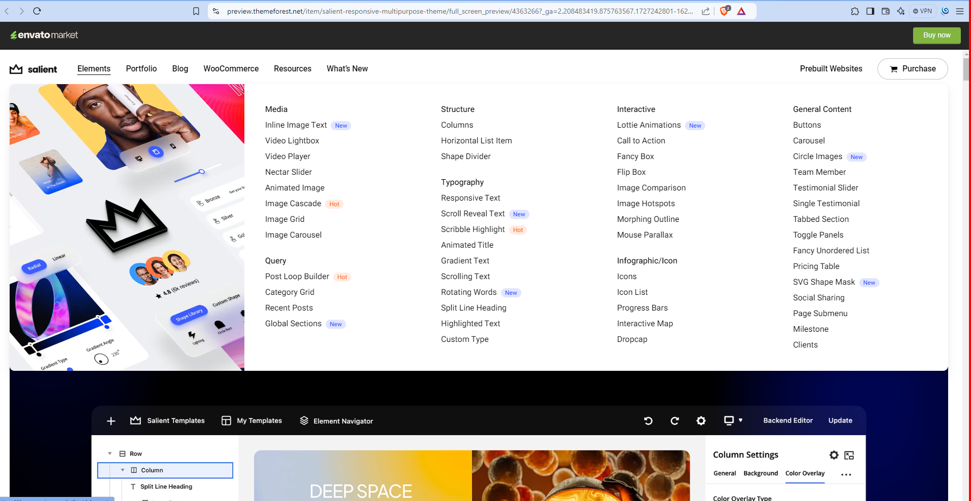

Slide 3
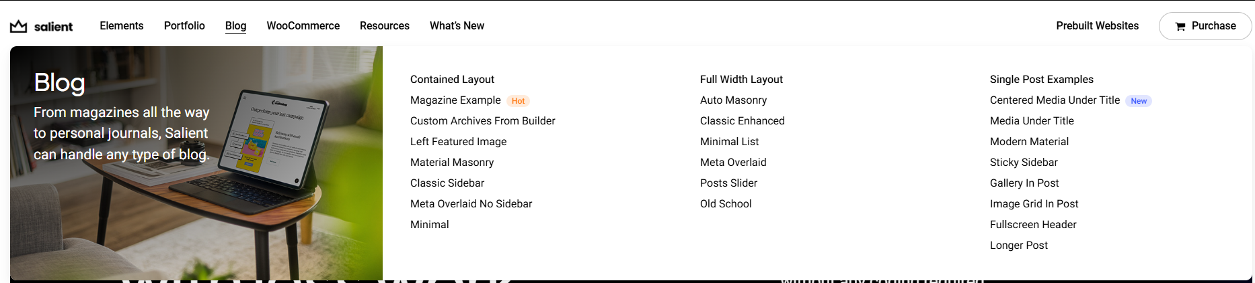
VGDS Global
Our Services
Our Solutions
Portfolio
Resources
Review
Pricing
Hire Us
Order Now
Our services
VGDS Global offers 24/7 support for your business design needs
Our Services
Presentation Design
Graphics Design
Editorial Services
Other Services
Business Presentation
PowerPoint Template
Google Slides
Investor Pitch Deck
Company Profile
Sales Pitch Deck
Marketing
Training
Conference
Event
Webinar
PowerPoint Videos
Interactive PowerPoint
Logo
Brochure
Flyer
Onepager
Report
Booklet
Social Media Poster
LinkedIn Carousel
LinkedIn Banner
Email Signature
Newsletter
Banner (Print)
Interactive PDF
Proofreading
Content Creation and Storytelling
Content Editing
Excel Sheet Data Entry
Web Search & Data Extraction
Word Document Formatting
Dashboard Design
Brand Identity

Slide 4
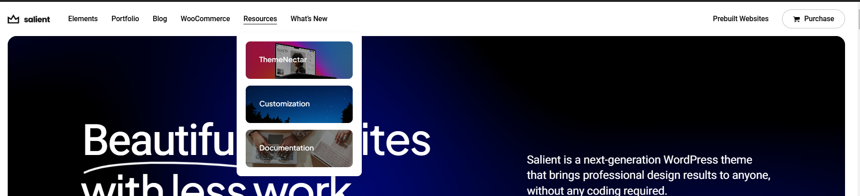
VGDS Global
Our Services
Our Solutions
Portfolio
Resources
Review
Pricing
Hire Us
Order Now
Presentation Experts on Demand
Overnight Presentations
Dedicated Team
Our Solutions
Presentation Experts on Demand
Overnight Presentations
Dedicated Team

Slide 5
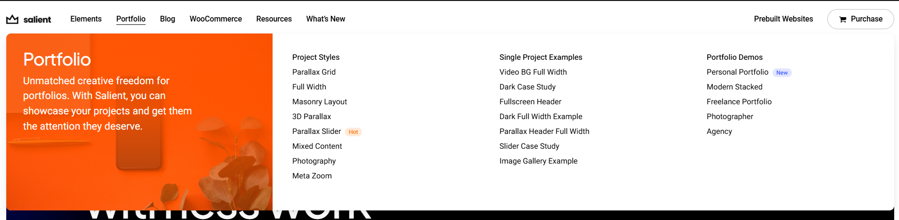
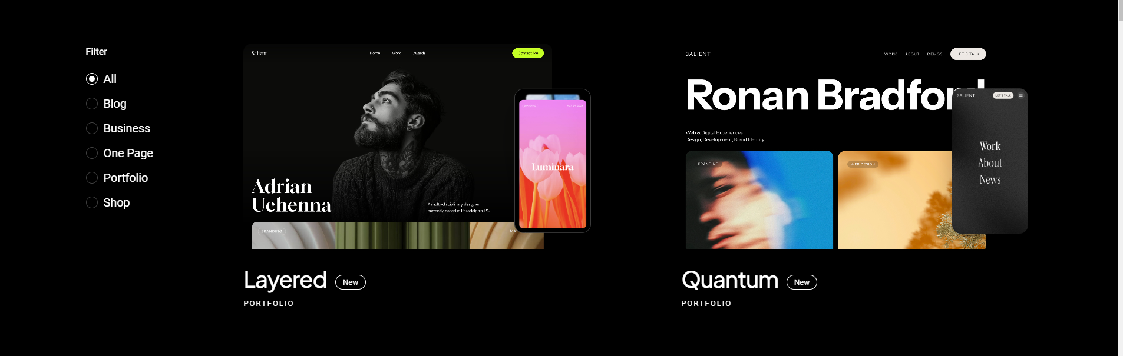

VGDS Global
Our Services
Our Solutions
Portfolio
Resources
Review
Pricing
Hire Us
Order Now
Portfolio
Business Presentation
Pitch deck design
Print design
Branding Template
Graphic design
PowerPoint
Word
Sales design
Company Profile
Brochure

Slide 6

VGDS Global
Our Services
Our Solutions
Portfolio
Resources
Review
Pricing
Hire Us
Order Now
Resources
Free Templates
Tutorials
Blogs
FAQs

Slide 7
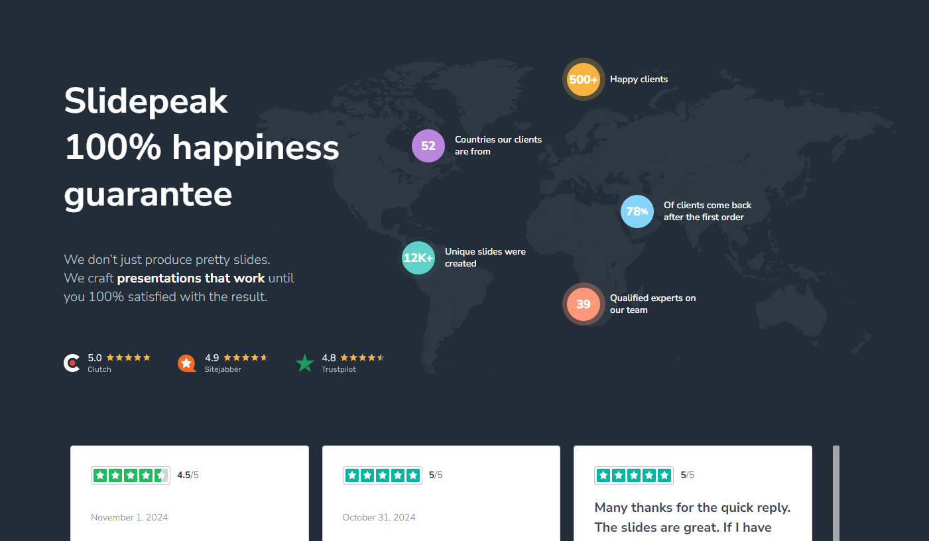
VGDS Global
Our Services
Our Solutions
Portfolio
Resources
Review
Pricing
Hire Us
Order Now
VGDS Global

Slide 8
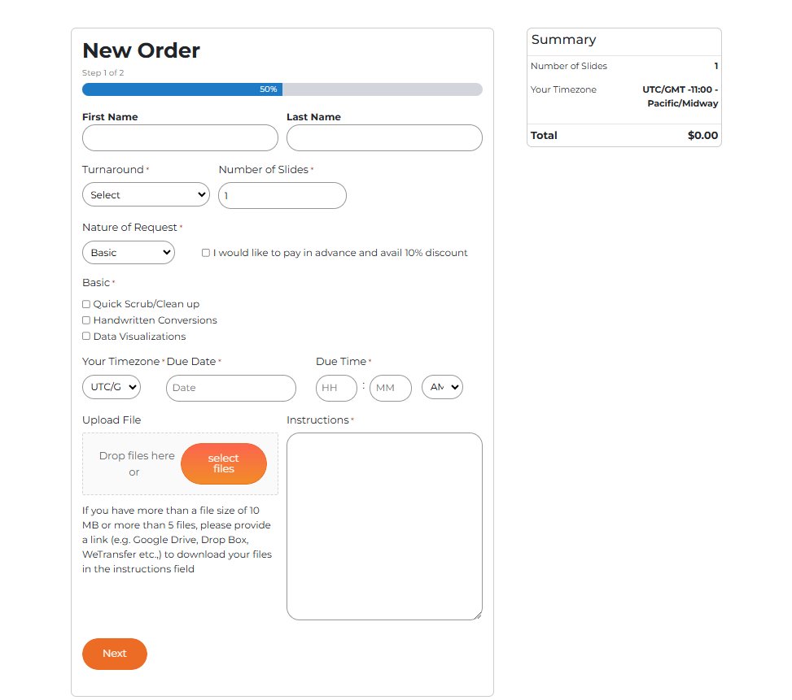
VGDS Global
Our Services
Our Solutions
Portfolio
Resources
Review
Pricing
Hire Us
Order Now
Sample – Add VGDS Pricing Page here
First Name
Last Name
Company Name
Email Address
Contact number
Design Style (Quick Scrub| Standard Design | High Level Enhancement)
Due Date and Time (Time Zone)
Number of slides
Upload File → File type (image, ppt, pdf, word, video)
Instructions
Upload Inspirations and Brand Guidelines
Other details

Slide 9
VGDS Global
Our Services
Our Solutions
Portfolio
Resources
Review
Pricing
Hire Us
Order Now
Sample – Add VGDS Pricing Page here
Shared in a separate file

Slide 10
VGDS Global
Our Services
Our Solutions
Portfolio
Resources
Review
Pricing
Hire Us
Order Now
Add VGDS old web page in the new template style
https://vgdsglobal.com/contact/
Add new Address: VGDS Global LLP 1st Floor - Clovers Blue Tower
Near InforPark Phase 1, Edachira Kakkanad, Kearla, India, 682030

