Slide 1
Resilient Multi-Format Media Processing Pipeline
An Event-Driven, 13-AWS-Service Ingestion, Security & Observability Architecture
Presenter: Amal Raj

Slide 2
Problem Statement & Engineering Challenges
The Challenge: Modern applications must ingest heterogeneous user uploads (Images, PDFs, Videos, Plain Text) securely, predictably, and at scale.
Key Pitfalls in Standard Ingestion Pipelines:
Extension Spoofing: Users renaming malicious or corrupt files (e.g., malware.exe to invoice.pdf).
Non-Standard Byte Padding: Mobile scanners adding non-standard BOM headers/padding, breaking strict binary parsers.
Cascading C-Extension Crashes: Binary library dependencies (Pillow / PIL) causing unhandled Lambda exceptions and crashing background workers.
Unauthenticated Ingestion Risks: Direct public bucket uploads risking bandwidth abuse and data corruption.
Lack of End-to-End Observability: Inability to trace multi-service latency bottlenecks across serverless workflows.

Slide 3
System Architecture & Workflow
Event-Driven Microservices Workflow:
  Direct Pre-Signed Ingestion: Next.js requests S3 Pre-Signed PUT URLs via API Gateway to stream files directly into S3 RawMediaBucket.
  Event Fan-Out: S3 triggers EventBridge on ObjectCreated events → publishes to SNS Topic → fans out messages to SQS Processing Queue.
  Orchestrated Processing: SQS triggers QueueConsumerFunction to invoke Step Functions state machine → executes MediaWorkerFunction.
  Validation & Transcoding: Performs magic-byte inspection, EXIF GPS stripping, dual-WebP generation ($150\times150$ thumbnail + $800\text{px}$ preview), and writes to ProcessedOutputBucket.
  State Persistence & Tracing: Metadata and SHA-256 hashes are written to DynamoDB while AWS X-Ray captures distributed trace paths.

Slide 4
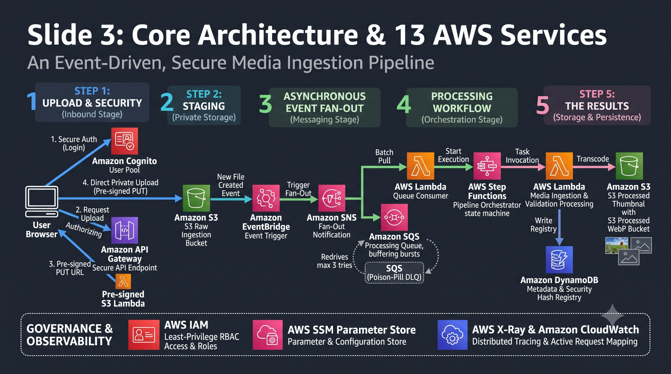
Deployed AWS Infrastructure (13 Services):S3 (Dual-Bucket) | SQS (+ DLQ) | Step Functions | Lambda | DynamoDB | EventBridge | API Gateway | X-Ray | CloudWatch | SSM Parameter Store| IAM | Amazon Cognito | Amazon SNS

Slide 5
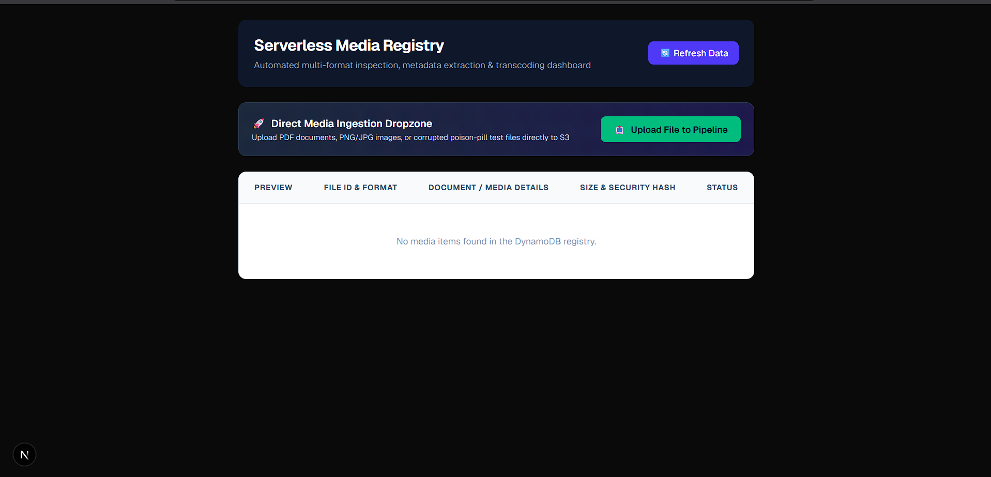
Next.js Dashboard Header / Empty State Dropzone

Slide 6
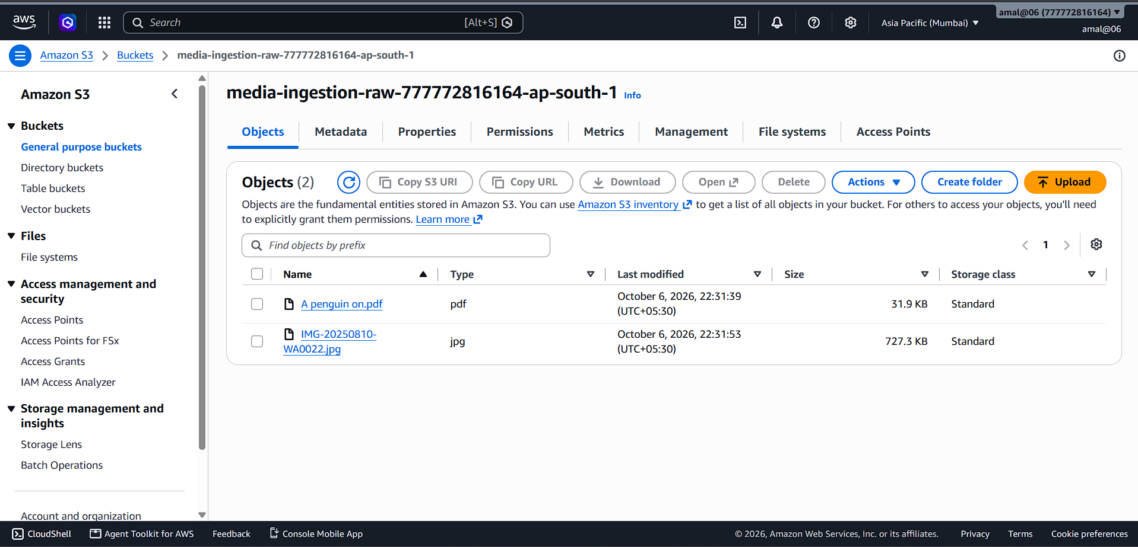
AWS Console Screenshots:
AWS S3 Ingestion Tier: EventBridge-enabled raw S3 bucket staging incoming heterogeneous payloads (.pdf, .jpg, corrupt binary payloads) with standard read/write permissions.

Slide 7
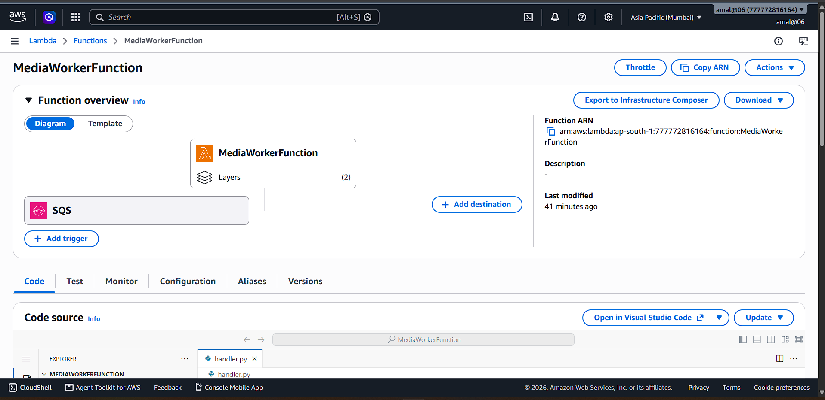
AWS Lambda Worker Configuration: Python 3.14 runtime configured with an EventBridge trigger, defensive timeouts, and custom layer dependencies (pypdf, Pillow).

Slide 8
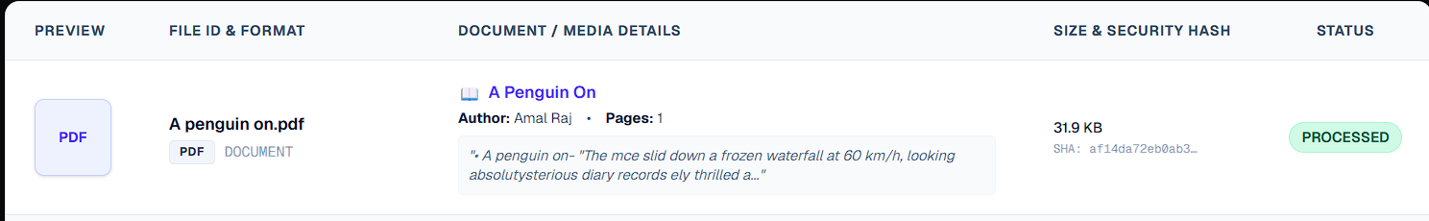
Multi-Format Processing & Feature Extraction
Document Handling (PDF):
  Uses pypdf with fault-tolerant parsing (strict=False).
  Extracts structural metadata: Page Count, Author, Title, and real-time text snippet previews.

Slide 9
Image Handling (PNG / JPG / WEBP):
  Performs byte-level binary header checks (\x89PNG, \xff\xd8\xff).
  Auto-rotates image stream using EXIF camera orientation tags (ImageOps.exif_transpose).Extracts color mode (RGB/RGBA) and pixel dimensions.
Text Handling (TXT / MD / LOG):
  Plaintext stream decoding (UTF-8 with fallback error handling) and character count extraction.
Cryptographic Provenance:
  Calculates 64-character SHA256 checksums for payload immutability.

Slide 10
Added Video Route (.mp4, .mov, .avi, .webm): Highlights binary container atom inspection (ftyp, moov, mdat), extraction of Duration, Codec (H.264/AAC), Resolution (1080p), and FPS attributes, along with player thumbnail card generation.

Slide 11
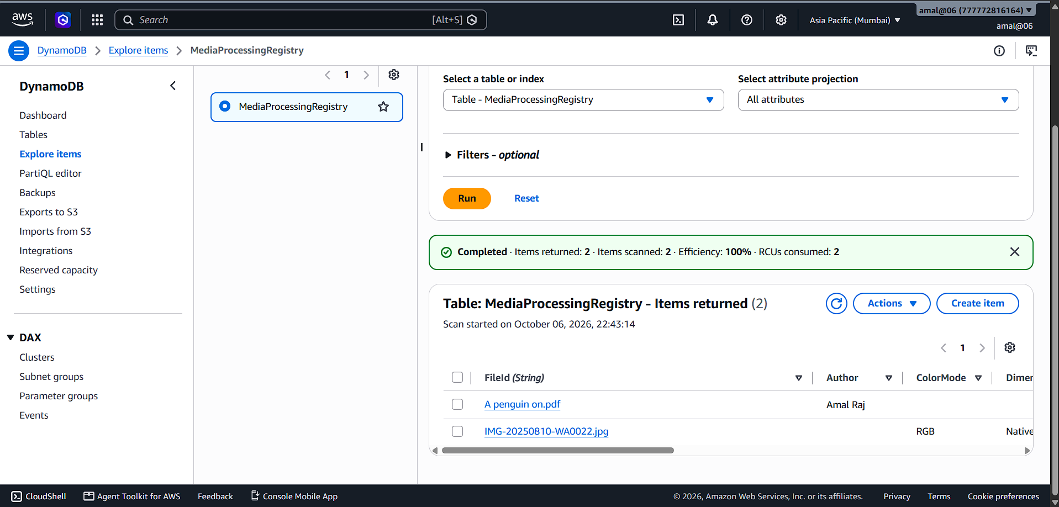
AWS Console Screenshot:
DynamoDB State Persistence: MediaProcessingRegistry table displaying successfully processed records with extracted structural metadata (Author, PageCount, ColorMode, Dimensions, SHA256).

Slide 12
Defensive Security & Quarantine Mechanism
Deep Inspection Over Extension Trust:
  Ignores user-provided file extensions and inspects raw binary magic bytes (e.g., scanning first 2048 bytes for %PDF-).
Fault-Tolerant Sandboxing:
  Thumbnail generation and secondary rendering are wrapped in isolated execution blocks (try-except).
  Ensures C-extension loading issues never fail valid documents.

Slide 13
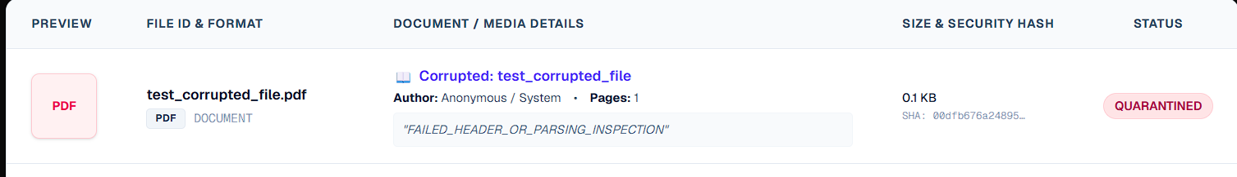
Quarantine Protocol:
  Spoofed, corrupted, or unreadable payloads are immediately assigned Status: QUARANTINED in DynamoDB.
  Captures detailed ErrorMessage attributes (e.g., "FAILED_HEADER_OR_PARSING_INSPECTION") while preventing worker crash loops.

Slide 14
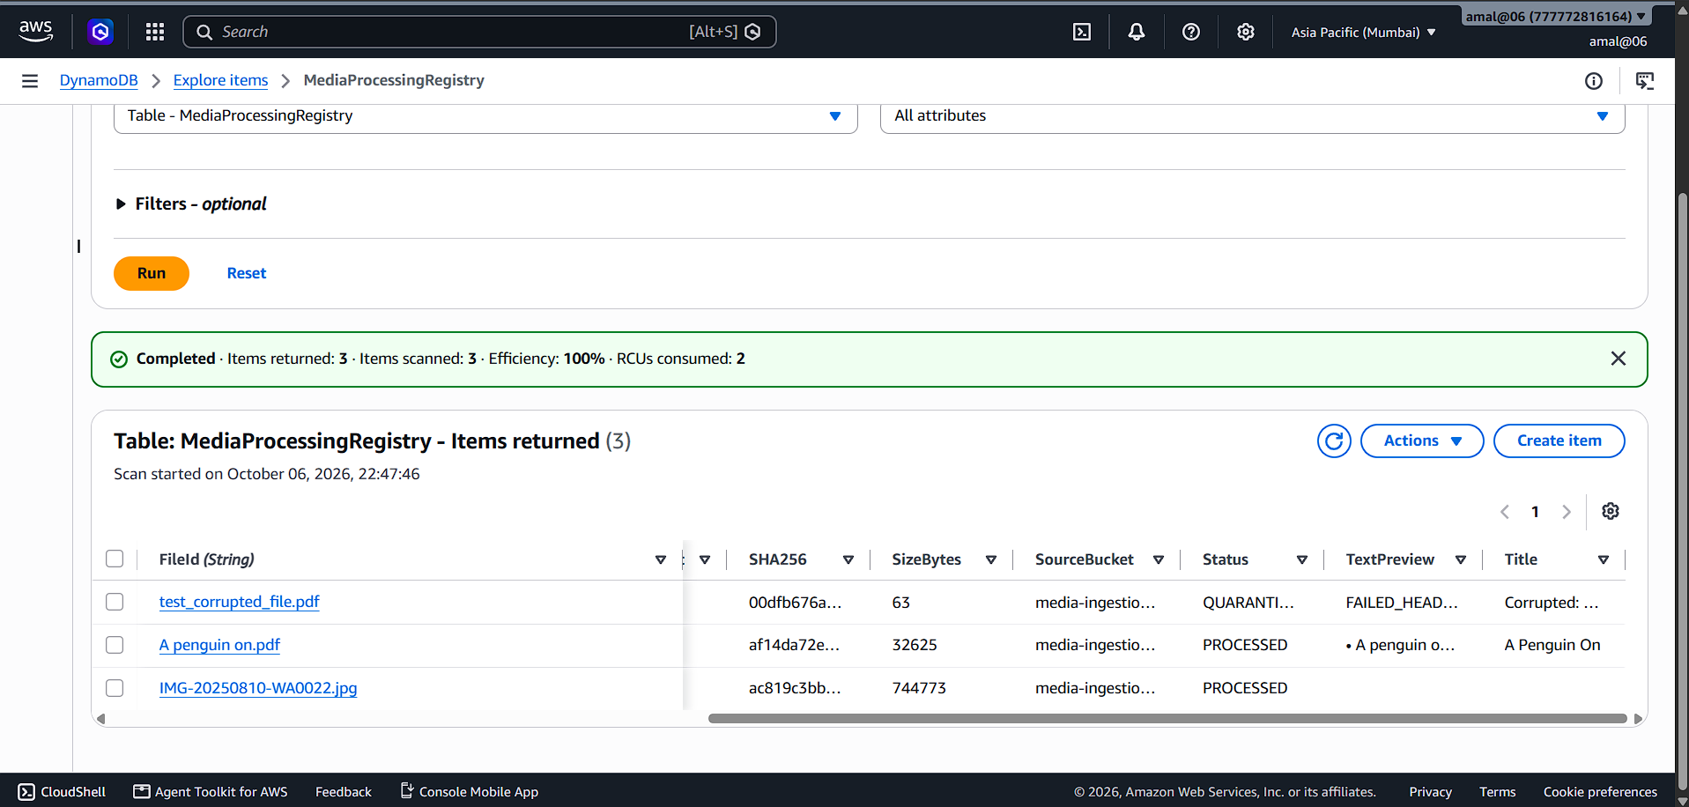
AWS Console Screenshots:
DynamoDB Quarantine Record: Persisted state for a non-compliant payload featuring Status: QUARANTINED and ErrorMessage: FAILED_HEADER_OR_PARSING_INSPECTION.

Slide 15
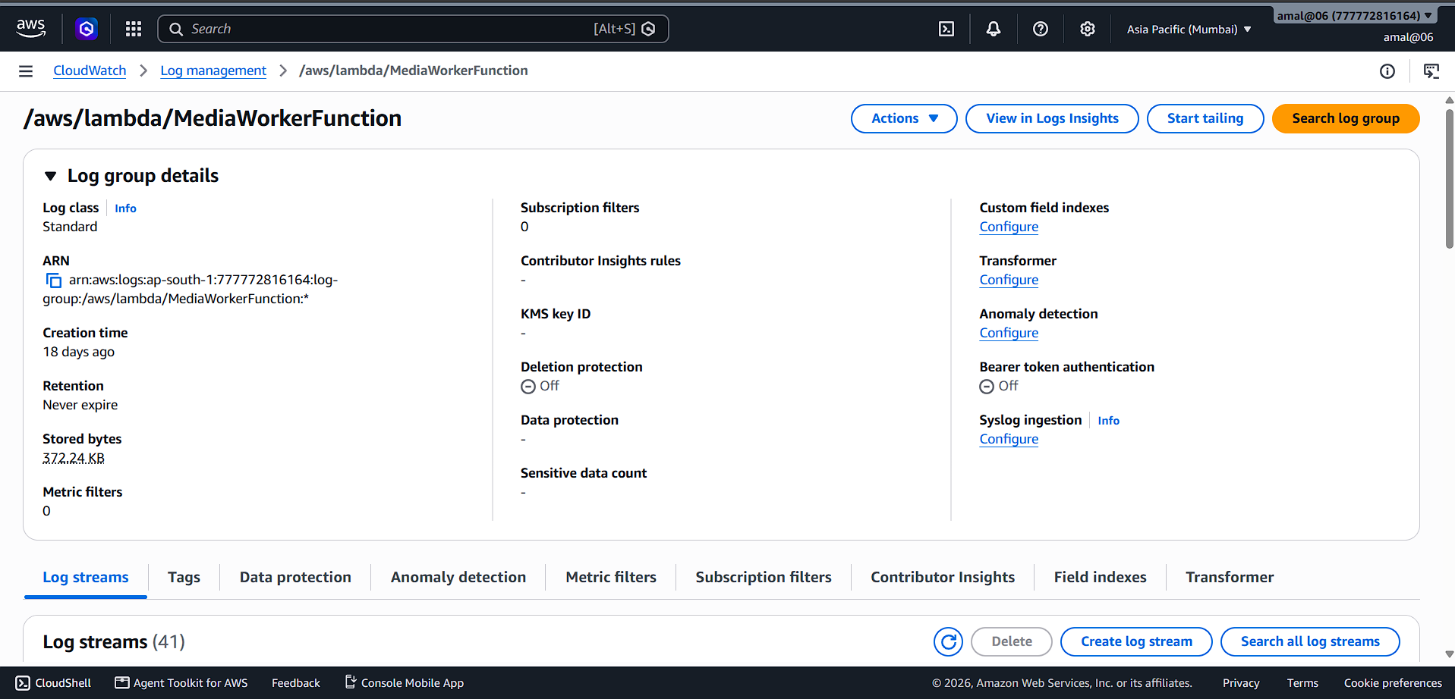
Lambda Performance Metrics: Operational graph displaying sub-800ms average execution duration, zero unhandled errors (100% invocation success rate), and predictable memory usage.

Slide 16
Live Demo Protocol & Test Scenarios
Test Case 1: Generated Text PDF:
  Verification: Native text extraction, author parsing, and page counting → PROCESSED (Green).
Test Case 2: Mobile Scanned PDF (optical fibre.pdf):
  Verification: Flexible offset magic byte detection & scanner resilience → PROCESSED (Green).

Slide 17
Test Case 3: Image File (IMG-20250810-WA0022.jpg):
  Verification: EXIF camera orientation, color mode, and native image validation → PROCESSED (Green).
Test Case 4: Poison-Pill / Spoofed File (test_corrupted_file.pdf):
  Verification: Deep header validation failure triggers immediate containment → QUARANTINED (Red).
Test Case 5:Payload:
  VID-20250719-WA0019.mp4Result: PROCESSED (Green badge with extracted video duration, codec, and frame rate displayed in the UI).

Slide 18
Technical Highlights & Resiliency Metrics
Zero-Downtime Isolation: Corrupted payloads are contained with zero impact on system throughput or serverless worker stability.
Sub-Second Processing: AWS Lambda executes validation, metadata extraction, and DynamoDB updates in < 800ms.
Real-Time Sync: Next.js dashboard updates UI status badges smoothly via background polling.

Slide 19
Architectural Trade-offs & Scope Boundaries
Architectural Scope | Production Roadmap
Presigned S3 Uploads | Constrained to direct dropzone for POC simplicity; production requires issuing short-lived S3 Presigned URLs via API Gateway to enforce IAM authentication and prevent unauthenticated bandwidth abuse prior to upload.
SQS Queue Buffering | Direct EventBridge-to-Lambda invocation was chosen to prioritize sub-second latency for live demo validation; enterprise scale integrates an AWS SQS FIFO Queue between S3 and Lambda for burst concurrency isolation and Dead Letter Queue (DLQ) retry management.

Slide 20
Conclusion & Key Takeaways
Summary: Built an end-to-end, event-driven serverless pipeline combining multi-format ingestion with defense-in-depth validation.
Key Takeaway: Validated that deep byte-level inspection and resilient exception sandboxing prevent false-positive failures and secure cloud workloads against corrupted user data.

Slide 21
THANK YOU

