Slide 1
Cameras

Slide 2
Nikon D3500
A brilliant blend of simplicity, value and quality for beginners
Type: DSLR | Sensor: APS-C | Megapixels: 24.2MP | Lens mount: Nikon F | Screen: 3-inch fixed, 921,000 dots | Viewfinder: Optical | Max video resolution: Full HD | User level: Beginner
$496.95
+Great ergonomics
+Superb image quality
+Versatile and affordable
-Fixed rear screen
The Nikon D3500 is a long-standing favorite of ours. It's by no means the most advanced DSLR you can get, but its simplicity, its controls and the quality of the images it can create make it our top recommendation for anyone just starting out. There’s a lot the D3500 doesn’t do – it has a fixed rear screen that’s not touch-sensitive, it doesn’t have hybrid on-sensor autofocus and it doesn’t shoot 4K video. But its 24-megapixel sensor delivers super-sharp, super-high quality images, Nikon’s latest AF-P retracting kit lens is a miniature marvel and focuses very fast in live view, even without on-sensor phase-detection autofocus. The D3500 handles well, it’s easy to use, it’s more powerful than it looks and it’s the perfect introduction to interchangeable lens photography.

Slide 3
Canon EOS Rebel SL3 / 250D
For features, price and user-friendliness, this is the best Canon DSLR
Type: DSLR | Sensor: APS-C | Megapixels: 24.2MP | Lens mount: Canon EF-S | Screen: 3in vari-angle touchscreen, 1,040,000 dots | Max burst speed: 5fps | Max video resolution: 4K | User level: Beginner
$649
+Easy to use
+Excellent live view autofocus
+4K video
-Bigger than a mirrorless model
The Canon EOS Rebel SL3 (called the EOS 250D in Europe) is a terrific camera for beginners, because although it costs a little more than entry-level models like the Nikon D3500, it has lots of features to make picture taking easier and more exciting, and the potential to take on more advanced projects as your skills grow. The 24-megapixel APS-C sensor delivers great results, but the star of the show is Canon's advanced Dual Pixel CMOS AF system, which makes the live view autofocus (when you use the rear screen rather than the viewfinder) extremely fast and responsive. Better still, the rear screen is both fully-articulating and touch-sensitive, so you can take pictures at all sorts of odd angles, and for the first time in a DSLR at this price it's possible to shoot 4K video – this is the perfect DSLR for bloggers and vloggers, not just regular photographers.

Slide 4
Olympus OM-D E-M10 Mark IV
The E-M10 Mark IV is portable but powerful, and beautiful to use
Type: Mirrorless | Sensor: Micro Four Thirds | Megapixels: 20.3 | Lens mount: MFT | Screen: 3-inch 180-degree tilting touchscreen, 1,037k dots | Viewfinder: EVF, 2,360k dots | Max shooting speed: 8.7fps | Max video resolution: 4K UHD | User level: Beginner/intermediate
$699.99
+Latest 20MP sensor
+5-axis in-body stabilisation
+Small body, small lenses
-MFT sensor smaller than APS-C
With a new 20MP sensor, incrementally improved in-body image stabilization and a new flip-down and tiltable monitor, the new Olympus OM-D E-M10 Mark IV is the best version yet of a camera we've been raving about for ages. Retaining the 4K video and attractive styling that made the Mark III so attractive to consumers, the Mark IV is set to be a new favorite for anyone looking for an entry-level camera that can do pretty much everything. This is one of our favorite pint-sized cameras ever, so we're really pleased that it has AT LAST got Olympus's latest 20MP sensor. It's still a little pricey for beginners, but this is a great little camera that's so much more powerful than it looks and could be with you for a long time to come.

Slide 5
Panasonic Lumix G100
Panasonic's new vlogging camera is pretty good at stills too
Type: Mirrorless | Sensor: Micro Four Thirds | Megapixels: 20.3 | Lens mount: MFT | Screen: 3-inch vari-angle, 1,840k dots | Viewfinder: EVF, 3.69m dots | Max continuous shooting speed: 10fps | Max video resolution: 4K UHD | User level: Beginner/enthusiast
$797.99
+Quality video and stills
+Smart audio recording
+Bright EVF, articulated LCD
-No in-body stabilisation
Vloggers and content creators will enjoy the simplicity of the Lumix G100. It makes it easy to capture high-quality video and stills with its approachable button layout. Even people uninterested in the technicalities of capturing great-looking videos will be able to get results with this camera. There’s an inherent risk of dumbing things down too much when creating a camera for social media, but Panasonic has avoided that pitfall with the Lumix G100. By giving it a decent viewfinder and “proper camera” ergonomics, Panasonic has given the G100 an edge in a highly competitive market. This is a great camera to start with if you're interested in travel photography, vlogging or both!

Slide 6
Fujifilm X-T200
The X-T200 is great for photo novices, instagramers and vloggers
Type: Mirrorless | Sensor: APS-C | Megapixels: 24.2MP | Lens mount: Fujifilm X | Screen: 3.5in vari-angle touchscreen, 2,760k dots | Viewfinder: EVF, 2,360k dots | Max continuous shooting speed: 8fps | Max video resolution: 4K | User level: Beginner/Intermediate
LOW STOCK
$799.99
+Big 3.5-inch vari-angle touchscreen
+Good 4K video features
+Neat design, and now even lighter
-Not the smallest
The Fujifilm X-T200 is light and compact, but looks and feels handles like an old-school 35mm SLR camera. Best of all, it has a big new 3.5-inch vari-angle touchscreen with twice the resolution of most rivals and a 1:6 aspect ratio perfectly suited to video. It also has an electronic viewfinder and can shoot 4K video as well as 24-megapixel stills. Its 15-45mm kit lens is electrically powered takes up much less space than a regular kit lens as well as offering wider angle of view than most, making it ideal for interior shots and big landmarks. The big touchscreen will help smartphone upgraders feel right at home, and if you decide you don't need an electronic viewfinder, the cheaper X-A7 is essentially the same but cheaper.

Slide 7
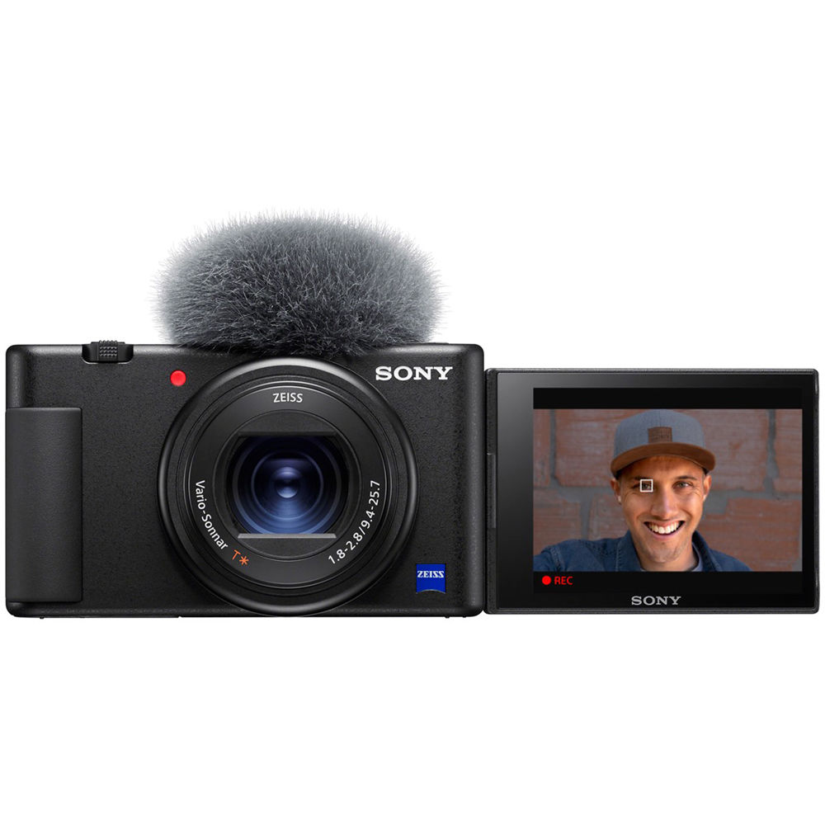
Sony ZV-1
A brilliant fixed-lens compact built for travel and vlogging
Type: Compact | Sensor: 1inch CMOS | Megapixels: 20.1MP | Lens mount: N/A | Screen: 3-inch vari-angle touchscreen, 921k dots | Viewfinder: No | Max continuous shooting speed: 24fps | Max video resolution: 4K | User level: Intermediate
$750.99
+Vari-angle rear screen
+Clip on wind shield
+Brilliantly fast AF
-No viewfinder
Normally we recommend interchangeable lens cameras for any kind of serious photography or filmmaking, but we'll make an exception with the Sony ZV-1. It has a fixed 3x zoom lens and a 1-inch sensor that's smaller than its Micro Four Thirds and APS-C rivals, but it makes up for it with a super-compact body small enough to slip into a jacket or even a trouser pocket, and a body, controls, audio system and rear that are optimised brilliantly for vlogging. The woolly hat you see in the pictures is a muffler to cut wind noise while filming, and it comes with the camera, and the autofocus on this camera is blazingly fast – and copes brilliantly when you hold objects up to show the camera.

Slide 8
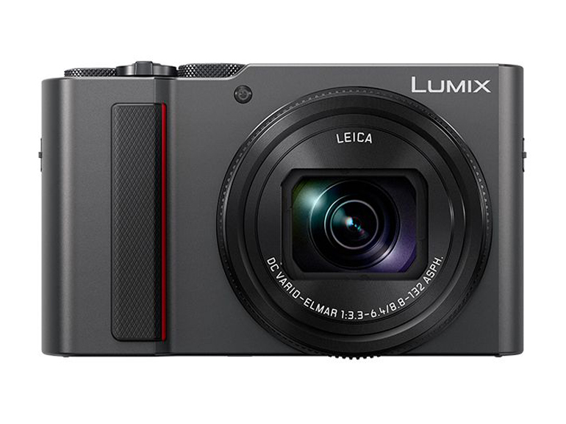
Panasonic TZ200/ZS200
The big zoom and good-sized sensor make this a top-quality buy
Type: Compact | Sensor size: 1-inch | Megapixels: 20.1MP | Lens: 26-390mm (equiv.), f/3.3-6.4 | LCD: 3in fixed touchscreen, 1.24 million dots | Viewfinder: EVF | Continuous shooting: 10fps | Max video resolution: 4K | User level: Enthusiast
$597.99
+Good 1-inch sensor
+Excellent 15x zoom range
+Manual controls and raw files
4K video and 4K Photo
Interchangeable lens DSLR and mirrorless cameras are great if you want to get seriously into photography, but can be overkill when you just want to grab pictures casually. Sometimes a fixed lens compact camera will be fine, especially if you want to do a lot of travelling, and if you're more concerned with capturing the moment than fussing over technicalities. A superzoom travel camera is the perfect solution, but most have really small 1/2.3-inch sensors which limit their picture quality. The Panasonic TZ200/ZS200 is different. It has a much larger 1-inch sensor for much better pictures, matched up with a big 15x zoom – and yet it will still fit in a jacket pocket when it’s powered down. The TZ200/ZS200 isn’t exactly cheap, but it’s surely one of the best long-zoom compact cameras you can get, and it has features and controls that will even please experts.

Slide 9
LAPTOPS

Slide 10
. DELL XPS 13 (2020)
$1,000
If you’re looking for a laptop that does just about everything right, we recommend Dell’s latest XPS 13.
11th Generation Intel® Core™ i3-1115G4 Processor (6MB Cache, up to 4.1 GHz)
Windows 10 Home, 64-bit, English
8GB 4267MHz LPDDR4x Memory Onboard
Intel® UHD Graphics with shared graphics memory
256GB M.2 PCIe NVMe Solid State Drive
Platinum silver exterior, black interior

Slide 11
HP ENVY X360 (2020)
You don’t need to spend $1,000 to get a laptop that looks and feels premium. The HP Envy x360 2020 is the best budget laptop you can buy, thanks to its sturdy and compact build, chic convertible design, and excellent performance.
Windows 10 Home 64
AMD Ryzen™ 5 4500U processor
AMD Radeon™ Graphics
8 GB memory; 256 GB SSD storage
15.6" diagonal FHD display
$750

Slide 12
MACBOOK AIR (2020)
The 2020 MacBook Air is the best option for most people who prefer the Apple ecosystem. The Air comes with 10th Gen Intel processors (though in a lower power variation than the XPS 13), a sharp Retina display, and a new scissor-switch keyboard. The base configuration (including a Core i3, 8GB RAM, and 256GB storage) comes in under $1,000, but we recommend that you go for, at minimum, the upgraded model with a Core i5 processor.
$999
1.1GHz Dual-Core Core i3 Processor with Turbo Boost up to 3.2GHz 256GB Storage Touch ID
Retina display with True Tone
1.1GHz dual-core 10th-generation Intel Core i3 processor
Turbo Boost up to 3.2GHz
Intel Iris Plus Graphics
8GB 3733MHz LPDDR4X memory
256GB SSD storage¹
Magic Keyboard
Touch ID
Force Touch trackpad
Two Thunderbolt 3 ports

Slide 13
ASUS ROG ZEPHYRUS G14
AN EXCELLENT GAMING LAPTOP
The Zephyrus G14 is an astonishingly powerful gaming laptop for a low price (relative to other notebooks with comparable hardware). It pairs AMD’s new Ryzen 9 4900HS with an Nvidia RTX 2060 Max-Q GPU and a 120HZ display, and it can run demanding games at their highest settings without a problem. It’s also quite light for such a powerful laptop, weighing just over 3.5 pounds. Its battery life is also impressive for a gaming rig; we got almost nine hours of multitasking
But you don’t need to be a gamer to appreciate the Zephyrus G14. It’s also a great notebook for business and everyday multitasking with a unique retro design. Plus, the keyboard and touchpad are exceptional and quiet enough not to bother officemates. On the flip side, if you need to use your laptop for videoconferences, the G14 would not be a great choice, as it lacks a webcam.
$1,450

Slide 14
MACBOOK PRO (16-INCH, 2019)
A GREAT CHOICE FOR MAC POWER USERS
The 16-inch MacBook Pro is the best Apple laptop for power users. Apple dealt with the biggest complaints that people have historically had about MacBook Pros, and if you can stomach the price, there’s not a lot else to complain about.
Most importantly, the keyboard is good again. The keys have a full millimeter of travel, and while the typing experience isn’t exceptional, it’s a world away from the maligned butterfly keyboard of MacBooks past. It’s fairly quiet, too.
This MacBook also features the best sound you’ll find on a laptop. Apple has crammed three speakers into each side, including two woofers. The result is balanced audio with audible bass and great stereo separation. For those who need a laptop that can crank through editing video, working with multiple audio tracks, or processing large batches of photos, the 16-inch MacBook Pro is the king of the hill
$2,399
2.3GHz 8-core 9th-generation Intel Core i9 processor
Turbo Boost up to 4.8GHz
AMD Radeon Pro 5500M with 4GB of GDDR6 memory
16GB of 2666MHz DDR4 memory
1TB of SSD storage¹
16-inch Retina display with True Tone
Magic Keyboard
Touch Bar and Touch ID
Four Thunderbolt 3 ports

Slide 15
HP ELITE DRAGONFLY
A BUSINESS LAPTOP WITH SOLID SECURITY $1,810
Windows 10 Pro 64
8th Generation Intel® Core™ i5 processor
16 GB memory; 256 GB SSD storage
13.3" diagonal FHD display with HP Sure View integrated privacy screen
Intel® UHD Graphics 620
If you’re a business professional and money is no object for you or your company, you can’t do better than the HP Elite Dragonfly. The 2020 model is the first Dragonfly that features HP’s super-secure SureView Reflect technology, which tints the screen so that snoops can’t see what you’re doing while you’re working in public. When it’s not tinted, the display gets quite bright (over 700 nits) and has great viewing angles.
The new Dragonfly is also the first laptop to include a built-in Tile tracker. That means if you lose the device, you can use the Tile smartphone app to set off an alarm (if it’s in Bluetooth range) or locate it anywhere in the world using Tile’s crowd-finding network. The tracker can work for a limited time even when the laptop is off.
Almost everything else about the Dragonfly is good; it has some of the best battery life of any laptop on the market (we got over 11 hours), a sleek and stunning 2-in-1 design, and an exceptional keyboard. Plus, it incorporates sustainable material, including ocean-bound plastics and recycled DVDs.
The Dragonfly is pricey, and there are cheaper business laptops that will suit the needs of most professionals just fine. But if you’re looking for the best of the best, it’s the unambiguous winner.

Slide 16
RAZER BLADE PRO 17
THE BEST PORTABLE GAMING LAPTOP $3,200
Usually, if you want a 17-inch laptop that can pull playable frame rates out of today’s most demanding games, you’d expect some compromises on portability and design. Notebooks of this size often weigh north of seven pounds and require multiple power bricks to charge.
But while the Blade Pro 17 doesn’t have quite the gaming chops of some bulky desktop replacements, it makes up for that by sporting the compact and attractive design that’s a trademark of the Razer Blade line. At just over six pounds, it’s not too difficult to move around (as 17-inch workstations go). You get an RTX GPU (up to Nvidia’s 2080 Super Max-Q) an eight-core CPU (Intel’s Core i7-10875H) and either a 300Hz screen or a 120Hz touchscreen. There’s even an RGB keyboard with color effects tailored to the game you’re playing.

Slide 17
HP SPECTRE X360 13 (LATE 2019)
OUR FAVORITE 2-IN-1 LAPTOP
The Spectre x360 is a premium-level 2-in-1 Windows laptop with the latest processor options from Intel, a vibrant touchscreen, and more port options than are found on other laptops in this segment.
The x360 weighs less than three pounds and is about two-thirds of an inch thick when closed, which makes it very easy to travel with. The latest model has a smaller footprint than before, thanks to shrunken bezels above and below the screen, but it still maintains a full-size keyboard and spacious trackpad. In addition, it provides both facial and fingerprint biometric authentication, so you can choose which way you prefer to log in.
HP updated the trackpad drivers it uses in the latest model to Microsoft’s Precision set and the experience is improved over the older versions to the point where it’s no longer an issue. The x360’s trackpad is now right up there with the best Windows trackpad options (which are still a tick behind what you get on a MacBook) in terms of scrolling, multifinger gestures, and palm rejection.
The biggest argument against the x360 is that it has a 16:9 display, as opposed to the 16:10 or 3:2 screens you’ll find on Dell or Microsoft’s computers. Those taller aspect ratios are much better for productivity work, whether that’s working in two documents side by side or researching on the web without having to scroll as much. But unless you are very particular about your screen’s aspect ratio, most people won’t find this to be a deal-breaker
$1,250

Slide 18
DELL XPS 15 (2020)
A GREAT LAPTOP FOR VIDEO EDITING
You can configure the XPS 15 with up to an eight-core Core i7 processor, Nvidia’s GTX 1650 Ti graphics, and a 3840 x 2400 touchscreen. Those specs are overkill for most people, but they’re ideal for anyone who needs to edit video or do other heavy creative work with Adobe Premiere. We recommend that anyone who’s just browsing and streaming go for the 1920 x 1200 screen and a Core i5, which will save you significant money. (We also experienced some heat management issues and disappointing battery life with the i7 unit.)
The XPS 15 isn’t a serious gaming rig, but the GTX 1650 Ti can help out with creative tasks. Our model was able to export a five-minute, 33-second video in Adobe Premiere Pro in just four and a half minutes — which is faster than we got with the 16-inch MacBook Pro.
If you’re looking for a large, attractive Windows laptop that packs decent power, this is the one for you.
$1,150

Slide 19
GIGABYTE AERO 15
A GREAT LAPTOP FOR CREATIVE WORK
The Gigabyte Aero 15 is a colorful, powerful laptop for creative professionals. This 15.6-inch workstation pairs a bright OLED screen with an eight-core i7-10875H processor and Nvidia’s cutting-edge GeForce RTX 2070 Super Max-Q GPU. It also comes with a laundry list of ports, including a full SD-card slot, so you’ll be able to plug in all kinds of projectors, monitors, and other equipment without a problem. We also found that it was able to run demanding games on their highest settings at acceptable frame rates, and export 4K video as fast as any other laptop we’ve tested.
This is an expensive machine, and if you just want to play games, it’s probably not worth spending so much money on an OLED screen. But if you need the combination of the high resolution and the high-powered specs, the Aero 15 is for you.
$2,658

Slide 20
DELL XPS 17
THE 17-INCH LAPTOP TO BUY
The XPS 17 is a workstation for professionals who need a huge screen and huge power. Its 17-inch 3840 x 2400 display allows you room to comfortably work in multiple tabs and apps, and it’s also bright enough to use for outdoor work without much obtrusive glare.
It contains H-series Intel processors, and can be configured with discrete RTX GPUs — our model had an RTX 2060 Max Q. That system flew through gaming benchmarks and complex video work — and didn’t burn itself up in the process, thanks to a new cooling system from Dell that includes a chassis-wide vapor chamber. Best of all, those specs and screen manage to function without decimating the XPS’s battery life; our unit (with a 97Wh brick) was able to last a full work day.
$2,940
10th Generation Intel® Core™ i7-10875H (16MB Cache, up to 5.1 GHz, 8 cores)
Windows 10 Home, 64-bit, English
NVIDIA® GeForce RTX™ 2060 6GB GDDR6 with Max-Q
32GB DDR4-2933MHz, 2x16G
1TB M.2 PCIe NVMe Solid State Drive

Slide 21
phones

Slide 22
iPhone 12 Pro
the best phone overall
Display: 6.1-inch OLED (2532x1170) | CPU: A14 Bionic | RAM: 6GB | Storage / Expandable: 128GB, 256GB, 512GB / No | Rear camera: 12MP wide (ƒ/1.6), 12MP ultrawide (ƒ/2.4), 12MP telephoto (ƒ/2.0) | Front camera: 12MP (ƒ/2.2) | Weight: 6.66 ounces | Battery life (Hrs:Mins): 9:06 (5G), 11:24 (LTE)
$999
Best-in-class cameras
A14 Bionic blows away Android phones
Tougher Ceramic Shield display
MagSafe charging is easy to use
No charger in box
The iPhone 12 Pro is the best phone you can buy because of everything Apple packs into its sleek new design. You get the most 5G bands in any phone along with the new A14 Bionic processor, which blows away all Android phones. But the real reason to pick up the iPhone 12 Pro is the cameras. The main sensor now lets in more light, and the Night Mode works on both the ultrawide camera and the front TrueDepth camera. You can take portraits at night, thank to the combination of the telephoto lens and LiDAR sensor. Not only does the iPhone 12 Pro boast a gorgeous 6.1-inch OLED display, its protected by Ceramic Shield, which is designed to deliver 4x the protection in case of a drop. The flat edges look pretty sleek, too, even if they did into your hands a bit. The optional MagSafe charger makes wireless charging a breeze, thanks to the magnets built into the iPhone 12 Pro. But Apple doesn’t include any charger in the box. Although the iPhone 12 Pro’s battery life could be better over 5G, it’s the most complete phone for the money and the best camera phone yet.

Slide 23
Samsung Galaxy Note 20 Ultra
The best Android phone money can buy
Display: 6.9-inch AMOLED (3088x1440) | CPU: Snapdragon 865 Plus | RAM: 12GB | Storage / Expandable: 128GB, 256GB, 512GB / Yes | Rear camera: 108MP wide (ƒ/1.8); 12MP telephoto with 5x optical zoom (ƒ/3.0); 12MP ultrawide (ƒ/2.2) | Front camera: 10MP (ƒ/2.2) | Weight: 7.33 ounces | Battery life (Hrs:Mins): 10:15
$949
+Dynamic 6.9-inch 120Hz display
+Smoother S Pen performance
+Powerful 50x zoom camera and laser autofocus
+Very good battery life
Expensive
The Samsung Galaxy Note 20 Ultra is pricey at $1,299 but no other big-screen phone can do as much as this phablet. You get a gorgeous 6.9-inch OLED display with a dynamic 120Hz refresh rate, as well as lots of new S Pen upgrades, ranging from new air gestures to a smoother 9 ms response time. Plus, the Note 20 Ultra packs one of the most versatile camera setups ever, including a 108MP main sensor, a whopping 50x Space Zoom and a dedicated laser autofocus sensor to reduce blur.
The Note 20 Ultra is also a mini desktop PC and game console in disguise. With the improved DeX mode, you can beam photos, apps and more to a nearby TV, and with Xbox Game Pass you can stream more than 100 Xbox titles over the cloud. The Note 20 Ultra works well with your PC, too, as Link to Windows enables you to run Android apps on your laptop as well as get notifications, make calls and more. Add it all up and you have one of the best phones yet.

Slide 24
iPhone 11
An even better value at a lower price
Display: 6.1-inch LCD (1792x828) | CPU: A13 Bionic | RAM: 4GB | Storage / Expandable: 64GB, 128GB, 256GB / No | Rear camera: 12MP wide (ƒ/1.8); 12MP ultrawide (ƒ/2.4) / 12MP | Front camera: 12MP (ƒ/2.2) | Weight: 6.84 ounces | Battery life (Hrs:Mins): 11:20
+Great photos, especially with Night Mode
+Fast A13 Bionic CPU
+Long battery life
+Fast charger not included
Just 64GB of storage to start
$599
For a very reasonable $699, the iPhone 11 offers amazingly good low-light photos via its Night Mode, and there’s a new ultra-wide lens that lets you fit in more subjects or scene with its 120-degree field of view. Selfies get a serious upgrade, too, with a 12-MP camera that automatically switches to a wider view when you turn the phone to landscape mode.
The 6.1-inch LCD on the iPhone 11 isn’t OLED-great, like what you get from the newer iPhone 12, but it’s colorful and bright. A blazing A13 Bionic processor, long battery life and your choice of six colors solidify the iPhone 11 as a winner. It's also an even better deal now that the iPhone 12 is out, as Apple will continue to offer the iPhone 11 for $100 less than before, meaning it now starts at just $599.

Slide 25
Samsung Galaxy S20 FE
The best Samsung bargain
Display: 6.5-inch OLED (2400x1080) | CPU: Snapdragon 865 | RAM: 6GB | Storage / Expandable: 128GB / Yes | Rear camera: Triple-lens: 12MP main (ƒ/1.8), 12MP ultrawide (ƒ/2.2), 8MP telephoto with 3x zoom (ƒ/2.4) | Front camera: 32MP (ƒ/2.2) | Weight: 6.7 ounces | Battery life (Hrs:Mins): 9:03
+Big 120Hz display
+Affordable price
+Solid performance
Battery life bit shorter than expected
Fast charger costs extra
$599

Slide 26
OnePlus 8 Pro
The affordable Android flagship
Display: 6.78-inch OLED (3168x1440) | CPU: Snapdragon 865 | RAM: 8GB, 12GB | Storage / Expandable: 128GB, 256GB / No | Rear camera: 48MP wide (ƒ/1.78); 48MP ultrawide (ƒ/2.2); 8MP 3X telephoto (ƒ/2.4); 5MP color filter | Front camera: 16MP (ƒ/2.5) | Weight: 7 ounces | Battery life (Hrs:Mins): 11:05
Bright and beautiful 120Hz display
Long battery life
Strong performance
Curved display causes accidental taps
No mmWave 5G
$1,553.27
The OnePlus 8 Pro is one of the best phones because it packs so many features into a phone that costs less than premium flagships. You get performance that can match any leading phone and a gorgeous display with a fast 120Hz refresh rate for ridiculously smooth scrolling.
Opting for the fastest refresh rate can reduce battery life, but set the screen refresh rate at 60Hz and you can expect more than 11 hours of battery life — well ahead of what the average smartphone can pull off on our battery test. The OnePlus 8 Pro becomes the first OnePlus phone to support wireless charging; even better, it's the fastest wireless charging we've ever seen.

Slide 27
Google Pixel 4a
The best cheap phone you can buy
Display: 5.81-inch OLED (2340x1080) | CPU: Snapdragon 730G | RAM: 6GB | Storage / Expandable: 128GB / No | Rear camera: 12.2MP (ƒ/1.7) | Front camera: 8MP (ƒ/2.0) | Weight: 5.04 ounces | Battery life (Hrs:Mins): 8:55
Best-in-class camera
Bright OLED display
128GB storage
Low price
Battery life could be better
What makes the new Google Pixel 4a so special is that it offers almost everything you’d desire in a smartphone for just $349. And it’s remarkably compelling for that price.
Google’s latest midrange offering contains a gorgeous 5.8-inch OLED screen; solid power from a Snapdragon 730G chipset; clever software features like Call Screen and Google’s handy Recorder live transcription app; and, of course, that marvel of a 12-megapixel camera, which includes perks like Night Sight and Super Res Zoom.
The only area where the Pixel 4a lags behind the competition is with respect to battery life. Even with a power pack significantly bigger than the iPhone SE’s, it still doesn’t last quite as long on a charge. It also can’t match Apple’s $399 iPhone where performance is concerned. But in practically every other way, Google’s new baby Pixel is a fantastically well-rounded handset that everyone who is looking for a cheap phone should consider, with the best photography for the money.
€439.95

Slide 28
iPhone SE 2020
the best cheap iPhone
Display: 4.7-inch LCD (1334x750) | CPU: A13 Bionic | RAM: 3GB | Storage / Expandable: 64GB, 128GB, 256GB / No | Rear camera: 12MP (ƒ/1.8) | Front camera: 7MP (ƒ/2.2) | Weight: 5.22 ounces
Very affordable
Fast A13 Bionic performance
Supports wireless charging
Big bezels
No camera night mode
€425.90
The iPhone SE 2020 finishes on the podium of our list of the best smartphones because it delivers exceptional power for under $400. The A13 Bionic chipset inside the new iPhone SE is the very same one you get in the iPhone 11 and iPhone 11 Pro. It's a rare feat to see a flagship processor inside a device that is so inexpensive, and it makes the iPhone SE far and away the finest value in the budget phone segment.
But it's not exclusively about that wicked-fast CPU. The latest baby iPhone also has a solid single-lens 12-megapixel camera, wireless charging, IP67 water resistance and premium build quality. The tradeoff to that is the SE's very dated design, owing to its iPhone 8 roots — though Touch ID loyalists and users who find themselves pining for a more compact handset may be able to overlook that in favor of everything else the iPhone SE offers.

Slide 29
Moto G Power
The longest-lasting phone you can buy
Display: 6.4-inch LCD (2300x1080) | CPU: Snapdragon 665 | RAM: 4GB | Storage / Expandable: 64GB / Yes | Rear camera: 16MP (f/1.7) main, 2MP (f/2.2) macro, 8MP (f/2.2) ultra wide angle | Front camera: 16MP (ƒ/2.0) | Weight: 7 ounces | Battery life (Hrs:Mins): 16:10
The best battery life we’ve tested
Low price tag
Good performance and photos for the price
Screen isn’t very colorful
No optical zoom
$179.99
If you want the best phone for lasting all day long, get the Moto G Power. This budget phone from Motorola makes the most of its massive 5,000 mAh battery, enduring for more than 16 hours on our battery test, in which we have a phone surf the web over LTE until it runs out of juice.

Slide 30
The best Bluetooth speakers 2020

Slide 31
1. Sonos Move
The best Bluetooth speaker in the world, Sonos Move brings the party indoors and outside
Weight: 6.61 pounds (3kg) | Battery life: 10 hours | Connectivity: Wi-Fi (802.11 b/g/n, 2.4 GHz, and 5GHz) and Bluetooth 4.2 | Drivers: One down-firing tweeter, one mid-woofer, two Class-D digital amplifiers | NFC: No | Aux-in: No | USB charging: Yes (USB-C, and comes with charging dock)
Integrates with a home Sonos speaker network
On-the-go tunes
Not as feature-rich when using Bluetooth
Cant be used as rear cinema speakers
Integrates with a home Sonos speaker network
On-the-go tunes
Not as feature-rich when using Bluetooth
Cant be used as rear cinema speakers
$598
Here’s the thing about the Sonos Move – it’s so good, you might want to consider it not only as your on-the-go party station, but also as your main in-the-home wireless speaker too.

Slide 32
2. UE Boom 3
The former best Bluetooth speaker is still great for travelling with
Weight: 1.2 pounds | Battery life: 15 hours | Wireless range: 30+ feet | Frequency response: 90Hz-20kHz | Drivers: Two 1.75" drivers and two 1.75" x 3" passive radiators | NFC: Yes | Aux-in: No | USB charging: Yes
$321
It's both water and dust-proof, and now has a one-touch mix button that lets you pull up your favorite playlists without ever picking up your phone.

Slide 33
3. JBL Flip 5
A fun, no frills portable speaker
Weight: 1.2 pounds | Battery life: 12 hours | Wireless range: N/A | Frequency response: 65Hz - 20kHz | Drivers: 40mm | NFC: No | Bluetooth version: 4.2 | Aux-in: No | USB charging: No
Engaging, entertaining sound
Easy to use
No 3.5mm input
No mic for hands-free calls
$129.10
The JBL Flip 5 is proof that the best Bluetooth speakers aren't always the ones with the most impressive specs.
JBL’s Flip 5 is a simple soul with Bluetooth-only playback and modest features, but if you desire a rugged, great-sounding portable speaker and can sacrifice voice control or hands-free call functionality, you won’t be disappointed.

Slide 34
Bose Home Portable Speaker
A great Sonos Move alternative
Weight: 2.4 pounds | Battery life: 12 hours | Wireless range: N/A | Frequency response: N/A | Drivers: N/A | NFC: No | Bluetooth version: 4.2 | Aux-in: No | USB charging: Yes
$349
Great design
Well-balanced sound
The Bose Portable Home Speaker isn’t the brand’s first outdoor-friendly speaker, and it shows: gorgeous minimalist design meets weather-ready robustness, with a light build and handle that lends itself to listening on the go.

Slide 35
Anker Soundcore Flare
The best budget Bluetooth speaker
Weight: 1.1 pounds | Battery life: 12 hours | Wireless range: 20m / 66ft | Frequency response: N/A | Drivers: 2 x 1.75" Full Range + 2 x Passive Radiator | NFC: No | Aux-in: Yes | Bluetooth version: 4.2 | Weatherproofing: Yes-IPX7 | Charges devices over USB: No
Impressive sound for the size
Excellent mobile app
Waterproof
$67.97
The Soundcore Flare is an amazing value in the sub-$100 wireless speaker segment. Competitors like the UE Wonderboom (listed above) give the Flare a run for its money in terms of build quality but we give the Flare the slight edge with sound quality.

Slide 36
UE Wonderboom 2
The best outdoor speaker gets a refresh
Weight: 0.93 pounds | Dimensions: 104 x 95.3mm (H x D) | Battery life: Up to 13 hours | Wireless range: 100 ft (33 m) | Frequency response: 75 Hz – 20 kHz | Drivers: two 40 mm active drivers and two 46.1mm x 65.2mm passive radiators | NFC: No | Bluetooth version: N/A | Aux-in: No | USB charging: No
Great sound for its size
IP67 dustproof/waterproof rating
30% better battery life
$99.99
The original UE Wonderboom has been at the top of our best waterproof speaker list since its debut and for good reason: it’s rugged, plays louder than its diminutive sound suggests, and could be paired to other UE Wonderboom speakers to amplify sound.

Slide 37
JBL Charge 4
The best mid-range speaker
Weight: 2.2 pounds | Dimensions: 8.66 x 3.74 x 3.66 (W x D x H) | Battery life: Up to 20 hours | Wireless range: 30 ft (10 m) | Frequency response: 60Hz–20kHz | Drivers: N/A | NFC: No | Bluetooth version: 4.2 | Aux-in: Yes | USB charging: Yes
Balanced, powerful sound
Can charge your phone
Long battery life
$139.95
The JBL Charge 4 isn't a huge step up from the JBL Charge 3, sure, but that's because the speaker series was already such a massive success. What the Charge 4 does do, however, is add much better tonal balance while still being able to dish out some serious bass that doesn’t overwhelm other parts of the frequency spectrum.
The JBL Charge 4 may seem like a boring update on paper, but it’s still one of the best waterproof speakers around. For the money, you get a speaker that sound great, is tough as nails, acts as a charger for your phone, and lasts all day.

Slide 38
Bang & Olufsen Beosound A1 (2nd gen)
A Bluetooth speaker with Alexa
Weight: : 1.2 pounds | Battery life: : 18 hours | Wireless range: : 30m (100ft) | Frequency response: : 55 - 20,000 Hz | Drivers: N/A | NFC: No | Aux-in: No | USB charging: USB-C
Crisp sound quality
Lightweight design
Flawed Alexa support
$228.79
Visually near imperceptible from the original A1, the Bang & Olufsen Beosound A1 (2nd Gen) is an appealing and highly portable Bluetooth speaker that comes with (admittedly flawed) Alexa support.

Slide 39
Tribit StormBox
You probably haven't heard of Tribit, but its line of Bluetooth speakers sound a lot better than they should for the price. The StormBox is my favorite model. It has dual firing drivers and passive radiators in a 7-inch-long pill shape. No, it can't fuel a trance dance party on its own, but its sound clarity is impressive, and it has a fun extra bass button that adds some surprising thump. That extra bass is a little muddy, but it's still fun.
With 20-ish hours of battery and an IPX7 waterproof rating (not dust-proof, but able to be submerged in water), it's a great companion for some backyard tunes, a trip down the river, or a ton of other informal gatherings.
$61.99

