Slide 1
Machine learning Introduction
By :
Amjad - M2016721
Amal - M2016719

Slide 2
Why “Learn”?
Machine learning is programming computers to optimize a performance criterion using example data or past experience.
There is no need to “learn” to calculate payroll
Learning is used when:
Human expertise does not exist (navigating on Mars),
Humans are unable to explain their expertise (image recognition)
Solution changes in time (routing on a computer network)
Solution needs to be adapted to particular cases (user biometrics)
‹#›

Slide 3
What We Talk About When We Talk About“Learning”
Learning general models from a data of particular examples
Data is cheap and abundant (data warehouses, data marts); knowledge is expensive and scarce.
Example in retail: Customer transactions to consumer behavior:
People who bought “Da Vinci Code” also bought “The Five People You Meet in Heaven”
Build a model that is a good and useful approximation to the data.
‹#›

Slide 4
Applications:
Retail: Market basket analysis, Customer relationship management (CRM)
Finance: Credit scoring, fraud detection
Manufacturing: Optimization, troubleshooting
Medicine: Medical diagnosis
Telecommunications: Quality of service optimization
Bioinformatics: Motifs, alignment
Web mining: Search engines
...
‹#›

Slide 5
What is Machine Learning?
Machine Learning
Study of algorithms that
improve their performance
at some task
with experience
Optimize a performance criterion using example data or past experience.
Role of Statistics: Inference from a sample
Role of Computer science: Efficient algorithms to
Solve the optimization problem
Representing and evaluating the model for inference
‹#›

Slide 6
Growth of Machine Learning
Machine learning is preferred approach to
Face , Image,Speech recognition, Natural language processing
Computer vision
Medical outcomes analysis
Robot control
Computational biology
This trend is accelerating
Improved machine learning algorithms
Improved data capture, networking, faster computers
Software too complex to write by hand
New sensors / IO devices
Demand for self-customization to user, environment
It turns out to be difficult to extract knowledge from human experts → failure of expert systems in the 1980’s.
‹#›

Slide 7
Classification: Applications
Aka Pattern recognition
Face recognition: Pose, lighting, occlusion (glasses, beard), make-up, hair style
Character recognition: Different handwriting styles.
Speech recognition: Temporal dependency.
Use of a dictionary or the syntax of the language.
Sensor fusion: Combine multiple modalities; eg, visual (lip image) and acoustic for speech
Medical diagnosis: From symptoms to illnesses
Web Advertizing: Predict if a user clicks on an ad on the Internet.
‹#›

Slide 8
Traditional Programming
Machine Learning
Data
Computer
Output
Program
Data
Computer
Program
Output

Slide 9
About project

Slide 10
Convert Male portraits to female and vice-versa
The purpose of this Machine-learning project is to show that it's possible to automatically transform pictures of faces in useful and fun ways. The way this is done is by filtering the type of faces used as inputs to the model and the types of faces used as the desired target. The exact same architecture can be used to transform masculine faces into feminine ones, or vice versa, just by switching the source and target images used during training.
Requirements:
Python (3.5+)
TensorFlow (r0.12+)
GPU (optional for faster training)
‹#›

Slide 11
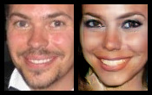
Face Recognition
Training examples of a Image
‹#›
Notes:
‹#›

Slide 12
Train Model
Training a model takes time and hard work in programming.
Training the model for about 60 to 80 batches. You will need to adjust “train time” depending on how many batches/hour your system can train.
‹#›

Slide 13
Training the model (script)
mport numpy as np
import os.path
import tensorflow as tf
import time
import dm_arch
import dm_input
import dm_utils
FLAGS = tf.app.flags.FLAGS
def _save_image(train_data, feature, gene_output, batch, suffix, max_samples=None):
"""Saves a picture showing the current progress of the model"""
if max_samples is None:
max_samples = int(feature.shape[0])
td = train_data
clipped = np.clip(gene_output, 0, 1)
image = np.concatenate([feature, clipped], 2)
image = image[:max_samples,:,:,:]
cols = []
num_cols = 4
‹#›

Slide 14
samples_per_col = max_samples//num_cols
for c in range(num_cols):
col = np.concatenate([image[samples_per_col*c + i,:,:,:] for i in range(samples_per_col)], 0)
cols.append(col)
image = np.concatenate(cols, 1)
filename = 'batch%06d_%s.png' % (batch, suffix)
filename = os.path.join(FLAGS.train_dir, filename)
dm_utils.save_image(image, filename)
def _save_checkpoint(train_data, batch):
"""Saves a checkpoint of the model which can later be restored"""
td = train_data
oldname = 'checkpoint_old.txt'
newname = 'checkpoint_new.txt'
oldname = os.path.join(FLAGS.checkpoint_dir, oldname)
newname = os.path.join(FLAGS.checkpoint_dir, newname)
# Delete oldest checkpoint
try:
tf.gfile.Remove(oldname)
tf.gfile.Remove(oldname + '.meta')
except:
pass
‹#›

Slide 15
# Rename old checkpoint
try:
tf.gfile.Rename(newname, oldname)
tf.gfile.Rename(newname + '.meta', oldname + '.meta')
except:
pass
# Generate new checkpoint
saver = tf.train.Saver()
saver.save(td.sess, newname)
print(" Checkpoint saved") def train_model(train_data):
"""Trains the given model with the given dataset"""
td = train_data
tda = td.train_model
tde = td.test_model
dm_arch.enable_training(True)
dm_arch.initialize_variables(td.sess)
# Train the model
minimize_ops = [tda.gene_minimize, tda.disc_minimize]
show_ops = [td.annealing, tda.gene_loss, tda.disc_loss, tda.disc_real_loss, tda.disc_fake_loss]
start_time = time.time()
step = 0
done = False
gene_decor = " "
‹#›

Slide 16
print('\nModel training...')
step = 0
while not done:
# Show progress with test features
if step % FLAGS.summary_period == 0:
feature, gene_mout = td.sess.run([tde.source_images, tde.gene_out])
_save_image(td, feature, gene_mout, step, 'out')
# Compute losses and show that we are alive
annealing, gene_loss, disc_loss, disc_real_loss, disc_fake_loss = td.sess.run(show_ops)
elapsed = int(time.time() - start_time)/60
print(' Progress[%3d%%], ETA[%4dm], Step [%5d], temp[%3.3f], %sgene[%-3.3f], *disc[%-3.3f] real[%-3.3f] fake[%-3.3f]' %
(int(100*elapsed/FLAGS.train_time), FLAGS.train_time - elapsed, step,
annealing, gene_decor, gene_loss, disc_loss, disc_real_loss, disc_fake_loss))
# Tight loop to maximize CPU utilization
if step < 200:
gene_decor = " "
for _ in range(10):
td.sess.run(tda.disc_minimize)
else:
gene_decor = "*"
for _ in range(2):
td.sess.run(minimize_ops)
td.sess.run(tda.disc_minimize)
td.sess.run(tda.disc_minimize)
td.sess.run(tda.disc_minimize)
step += 1
‹#›

Slide 17
# Finished?
current_progress = elapsed / FLAGS.train_time
if current_progress >= 1.0:
done = True
# Decrease annealing temperature exponentially
if step % FLAGS.annealing_half_life == 0:
td.sess.run(td.halve_annealing)
# Save checkpoint
#if step % FLAGS.checkpoint_period == 0:
# _save_checkpoint(td, step)
_save_checkpoint(td, step)
print('Finished training!')
‹#›

Slide 18
Uniqueness

Slide 19
Decision Theory
Search & Optimization
Decision processes
Deep Learning
Machine Learning – Classification
Machine Learning – Clustering
Natural Language Processing
(All Things use in this project)
‹#›

Slide 20
Outline
Machine Learning Problems

Slide 21
Choosing the Training Experience
Choosing the Training Experience
Sometimes straightforward
Text classification, disease diagnosis
Sometimes not so straightforward
Chess playing
Other Attributes
How the training experience is controlled by the learner?
How the training experience represents the situations in which the performance of the program is measured?

Slide 22
Choosing the Target Function
Choosing the Target Function
What type of knowledge will be learned?
How it will be used by the program?
Reducing the Learning Problem
From the problem of improving performance P at task T with experience E
To the problem of learning some particular target functions

Slide 23
Solving Real World Problems
What Is the Input?
Features representing the real world data
What Is the Output?
Predictions or decisions to be made
What Is the Intelligent Program?
Types of classifiers, value functions, etc.
How to Learn from experience?
Learning algorithms

Slide 24
Feature Engineering
Representation of the Real World Data
Features: data’s attributes which may be useful in prediction
Feature Transformation and Selection
Select a subset of the features
Construct new features, e.g.
Discretization of real value features
Combinations of existing features
Post Processing to Fit the Classifier
Does not change the nature

Slide 25
Intelligent Programs
Value Functions
Input: features
Output: value
Classifiers (Most Commonly Used)
Input: features
Output: a single decision
Sequence Labeling
Input: sequence of features
Output: sequence of decisions

Slide 26
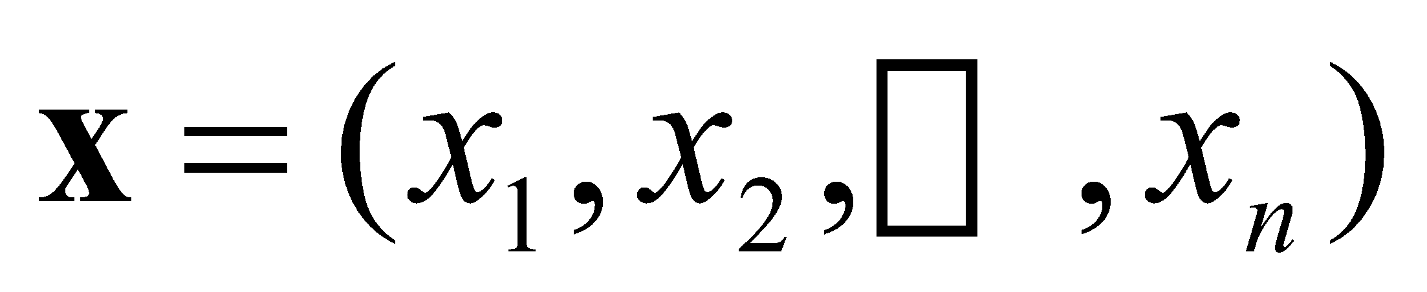
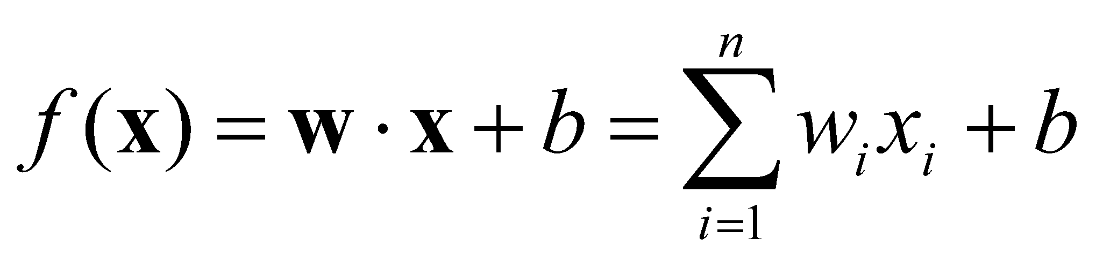
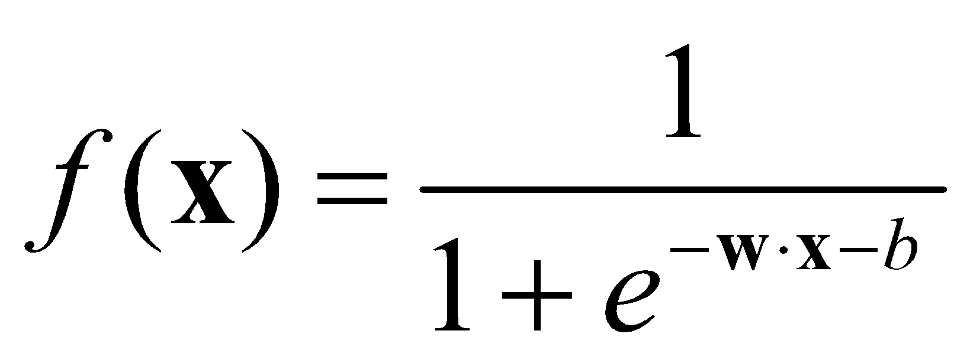
Examples of Value Functions
Linear Regression
Input: feature vectors
Output:
Logistic Regression
Input: feature vectors
Output:

