Slide 1

Classification images (deep learning)
In this project, we will deal with an important algorithm, which is CNN. We will deal with x-ray images of three patients, the first is normal, the second is infected with the virus, and the third is infected with Covid-19.

Slide 2

Step [1]: Prepare libraries and data

Slide 3
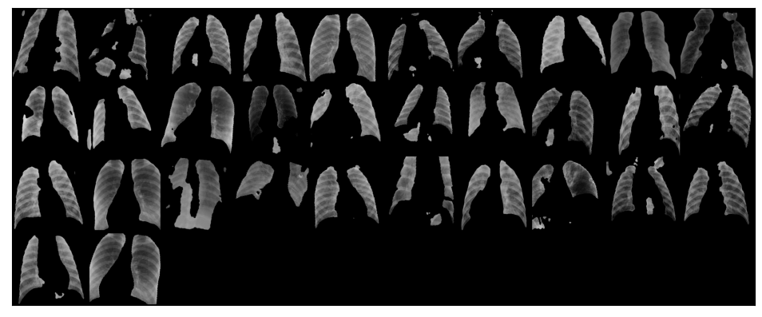
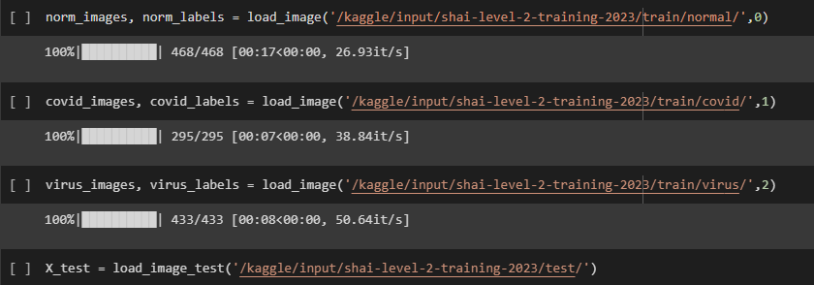
Step [2]: Read data

Slide 4
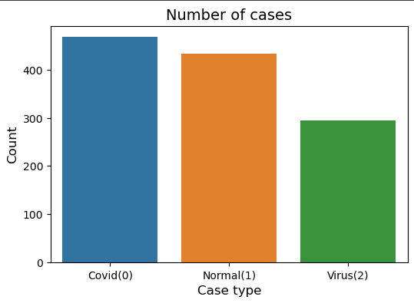
EDA and Data Visualization

Slide 5
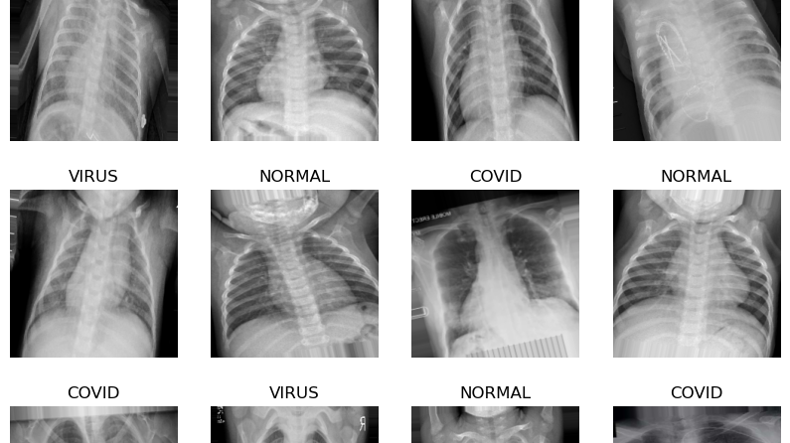
Step [3]: Data Generator

Slide 6
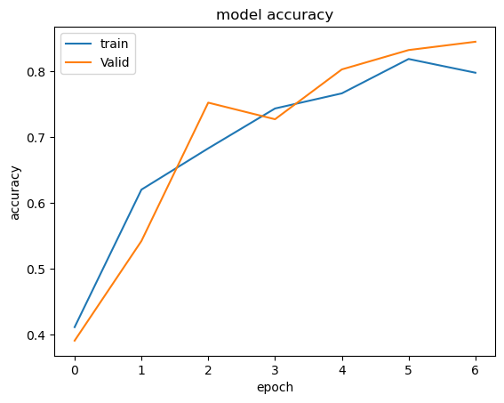
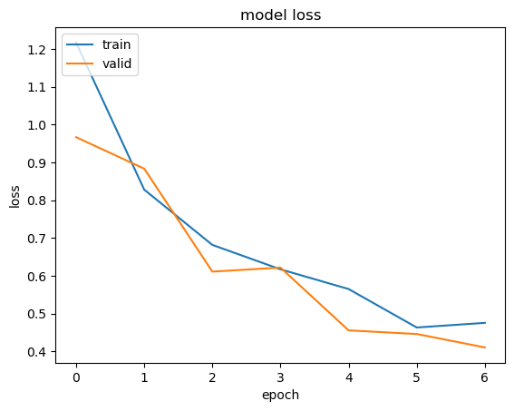
Step [4]: Build Baseline
Step [4:1]: CNN Model

Slide 7
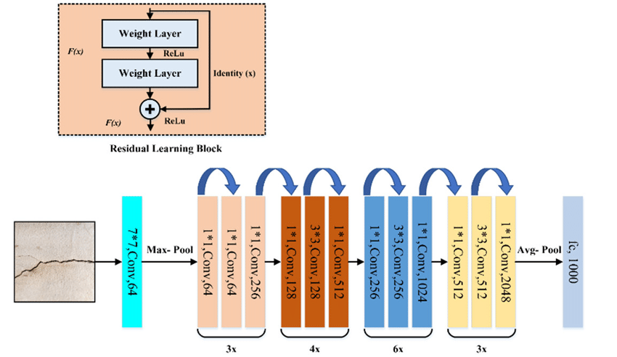
Step [4:2]: ResNet50 Model

Slide 8
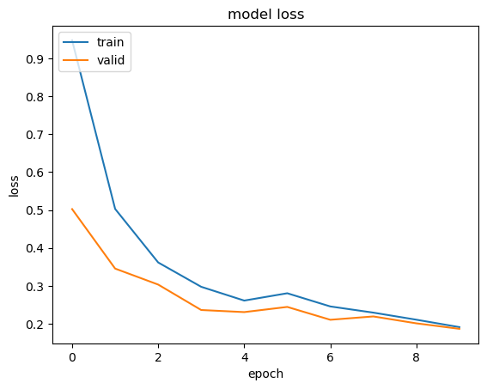
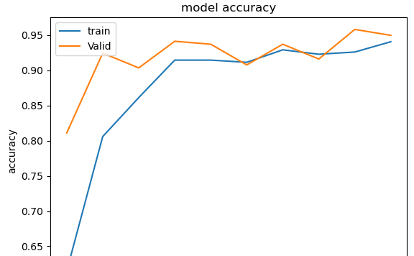
Step [4:3]: vgg-19 Model

Slide 9
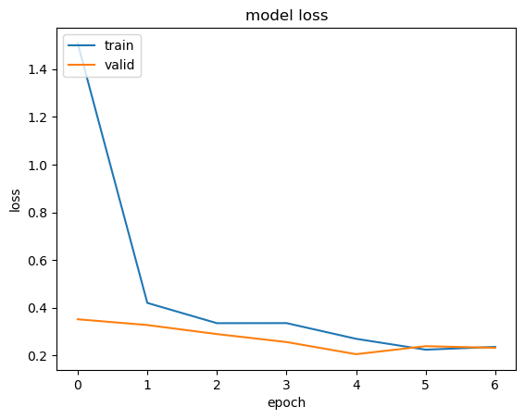
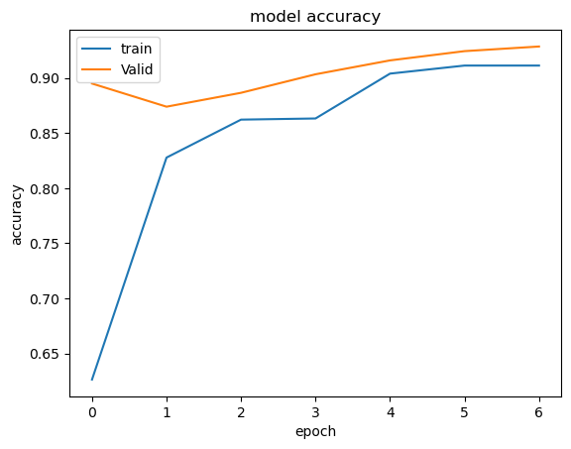
Step [4:4]: DenseNet Model

Slide 10
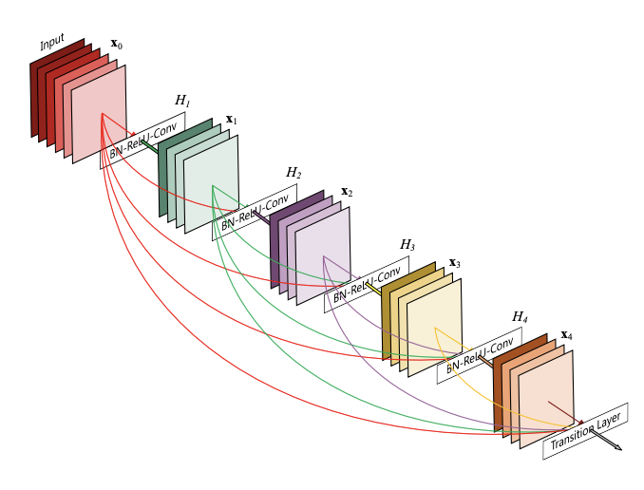
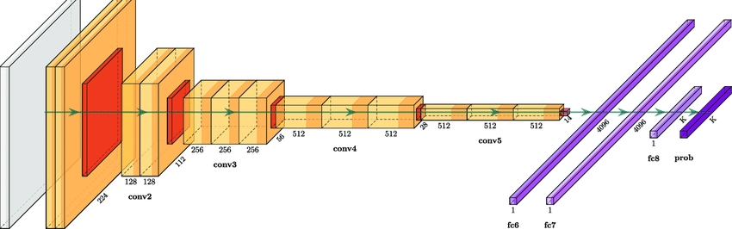
Accuracy for 3 models
CNN : 84%
ResNet50 : 85%
vgg-19 : 94%
DenseNet : 92%

