Slide 1
Smart Attendance Monitoring System (SAMS)
Guide: Ms.Ramitha Rajesh
Group Members: Amal A A
Anwin Antony
Christy Augustine

Slide 2
ABSTRACT
The regular class attendance of students plays a significant role in performance assessment and quality monitoring.
The system is developed by the integration of various components for managing the students attendance.
In order to reduce the workmanship, we propose a more sophisticated way of marking attendance by Digital Image Processing(DIP).

Slide 3
TIMELINE
MONTH | WORK DONE
December | Face Detection
January | Image Pre-processing
February | Training the CNN
March | Face Recognition
April | Representation
May | Classification

Slide 4
Python
An interpreted , high level, general purpose programming language.
Object oriented approach that aims to write clear and logical codes.
It supports multiple programming paradigms including structured, object oriented and functional programming.

Slide 5
OpenCV
OpenCV is the most popular library for computer vision.
Originally written in C/C++, it now provides bindings for Python.
PythonOpenCV is a Python wrapper for the original OpenCV C++ implementation.

Slide 6
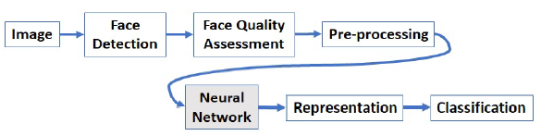
Block Diagram

Slide 7
Face Detection
It is the first step in face recognition.
Face detection is a computer technology being used in a variety of applications that identifies human faces in digital images.
The primary aim of face detection algorithms is to determine whether there is any face in an image or not.

Slide 8
Face Detection
Face detection is basically an image segmentation process as the image is to be segmented into two parts:
one containing faces and
the other representing non-face regions.
The classifier decides face and non-face class based on information learned from during training.

Slide 9
Haar Cascade Classifiers
Haar-like characteristics are computerized image characteristics using facial detection.
Haar feature-based cascade classiers is an effective object detection method proposed by Paul Viola and Michael Jones.
The algorithm needs a lot of positive images (images of faces) and negative images (images without faces) to train the classier.

Slide 10
Image Pre-Processing
Pre-processing is a common name for operations with images at the lowest level of abstraction.
The aim is improvement of the image data that suppresses unwanted distortions or enhances some image features important for further processing.

Slide 11
Image Pre-Processing
Face landmark detection is the process of finding points of interest in an image of a human face.
Landmark detection starts with face detection, finding faces in the image and their extents (bounding boxes).
OpenCV contains one of the first robust face detectors freely available to the public.

Slide 12
Face Recognition
The preprocessed images are too high-dimensional for a classifier to take directly on input.
To obtain a low-dimensional distinct feature from the face images we used Convolution Neural Network (CNN), popularly known as deep learning.
There are three steps in face recognition :
data pre-processing,
facial feature extraction, and
comparison of features between the target face and faces from database.

Slide 13
Convolutional Neural Network
CNN is a class of deep, feed-forward (not recurrent) artificial neural networks that are applied to analyzing visual imagery.
Images are high-dimensional vectors. It would take a huge amount of parameters to characterize the network.
To address this problem, convolutional neural networks are used to reduced the number of parameters and adapt the network architecture specifically to vision tasks.

Slide 14
Convolutional Neural Network
Convolutional neural networks are usually composed by a set of layers that can be grouped by their functionalities.
There are three main types of layers to build CNN architectures: Convolutional layer, Pooling layer, and Fully-Connected layer.

Slide 15
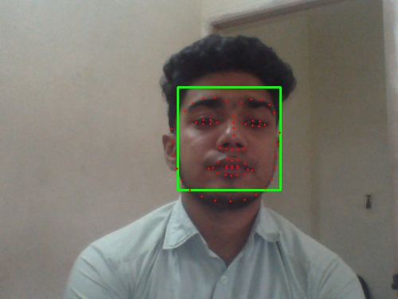
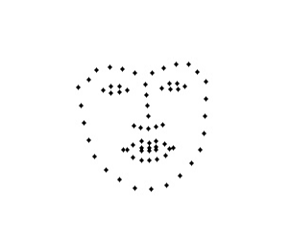
Results

Slide 16

Results

Slide 17
Observation
SAMS was designed to register the face of every individual.
The algorithm gives the result when the given image is perfectly matched with the database image.
AlexNet worked properly and gave desired output.

Slide 18
Contribution
WORK DONE | GROUP MEMBERS
Study of face detection and Haar cascade classifier | Amal A A
Code development and study of pre-processing | Anwin Antony
Study of CNN and Deep learning | Christy Augustine

Slide 19
References
Kwolek, Bogdan. "Face detection using convolutional neural networks and Gabor filters." International Conference on Artificial Neural Networks. Springer, Berlin, Heidelberg, 2005.
Kar, Nirmalya, et al. "Study of implementing automated attendance system using face recognition technique." International Journal of computer and communication engineering 1.2 (2012): 100.
Patil, Ajinkya, and Mrudang Shukla. "Implementation of classroom attendance system based on face recognition in class." International Journal of Advances in Engineering Technology 7.3 (2014): 974.

Slide 20
THANK YOU

