Slide 1
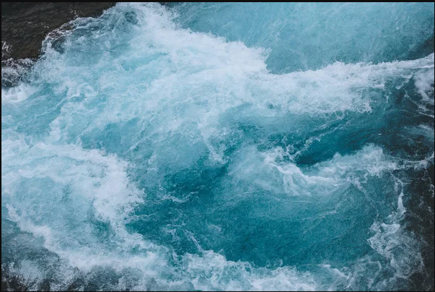

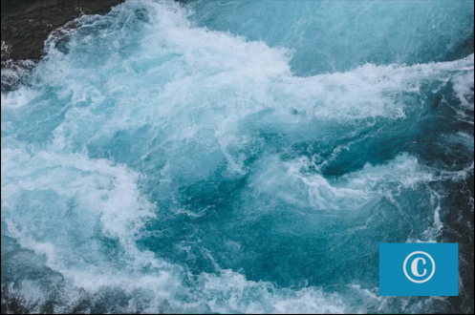
Original IMG
Digital Image Processing: The Art of Watermarking
Watermarked IMG
Protecting the ownership and authenticity of digital images is crucial in today's interconnected world. This presentation explores the principles and applications of digital watermarking, a powerful technique within the realm of Digital Image Processing (DIP).

Slide 2

The Art of Digital Watermarking
Embedding
1
The process of inserting a watermark, either visible or invisible, into the digital image without degrading its visual quality.
2
Extraction
The process of retrieving the embedded watermark, allowing for ownership verification and tamper detection.
Robustness
3
The ability of the watermark to withstand various image manipulations, such as cropping, scaling, or compression, without losing its integrity.

Slide 3
Types of Digital Watermarking
Visible Watermarking
Invisible Watermarking
Hybrid Watermarking
Embedding a visible logo, text, or symbol into the image, often used for copyright protection and content ownership identification.
Embedding imperceptible information into the image, enabling authentication, tamper detection, and tracing of image origins.
Combining both visible and invisible watermarks to provide multi-level security and enhanced protection for digital content.

Slide 4
Applications of Digital Watermarking
Copyright Protection
Medical Image Authentication
Safeguarding the intellectual property of photographers, artists, and content creators by embedding their unique watermarks.
Ensuring the integrity and provenance of sensitive medical images used in diagnosis and treatment.
Multimedia Forensics
Content Distribution Tracking
Detecting tampering and verifying the authenticity of digital media, such as images, videos, and audio files.
Embedding watermarks to monitor the distribution and usage of digital content, enabling better royalty management.

Slide 5




Watermarking Techniques in Action
Python
OpenCV
Algorithms
Live Demo
Leveraging Python's robust image processing libraries, such as OpenCV and PIL, to develop watermarking algorithms.
Utilizing OpenCV's computer vision capabilities to seamlessly embed and extract watermarks from digital images.
Exploring advanced watermarking techniques, including spatial domain, frequency domain, and robust algorithms.
Showcasing a live demonstration of the watermarking process, from embedding to extraction, with real-world examples.

Slide 6
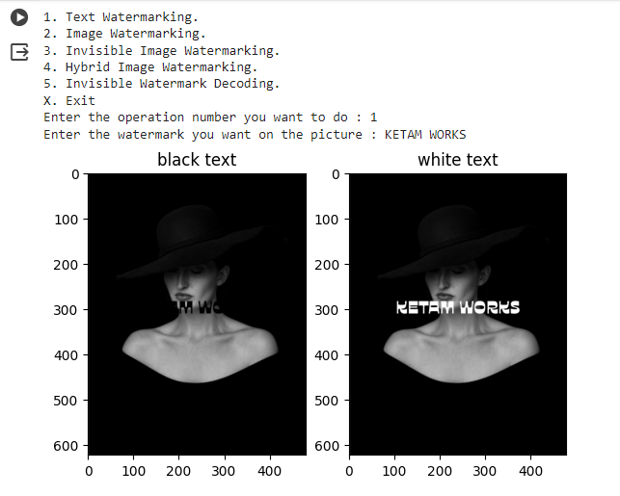
Implementation
Text Watermarking

Slide 7
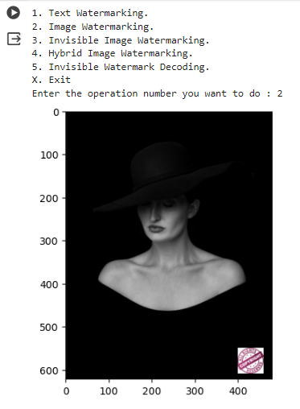
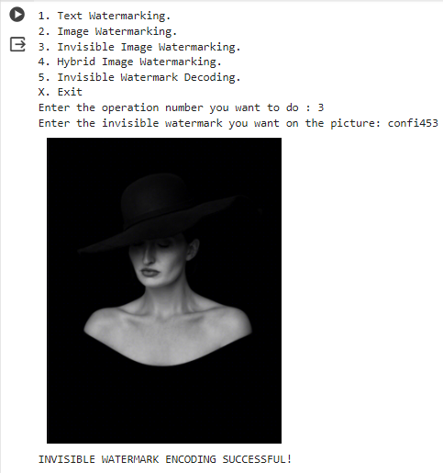
I
M
P
L
E
M
E
N
T
A
T
I
O
N
Image Watermark Image
Invisible Watermark Image

Slide 8
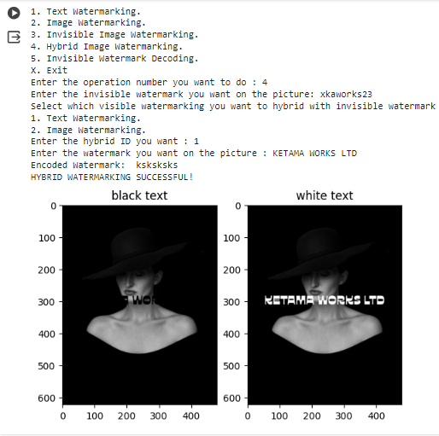
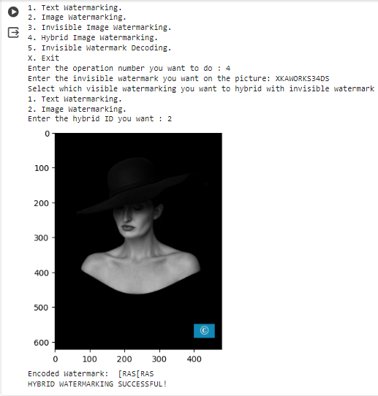
Hybrid Text Watermark Image
Hybrid Image Watermark Image

Slide 9
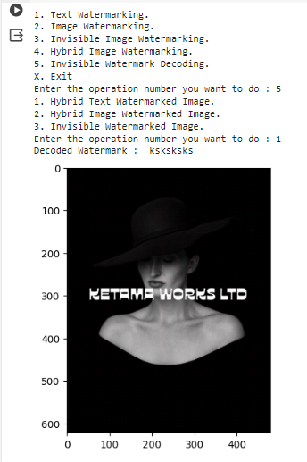
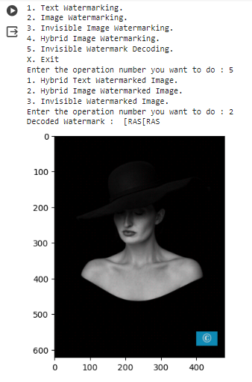
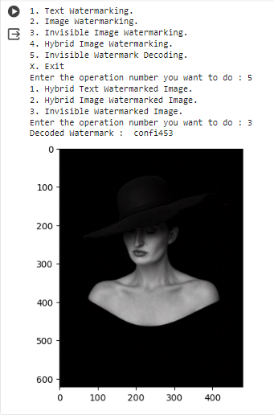
Hybrid Text Invisible Watermark Decoded
Hybrid Image Invisible Watermark Decoded
Invisible Watermark Decoded

Slide 10



The Future of Digital Watermarking
Emerging Trends
Adaptive Watermarking
Multimodal Watermarking
Advancements in deep learning, blockchain, and quantum computing are poised to revolutionize digital watermarking techniques.
Developing watermarks that can adapt to changing image formats, resolutions, and distribution channels for enhanced robustness.
Incorporating watermarks into various media types, such as video, audio, and 3D models, to provide comprehensive content protection.

Slide 11

Conclusion
Digital watermarking is a powerful tool within the realm of Digital Image Processing, enabling the protection, authentication, and tracing of digital content. As technology continues to evolve, the future of digital watermarking holds immense potential, promising enhanced security and innovative applications across diverse industries.

Slide 12
ThankYou

