Slide 1
MCA Mini Project Presentation CANDREAM
A Student Migration Support System

Slide 2
ABSTRACT
CANDREAM is a Student Migration System website for supporting Malayali Students who are waiting to move Canada for their Educational purposes. All the huge list of processes can be done through a single system CANDREAM. With the rapid rise of International Education more students are seeking higher education in Canadian Countries. Based on Statistics, around 14% of International students in Canada are comprised of Indian students. So, we are here to combine all the immigration processes under one system with modules Admin, Students, Immigration Office, University, and Immigration Consultancy. Here the students can search and compare Consultancies and Universities by their services and policies. That will help students to choose the best matching one for them, Also this will avoid fraud Consultancies, by evaluating the registration of consultancies into the system by Admin. Registrations to consultancies and further procedures can be done by Students. Students can upload and their documents in the system. Consultancies can proceed the application to University and Canadian Immigration Office. They can verify and approve student applications.
Here the student can apply for admission by checking Universities, Courses and Consultancies through the portal available for students. Admin will verify the applications and confirm the acceptance of that. Also admin can manage Universities, Consultancies and Courses. The rest of the things can be done later.

Slide 3
The system includes 2 modules. They are:
1.Admin
Login
Add University
Manage University
Add Courses
Manage Courses
Consultancies
Manage Consultancies
2.Student
Registration
Login
View Consultancies
View Universities
View Course eligibility
Apply for Admission

Slide 4
Tables
tb_login
Field | Data type | Constrains | Description
Login_id | Integer | Primary key | Login id of user
username | Varchar(20) | Not null | Username of user
password | password | Not null | Password of user
User_type | Varchar(20) | Not null | Type of user

Slide 5
tb_student
Field | Data type | Constrains | Description
Student_id | Integer | Primary key | Id of Student
name | Varchar(20) | Not null | name of Student
Email | Varchar(20) | Not null | Email of Student
Phone_number | Varchar(20) | Not null | Phone number of Student
Country | Varchar(20) | Not null | Country of student
City | Varchar(20) | Not null | City of Student
State | Varchar(20) | Not null | City of Student
Pincode | Varchar(20) | Not null | Pincode of Student
User_name | Varchar(20) | Not null | User Name of Student
Password | Varchar(20) | Not Null | password of Cunsultent
Retype password | Varchar(20) | Not Null | Retype User Password

Slide 6
tb_university
Field | Data type | Constrain | Description
University_id | Integer | Primary key | Id of University
University_name | Varchar(20) | Not null | Name of University
Course_id | Integer | Foreign key | Id of course
Location | Varchar(20) | Not null | Location of University
tb_course
Field | Data type | Constrain | Description
Course_id | Integer | Primary key | Id of course
Course_name | Varchar(20) | Not null | Name of course
Course_stream | Varchar(20) | Not null | Name of stream
Course_fee | Varchar(20) | Not null | Fees of course
Eligibility | Varchar(20) | Not null | Eligibilityof course

Slide 7
tb_studentapplication
Field | Data type | Constrain | Description
Application_id | Integer | Primary key | Id for application
Student _id | Integer | Foreign key | Id of student
Passport_no | Varchar(20) | Not null | Passport number of Student
Adhar_no | Varchar(20) | Not null | Adhar number of syudent
Education_id | Integer | Foreign key | Education id of Student
Ielts_id | Integer | Foreign key | Ielts id of Student
Document_id | Integer | Foreign key | Document id of Student

Slide 8
tb_education
Field | Data type | Constrain | Description
Education_id | integer | Primary key | Education id of Student
Student_id | Integer | Foreign key | Id of Student
Mark_10 | Float | Not null | Marks in 10th
Certificate_10 | Blob | Not null | Certificate of 10th
Mark_12 | Float | Not null | Marks in 12th
Stream_12 | Varchar(20) | Not null | Stream of 12th
Certificate_12 | Blob | Not null | Certificate of 12th
Mark_diploma | Float | Null | Marks in diploma
Stream_diploma | Varchar(20) | Null | Stream of diploma
Certificate_diploma | Blob | Null | Certificate of diploma
Mark_degree | Float | Not null | Marks in degree
Stream_degree | Varchar(20) | Not null | Stream of degree
Certificate_degree | Blob | Not null | Certificate of degree

Slide 9
tb_ielts
Field | Data type | Constrain | Description
Ielts_id | Integer | Primary key | Ielts id of student
Speaking | Float | Not null | Marks in speaking
Listening | Float | Not null | Marks in listening
Writing | Float | Not null | Marks in writing
Reading | Float | Not null | Marks in reading
Overall | Float | Not null | Overall scores
Exam_date | Date | Not null | Date of exam

Slide 10
tb_documents
Field | Data type | Constrain | Description
Document_id | Integer | Primary key | Document id of Students
Adhar | Blob | Not null | Adhar document of Student
Passport | Blob | Not null | Passport document of Student
Police_clearance | Blob | Not null | Police_clearance certificate
Medical_document | Blob | Not null | Medical report of Student
Self_declaration | Blob | Not null | Self declaration form of Student
Bank_passbook | Blob | Not null | Passbook document of Student
Photo | Blob | Not null | Passport size photo of Student

Slide 11
tb_consultancy
Field | Data type | constrain | Description
Consultancy_id | Integer | Primary key | Id of consultancy
Consultancy_name | Varchar(20) | Not null | Name of consultancy
Location | Varchar(20) | Not null | Location of consultancy
License_no | Varchar(20) | Not null | Licence number of Consultancy
Email_id | Varchar(20) | Not null | Email id of Consultancy
Phone_no | Varchar(20) | Not null | Phone number of consultancy
Service_id | Varchar(20) | Not null | Service id of consultancy

Slide 12
tb_service
Field | Data type | Constrain | Description
Service_id | integer | Primary key | Service id of Consultancy
Counselling_time | Time | Not null | Counselling time
Counselling_date | Date | Not null | Counselling date
Admission | Varchar(20) | Not null | University admission of Student

Slide 13
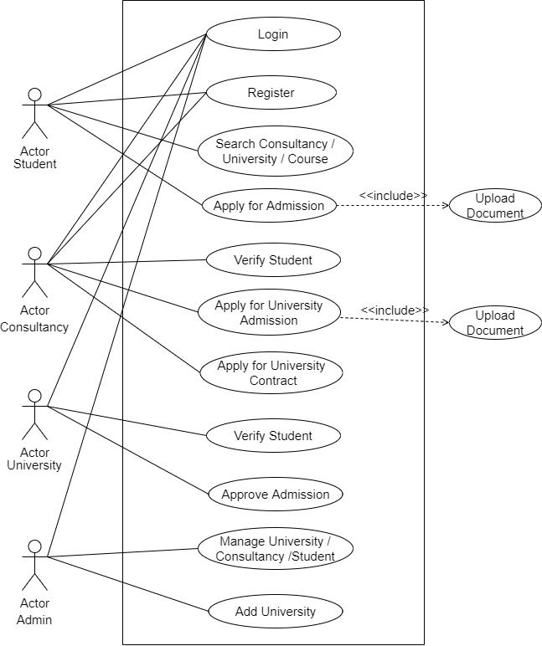
UML DIAGRAM
USE CASE DIAGRAM

Slide 14
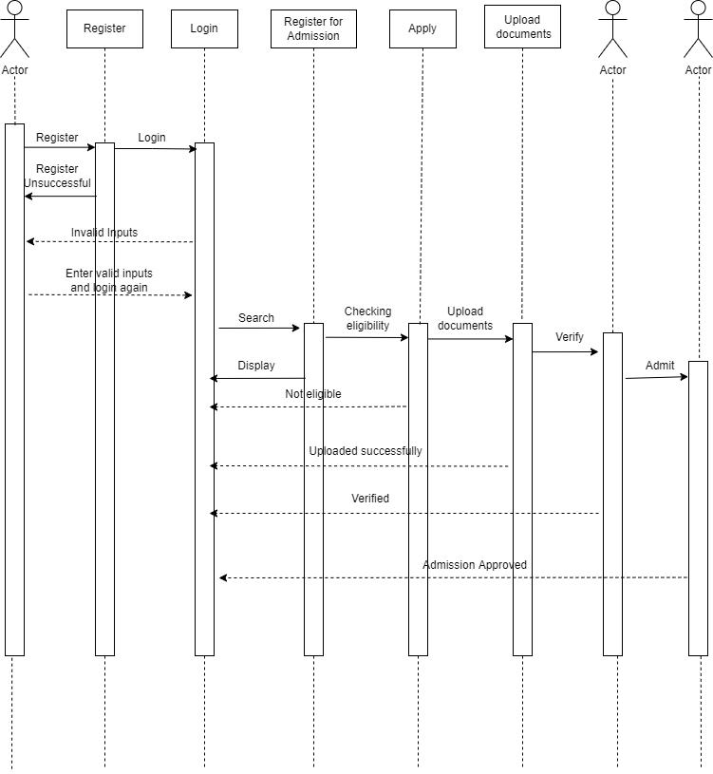
SEQUENCE DIAGRAM

Slide 15
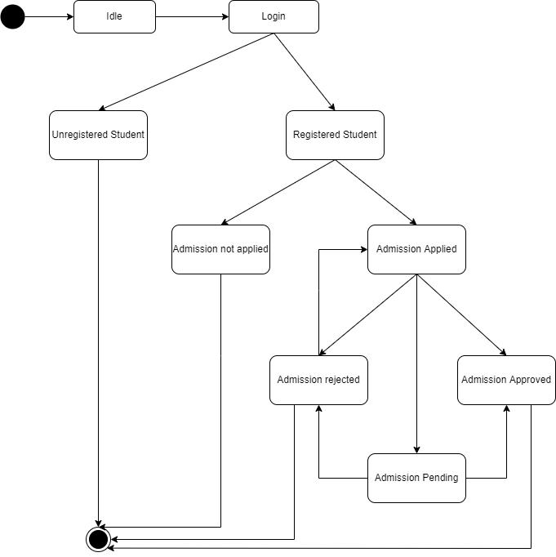
State Chart Diagram

Slide 16
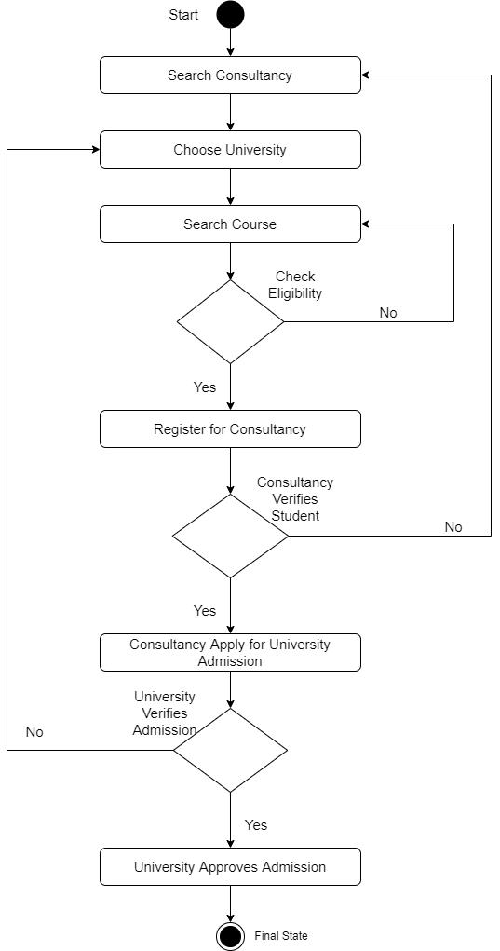
Activity Diagram

Slide 17
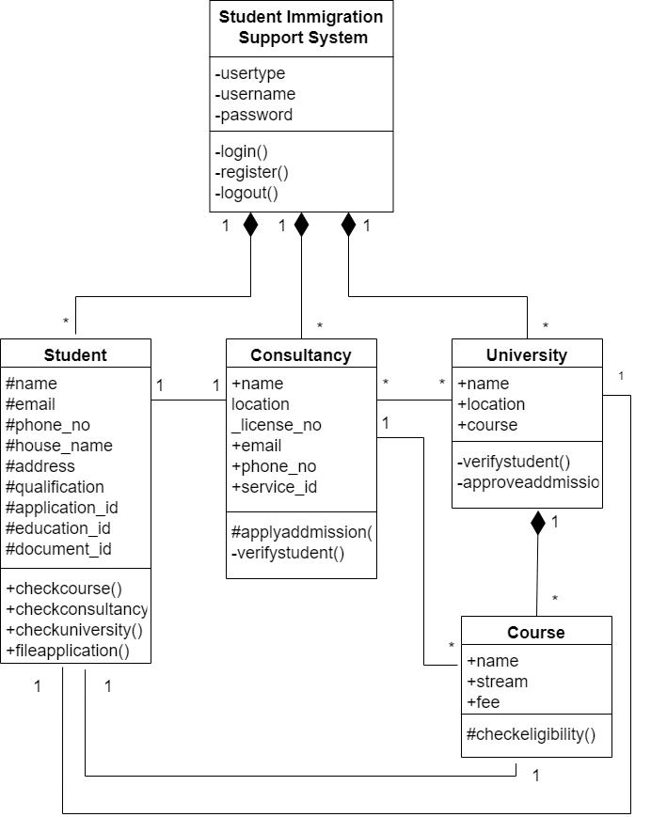
Class Diagram

Slide 18
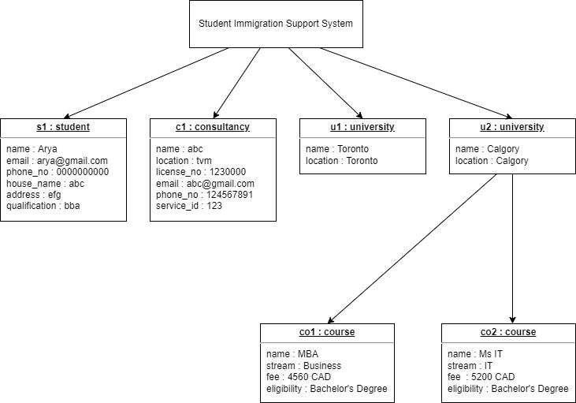
Object Diagram

Slide 19
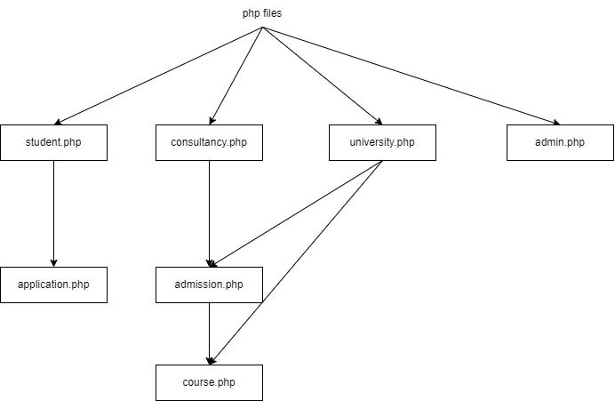
Component Diagram

Slide 20
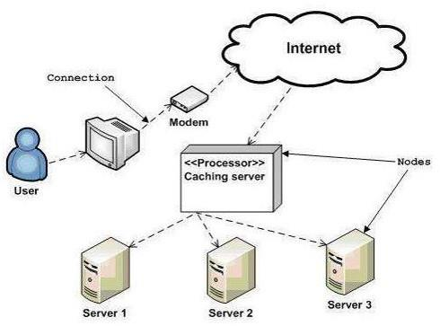
Deployment Diagram

