Slide 1
The Battle of the Neighborhoods
By,
Amala Mary Vincent

Slide 2
Introduction
Background
There are over a hundred restaurants in Chicago. Most of them are American restaurants and cafes.
To open a new cafe, we need to find the best location in the city.
The optimal location would be one less crowded with other restaurants especially coffee shops and other cafes

Slide 3
2. Problem Statement
To find the best land site to start an cafe in Chicago
Factors that will influence our decision are
number of existing restaurants in the neighborhood
number of and distance to cafes in the neighborhood, if any
distance of neighborhood from city center

Slide 4
Data
1. Data Sources
Data is collected from kaggle website. Chicago neighborhoods data is a json file that contains the longitude and latitudes of neighborhoods.
2. Load and explore the data
Downloaded data is read into a pandas data frame named ‘neighborhoods’.

Slide 5
3. Foursquare API
Interested in venues in 'food' category.
List venues that have 'restaurant', 'cafe', 'cafeteria', 'bakery', 'coffee shop' in category name.
Find the total number of restaurants, total number of cafes, percentage of cafes and the average number of restaurants in neighborhood from the data.
Based on which we will plot the map of Chicago with red circles on cafes and blue circles on restaurants, using folium.

Slide 6
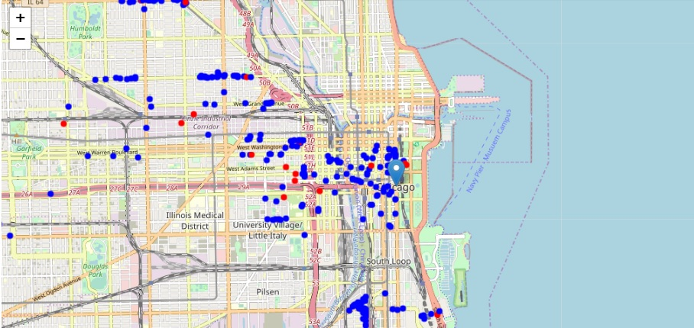
Map drawn from the data frame using folium.

Slide 7
Methodology
Collect the required data: location and type (category) of every restaurant within 6km from Chicago center.
Identify the cafes (according to Foursquare categorization).
Calculation and exploration of 'restaurant density' across different areas of Chicago.
Using heatmaps, identify a few promising areas close to center with low number of restaurants and no cafes in vicinity.
Consider locations with no more than one restaurant in radius of 500 meters and locations without cafes in radius of 400 meters.
Create maps of all such locations and also create clusters (using k-means clustering) of those locations to identify general zones.

Slide 8
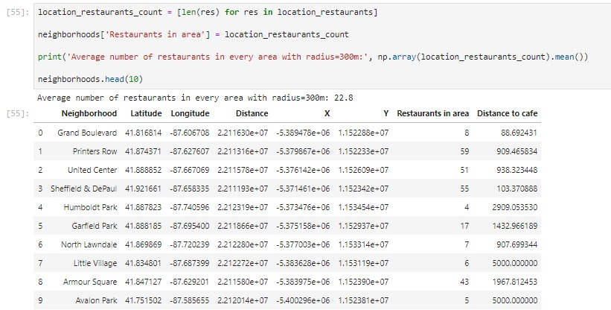
Analysis
Count the number of restaurants in every area candidate

Slide 9
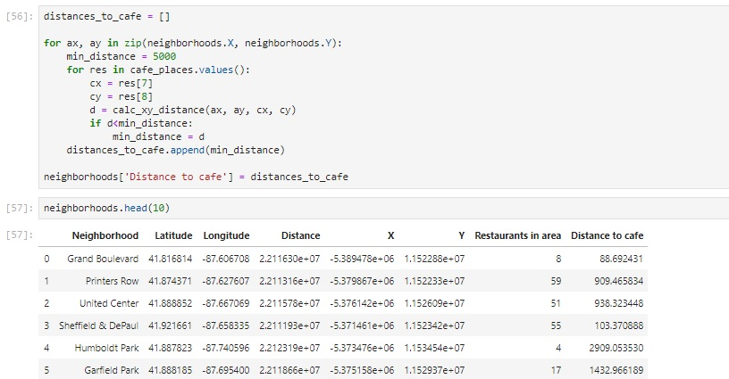
Calculate the distance to nearest cafe from every area candidate center

Slide 10
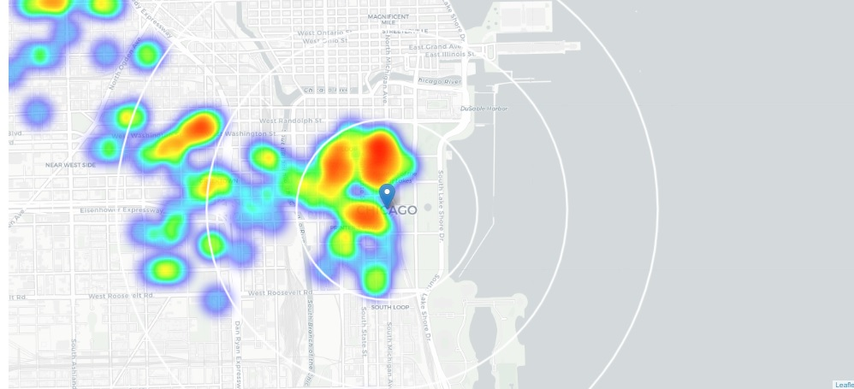
Find the average distance to closest cafe from each area center. We got it as 1888 meters.
So on average cafe can be found within ~2km from every area center candidate. We need to filter our areas carefully.
Let's create a map showing heatmap / density of restaurants.

Slide 11
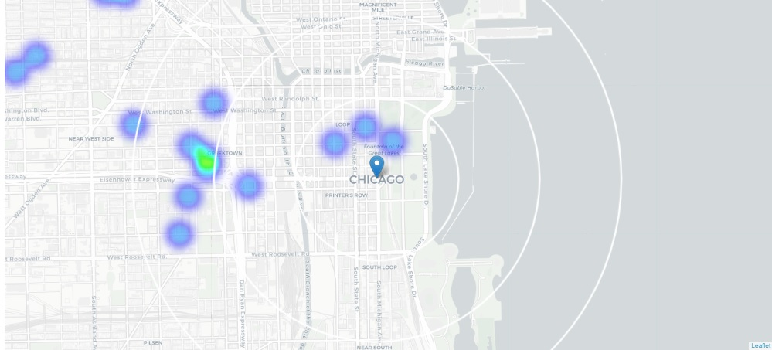
Create another heatmap map showing heatmap/density of cafes only.
Closest pockets of low cafe density positioned north, south-west and south from city center.

Slide 12
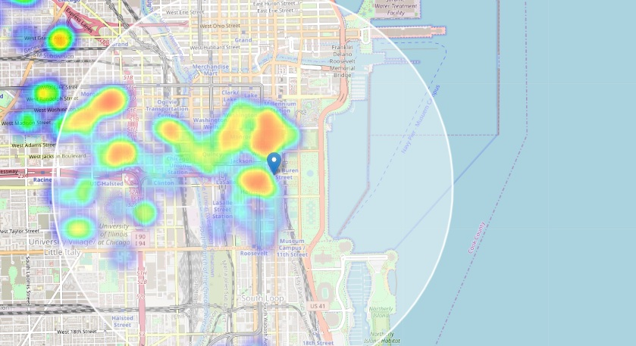
Now focus our analysis on areas north, south-west and south from Chicago center.
Move the center of our area of interest and reduce its size to have a radius of 2.5km.
This covers all the pockets of low restaurant density closest to Chicago center.

Slide 13
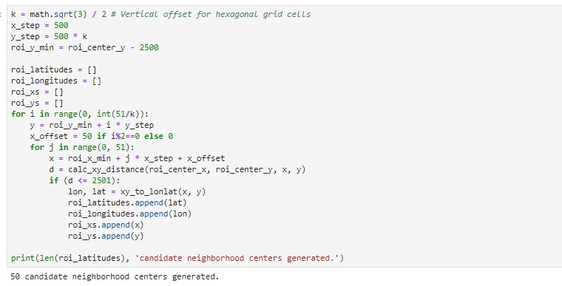
Now, create new, more dense grid of location candidates restricted to our new region of interest (our location candidates are 500m apart).

Slide 14
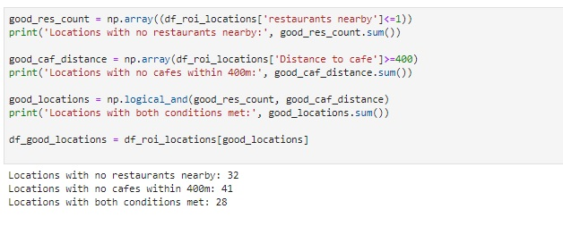
Calculate two most important things for each location candidate: number of restaurants in vicinity and distance to closest cafe.
Then we will filter those locations: we're interested only in locations with no more than one restaurant in radius of 250 meters, and no cafes in radius of 400 meters.

Slide 15
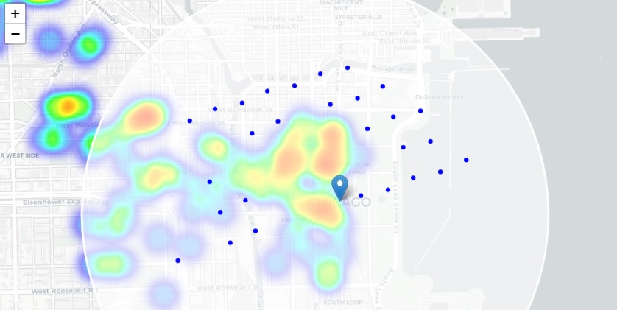
In the map, this appears as follows:

Slide 16
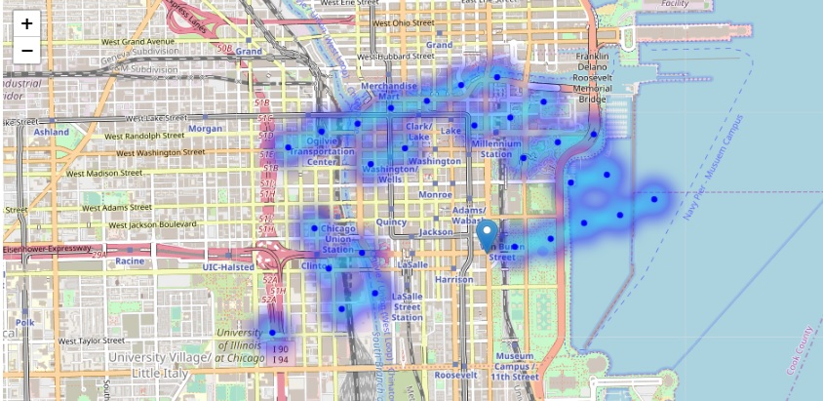
Now we have locations with no more than one restaurant in radius of 250m, and no cafes closer than 400m, we will show those good locations in a form of heatmap:

Slide 17
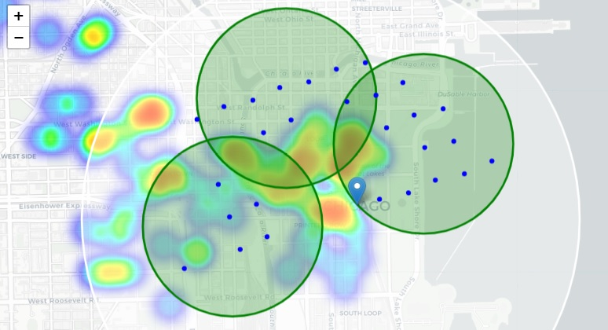
Cluster those locations to create centers of zones containing good locations.

Slide 18
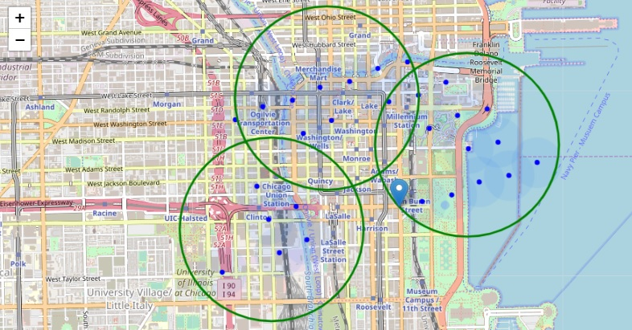
Let's see those zones on a city map without heatmap, using shaded areas to indicate our clusters:

Slide 19
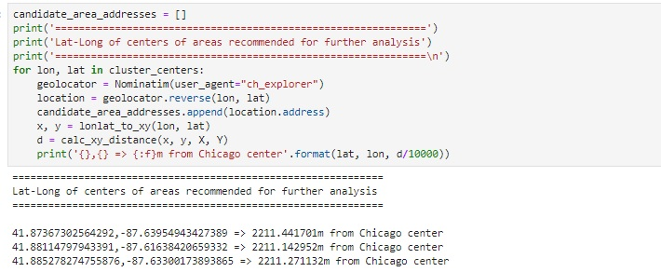
Now, list the latitudes and longitudes of centers of this cluster.

Slide 20
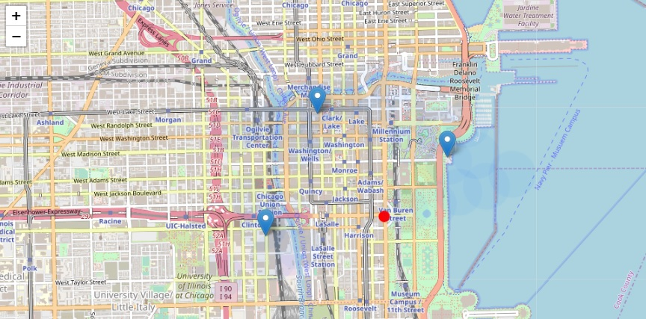
Map shows the final three locations.

Slide 21
Results and Discussion
Our analysis shows that although there are a great number of restaurants in Chicago, there are pockets of low restaurant density fairly close to city center.
Highest concentration of restaurants was detected west from city center, so we focused our attention to areas north, east, south-west and south.
Direct our attention to the narrow area of interest we first created a dense grid of location candidates (spaced 500m apart).
These locations were then filtered so that those with more than one restaurant in radius of 250m and those with an Italian restaurant closer than 400m were removed.

Slide 22
Cluster the location candidates to create zones of interest containing greatest number of location candidates.
Latitude and longitudes of centers of those zones were identified.
Can be used as markers/starting points for more detailed local analysis based on other factors.
Result of all this is 3 zones containing largest number of potential new cafe locations based on number of and distance to existing venues - both restaurants in general and cafes particularly.

Slide 23
Conclusion
Purpose of this project was to identify areas close to Chicago center with low number of restaurants (particularly cafes).
To aid stakeholders in narrowing down the search for optimal location for a new cafe.
By calculating restaurant density distribution from Foursquare data we have first identified general neighborhood locations.
By further analysis, generated extensive collection of locations which satisfy some basic requirements regarding existing nearby restaurants.

Slide 24
Conclusion(Contd.)
Clustering of those locations was then performed in order to create major zones of interest.
Addresses of those zone centers were created to be used as starting points for final exploration by stakeholders.
Final decision on optimal restaurant location will be made by stakeholders based on their preferences.

