Slide 1
Internet Banking
Generic Component
By:
Amalan J

Slide 2
Screen Components
The Client configures with the following inputs in the screen provided
Source Directory
Destination Directory
Encrypted File name
Delete/Save Source file
Save source file directory
Polling Interval(in minute)

Slide 3
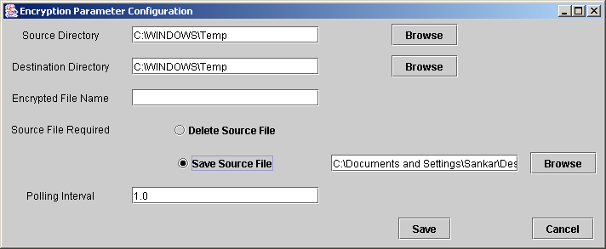
Screen Layout- Parameter configuration Screen

Slide 4
Encryption Utility- algorithm
Triple DES file encryption API is to be implemented at client side for encryption. It is a mode of the DES encryption algorithm that encrypts data three times.

Slide 5
Continues….
Triple DES algorithm converts data to an unintelligible form called cipher text.
Decrypting ciphered text converts the data back to its original form called plaintext.

Slide 6
Symmetric Algorithm
Symmetric Algorithm uses a single key. With this key, the sender can encrypt a message and a recipient can decrypt the message with the same key. The encryption key and the decryption key are interrelated and may even be the same.

Slide 7
Symmetric Key Encryption/Decryption
Encryption
Algorithm
Decryption
Algorithm
Key
Key
Plain Text
Plain Text
Cipher Text
Symmetric Key Encryption/Decryption

Slide 8
Packaging / Directory structures
ABCD_enc
lib
jar files
logs
debug
Health files
Status
Statistics
config
Property files
Key file
startDaemon.bat
bin
Executable batch files
startGUI.bat
Application Jars

Slide 9
Sample Code – Frame.java
/* Frame.java
* Created on February 3, 2006, 4:40 PM
// Package Name
package Bank_client;
// Import necessary packages and classes
import java.awt.*;
import java.io.*;
import java.util.*;
import javax.swing.*;
import java.security.*;
import javax.crypto.*;
/**
*
* @author SolutionNET India Pvt Ltd.,
*/
public class Frame extends java.awt.Frame {
/** Creates new form Frame */
public Frame() {
initComponents();
}
/** This method is called from within the constructor to
* initialize the form.
* WARNING: Do NOT modify this code. The content of this method is
* always regenerated by the Form Editor.
*/

Slide 10
Sample Code – Frame.java
private void initComponents() {
java.awt.GridBagConstraints gridBagConstraints;
// *************** Initialize all the components
// **************** Set Layout
setLayout(new java.awt.GridBagLayout());
// Set Background and add window listener for the frame
setBackground(new java.awt.Color(204, 204, 204));
addWindowListener(new java.awt.event.WindowAdapter() {
public void windowClosing(java.awt.event.WindowEvent evt) {
exitForm(evt);
}
});
// ************** Set the text for each component
// ************** Provide the gridBagConstraints for each component
// ************** Add each component to the frame
label1.setText("Source Directory");
gridBagConstraints = new java.awt.GridBagConstraints();
gridBagConstraints.insets = new java.awt.Insets(7, 7, 7, 7);
add(label1, gridBagConstraints);
jTextField1.setText("jTextField1");
gridBagConstraints = new java.awt.GridBagConstraints();
gridBagConstraints.insets = new java.awt.Insets(7, 7, 7, 7);
add(jTextField1, gridBagConstraints);

Slide 11
Sample Code – Frame.java
jRadioButton1.setText("Delete Source File");
buttonGroup1.add(jRadioButton1);
gridBagConstraints = new java.awt.GridBagConstraints();
gridBagConstraints.gridx = 1;
gridBagConstraints.gridy = 3;
gridBagConstraints.insets = new java.awt.Insets(7, 7, 7, 7);
add(jRadioButton1, gridBagConstraints);
jRadioButton1.addActionListener(new java.awt.event.ActionListener() {
public void actionPerformed(java.awt.event.ActionEvent evt) {
jRadioButton1ActionPerformed(evt);
}
}); pack();
// Open the Property file which stores the default Encryption parameters
// Fetch the values from the file and place it in the appropriate fields
// Use String Tokenizes to tokenize each parameter
try {
DataInputStream dis=new DataInputStream(new FileInputStream("prop.txt"));
StringTokenizer st=new StringTokenizer(line,"=;");
while(st.hasMoreTokens())
{
/* ************* Using the String Tokenizer object.nextToken()
*************** Fill each field */
}
} catch (IOException e1) {
// Generate error : Error in opening property file
e1.printStackTrace(); }
}

Slide 12
Sample Code – Frame.java
// Add the Action Performed function for each Action Listener
private void jButton1ActionPerformed(java.awt.event.ActionEvent evt) {
// Add File Chooser for selecting the directory for
// sourece and destination directory
JFileChooser fc=new JFileChooser();
fc.setDialogType(JFileChooser.OPEN_DIALOG);
fc.setFileSelectionMode(JFileChooser.FILES_AND_DIRECTORIES);
int ret=fc.showDialog(this,null);
jTextField4.setText(fc.getSelectedFile().getPath());
}
private void jButton2ActionPerformed(java.awt.event.ActionEvent evt) {
// Get the values from the user interface and store it in the property file.
// This save button must fetch all the parameter values
// and using DataOutputStream(FileOutputStream) store all the parameter values
In=label_srcdir.getText()+"="+TextField_srcdir.getText()+";"+label_destdir.getText()+"="+TextField_destdir.getText()+";"+label_encfile.getText()+"="+”TextField_encfile.getText()"+";"+label_pollint.getText()+"="+TextField_pollint.getText();
try {
DataOutputStream d=new DataOutputStream(new FileOutputStream("h:/prop.txt"));
d.writeBytes(in);
} catch (IOException e1) {
// TODO Auto-generated catch block
e1.printStackTrace(); }
// ***************** Call the ENCRYPT function
encrypt();
}

Slide 13
Sample Code – Frame.java
/** Exit the Application */
private void exitForm(java.awt.event.WindowEvent evt) {
System.exit(0);
}
private static void encrypt()
{
// Apply the Triple DES Algorithm to encrypt the files
// The directory from which the files has to be fetched will be given by the
// Property file.
try
{
System.out.println("************ Encrypted Successfully **********");
}
catch(Exception ex)
{
System.out.println("Error During TDES-Encrypt function : "+ex);
}
}
/**
* @param args the command line arguments
*/
public static void main(String args[]) {
new Frame().show();
}
// Variables declaration - do not modify
private javax.swing.JButton jButton2;
// End of variables declaration
}

Slide 14
Sample Code – enc_daemon.java
import java.io.*;
import java.util.*;
import java.io.*;
import java.security.*;
import javax.crypto.*;
import org.apache.log4j.*;
class Daemon1 extends Thread
{
private Thread t = new Thread();
public Daemon1()
{
setDaemon(true);
start();
}
public void run()
{
des td=new des();
try
{
DataInputStream dis=new DataInputStream(new FileInputStream("prop.txt"));
line = dis.readLine();
StringTokenizer st=new StringTokenizer(line,"=;");
int i,cnt=0;

Slide 15
Sample Code – enc_daemon.java
while(st.hasMoreTokens())
{
i = cnt++;
String key=st.nextToken();
String val=st.nextToken();
if(cnt==5)
poll_int=Long.parseLong(val);
}
poll_int=poll_int*1000;
}
catch(Exception e)
{
System.out.println("Error opening property file");
}
while(true)
{
try {
td.tdes();
} catch (Exception e) {
e.printStackTrace();
}
try {
Thread.sleep(poll_int);
} catch (InterruptedException e1) {
e1.printStackTrace(); }
}
}
}

Slide 16
Sample Code – enc_daemon.java
public class enc_daemon {
static Logger logger = Logger.getLogger(Daemon1.class);
public static void main(String[] args) throws IOException
{
HTMLLayout layout = new HTMLLayout();
WriterAppender healthappender = null;
try {
FileOutputStream health = new FileOutputStream("logs/health.html",true);
healthappender = new WriterAppender(layout,health);
logger.addAppender(healthappender);
logger.setLevel((Level) Level.DEBUG);
} catch (FileNotFoundException e2) {
e2.printStackTrace();
}
Thread d = new Daemon1();
Date dte=new Date();
logger.info("Daemon Started @ : "+dte);
int stp=System.in.read();
dte=new Date();
logger.info("Daemon Closed @ : "+dte);
}
}

Slide 17
Sample Code – des.java
import java.io.*;
import java.security.*;
import java.util.*;
import javax.crypto.*;
import org.apache.log4j.*;
public class des {
static Logger logger = Logger.getLogger(des.class);
WriterAppender debugappender = null;
WriterAppender statusappender = null;
WriterAppender statsappender = null;
public void tdes() throws NoSuchAlgorithmException, NoSuchPaddingException, InvalidKeyException, IllegalStateException, IllegalBlockSizeException, BadPaddingException, IOException
{
try {
HTMLLayout layout = new HTMLLayout();
try {
status = new FileOutputStream("logs/status.html",true);
debug = new FileOutputStream("logs/debug.html",true);
stats = new FileOutputStream("logs/stats.html",true);
debugappender = new WriterAppender(layout,debug);
statusappender = new WriterAppender(layout,status);
statsappender = new WriterAppender(layout,stats);
} catch(Exception e) {
logger.addAppender(debugappender);
logger.error(e);
}
logger.setLevel((Level) Level.DEBUG);
DataInputStream dis=new DataInputStream(new FileInputStream("prop.txt"));

Slide 18
Sample Code – des.java
KeyGenerator keygen = KeyGenerator.getInstance("DESede");
SecretKey desKey = keygen.generateKey();
DataOutputStream f5 = null;
File list=new File("src");
String[] flist;
flist=list.list();
try
{
for(int size=0;size<flist.length;size++)
{
logger.info(src_dir+"/"+flist[size]+"started encryption @ : "+d); try
{
c=new byte[sa];
}
catch(OutOfMemoryError e) {
}
f.read(c);
Cipher desCipher = Cipher.getInstance("DESede");
desCipher.init(Cipher.ENCRYPT_MODE, desKey);
try {
ciphertext = desCipher.doFinal(c); } catch(OutOfMemoryError e)
{
logger.addAppender(debugappender);
logger.error(e+" - while encrypting "+src_dir+"/"+flist[size]);
}

Slide 19
Sample Code – des.java
try
{
f5=new DataOutputStream(new FileOutputStream(dest_dir+"/"+enc_file+"."+sl));
f5.write(ciphertext);
}
catch(Exception e)
{
}
logger.addAppender(statusappender);
logger.info(src_dir+"/"+flist[size]+"finished encryption @ : "+d); logger.addAppender(statsappender);
logger.info("Time taken to encrypt "+src_dir+"/"+flist[size]+" : "+time+" milliseconds");
desCipher.init(Cipher.DECRYPT_MODE, desKey);
logger.addAppender(statusappender);
logger.info(dest_dir+"/"+enc_file+"."+sl+"started decrypting @ : "+d);
try
{
cleartext1 = desCipher.doFinal(ciphertext);
}
catch(OutOfMemoryError e)
{
logger.addAppender(debugappender);
logger.error(e+" - while decrypting "+src_dir+"/"+flist[size]);
}
time=etime-stime;
logger.addAppender(statusappender);
logger.info(dest_dir+"/"+enc_file+"."+sl+"finished decrypting @ : "+d);
logger.info("Time taken to decrypt "+dest_dir+"/"+enc_file+"."+sl+" : "+time+" milliseconds");

Slide 20
Sample Code – des.java
f.close();
f5.close();
fo.close();
String n="null";
if(save_file.equals(n))
{
File f1=new File(src_dir+"/"+flist[size]);
f1.delete();
}
else
{
DataOutputStream fos=new DataOutputStream(new FileOutputStream(save_file+"/"+flist[size]));
fos.write(c);
File f1=new File(src_dir+"/"+flist[size]);
f1.delete();
}
sl++;
}
}
catch(Exception e)
{
logger.addAppender(debugappender);
logger.error(e);
}
}
}

Slide 21
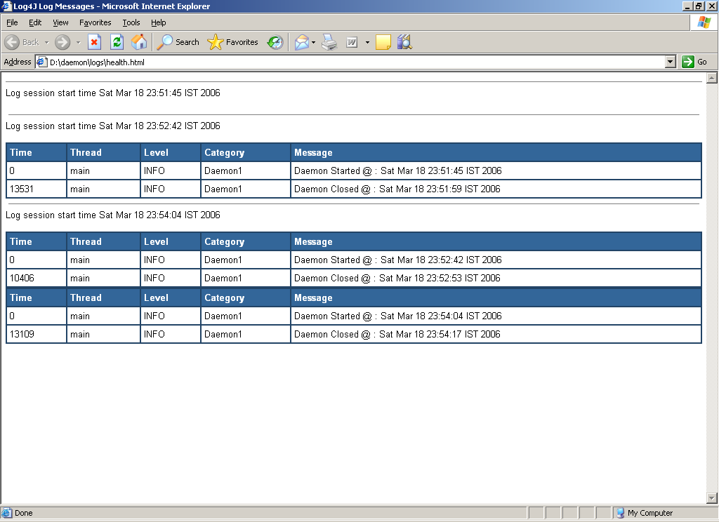
Log File – Health.html

Slide 22
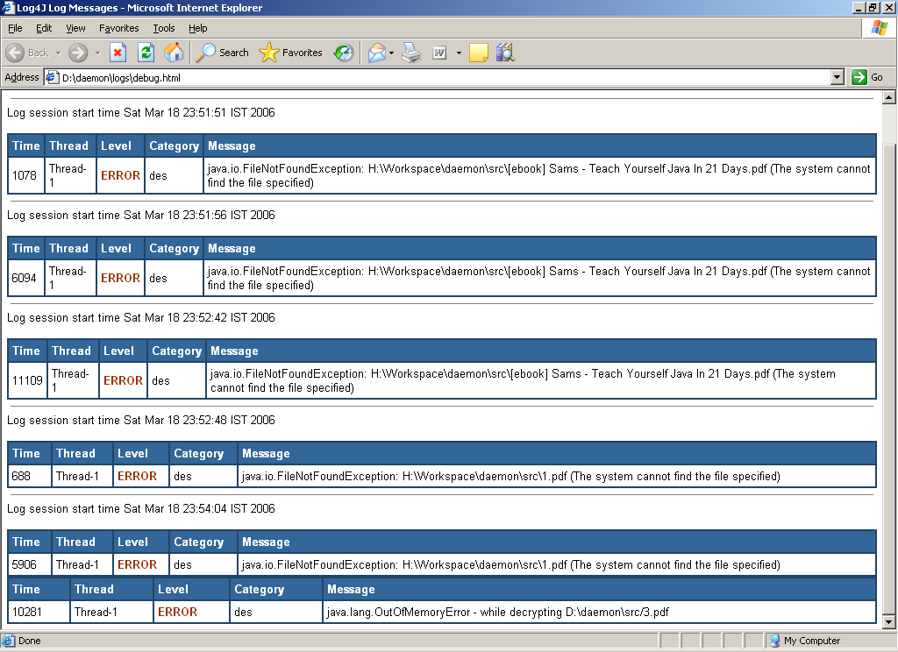
Log File – Debug.html

Slide 23
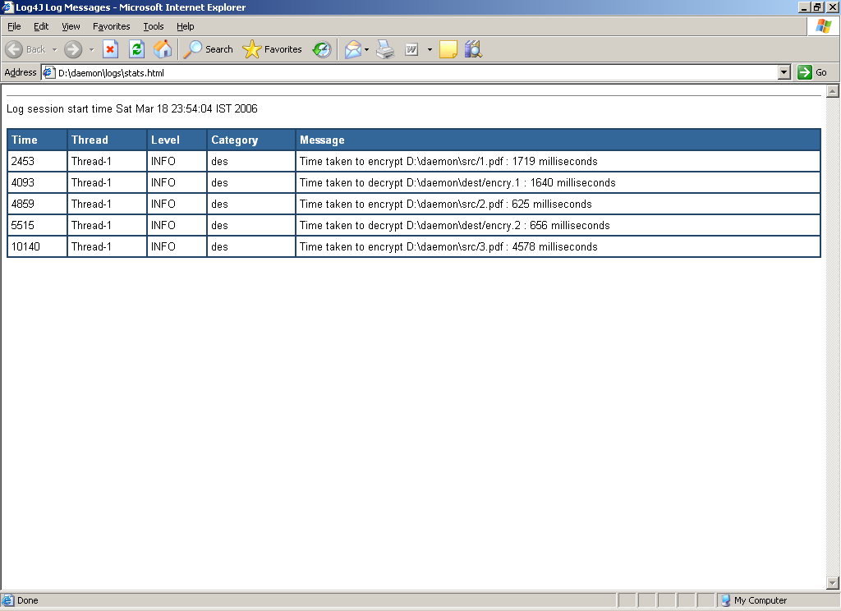
Log File – Stats.html

Slide 24
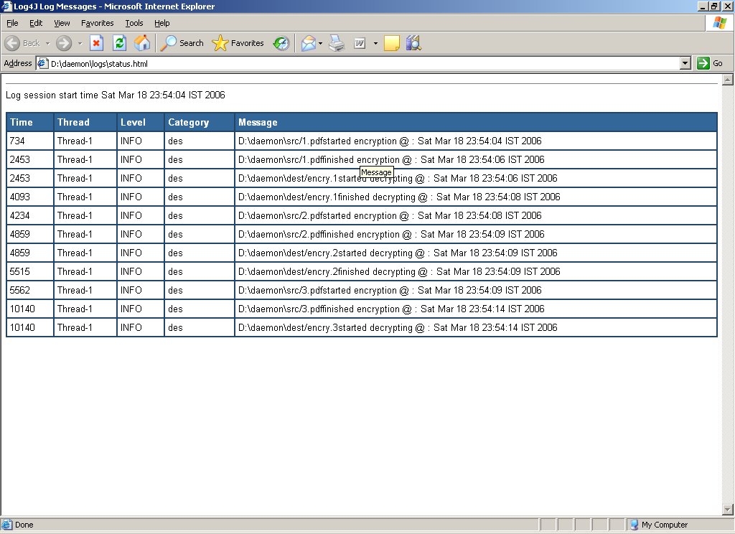
Log File – Status.html

Slide 25

Thank You

