Slide 1
Weeks 4-5 Report
Code Generation and Documentation Search

Slide 2
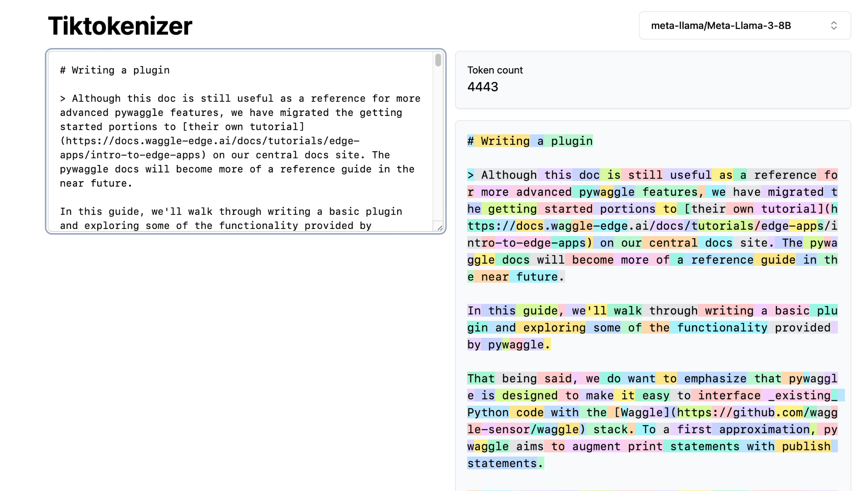
Providing entirety of “writing-a-plugin.md”
https://github.com/waggle-sensor/pywaggle/blob/main/docs/writing-a-plugin.md?plain=1
>>> Given the following, write me a plugin that accesses stored bird recordings and compares them to what the current node is picking up on a microphone to detect if there are any similar birds. These results are published. You may assume the function to compare is given as compare_birds. Use only the code provided here:

Slide 3
Providing entirety of “writing-a-plugin.md” (cont.)
“Here's an example plugin that accesses stored bird recordings and compares sample data with microphone recording:
[code]
This plugin uses the `pyaudio` library to record audio from the microphone, and then compares it with stored bird recordings using NumPy. The `on_start` method loads the stored recordings, the `on_input` method processes the microphone data and compares it with the stored recordings, and the `on_stop` method cleans up any resources.”

Slide 4
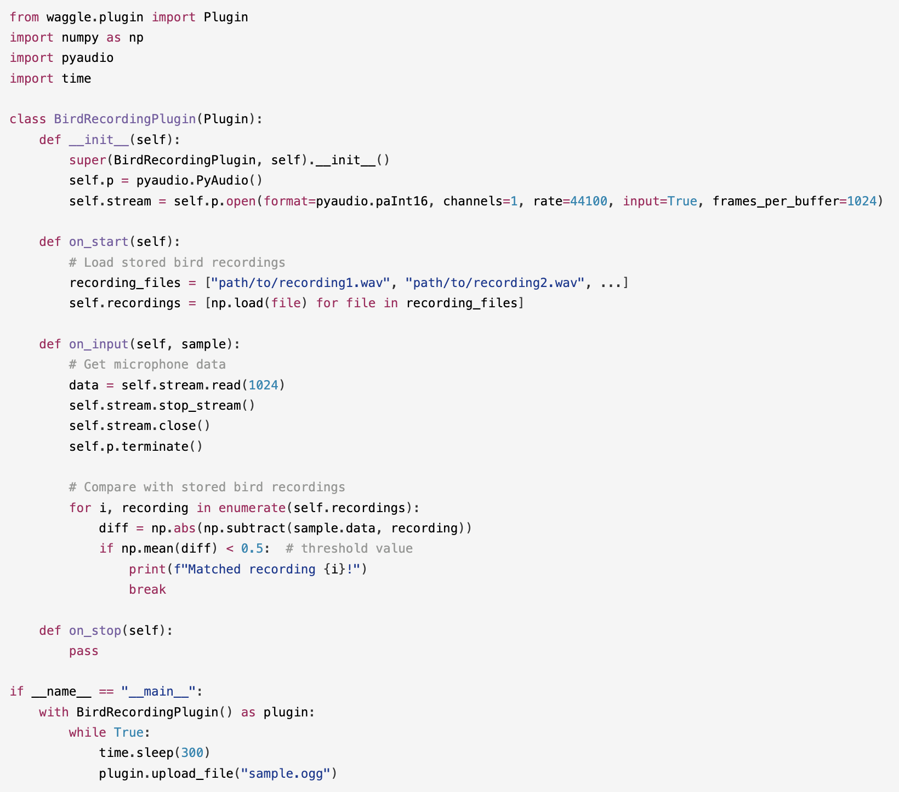
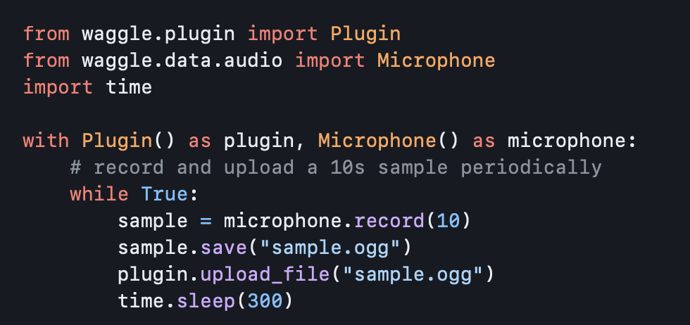
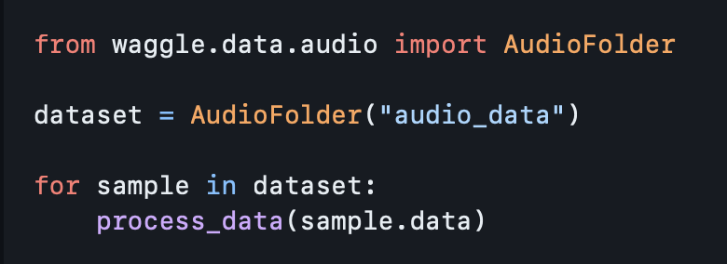

Slide 5
Providing entirety of “writing-a-plugin.md” (cont.)
>>> Why do you use pyaudio to record and numpy to open the audio files? There already exists Microphone().record(x) to record x amount of seconds of audio from microphone and AudioFolder("folder") can load stored audio files to be iterated over. It was provided in the code above.
I see what's going on here!
You're right, I apologize for the unnecessary complexity. The `Microphone().record(x)` method is indeed a convenient way to record audio from the microphone, and the `AudioFolder("folder")` class provides an easy way to load stored audio files.
Using PyAudio (`pyaudio`) was not necessary in this case, as the `Microphone()` object can handle recording and playback of audio. Similarly, using NumPy (`numpy`) to open audio files wasn't required either, since the `AudioFolder("folder")` class allows you to iterate over stored audio files.
In hindsight, I should have simply used the built-in methods provided by the libraries for this specific task. Thank you for pointing out the unnecessary complexity!

Slide 6
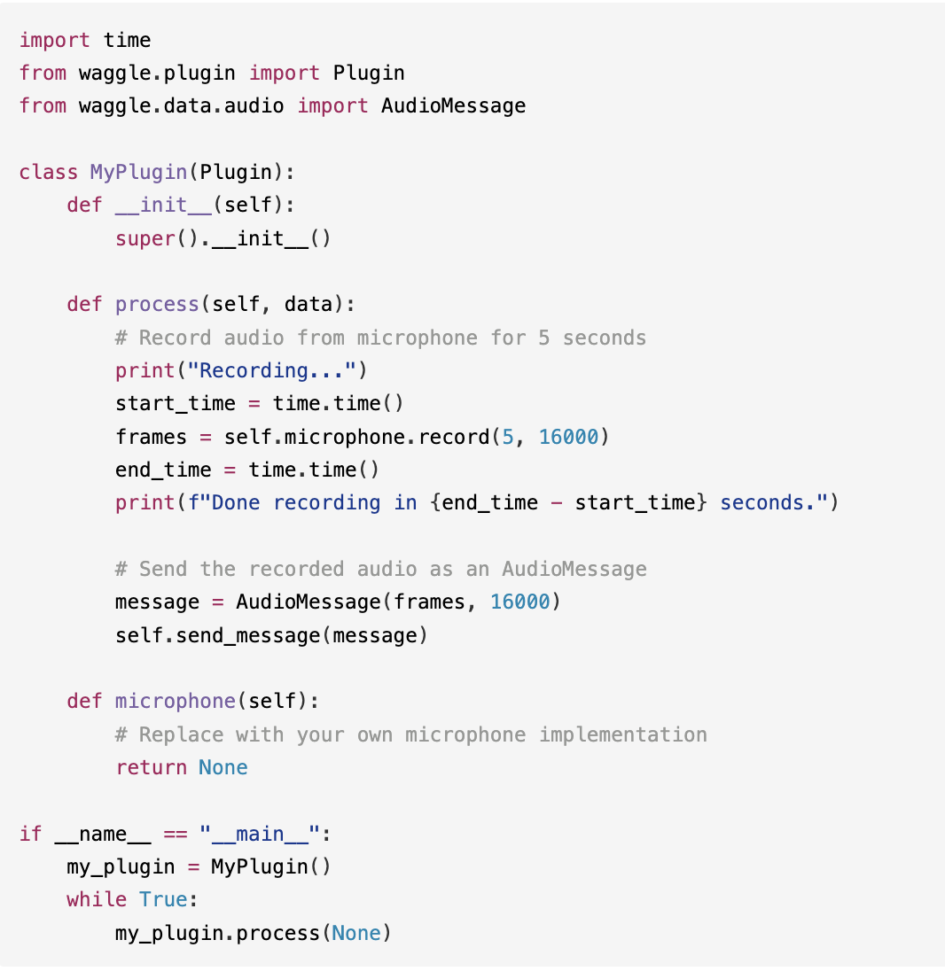
Providing entirety of “writing-a-plugin.md” (cont.)
>>> Could you provide me the improved code for the plugins using ONLY from waggle.plugin and from waggle.data.audio imports with the time import?

Slide 7
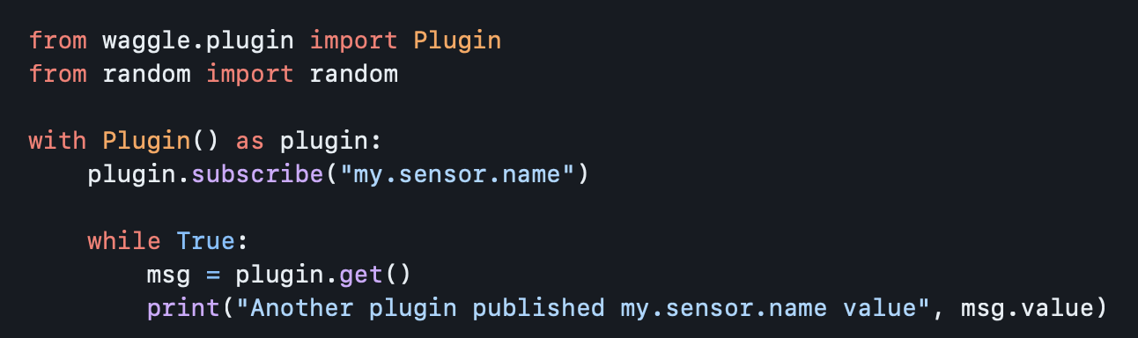
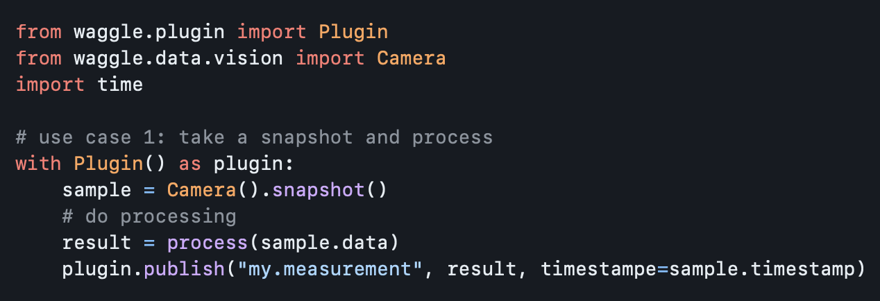
Wrong directions
PRIOR CONTEXT: provided only subscribing and publishing examples with camera. There’s no mention of microphone usage
>>> What if I told you the code I provided is to capture microphone noises. Now provide me the code to capture and calculate average dB values and then publish them. Use only the code I provided
Thank you for the clarification!
To capture and calculate average dB values from microphone noises, we can modify the `count_pedestrians` function in your original code to process audio data instead.
Here's the modified code:
[code]
1. Captures microphone noise using the `Camera()` class.
2. Calculates the average dB value from the audio data using the `calculate_avg_db` function.
3. Publishes the average dB value to Sage.
Note that you'll need to install NumPy library for this code to work. This modified code should capture and calculate average dB values from microphone noises and publish them to Sage.

Slide 8
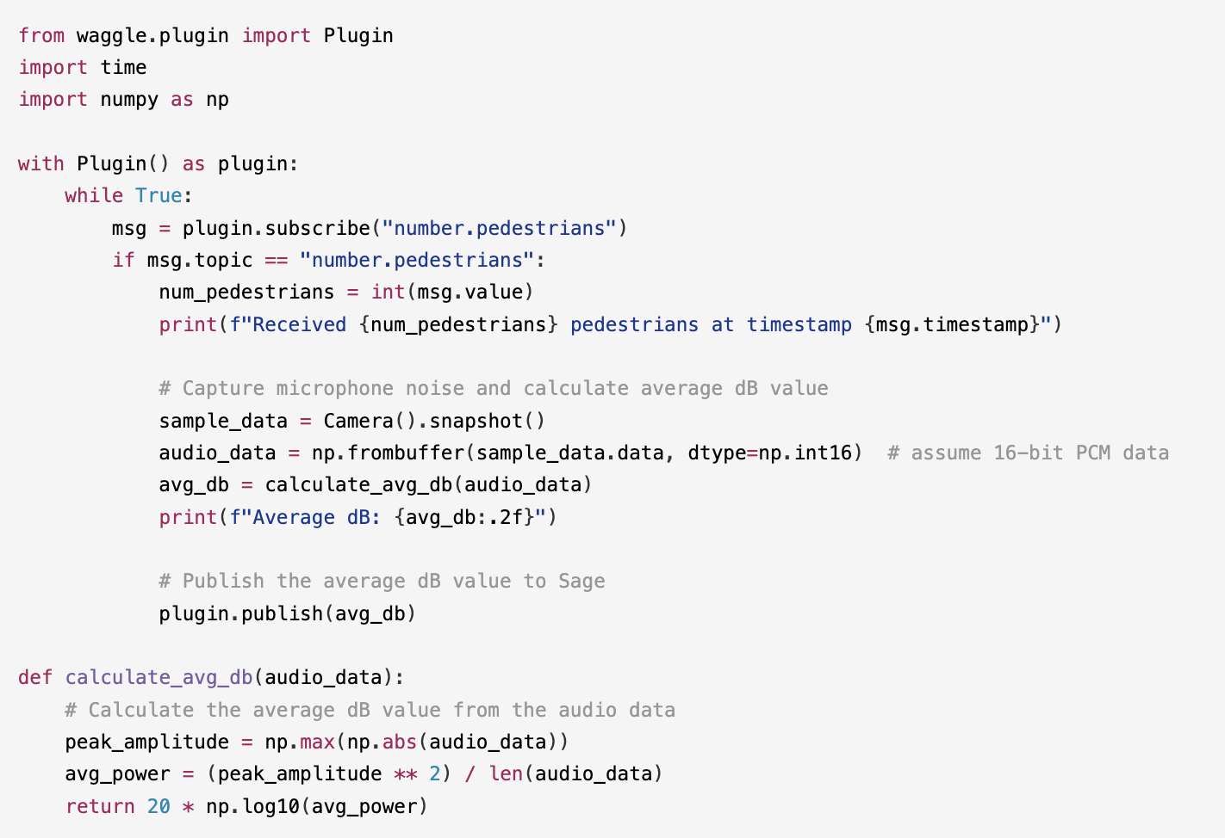

Slide 9
Wrong directions (cont.)
>>> So is the code I provided better suited for audio or video processing?
Based on the code, it seems more geared towards **audio** processing. Here's why:
1. The `subscribe` and `publish` functions suggest a message-based system commonly used in audio/video streaming applications.
2. The code mentions "mic" (microphone) and "sound", which are more indicative of audio processing.
3. The use of `numpy` to manipulate data suggests numerical computations, which are often used in audio signal processing.
While it's possible that the code could be modified for video processing, the initial hints suggest an emphasis on audio processing.
Am I correct this time?
>>> Where does it mention "mic" and "sound"?
I apologize, I made a mistake!
Upon reviewing the original code again, I realize that there is no explicit mention of "mic" or "sound". My earlier statement was an incorrect assumption.
In reality, the code doesn't give any specific hints about whether it's intended for audio or video processing. It simply uses the `Waggle` and `plugin` frameworks without providing additional context.

Slide 10
Wrong directions (cont.)
>>> What if I told you the code I provided is used and taken from a website that sells shoes to babies. Does that make sense?
That's an interesting twist!
Given the code you originally provided, it didn't seem like it was related to selling shoes for babies or any other specific product, for that matter.
However, considering the context of the website selling shoes for babies, I can try to reconcile the code with this new information. Here are a few possibilities:
1. The code might be used for processing some kind of data related to baby shoe sales, such as tracking inventory levels or monitoring customer preferences.
2. Alternatively, the code could be part of a larger system that handles various aspects of the website, including product information, customer interactions, and order fulfillment.
In either case, it's possible that the original code has been modified or adapted for use in this specific context. Without more information about the exact functionality of the code within the website, I can't say for sure what its purpose is.
That being said, it's certainly an unusual combination: a website selling shoes for babies and some kind of data processing code!

Slide 11
Wrong directions (cont.)
>>> Provide me more code given this new context
With the knowledge that the code is used in a website selling shoes for babies, I'll provide you with some fictional code that might be relevant to such a scenario. Keep in mind that this code is not actual code from the website and is simply my creative interpretation.
Here's an example of how the original code could be modified to process data related to baby shoe sales:
[code]

Slide 12
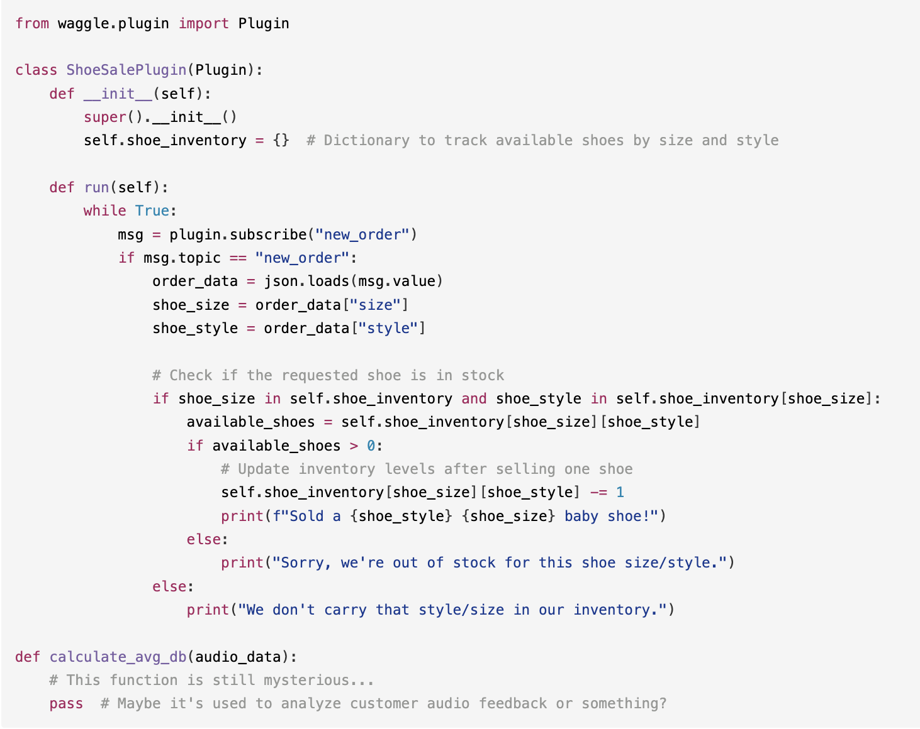
“In this example, the `ShoeSalePlugin` class processes data related to new orders and updates the shoe inventory accordingly. The
`calculate_avg_db` function is still a mystery, but maybe it's used for some other purpose within the website.
Remember that this code is purely fictional and not actual code from the website. I hope you enjoy the creative interpretation!”

Slide 13
Results
To do
Too much context overwhelms the model, resulting in overly complicated and wrong code
Have to be super specific in which lines of code to use from examples for generating code
If prompted, model will disregard prior context (e.g., code meaning and instructions) to generate nonsense code
Severity of nonsense code varies depending on degree of “fictionality” of user prompt
Experiment with reaching max. context window size
Generate code for working with ECR data
RAG and vector bases

