Slide 1
Weeks 6 Report
Code Generation and Documentation Search

Slide 2
Sage Data Client
Goal: generate code to obtain readings from any node

Slide 3
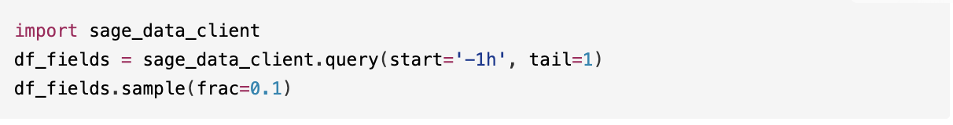
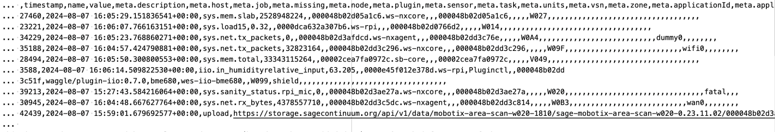
Nonsensical code
>>> The following is the general structure of the dataframe resulted from these lines of code:

Slide 4
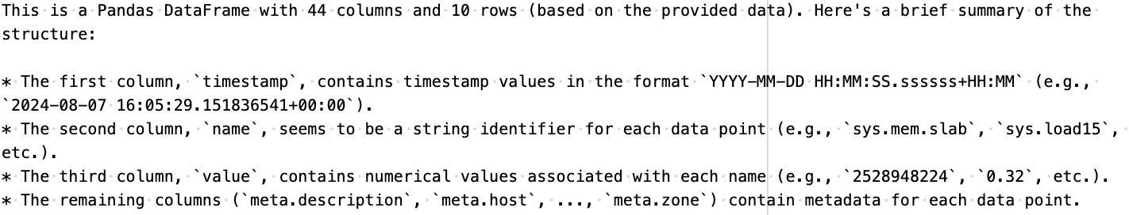

Slide 5
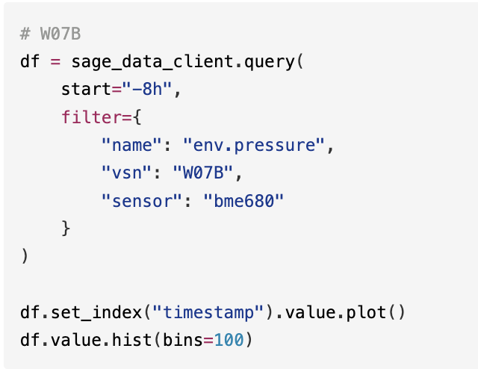
Nonsensical code (cont.)
>>> Provided the following code, generate the code for the line plot and histogram of the temperature and humidity for the last hour for node W0B0

Slide 6
Nonsensical code (cont.)
Based on the provided code, I'll assume you want to create a line plot and histogram for the temperature and humidity readings from node `W0B0` for the last hour.
Here's how you can modify the code to achieve this:
[code]
This code will create a line plot showing the temperature (`sys.mem.slab`) and humidity (`iio.in_humidityrelative_input`) readings for node `W0B0` over the last
hour. It also generates a histogram of these values.
Note: Make sure you have imported the necessary libraries (e.g., `import sage_data_client`, `import matplotlib.pyplot as plt`) and that your environment is set up to
run Python code with Jupyter Notebook or similar environment.

Slide 7
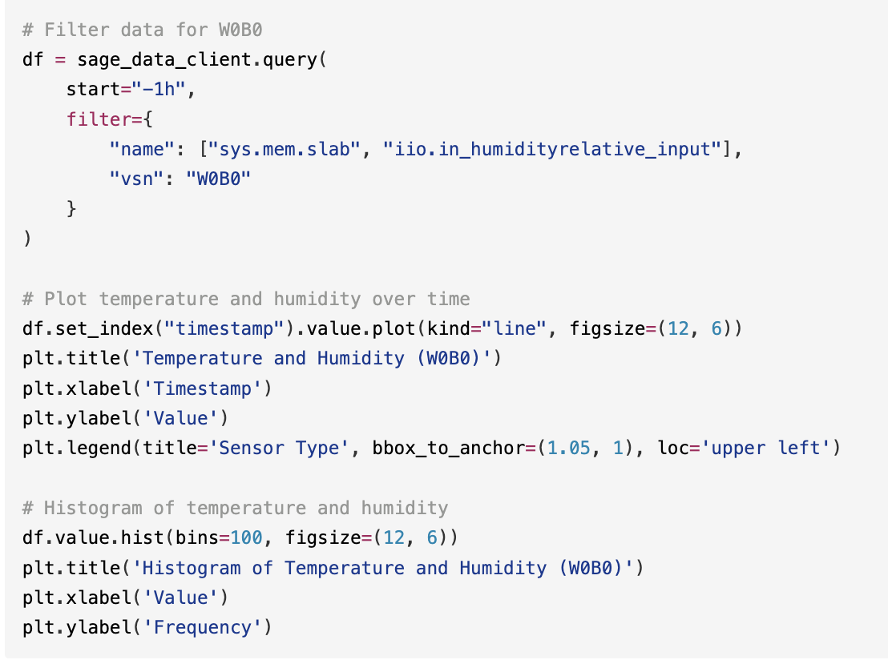
Does not work because you can’t provide lists in the filter field
HTTP ERROR 400
Also note the humidity and temperature names

Slide 8
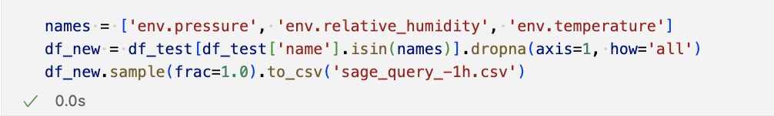
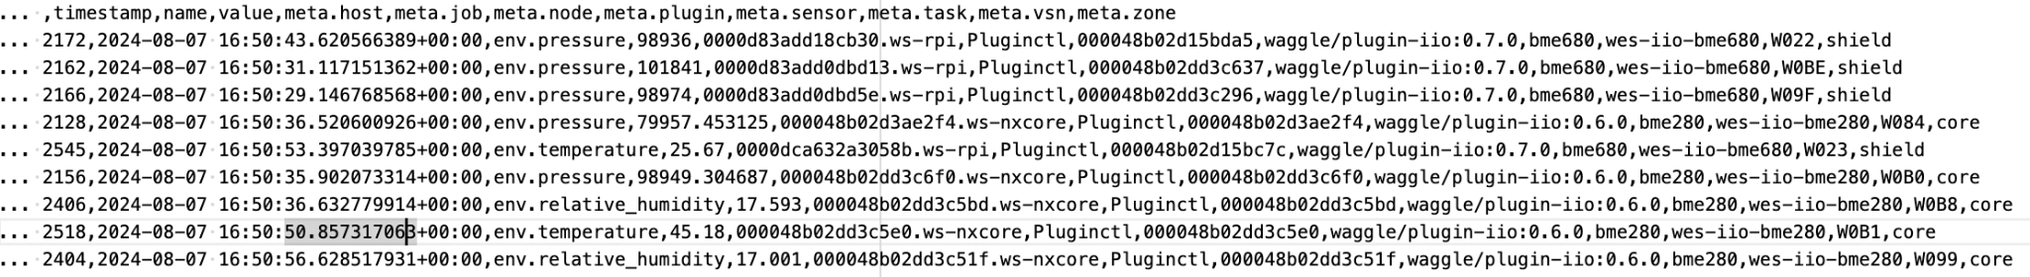
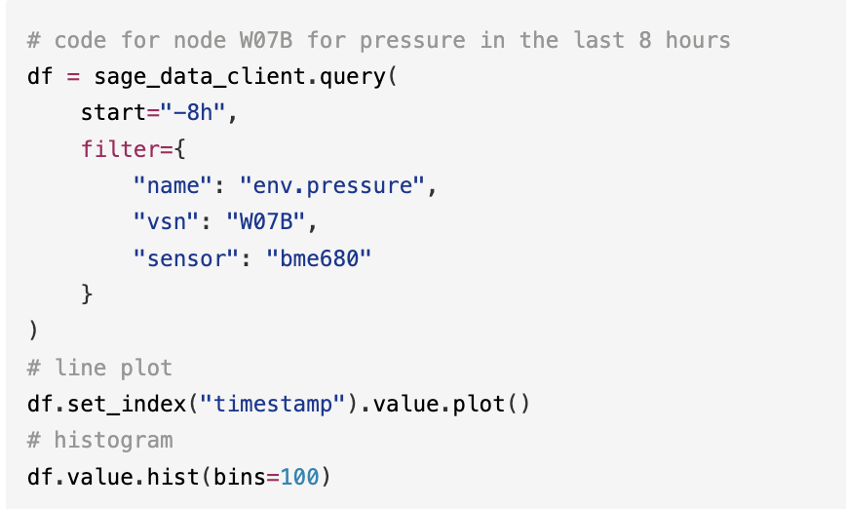
Sensical code
Cleaned dataframe with:
>>> Below are randomized and cleaned up entries from a dataframe that was produced by `df_test = sage_data_client.query(start='-1h', tail=1)`
That is the general structure of the dataframe. Given the following code that makes the line plot and histogram of pressure, can you provide me the code to graph the line plot and histogram of both pressure and temperature for node W0B0 from the last three hours?

Slide 9
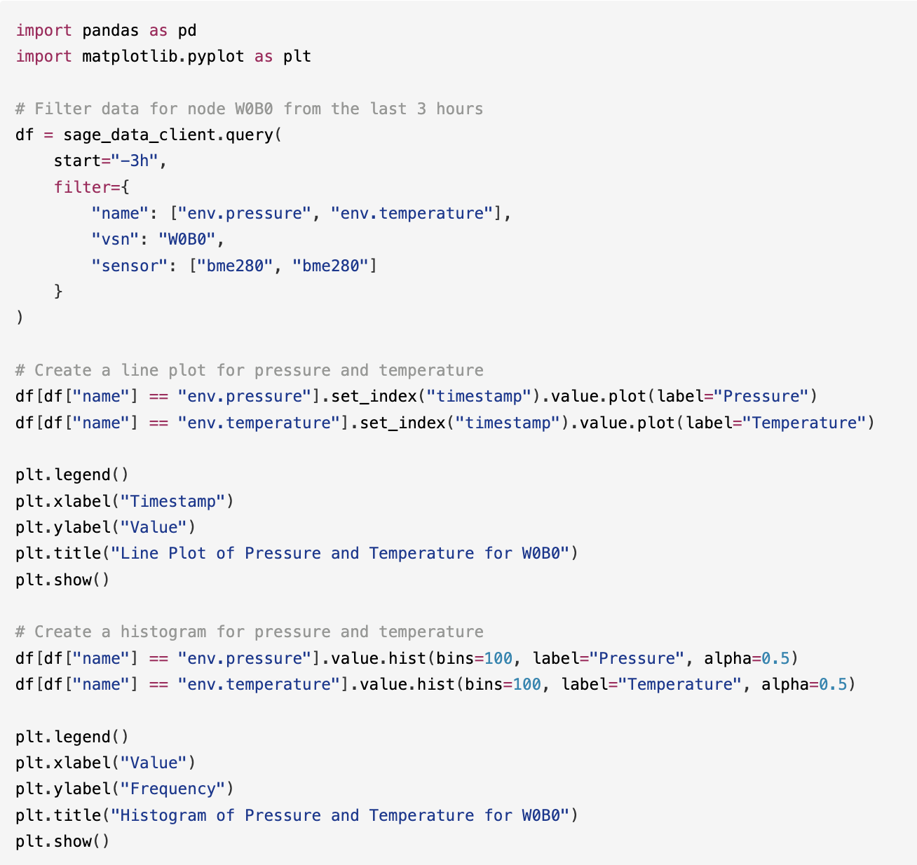
Again, cannot provide lists to filter
But almost perfect!

Slide 10
Sensical code (cont.)
>>> Can you make it two separate functions, one for pressure and one for temperature? I get HTTP Error 400 because you can't group the field conditions like that (e.g., "['env.pressure', 'env.temperature']")

Slide 11
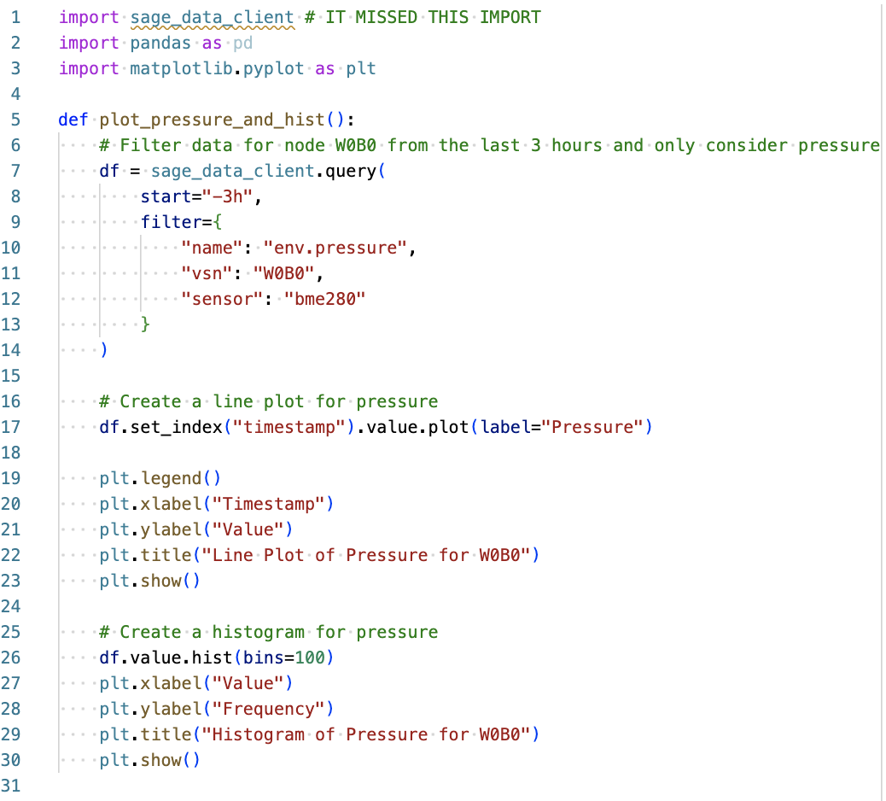
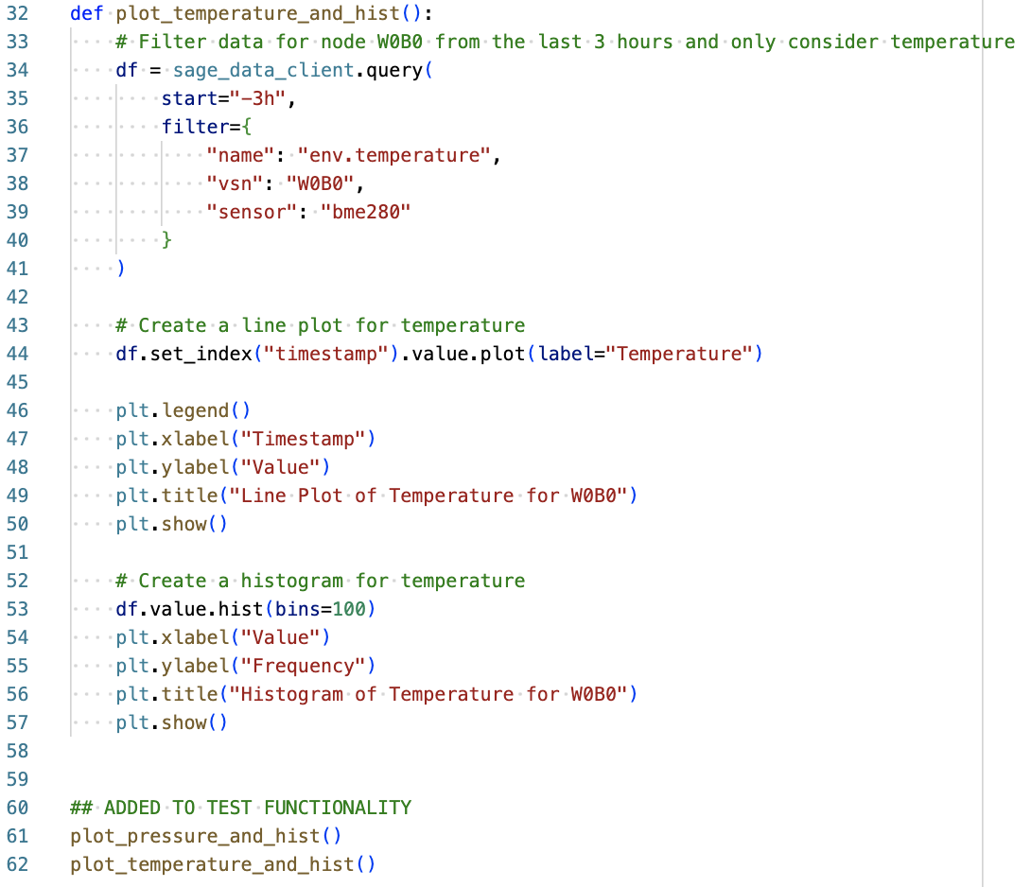
~Perfect code! It only missed the sage_data_client import

Slide 12
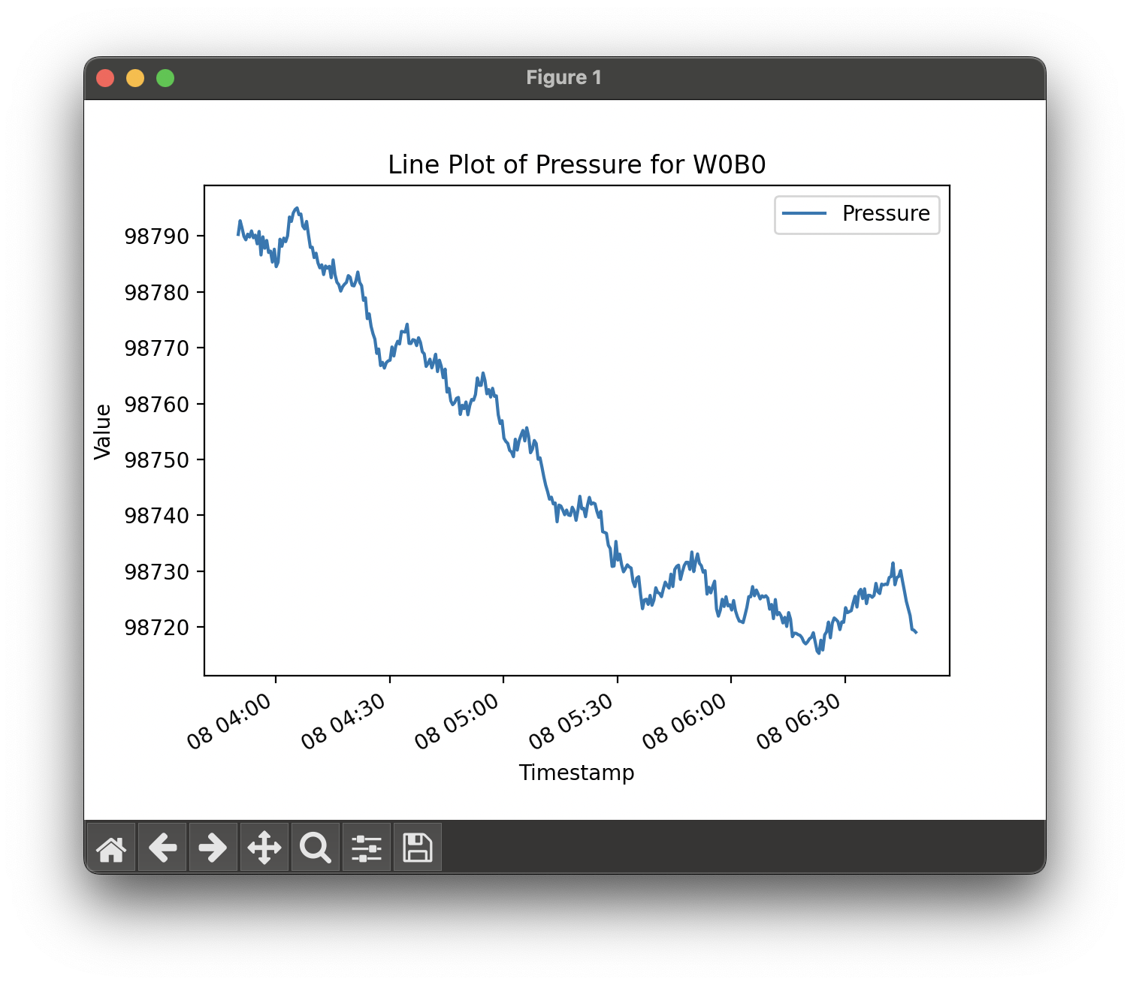
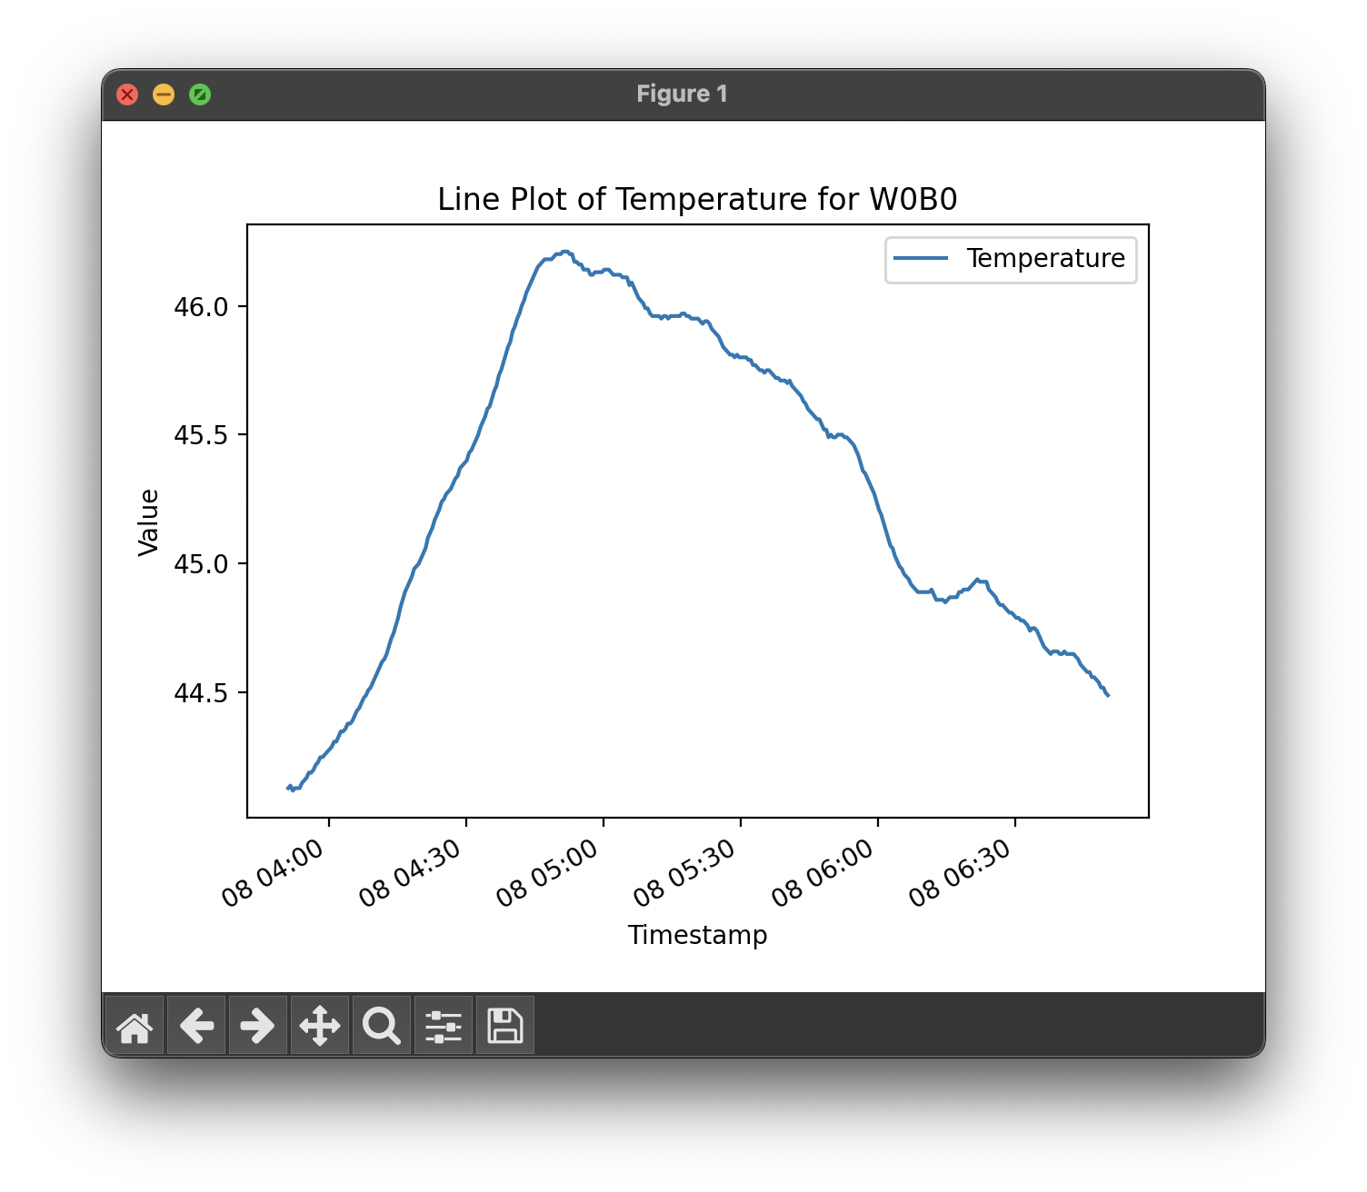
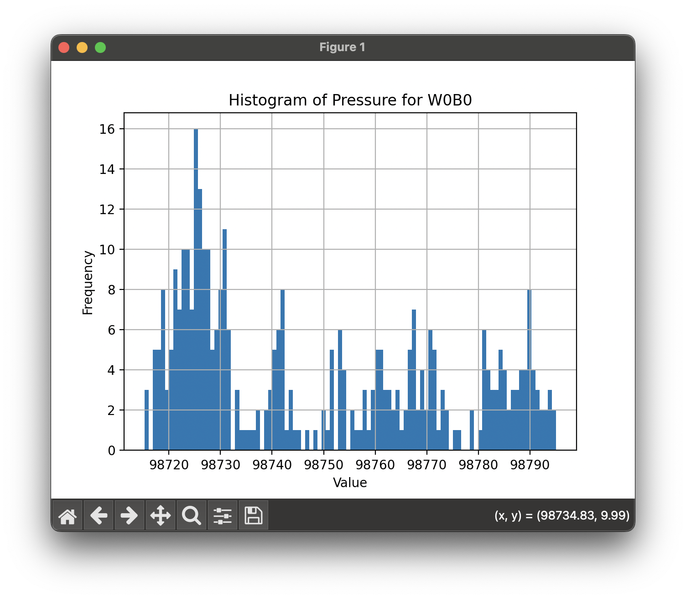
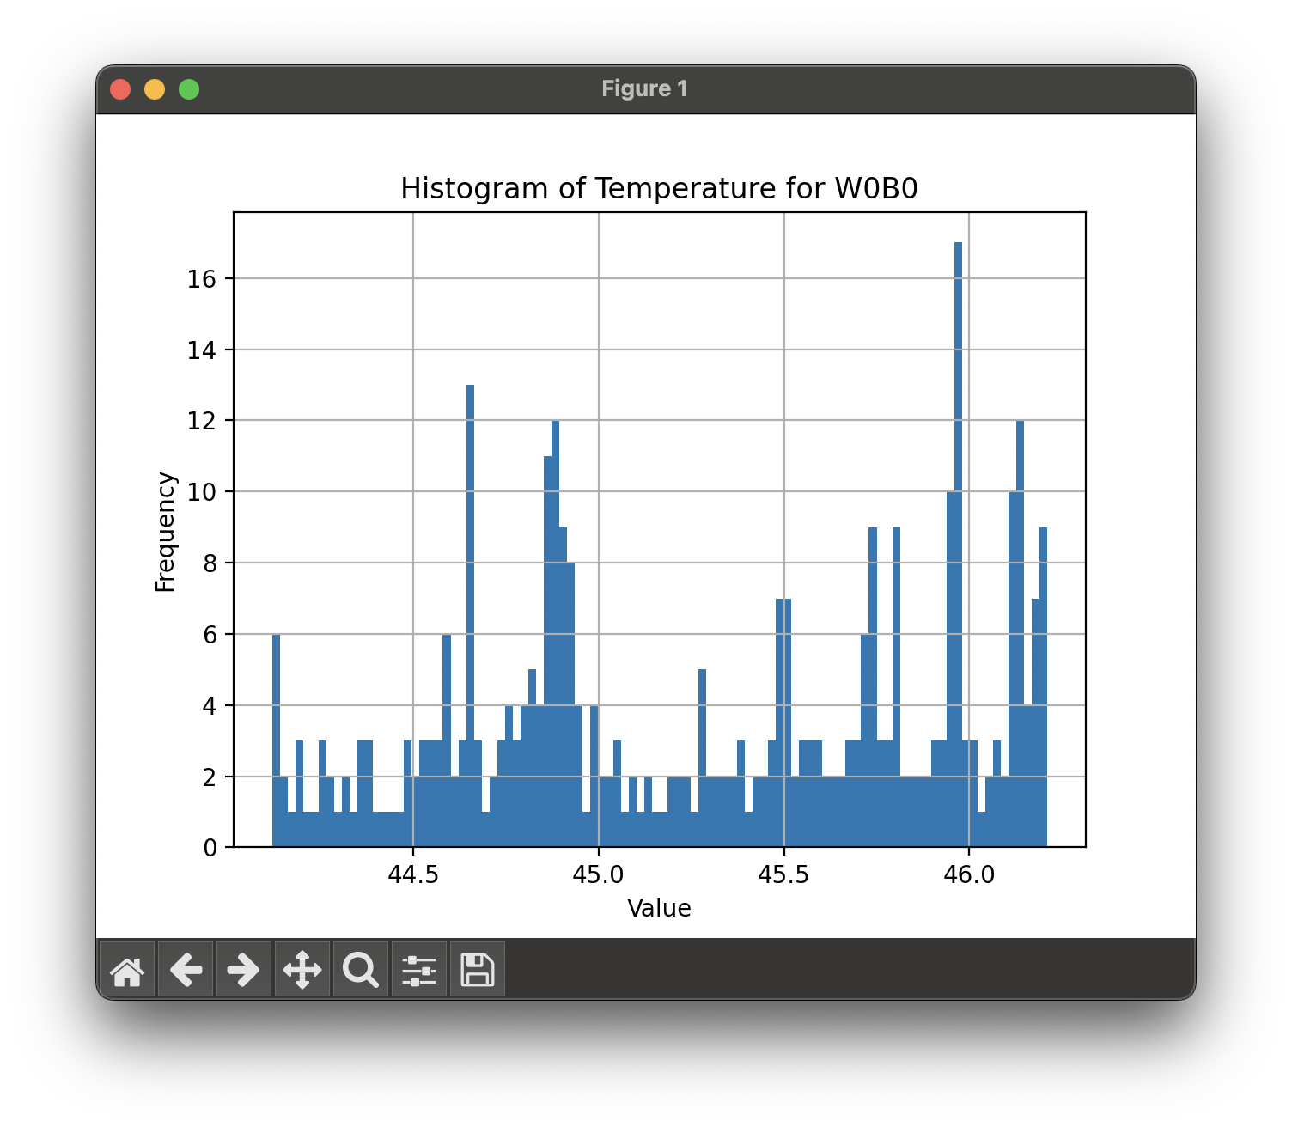

Slide 13
Results
To do
Model can query sage data client as long as it’s provided the structure of the data it’s querying
Providing a clean and specific structure to the model is necessary for the best performance
RAG and vector bases

