Slide 1
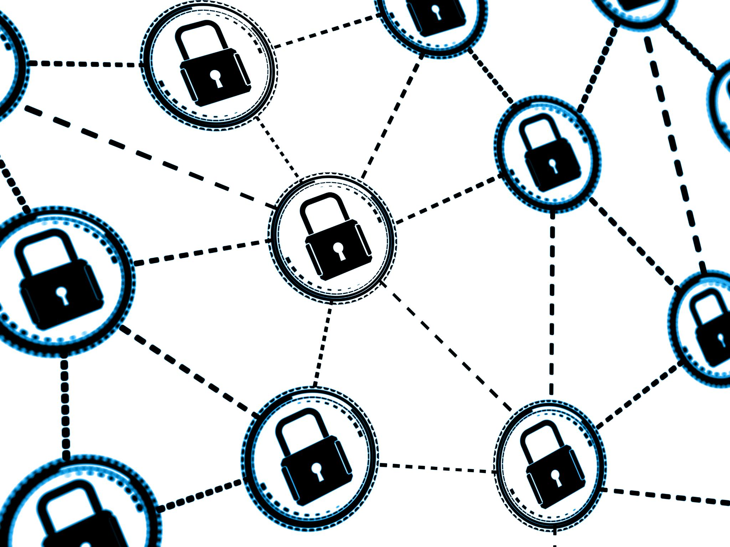
SecureChain Enterprise Platform: A Blockchain-Based Secure Transaction System
Innovative blockchain solution ensuring secure enterprise transactions
Notes:
AI-generated content may be incorrect. ---

Slide 2
Project Overview and System Architecture
Notes:
Project Vision, Objectives, and Real-World Relevance, Client-Server Architecture and Networking Design, Server-Based Deployment Strategy

Slide 3

Project Vision, Objectives, and Real-World Relevance
Project Vision
Eliminate fraud and trust issues in digital transactions with secure blockchain and cybersecurity integration.
Core Objectives
Enable verifiable, immutable, and protected digital transactions via desktop application and secure server deployment.
Real-World Relevance
Supports FinTech, e-commerce, and enterprise platforms by integrating payment gateways, networking, and cybersecurity.
Notes:
The SecureChain Enterprise Platform is designed as a flagship C# and .NET desktop application that demonstrates how modern enterprise systems can securely handle digital transactions using blockchain, cybersecurity, networking, and payment gateway technologies. The core vision of the project is to eliminate fraud, data tampering, and trust issues commonly found in traditional centralized transaction systems. By combining a desktop-based client application with a secure server-side deployment, the system reflects how real-world financial and enterprise platforms are built and operated. The primary objective is to allow users to perform secure transactions—such as purchasing digital services or assets—while ensuring that every transaction is verifiable, immutable, and protected against cyber threats. Blockchain technology is used to record transaction hashes and timestamps, making the data tamper-proof and transparent. Cybersecurity mechanisms such as encryption, hashing, authentication, and intrusion detection ensure that sensitive user and payment data remain protected. Payment gateway integration enables real-world transaction handling through sandbox environments like Stripe or Razorpay, demonstrating FinTech capabilities. Networking concepts such as client-server communication, REST APIs, and secure data transfer are central to the system’s operation. This project is highly relevant to industries like FinTech, e-commerce, secure digital marketplaces, and enterprise transaction platforms. It also aligns strongly with job roles in software development, cybersecurity, blockchain engineering, and system architecture, making it an ideal high-impact academic and portfolio project.

Slide 4
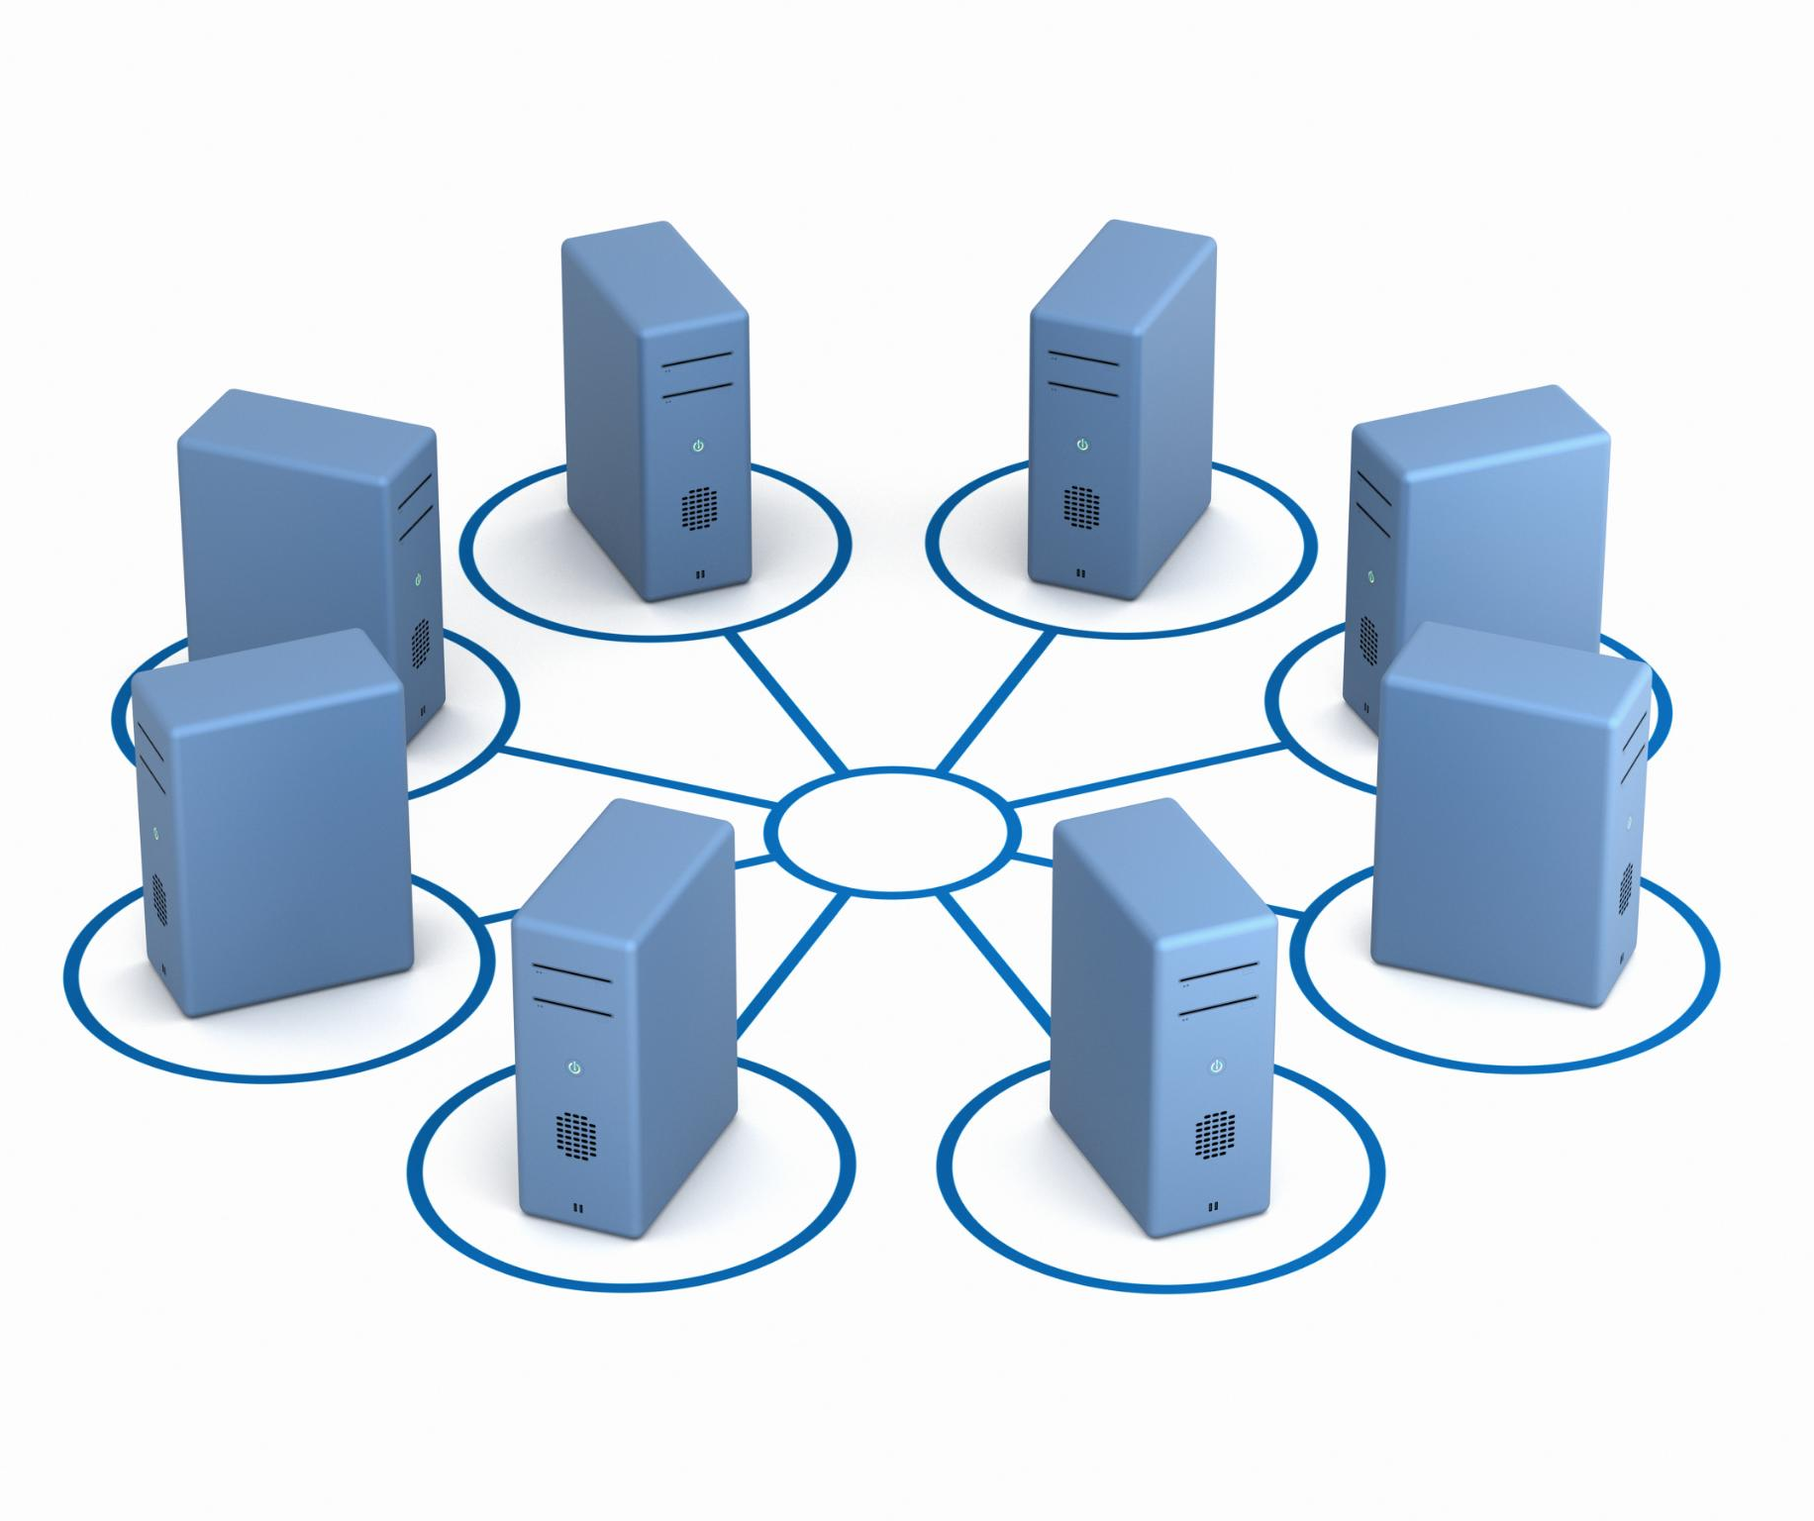
Client-Server Architecture and Networking Design
Client Application Interface
The client is a C# .NET desktop app using WPF or WinForms, enabling rich user interaction and service browsing.
Server Backend and APIs
The server uses ASP.NET Core Web API, handling business logic, database, blockchain, and payment gateways securely.
Secure Communication Protocols
Client-server communication employs secure channels with RESTful APIs over HTTPS and token-based authentication.
Scalability and System Design
Architecture supports multiple clients and future extensions like mobile and web interfaces for scalability.
Notes:
The SecureChain Enterprise Platform follows a robust client-server architecture, which is the backbone of most enterprise-grade applications. The client side is implemented as a C# .NET desktop application using WPF or WinForms, providing a rich and responsive user interface for end users. This desktop client handles user interactions such as login, browsing services, initiating payments, and viewing transaction history. All business logic and sensitive operations are delegated to the backend server to ensure security and scalability. The server side is developed using ASP.NET Core Web API and is deployed on a local server or cloud infrastructure such as Azure or AWS. Communication between the client and server occurs over secure network channels using RESTful APIs and HTTPS. Networking concepts such as request-response models, stateless communication, and token-based authentication are implemented to simulate real-world enterprise systems. The server manages database operations, blockchain interactions, payment gateway communication, and security monitoring. This separation of concerns improves system maintainability and allows multiple clients to connect simultaneously. Additionally, the architecture supports future scalability, such as adding mobile clients or web interfaces, making the project a realistic representation of modern distributed systems.

Slide 5

Server-Based Deployment Strategy
Centralized Backend Server
The backend server handles core operations like authentication, transaction processing, and blockchain logging centrally.
Secure Deployment Configuration
Deployment includes secure endpoints, HTTPS, environment variable management for sensitive credentials, ensuring data protection.
Database and Blockchain Integration
Database services store user data and metadata while blockchain nodes are managed server-side for secure logging.
Enterprise Hosting and Monitoring
This deployment model mirrors enterprise hosting with monitoring of system health, logs, and network activity.
Notes:
Server-based deployment is a critical aspect of the SecureChain Enterprise Platform, as it demonstrates how applications transition from development environments to real-world usage. The backend server is deployed as a centralized service that handles all core operations, including authentication, transaction processing, blockchain logging, and payment verification. This server can be hosted on a physical machine, a virtual machine, or a cloud platform, depending on project scope. The deployment includes configuring secure endpoints, enabling HTTPS, and managing environment variables for sensitive credentials such as payment gateway keys. Database services like SQL Server are hosted alongside the server to store user profiles, encrypted data references, and transaction metadata. Blockchain nodes, whether simulated or connected to a test network, are also managed at the server level. This deployment model ensures that critical logic is protected from client-side tampering and allows administrators to monitor system health, logs, and network activity. Demonstrating server-based deployment adds strong practical value to the project, as it mirrors enterprise application hosting, DevOps practices, and secure service management used in real organizations.

Slide 6
Blockchain, Cybersecurity, and Payment Integration
Notes:
Blockchain Integration for Secure and Tamper-Proof Transactions, Cybersecurity Mechanisms and Threat Protection, Payment Gateway Integration and Secure Transaction Flow

Slide 7

Blockchain Integration for Secure and Tamper-Proof Transactions
Blockchain Data Security
Blockchain ensures immutability and transparency by storing transaction hashes with cryptographic linking between blocks.
SHA-256 Hashing
Each transaction is hashed with SHA-256, making even small data changes produce different unique hashes.
Verification and Fraud Prevention
Transactions can be verified later by recomputing hashes, aiding in fraud prevention and audit trails.
Private and Public Blockchains
The project supports private blockchain simulations and connections to public test networks for versatile deployment.
Notes:
Blockchain technology is a central pillar of the SecureChain Enterprise Platform, providing immutability, transparency, and trust in digital transactions. In this project, blockchain is used to store critical transaction data such as transaction hashes, timestamps, user identifiers (encrypted), and payment confirmation references. Each transaction is converted into a cryptographic hash using SHA-256, ensuring that even a small change in data results in a completely different hash. These hashes are stored in blockchain blocks that are cryptographically linked to previous blocks, making tampering virtually impossible. The project can use a private blockchain simulation for academic purposes, where blocks are generated and validated within the server environment, or it can connect to a public test network like Ethereum for advanced implementation. The blockchain layer allows any transaction to be verified at a later time by recomputing the hash and comparing it with the blockchain record. This mechanism is highly effective for fraud prevention, dispute resolution, and audit trails. By integrating blockchain into a desktop-based enterprise system, the project clearly demonstrates how distributed ledger technology can be applied beyond cryptocurrencies into secure business applications.

Slide 8
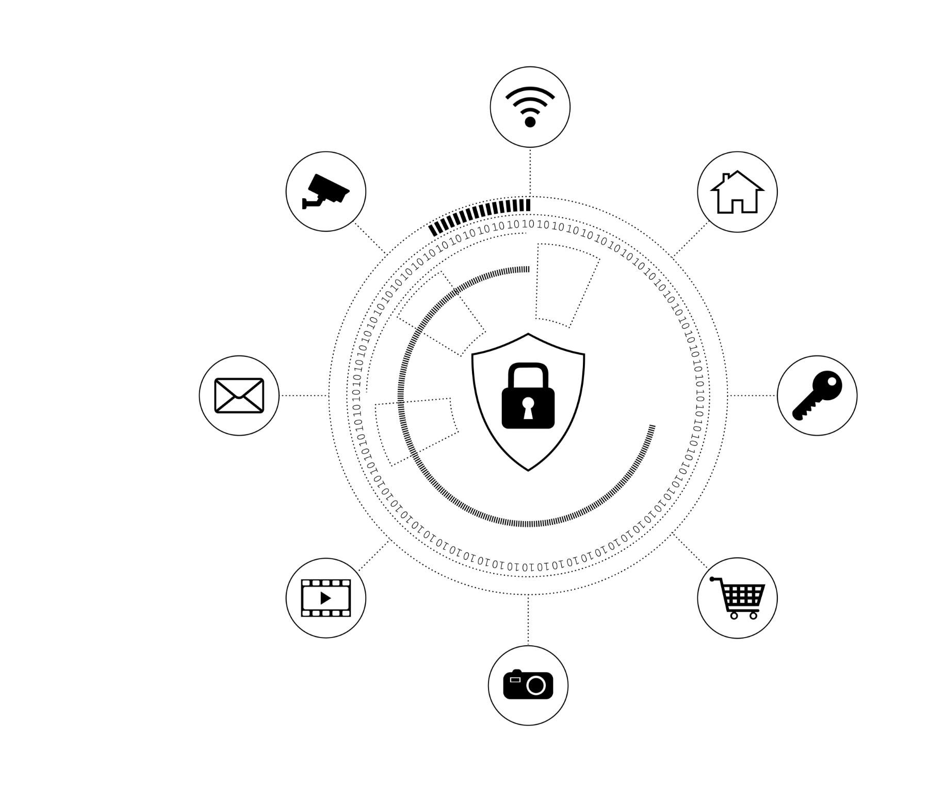
Cybersecurity Mechanisms and Threat Protection
User Authentication Security
User authentication uses SHA-256 hashed passwords and optional two-factor authentication with one-time passwords for strong access control.
Data Encryption and Key Exchange
Sensitive data is protected using AES encryption and RSA cryptography ensures secure key exchange and digital identity protection.
Secure Network Communication
HTTPS protocol safeguards client-server communication from man-in-the-middle attacks ensuring network security.
Intrusion Detection and Alerts
Monitoring of failed logins, suspicious IPs, and abnormal patterns triggers alerts for proactive threat management.
Notes:
Cybersecurity is deeply integrated into every layer of the SecureChain Enterprise Platform to protect data, users, and transactions from cyber threats. User authentication is secured using hashed passwords with SHA-256 and optional two-factor authentication through one-time passwords. Once authenticated, users receive JWT tokens that are used to securely access server APIs without repeatedly transmitting credentials. Sensitive data such as personal information and transaction details are encrypted using AES encryption before storage or transmission. RSA public-private key cryptography is used for secure key exchange and digital identity protection. Network security is enforced through HTTPS, preventing man-in-the-middle attacks during client-server communication. The system also includes basic intrusion detection features, such as monitoring multiple failed login attempts, suspicious IP addresses, and abnormal request patterns. Alerts are generated for administrators when potential threats are detected. These cybersecurity measures collectively demonstrate best practices used in real-world enterprise systems, highlighting the importance of defense-in-depth and proactive threat monitoring in modern software applications.

Slide 9
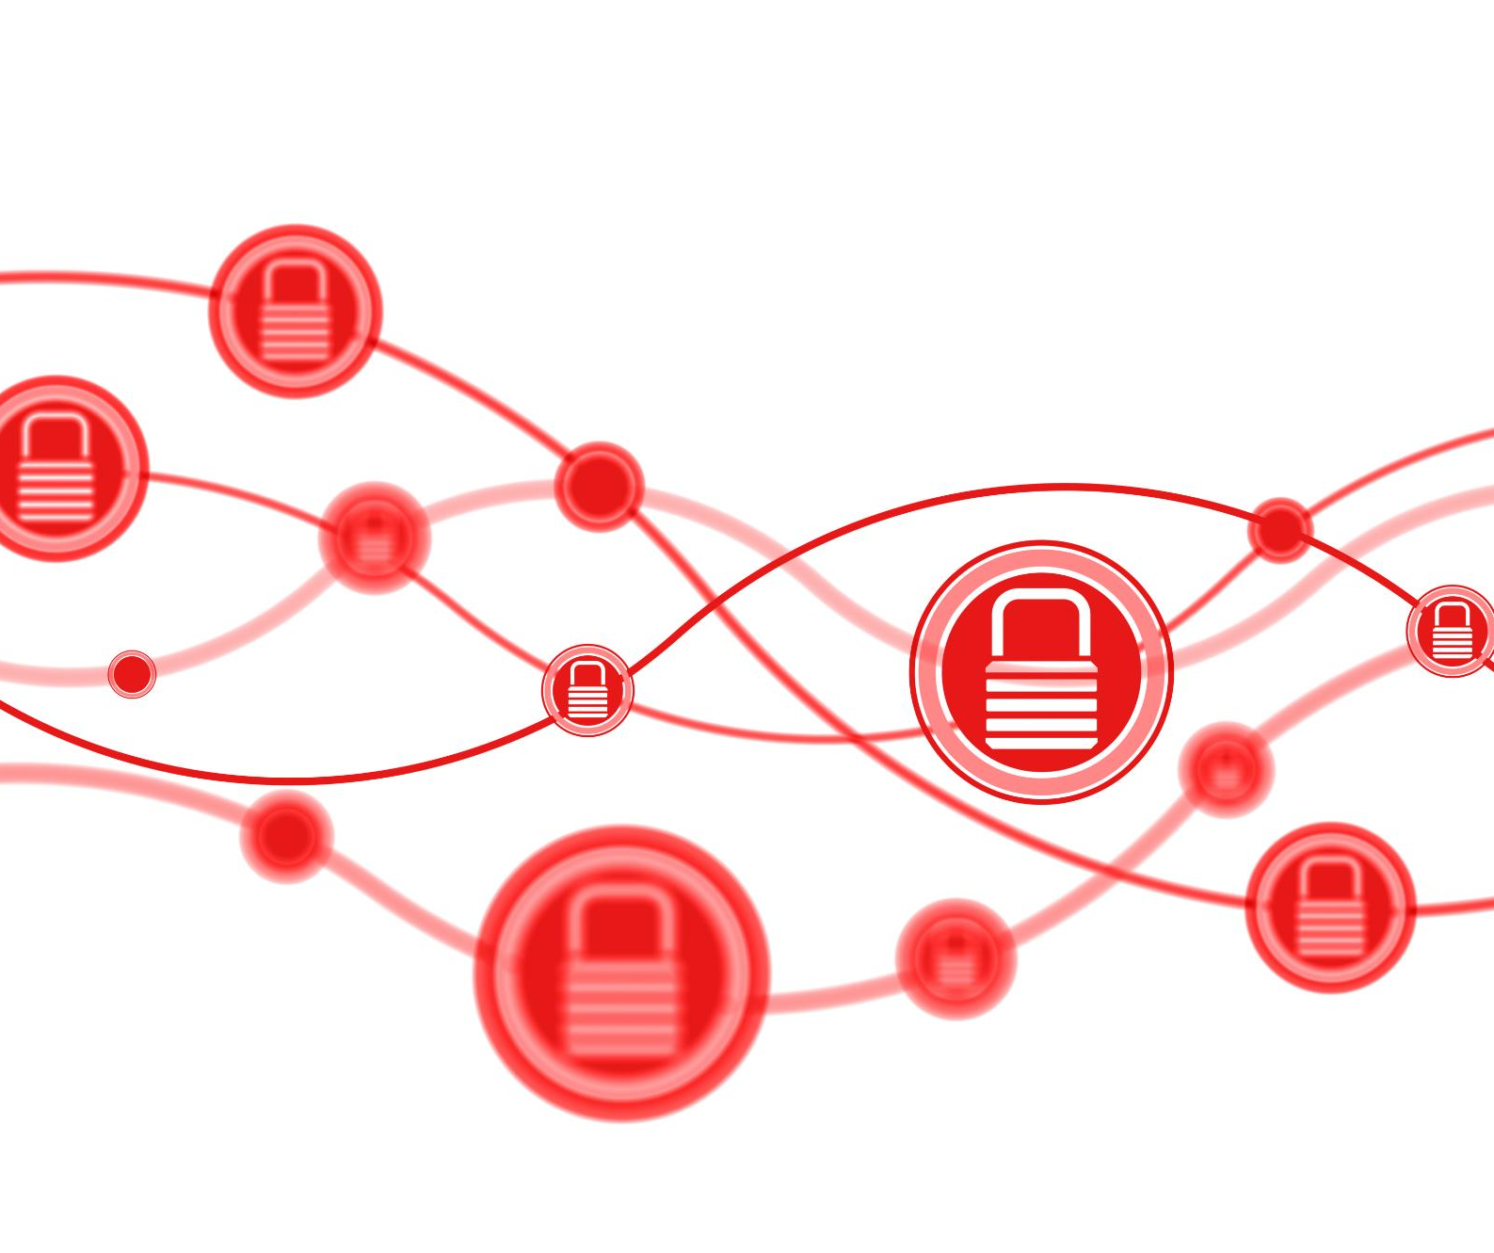
Payment Gateway Integration and Secure Transaction Flow
Payment Gateway Integration
The platform integrates with payment gateways via sandbox environments for secure, risk-free transaction testing.
Secure Transaction Flow
Secure payment requests and callbacks ensure only confirmed transactions proceed to blockchain recording.
Blockchain Transaction Logging
Confirmed payments are logged on blockchain with verification codes linked to transaction hashes for consistency.
Security and Validation Controls
Integration includes secure API usage, transaction validation, and rollback handling to maintain trust and accountability.
Notes:
Payment gateway integration transforms the SecureChain Enterprise Platform into a realistic FinTech-style application. The system integrates with popular payment gateways such as Stripe or Razorpay using their sandbox environments, allowing safe testing without real financial risk. When a user initiates a purchase from the desktop client, a secure payment request is sent to the server, which then communicates with the payment gateway API. The gateway processes the payment and returns a success or failure response through secure callbacks. Only after a successful payment confirmation does the server proceed to record the transaction on the blockchain, ensuring consistency between financial and blockchain records. This flow prevents fake or incomplete transactions from being logged. Payment identifiers and confirmation codes are securely stored and linked with blockchain transaction hashes for verification. The integration demonstrates key concepts such as secure API usage, transaction validation, and rollback handling in case of failures. By combining payments, blockchain logging, and cybersecurity controls, the project effectively showcases how modern digital transaction systems ensure trust, accountability, and user confidence in enterprise environments.

