Slide 1
PV204 Project Phase 1
Amal Chukkinin, Marek Hrašna and Jan Kubeša

Slide 2
Dencrypt Talk for iPhone version 4.2.794
Analysis by Jan Kubeša

Slide 3
Introduction
Dencrypt Talk is a WharsApp-like messaging service
TOE is the iOS client application only with MDM rollout in group
Certified at EAL4 with ALC_FLR.2 flaw reporting enhancement
Evaluated by atsec Information Security ag
Certified by CSEC in Sweden

Slide 4
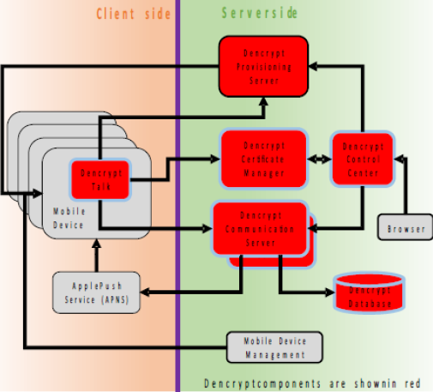
Architecture overview

Slide 5
SARs evaluated
Development: modular design, fun. requirements, architecture
Documentation: Deployment and User guides
Lifecycle: flaw reporting, dev stack, problém tracing, delivery
ST evaluation: component definition, Security requirements, objectives
Tests: coverage, design, automatic, manual, randomness
Pentesting: known flaws, CVE, induced 3rd party faults

Slide 6
Security functions and OSPs
Secure initialization – enroll by link
Secure management – phonebook management off device
Secure messaging – both voice and chat
Secure channel – communication towards server is secured
Key generation, closed comms, forward secrecy, up to date remote tamper-proof phonebook management

Slide 7
Scope – assumed attacker model
Data – attacker gets credentials, phonebook, settings
Impersonation – another user in the group is pretending to be someone elese
Sniffing – traffic of the conversations is intercepted

Slide 8
Out of scope + my opinion
Out of scope: everything (physical access, untrained user, most side channels, RNGs, …)
Very limited applicability: application version, iOS version, headset
Server at EAL 2, other components are not certified
Would I use it: depends on the cost

