Slide 1
NXP JCOP 5.1 on SN100.C48 Secure Element
Analysis by marek Hrasna

Slide 2
TOE (Target of evaluation)
Composite TOE
Java Card smart card OS
Secure element (micro-controller)
Out of scope
NFC controller
System mailbox

Slide 3
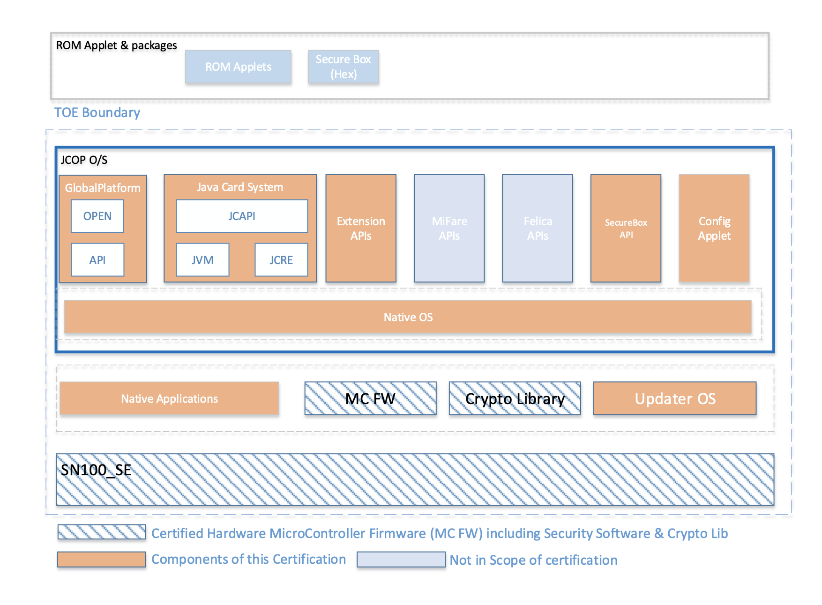

Slide 4
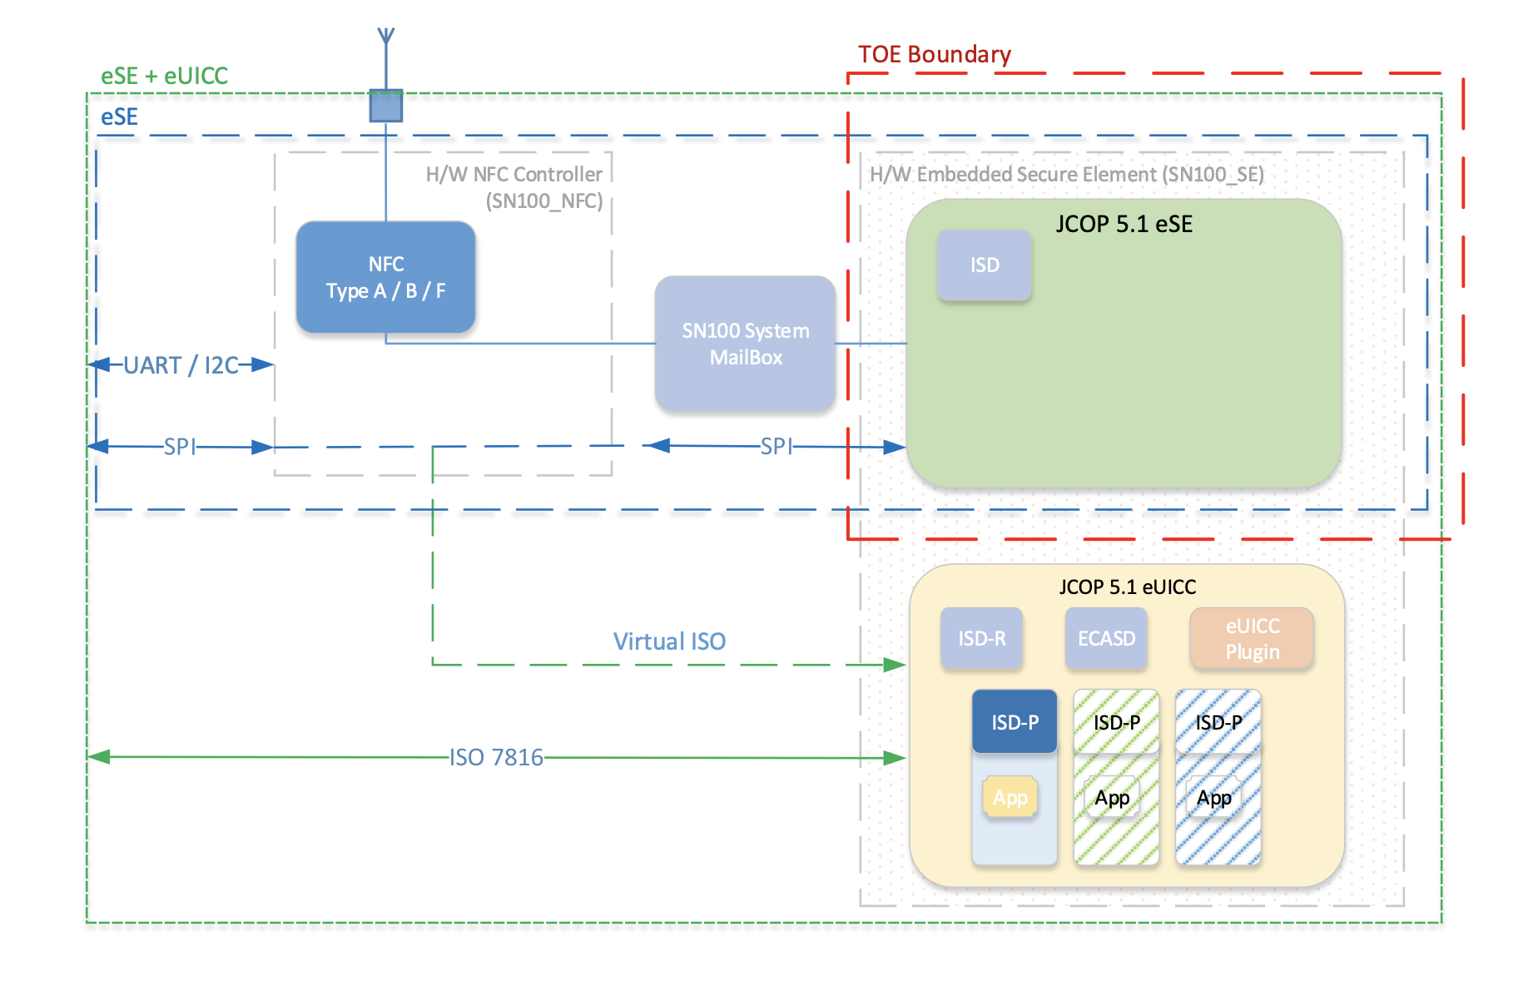
The NFC controller and system mailbox are not within the scope of the evaluation

Slide 5
Certificate details
Assurance Package: EAL5 augmented with AVA_VAN.5, ALC_DVS.2, ASE_TSS.2, ALC_FLR.1
Protection Profile Conformance: Java Card Protection Profile - Open Configuration, v 3.0.5 certified by BSI (GER)
StandardL Common Criteria for Information Technology Security Evaluation (CC) Version 3.1 Revision 5 (ISO/IEC 15408)
Certificate number: CC-19-221699-2
Project number: 221699
Evaluation facility: Brightsight BV, Delft, NE; Applying the Common Methodology for IT Security Evaluation (CEM) v 3.1 Revision 5 (ISO/IEC 18045)
Validity
1st issue: 30/04/2019, 2nd issue: 29/11/2019, Expiry: 30/04/2024

Slide 6
Security assumptions & scope
The assumptions defined in the Security Target are not covered by the TOE itself, the security objectives must be fulfilled by the TOE-environment
Proprietary applications such as FeliCa and Mifare API are included in the TOE, but there are no security claims for these applications in this certificate.

Slide 7
Conclusion and evaluation
Expected results, giving assurance that TOE behaves as specified.
No exploitable vulnerabilities have been found with the independent penetration tests.
Algorithmic security level of cryptographic functionality has not been rated in this certification process
Not all key sizes have sufficient cryptographic strength (AVA_VAN.5), but still more than 80 bits

Slide 8
Maintenance Report
There was only a minor change in the naming of the TOE and an addition to the platform manufacturing site, nothing that would impact the security functionality of the certified product.

Slide 9
Conclusion
The product is a modern Java Card, providing many cryptographic operations, some handy proprietary functionality and is certified for the next 4 years, so it is secure against all currently publicly known attacks.

Slide 10
Sources
https://www.commoncriteriaportal.org/files/epfiles/[ST-LITE]%20SecurityTarget-Lite_JCOP5.1_v2.2.pdf
https://www.commoncriteriaportal.org/files/epfiles/Certification%20Report%20NSCIB-CC-221699-CR2.pdf
https://www.commoncriteriaportal.org/files/epfiles/NSCIB-CC-221699-MA.pdf

