Slide 1
NXP JCOP 5.1 on SN100.C48 Secure Element
Analysis by marek Hrasna

Slide 2
TOE (Target of evaluation)
Java Card smart card OS
an OS updater
restricted mode and underlying platform
a library providing cryptographic function
a secure micro-controller

Slide 3
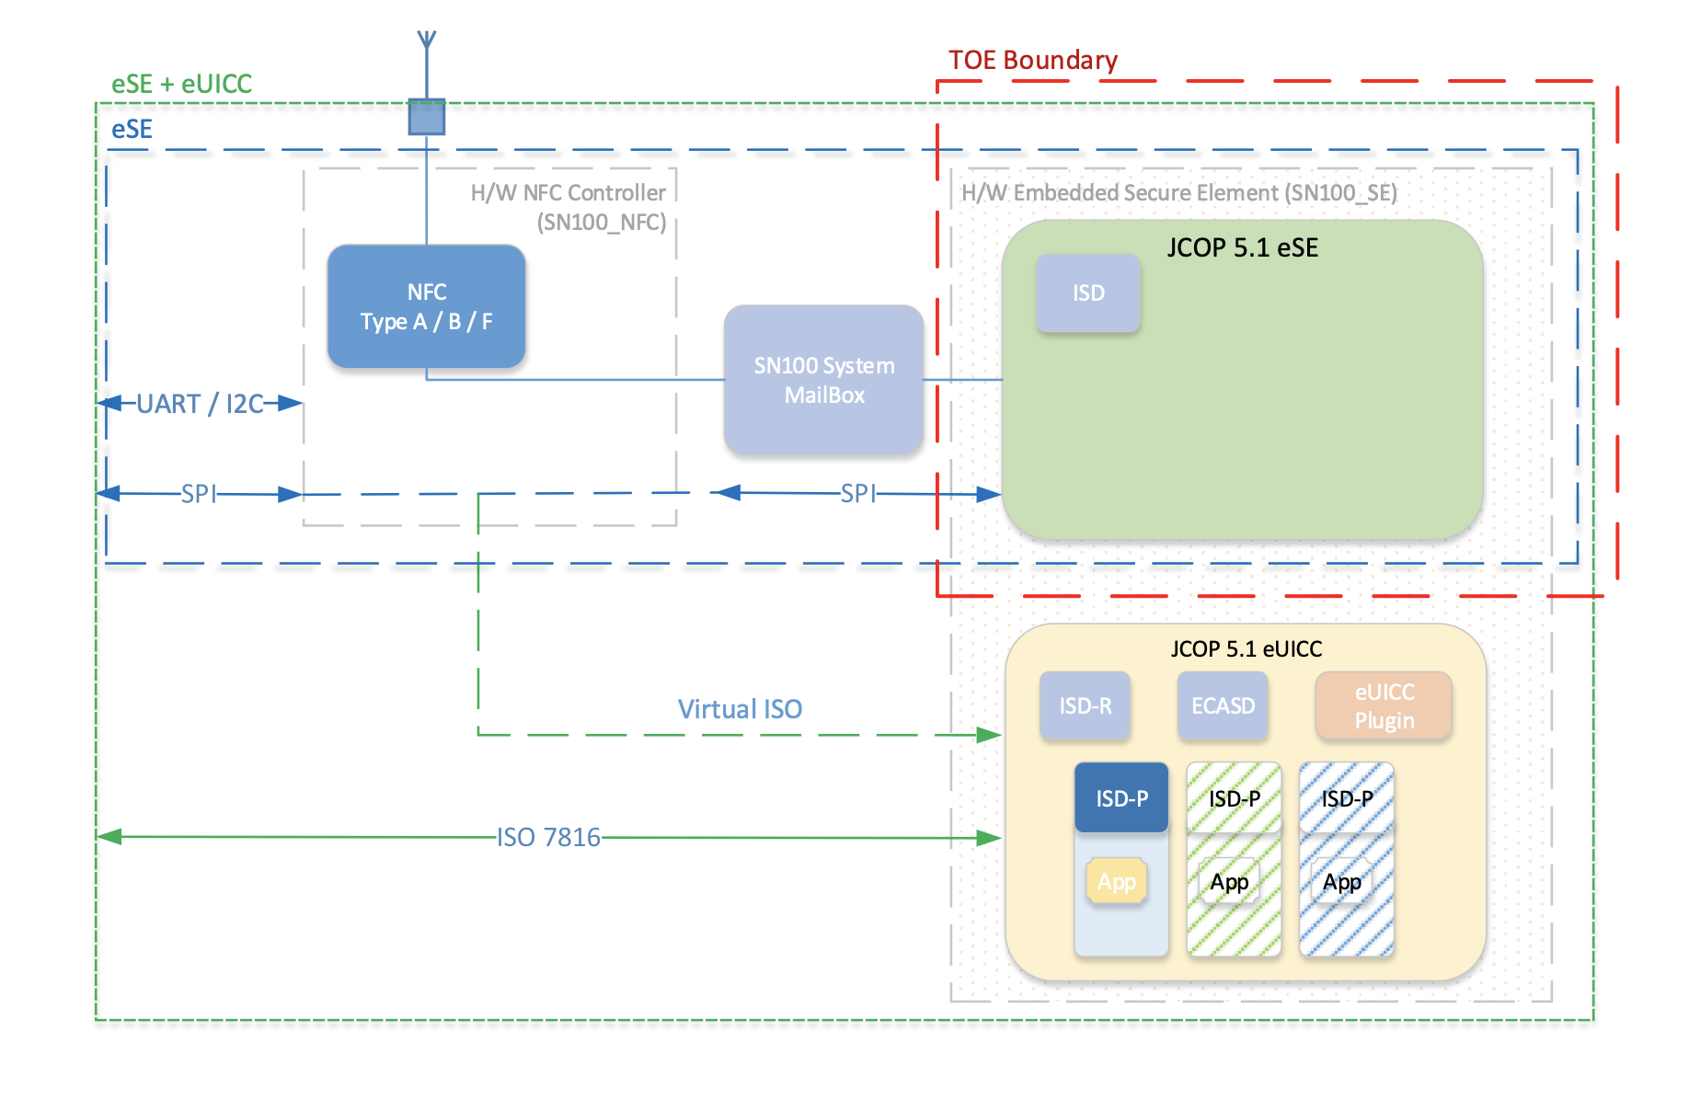
The NFC controller and system mailbox are not within the scope of the evaluation

Slide 4
Certificate details
Assurance Package: EAL5 augmented with AVA_VAN.5, ALC_DVS.2, ASE_TSS.2, ALC_FLR.1
Protection Profile Conformance: Java Card Protection Profile - Open Configuration, v 3.0.5 certified by BSI (GER)
StandardL Common Criteria for Information Technology Security Evaluation (CC) Version 3.1 Revision 5 (ISO/IEC 15408)
Certificate number: CC-19-221699-2
Project number: 221699
Evaluation facility: Brightsight BV, Delft, NE; Applying the Common Methodology for IT Security Evaluation (CEM) v 3.1 Revision 5 (ISO/IEC 18045)
Validity
1st issue: 30/04/2019, 2nd issue: 29/11/2019, Expiry: 30/04/2024

Slide 5
Security assumptions & scope
The assumptions defined in the Security Target are not covered by the TOE itself, the security objectives must be fulfilled by the TOE-environment
Proprietary applications such as FeliCa and Mifare API are included in the TOE, but there are no security claims for these applications in this certificate.

Slide 6
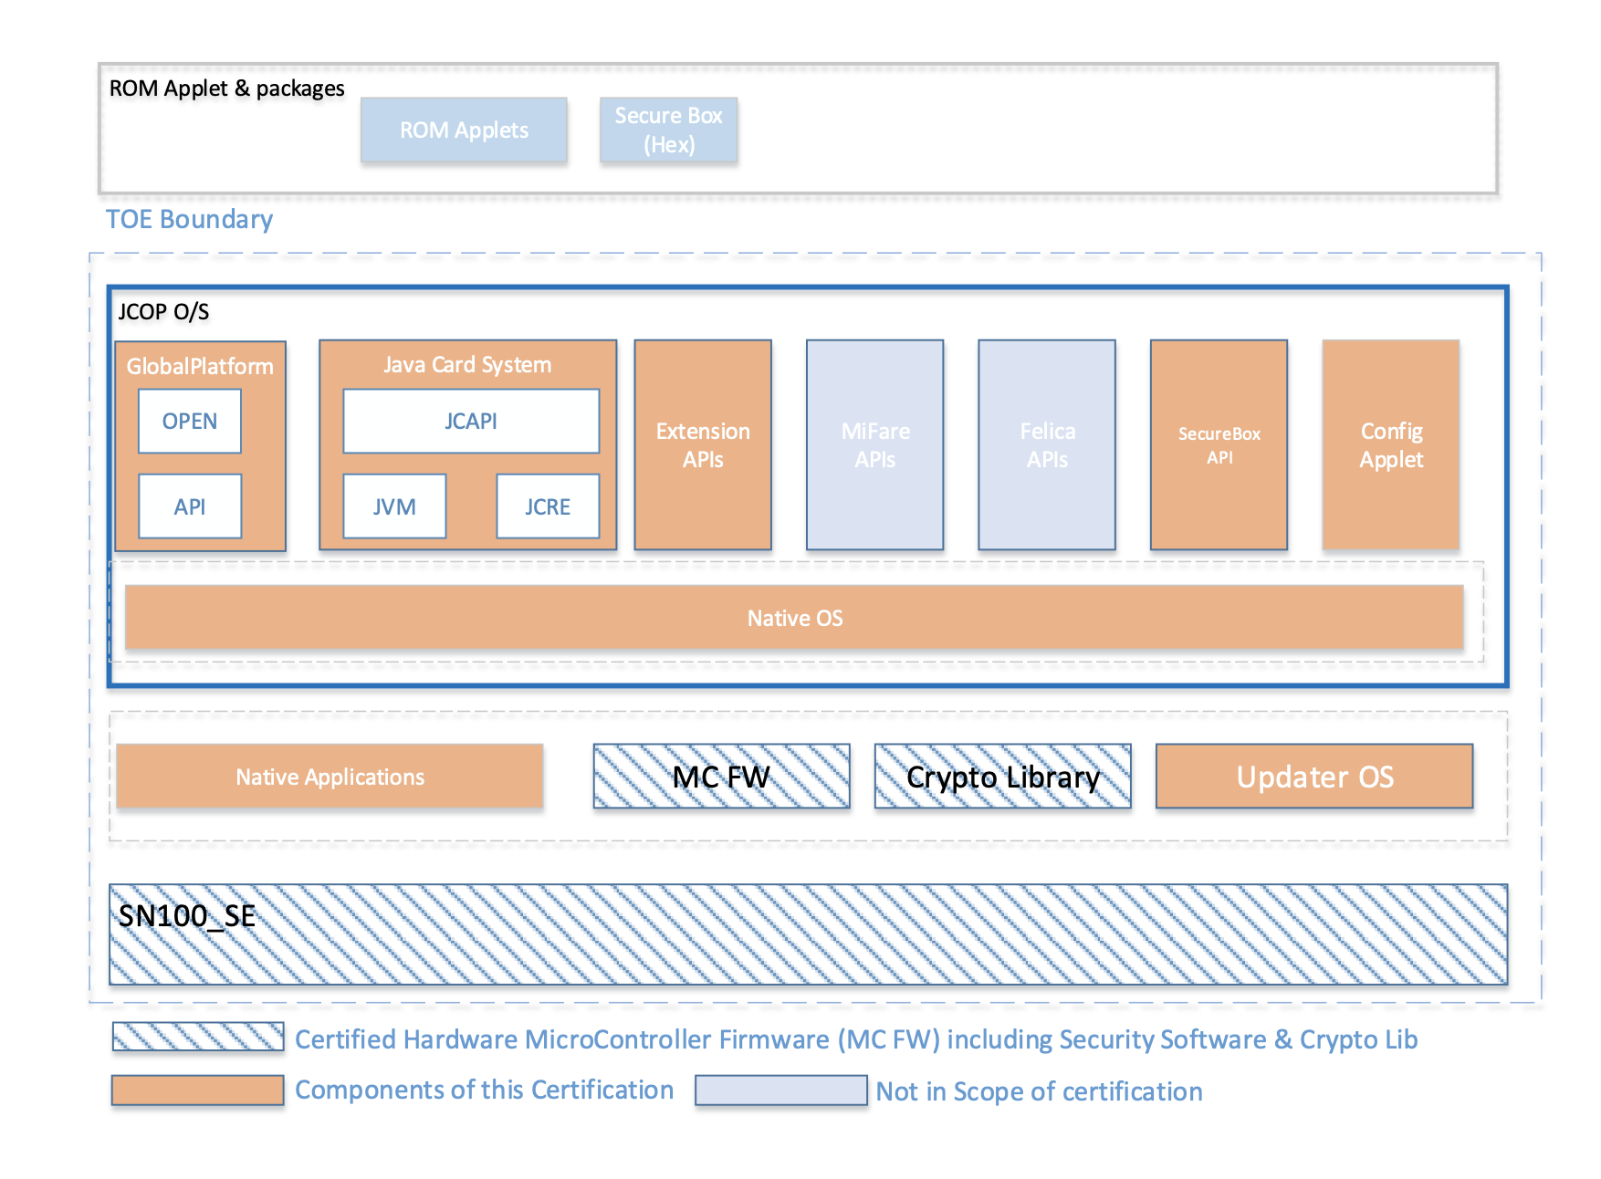

Slide 7
Conclusion and evaluation
Expected results, giving assurance that TOE behaves as specified.
No exploitable vulnerabilities have been found with the independent penetration tests.
Algorithmic security level of cryptographic functionality has not been rated in this certification process
Not all key sizes have sufficient cryptographic strength (AVA_VAN.5), but still more than 80 bits

Slide 8
Maintenance Report
The changes to the certified product are related to a minor change in naming of the TOE and additional platform manufacturing site, not impacting the security functionality of the certified product. The identification of the maintained product is modified to NXP JCOP 5.1 on SN100.C48 Secure Element.

