Slide 1
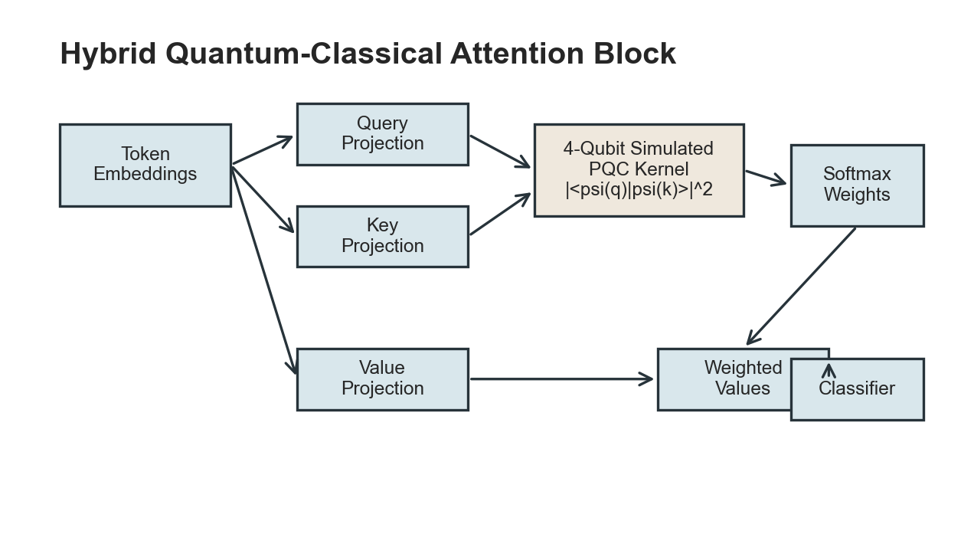
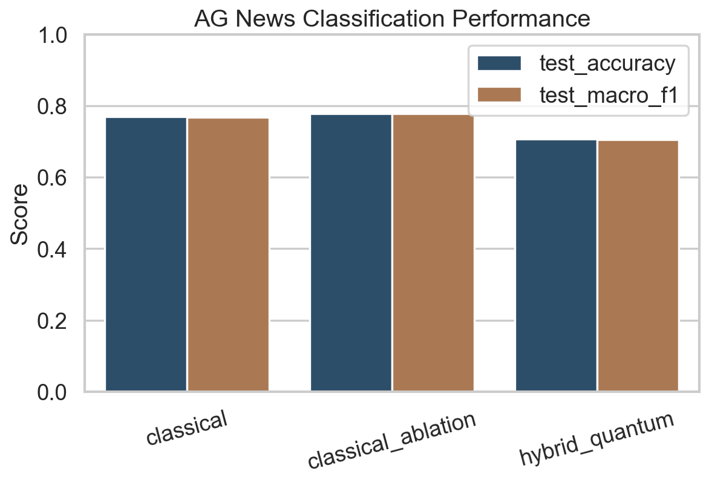
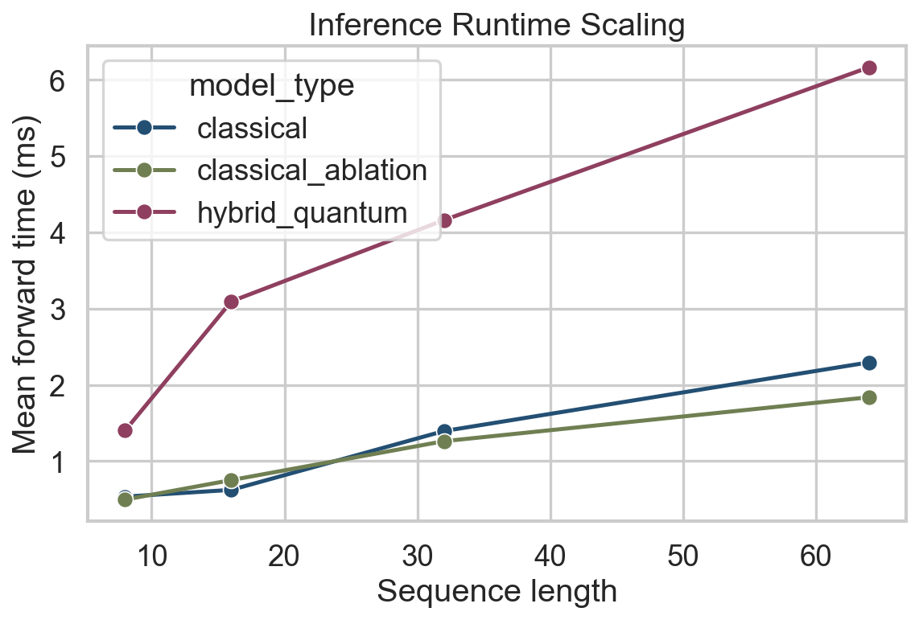
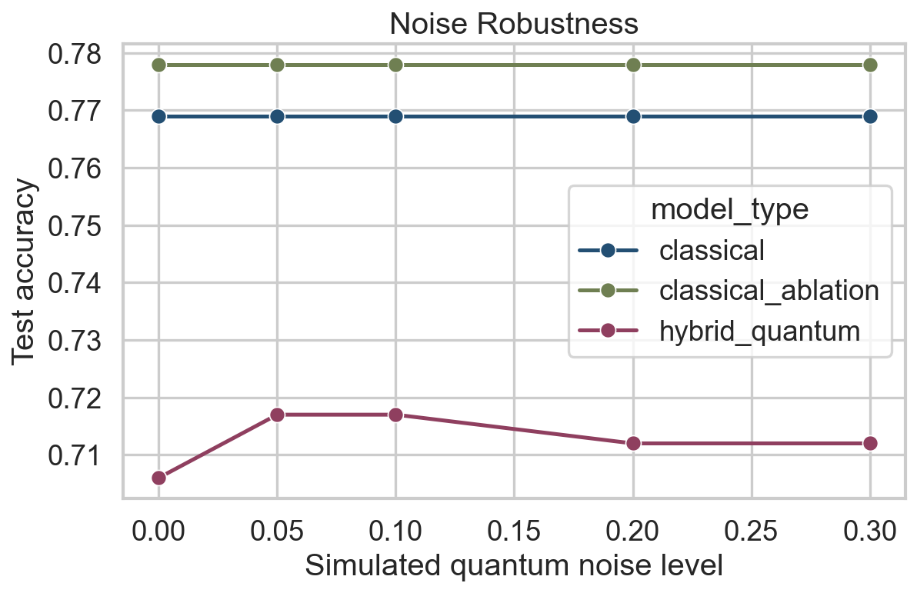
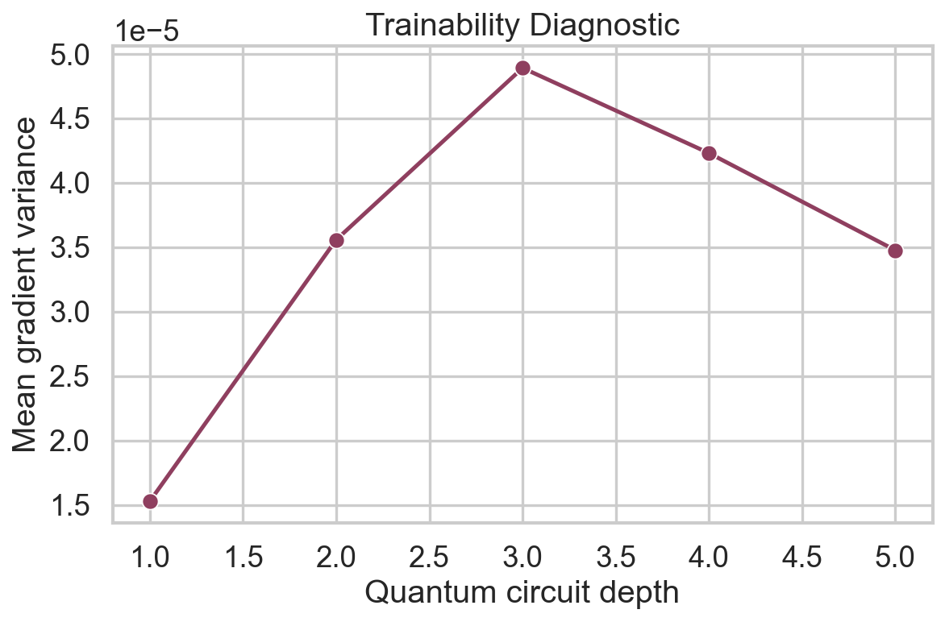
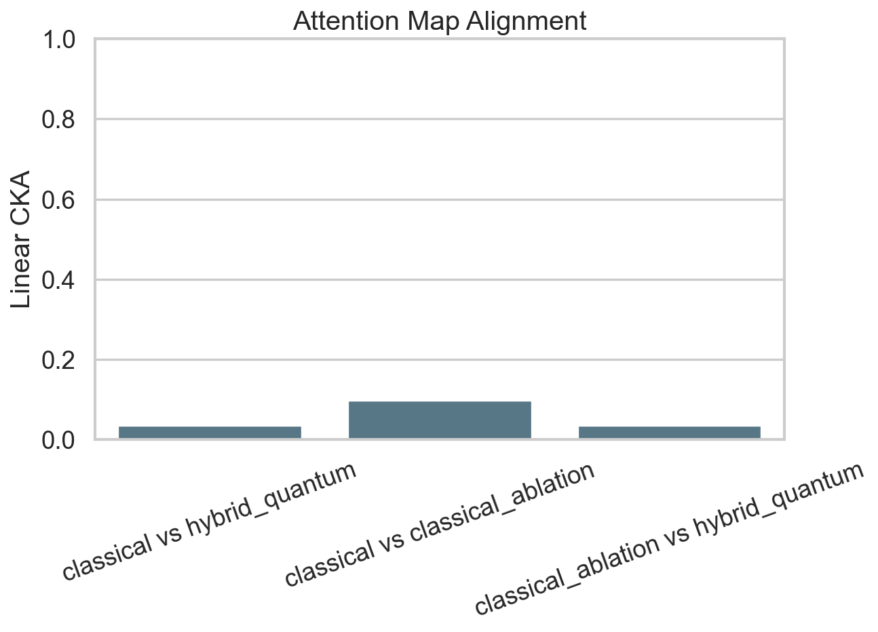
A Hybrid Quantum-Classical Attention Mechanism for Efficient LLMs
Ansh Malhotra and Smaran Kudapa | QLab Senior Research Project
Research Question Can a simulated quantum kernel replace only the query-key dot product while preserving useful attention behavior? Models Classical attention Matched low-dimensional ablation Hybrid four-qubit PQC kernel
Main Result Classical accuracy: 76.9% Hybrid accuracy: 70.6% Ablation accuracy: 77.8% At sequence length 32, the hybrid simulation took 2.99x the classical runtime.
Conclusion The hybrid block runs end-to-end, but classical state-vector simulation does not deliver speedup. The value is diagnostic: attention alignment, gradient variance, and noise response can now be measured cleanly.
Real metrics are generated by scripts/run_all.py and saved as CSV files in results/metrics/. Negative or mixed findings are reported directly.

