Slide 1
MCAT:
The Basics for Students
Prepared by AAMC
Presented by: <insert your name here>
Notes:
Welcome! Thanks so much for being here today to learn more about the process of applying to medical school and taking the MCAT exam.
Introduce yourself.
While I’m here to share my own knowledge and experience with the medical school admissions process, I’m also going to share some information from the Association of American Medical Colleges (AAMC)- that’s the organization that represents the medical schools in the United States and Canada. The MCAT program is a program of the AAMC. I have agreed to share the information about MCAT that they have provided. I may not know all the answers – if something comes up, I will tell you how to get in touch with staff from the MCAT program so that you can get answers to all of your questions.

Slide 2
Here’s what we’ll talk about:
  The MCAT is the Medical College Admission Test.
  Virtually all medical schools ask applicants for MCAT scores.
  There are lots of ways to learn about MCAT.
  There’s lots of available information on MCAT.
  The MCAT is changing in 2015 and what you’ll study for the current and 2015 exams is different.
Notes:
The MCAT is the Medical College Admission Test. It’s the test that medical school admissions committees use in student selection.
Virtually all medical schools ask applicants to submit MCAT scores.
There are lots of ways to learn about MCAT, and we’ll discuss many of them today.
There’s lots of available information about MCAT. We’ll talk about what MCAT tests and how you can prepare for it.
You’ve probably already heard that MCAT is changing in 2015. We’ll talk about what you need to study if you’re taking the current exam and what you’ll need to study if you’re taking the 2015 exam.

Slide 3
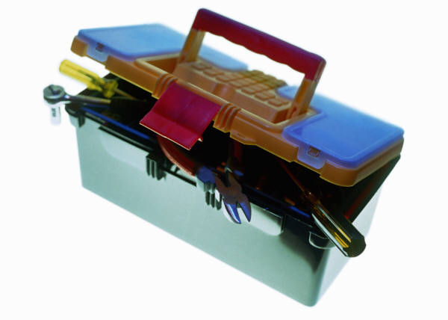
We’ll also talk about:
  Things you should know if you’re testing in 2013 or 2014
  Things you should know if you’re testing in 2015 or 2016
  Either way, there’s no “one-size-fits-all” approach to preparation
  Ways to plan ahead for preparation, MCAT registration, and medical school application
Notes:
We will discuss the things you should know if you’re testing in 2013 or 2014. And we’ll talk about the things you should know if you’re testing in 2015 or 2016. As I just mentioned, we’ll talk about how you can prepare for the current and new exams.
It’s important to know that whichever MCAT exam you take, there’s no “one-size-fits-all” approach to preparation. But there are ways to plan ahead for preparation, MCAT registration, and the medical school application process. We’ll discuss these later on.

Slide 4
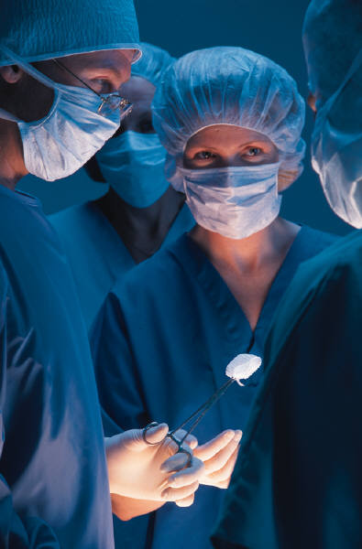
Virtually all medical schools ask for MCAT scores
  Virtually all of the 138 U.S. medical schools ask applicants for MCAT scores.
  11 of the Canadian medical school do.
  Medical schools select students using MCAT scores and other information about applicants’ academic and non-academic experiences.
Notes:
Virtually all of the 138 U.S. medical schools ask applicants to submit MCAT scores.
11 of the Canadian medical school do too.
Medical schools select students using MCAT scores and other information about applicants’ academic and non-academic experiences. In addition to MCAT, medical school admissions committees consider—
Undergraduate grades
The breadth and difficulty of your coursework
Your personal statements
Letters of recommendation
Lists of experiences
How well you do in interviews
And more
Admissions officers are looking for applicants with the right combination of academic competencies, attributes, and experiences. They want to use a range of data about their applicants to select students who have the potential to be great physicians and are a good fit with the institution's unique mission and goals.
MCAT is only one piece of information in this equation.

Slide 5
There are lots of ways to learn about the MCAT
  MCAT has a great website—www.aamc.org/mcat.
  There’s a good book about MCAT with sample questions—The Official Guide to the MCAT Exam.
  There’s a free practice test—www.e-mcat.com.
  The MCAT program sells additional practice tests too.
  And a diagnostic test to identify strengths and weaknesses—The Official MCAT Self Assessment Package—www.e-mcat.com.
Notes:
One of the best resources at your disposal is the MCAT website. In addition to the website, the MCAT program sells a great book, The Official Guide to the MCAT Exam, which includes additional details about the exam and sample test questions.
Also, you can get a free practice test at www.e-mcat.com, and additional practice tests are sold at this same location.
Another great tool is the Official MCAT Self Assessment Package, also at www.e-mcat.com, which is a diagnostic test to help you identify your strengths and weaknesses on the exam.

Slide 6
There are lots of ways to learn about the MCAT
  Your pre-health advisor knows a lot about the MCAT.
  Faculty at your school may too.
  Some universities offer MCAT preparation courses.
    Some medical schools do too.
  Some private companies also have MCAT preparation courses.
Notes:
Plus, don’t forget about the resources you already have at your disposal.
Your pre-health advisor knows a lot about MCAT, as do some of your professors.
Some universities offer MCAT preparation courses, as do some medical schools.
Additionally, some private companies also have MCAT preparation courses.

Slide 7
It’s easy to get information about the MCAT
  MCAT’s website describes:
    What the exam tests
    What the questions look like
    How your test will be scored
    The scores that different medical schools typically look for
    How you should register for the MCAT
    What to expect on test day
  www.aamc.org/mcat
Notes:
Here are the kinds of things you will see on MCAT’s website. It describes:
What the exam tests
What the questions look like
How your test will be scored
The score levels that different medical schools typically look for
How you should register for MCAT
What to expect on test day

Slide 8
It’s easy to get information about the MCAT
  You can ask MCAT staff questions by emailing mcat@aamc.org.
  There’s a phone number too—(202) 828-0690.
  The MCAT website also answers FAQs— https://www.aamc.org/students/applying/mcat/preparing/85556/preparing_prepfaq.html
Notes:
Of course, if the MCAT resources do not answer your questions, visit the FAQ section on the MCAT website or contact the MCAT staff directly by email or phone.

Slide 9
The MCAT is changing in 2015
  The MCAT is changing in 2015 to keep pace with recent changes in what medical faculty teach
  Changes in our increasingly diverse and aging population are altering what medical schools teach
  Changes in health care delivery and new scientific knowledge are too
  These changes are shaping what admissions committees look for in future physicians
Notes:
As you probably already know, MCAT is changing in 2015 to keep pace with recent changes in what medical faculty teach.
The shifts in our increasingly diverse and aging population are changing what medical school faculty teach. Changes in health care delivery systems and new scientific knowledge do too.
These changes are shaping what admissions committees and faculty look for in future physicians.

Slide 10
Whether you’ll take the current or new test depends on when you’ll be ready to test and apply
  Knowing when you’ll be ready to test and start medical school will help you decide whether to take the current or new test.
  The current MCAT exam tests concepts from introductory, year-long courses in biology, general chemistry, inorganic chemistry, and physics.
  The new exam tests these along with concepts from first-semester biochemistry, psychology, and sociology.
Notes:
Knowing when you’ll be ready to take the MCAT and start medical school will help you decide whether to take the current or new test.
The current MCAT will be administered in 2013 and 2014. It tests concepts from introductory, year-long courses in biology, general chemistry, inorganic chemistry, and physics.
The new exam will be administered for the first time in 2015. It will tests these concepts along with concepts from first-semester biochemistry, psychology, and sociology.
[NOTE--the current exam will be administered for the last time in January 2015. the new exam will first be administered in spring 2015. The reason the current exam will be given in January 2015 is January examinees typically include applicants who are on waiting lists for entry to medical school that calendar year.]

Slide 11
Whether you’ll take the current or new test depends on when you’ll be ready to test and apply
  Applicants who want to start medical school in 2014 and 2015 will take the current MCAT exam.
  Most applicants who want to start school in 2016 and 2017 will take the new MCAT exam.
    Note: medical schools will also accept current MCAT scores for 2016 and 2017 admission.
Notes:
Before you know how to prepare, you’ll need to know which MCAT exam you’ll take.
Applicants who want to start medical school in 2014 and 2015 will take the current MCAT.
Most applicants who want to start medical school in 2016 and 2017 will take the new MCAT, MCAT²⁰¹⁵.
Note: medical schools will also accept current MCAT scores for 2016 and 2017 admission.

Slide 12
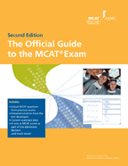
The Official Guide describes the 2013 and 2014 exams
Notes:
The Official Guide to the MCAT Exam describes the current test.
Everything we’ll talk about today is in the guide.
The guide includes over 100 sample questions for the 2013 and 2014 exam.

Slide 13
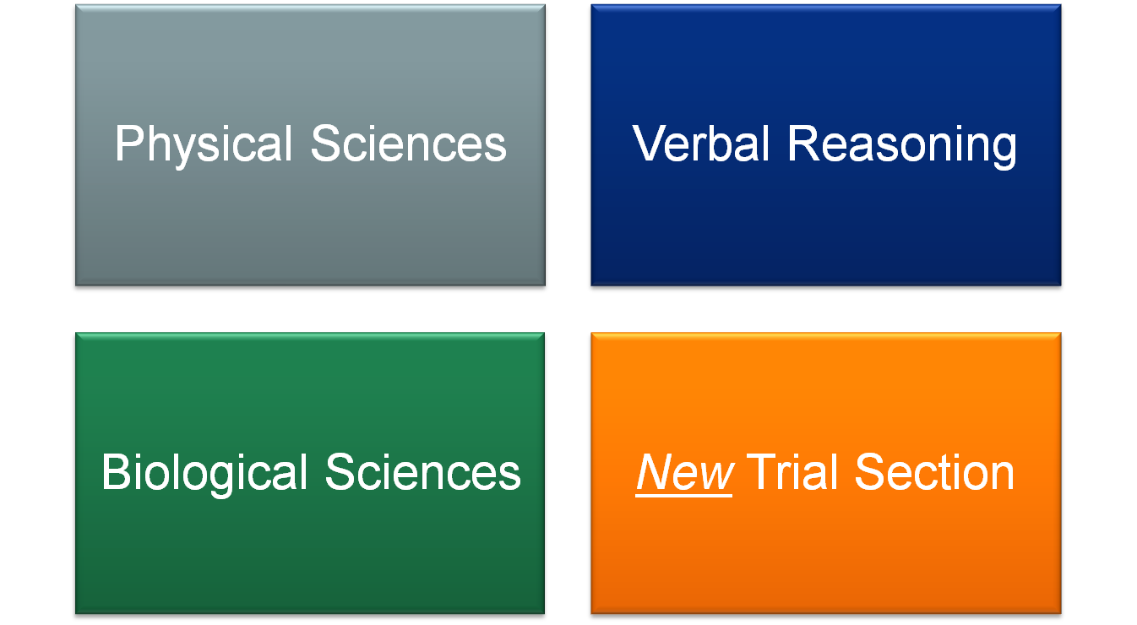
If you’re testing in 2013 or 2014
Notes:
The current exam includes three sections and reports three scores. They are:
Physical Sciences
Verbal Reasoning
Biological Sciences
The current exam also includes a new trial section. We’ll talk more about this in a second.

Slide 14
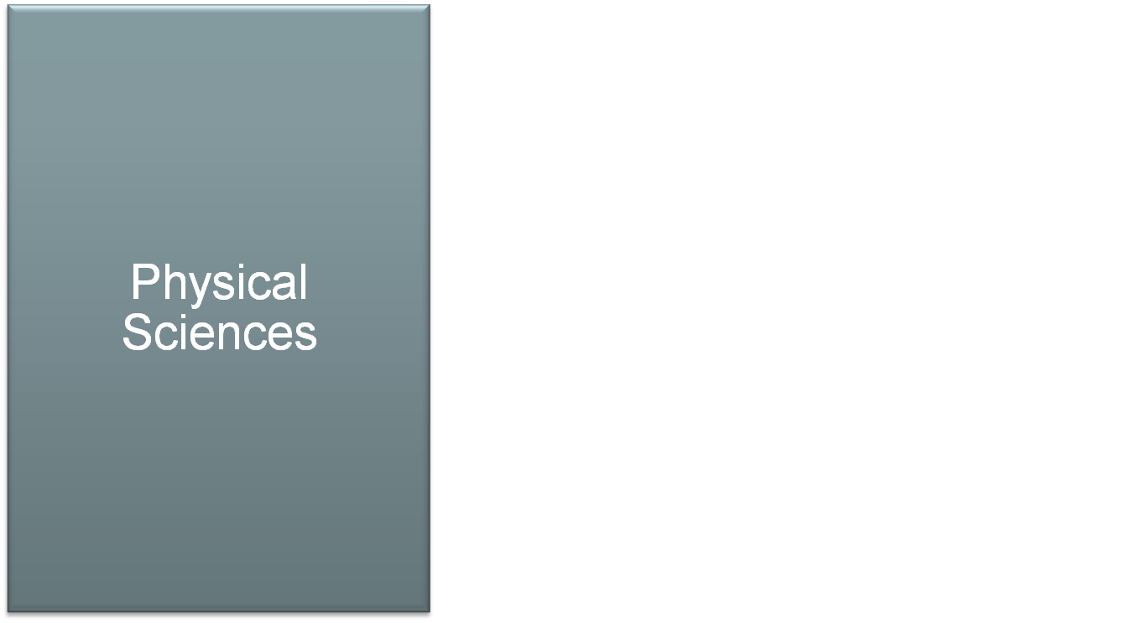
If you’re testing in 2013 or 2014
Tests general chemistry and physics topics including:
    Electronic structure
    Phases and phase equilibria
    Thermochemistry
    Acids and bases
    Work and energy
    Fluids and solids
    And more
Notes:
The Physical Sciences exam tests introductory-level knowledge of physics and general (inorganic) chemistry concepts and the application of these concepts to solving scientific problems.
Examples of the topics it tests are:
Electronic structure
Phases and phase equilibria
Thermochemistry
Acids and bases
Work and energy
Fluids and solids
And more

Slide 15
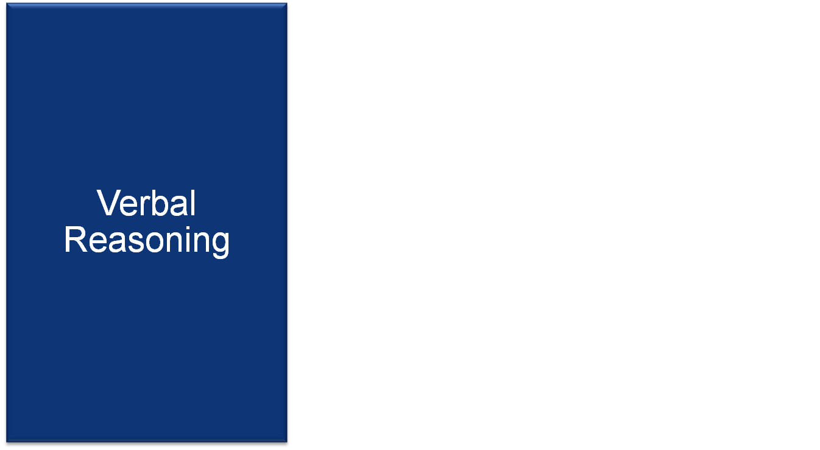
If you’re testing in 2013 or 2014
Tests comprehension, evaluation, and application skills using passages from:
    Humanities
    Social sciences
    Natural sciences and technology
All needed information appears in the passages
Notes:
The Verbal Reasoning exam tests your understanding, evaluation, and application of information and arguments presented in passages drawn from the Natural Sciences, Social Sciences, and Humanities.
All of the information you need to answer Verbal Reasoning questions will appear in the passages.

Slide 16

If you’re testing in 2013 or 2014
Tests biology and organic chemistry topics including:
    Enzymes and metabolism
    Body systems
    Molecular structure
    Oxygen-containing compounds
    Biological molecules
    And more
Notes:
The Biological Sciences section tests introductory-level knowledge of biology and organic chemistry concepts and the application of these concepts to solving scientific problems.
Examples of the topics it tests are:
Enzymes and metabolism
Body systems
Molecular structure
Oxygen-containing compounds
Biological molecules
And more

Slide 17

If you’re testing in 2013 or 2014
  Unlike past examinees, you won’t take the MCAT Writing Sample.
  Instead, you’ll be asked to volunteer to test out questions for MCAT²⁰¹⁵.
  Building the new exam will take lots of questions, and medical schools can’t get there without your help.
Notes:
Unlike last year’s examinees, 2013 examinees will not take the Writing Sample section of the MCAT exam.
The Writing Sample section was removed from the exam to make room for a trial section.
The trial section of the 2013 exam is a voluntary section of the exam that asks you to test out questions for a future version of the MCAT exam.
As you might guess, building the 2015 exam will call for lots of new test questions, and the medical schools can’t get there without your help.
Medical schools would like your help in building the next version of the MCAT exam by answering the questions in the trial section.

Slide 18
If you’re testing in 2013 or 2014
  The trial section will be at the end of the day and take 45 minutes (so the day will be shorter than in the past).
  You will get 32 questions in subjects you said you completed during MCAT registration.
  Question will cover biochemistry or psychology, or sociology concepts.
Notes:
The trial section will be the last section of the test day and will take 45 minutes to complete.
Instead of writing MCAT essays, the MCAT program is asking you to try out 32 new questions in biochemistry or psychology or sociology.
MCAT staff will choose questions for you using the answers you provided during the MCAT registration process about the courses you’ve already taken.
Note: they will try not to give you questions on the subjects that you haven’t taken.

Slide 19
If you’re testing in 2013 or 2014
  Your work on the trial questions will not count toward your MCAT scores (only you will see how you did).
  If you volunteer and make a good-faith effort, you will get a $30 Amazon gift card.
  You’ll also receive feedback that lets you compare yourself to others.
Notes:
You don’t have to worry about not doing well. No one will know how well you did but you – not the medical schools or your advisor.
Your answers will not contribute to your MCAT scores in any way.
If you volunteer to participate and put forth a good-faith effort, you’ll receive:
A $30 Amazon gift card gift card code e-mailed to you within 3-4 weeks
Feedback on your performance that allows you to compare yourself to others who participate in the trial

Slide 20
If you’re testing in 2013 or 2014
  You’ll also get a chance to preview content medical schools find important.
  Volunteer and help medical schools select students who will be great colleagues for you and great health care providers!
Notes:
You’ll also have an opportunity to preview content that medical schools find important.
Also, the test day will still be shorter for you than it was for last year’s examinees.
Please volunteer for the Trial Section.
Medical schools will use the MCAT²⁰¹⁵ exam to select the first-year students who’ll join you when you’re a seasoned medical student.
Please help the medical schools select students who will be great colleagues for you and the next generation of health care providers.

Slide 21
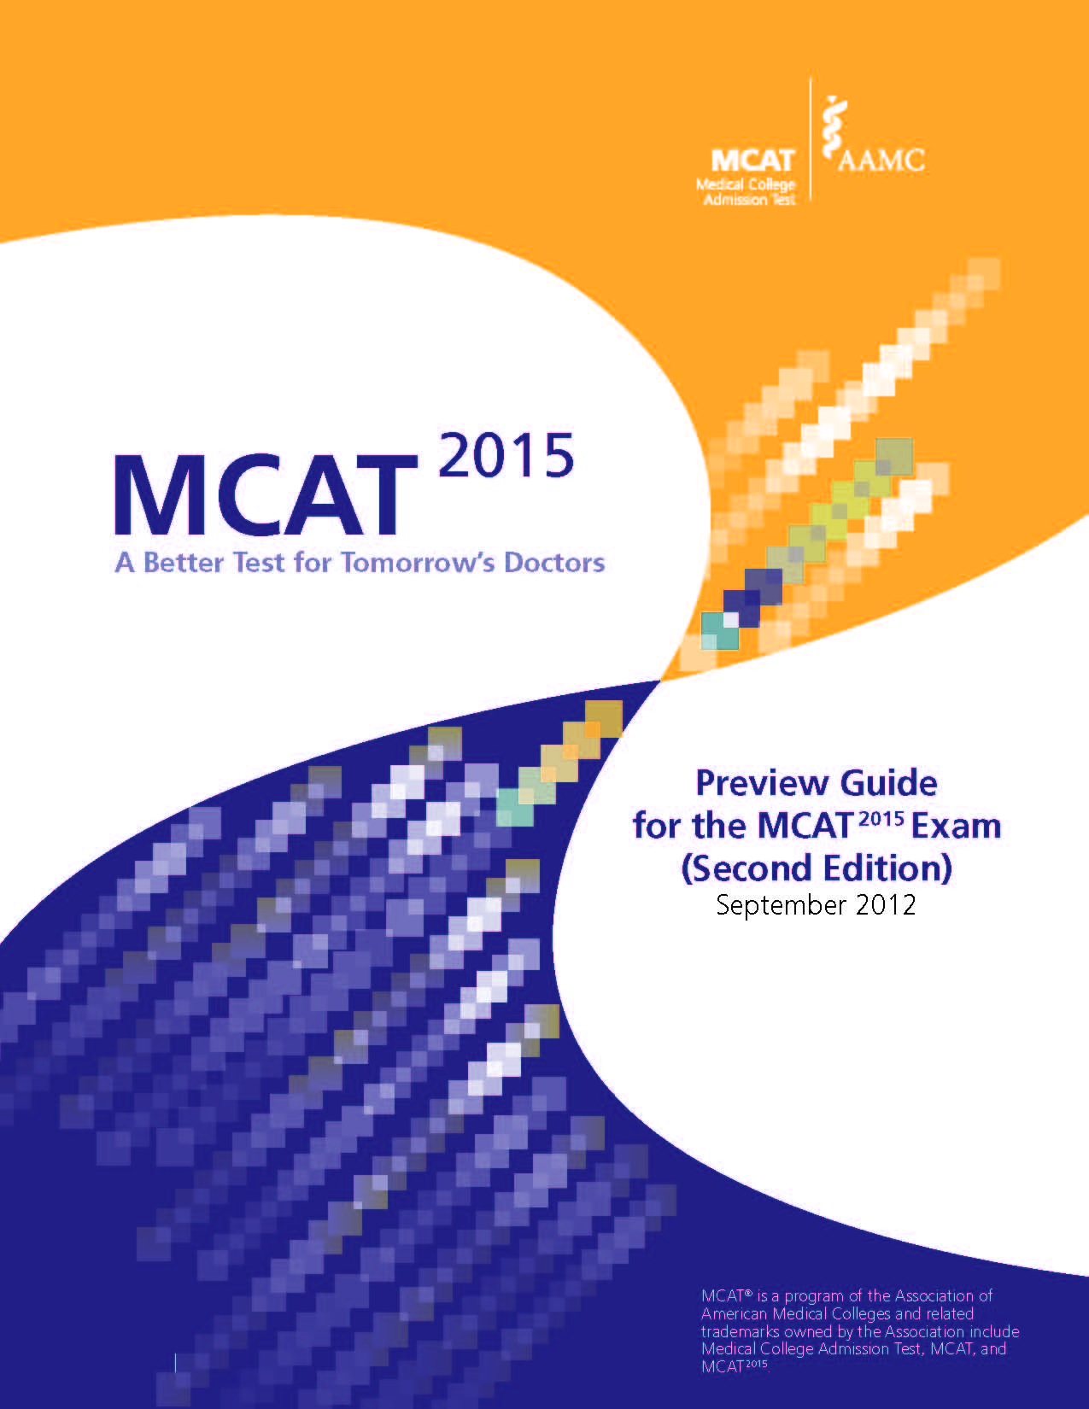
The Preview Guide describes the 2015 and 2016 tests
Notes:
The Preview Guide for the MCAT²⁰¹⁵ Exam (Second Edition) describes the new test.
Everything we’ll talk about today is in the guide.
The guide includes almost 100 sample questions for the 2015 and 2016 exam.
You can get a free copy from the MCAT website
www.aamc.org/mcat2015

Slide 22
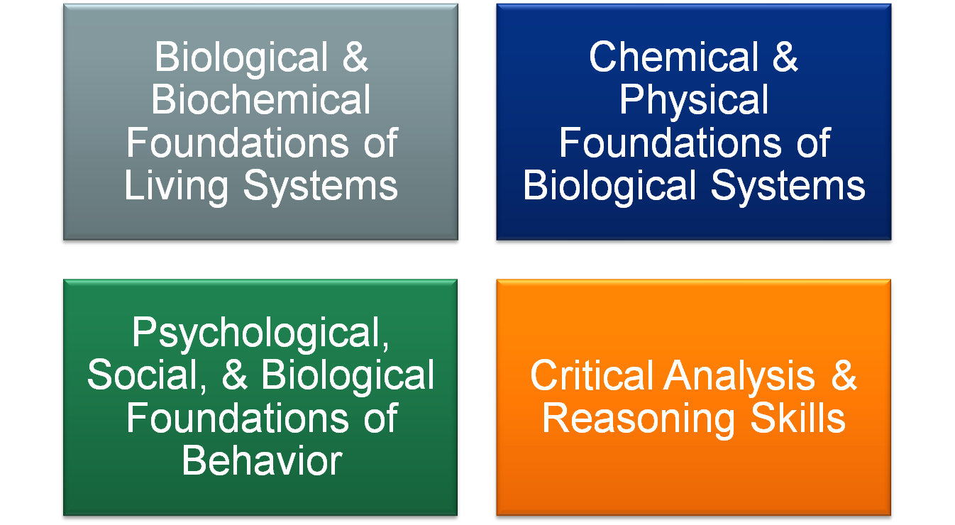
If you’re testing in 2015 or 2016
Notes:
The MCAT²⁰¹⁵ exam includes 4 sections and will report 4 scores. It tests:
Biological and Biochemical Foundations of Living Systems
Chemical and Physical Foundations of Biological Systems,
Psychological, Social, and Biological Foundations of Behavior, and
Critical Analysis and Reasoning Skills.

Slide 23

Chemical & Physical
Foundations of Biological Systems
  Asks you to combine your knowledge of foundational concepts in the chemical and physical sciences with your scientific inquiry, reasoning, and research and statistics skills to solve problems that demonstrate readiness for medical school
Notes:
The Chemical and Physical Foundations of Biological Systems section asks you to combine your knowledge of foundational concepts in the chemical and physical sciences with your scientific inquiry, reasoning, and research and statistics skills to solve problems that demonstrate readiness for medical school.

Slide 24
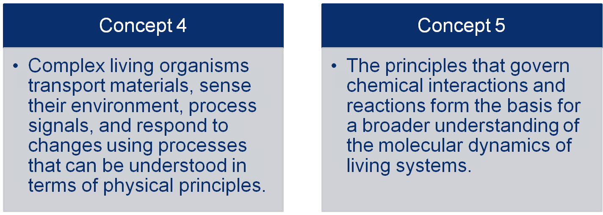
Chemical & Physical
Foundations of Biological Systems
Notes:
It is organized around two foundational concepts—or ‘big ideas’ in the sciences--that focus on chemical and physical processes that affect living systems.
The new MCAT²⁰¹⁵ Exam is organized around related Foundational Concepts—like the concepts shown on this slide—rather than organized around disciplines.
The first says: Complex living organisms transport materials, sense their environment, process signals, and respond to changes using processes that can be understood in terms of physical principles
And the second foundational concepts says: The principles that govern chemical interactions and reactions form the basis for a broader understanding of the molecular dynamics of living systems.
Again, the topics that you need to know in order to understand these concepts come from introductory biology, chemistry, and physics and first-semester biochemistry.

Slide 25

Critical Analysis & Reasoning Skills
  Asks you to critically analyze, evaluate, and apply information presented in a passages from humanities and social sciences disciplines, including ethics, philosophy, cultural studies and population health
  All needed information will appear in the passages
Notes:
The Critical Analysis and Reasoning Skills section asks you to critically analyze, evaluate, and apply information presented in a passages from humanities and social sciences disciplines, including ethics, philosophy, cultural studies and population health
It is different from the other sections of the exam because specific content knowledge is not needed. All the information you need to perform well is included in the passage and associated items.

Slide 26

Biological & Biochemical
Foundations of
Living Systems
Asks you to combine knowledge of foundational concepts in the biological and biochemical sciences with your scientific inquiry, reasoning, and research and statistics skills to solve problems that demonstrate readiness for medical school.
Notes:
The Biological and Biochemical Foundations of Living Systems Section asks you to combine knowledge of foundational concepts in the biological and biochemical sciences with your scientific inquiry, reasoning, and research and statistics skills to solve problems that demonstrate readiness for medical school.

Slide 27
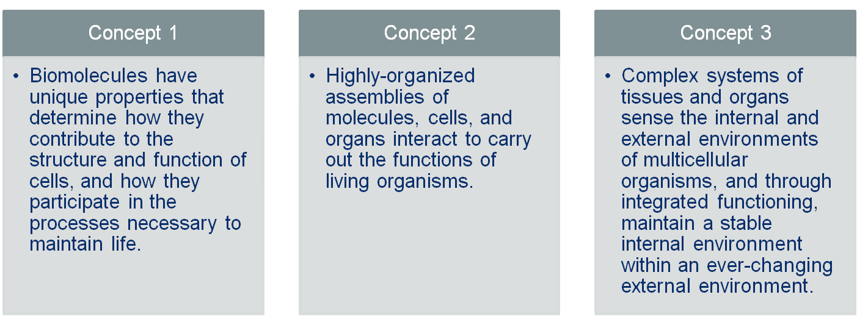
Biological & Biochemical
Foundations of
Living Systems
Notes:
This section is organized around three foundational concepts that focus on processes unique to living organisms, such as:
growing and reproducing
maintaining a constant internal environment
acquiring materials and energy

Slide 28

Psychological, Social, & Biological Foundations of Behavior
  Tests knowledge and use of the concepts in psychology, sociology, biology, research methods, and statistics that provide a solid foundation for learning in medical school about the behavioral and socio-cultural determinants of health and health outcomes
Notes:
The Psychological, Social and Biological Foundations of Behavior tests your knowledge and use of the concepts in psychology, sociology, biology, research methods, and statistics that provide a solid foundation for learning in medical school about the behavioral and socio-cultural determinants of health and health outcomes

Slide 29
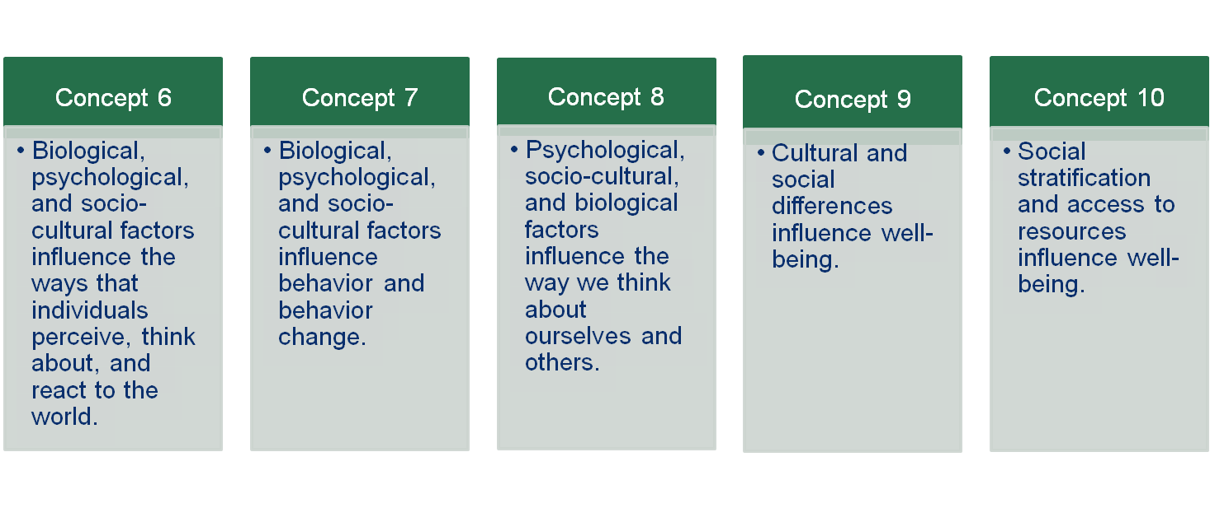
Psychological, Social, & Biological Foundations of Behavior
Notes:
It is organized around five Foundational Concepts that ask you to demonstrate knowledge of the ways in which psychological, social, and biological factors influence:
perceptions and reactions to the world,
behavior and behavior change, and
what people think about themselves and others.
In addition, it also tests:
knowledge of the cultural and social differences that influence well-being, and
the relationships between social stratification, access to resources, and well-being.

Slide 30
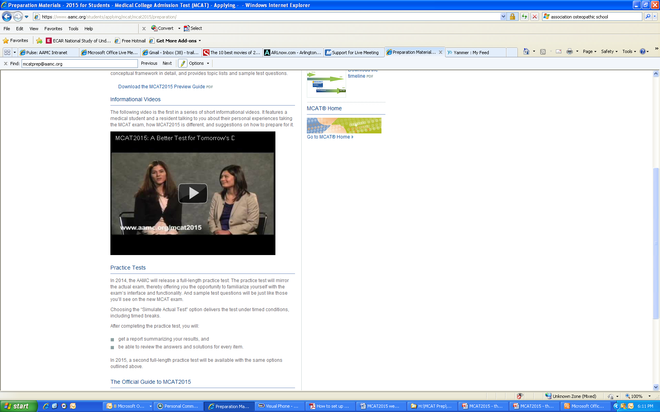
Learn more by watching this video
www.aamc.org/mcat2015
Notes:
We’ve already talked about the Preview Guide for the MCAT²⁰¹⁵ – this is the best place to start learning more today.
This video and others on the MCAT website are also a good way to get an overview. Find them at www.aamc.org/mcat2015.

Slide 31
There’s no “one-size-fits-all” preparation approach
Know yourself and prepare for whichever MCAT you take in the way that suits you best:
  Understand your likely strengths and weaknesses on the MCAT
  Know how you like to prepare
    Using your own plan or with the structure of a course
    Alone or with a study group
    By taking a couple (or many) practice exams
Notes:
No matter which version of the exam you take, it’s important to know that there’s no ‘one-size-fits-all’ approach to MCAT preparation.
You should know yourself and prepare for whichever MCAT you take in the way that suits you best:
Understand your likely strengths and weaknesses on the MCAT Exam
Know how you like to prepare
Using your own plan or with the structure of a course
Alone or with a study group
By taking a couple (or many) practice exams

Slide 32

Plan ahead for preparation, registration, and application
  Give yourself plenty of time for test preparation
  Register early for the exam so you—
    Get the testing date and location you want (registration opens in October)
    Have time to retest if you don’t like your first scores
    Can submit your medical school applications on time
Notes:
You should also plan ahead so you have plenty of time to organize yourself for the exam.
Give yourself plenty of time for test preparation
Register early for the exam so you—
Get the testing date and location you want (registration opens in October)
Have time to retest if you don’t like your first scores
Can submit your medical school applications on time

Slide 33
Apply for fee assistance if you need it
2013 Benefits:
  Fee reduction for MCAT $100
  14 free AMCAS applications
  Free copy of Official Guide to the
  MCAT Exam and Medical School Admissions Requirements (MSAR) tool®
For families at or below 300% of poverty level
Application released in January each year
Online application
    www.aamc.org/fap
Notes:
AAMC is committed to ensuring that the costs of testing and applying to medical school are not a barrier. The Fee Assistance Program (FAP) offers assistance to examinees whose total family income is 300 percent or less of the poverty level for their family size. Benefits include:
Reduced Registration Fee ($100 instead of $270)
A free copy of The Official Guide to the MCAT Exam and other preparation products
FAP recipients also get benefits when they apply to medical school.

Slide 34
Plan ahead for preparation, registration, and application
  Be organized on test day—
    Know where the testing center is and how long it will take you to get there
    Have the right ID with you
    Bring something to eat and drink during breaks
    Dress in layers in case the center’s cold (or hot)
Planning ahead will (or may!) make the test day less stressful
Notes:
Make sure that you’re organized on test day—
Know where the testing center is and how long it will take you to get there
Have the right ID with you
Bring something to eat and drink during breaks
Dress in layers in case the center’s cold (or hot)
Planning ahead will (or may) make the test day less stressful

Slide 35

I wish you the best of luck!
Questions?
Notes:
I wish you the best of luck on the exam and in the application process, and I’m happy to answer your questions.

