Slide 1
TRAINING PHYSICIAN-SCIENTISTS MD-PhD: Is it the right choice for me?
Training & Career Paths
Application Process
Olaf S. Andersen, MD Director Weill Cornell/Rockefeller/Sloan-Kettering Tri-Institutional MD-PhD Program
Johns Hopkins University
November 4, 2013

Slide 2
Olaf Sparre Andersen
MD University of Copenhagen 1971
Post-doc University of Copenhagen 1971-1972
The Rockefeller University 1972-1973
Faculty Weill Medical College of Cornell University 1973 - present
(Cornell University Medical College)
Current & recent Professor of Physiology & Biophysics
activities and of Biochemistry & Structural Biology
Director,
Weill Cornell/Rockefeller/Sloan-Kettering
Tri-Institutional MD-PhD Program
Editor-Emeritus, The Journal of General Physiology
Research Molecular physiology of ion channels
interests Membrane protein-lipid bilayer interactions

Slide 3
MD-PhD Training
OVERVIEW
HISTORY OF MD-PhD TRAINING
MD-PhD TRAINING
OUTCOMES
APPLICATION PROCESS

Slide 4
MD-PhD Training
OVERVIEW
HISTORY OF MD-PhD TRAINING
MD-PhD TRAINING
OUTCOMES
APPLICATION PROCESS

Slide 5
MD-PhD Training
The goal of MD-PhD training programs is to educate and train physician-scientists, who are prepared to bridge the gap between clinical medicine and laboratory research, which is brought about by technological developments and specialization in both fields.
Graduates of MD-PhD programs are prepared to be leaders in all aspects of modern biomedical research and academic medicine:
RESEARCH:
Basic Research
Disease-Oriented Research (aka Translational Research)
Patient-Oriented Research
Population-Oriented Research
CLINICAL MEDICINE
Generalist Specialist
TEACHING:
Basic Science
Clinical Disciplines

Slide 6
MD-PhD Training
Science
Medicine
Physician-scientists tend to work at the
intersection of science and medicine

Slide 7
Pathways to become a Physician-Scientist or Clinical Investigator
Physician- Scientist
MD-PhD
College Student
MD
Clinical Research
PhD

Slide 8
MD-PhD Training
OVERVIEW
HISTORY OF MD-PhD TRAINING
MD-PhD TRAINING
OUTCOMES
APPLICATION PROCESS

Slide 9
MD-PhD Training
1956 CWRU (Structured MD-PhD training)
1964 NYU, AECOM & NWU (NIH MSTP support)

Slide 10
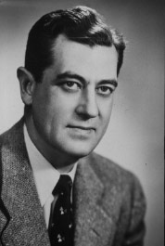
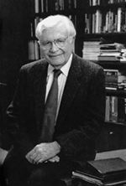
MD-PhD Training
Medical Scientist Training Program (MSTP)
James Shannon, MD Director, NIH (1955-68)
Saul J. Farber, MD Acting Dean, NYU (1963-66)

Slide 11
MD-PhD Training
1956 CWRU (Structured MD-PhD training)
1964 NYU, AECOM & NWU (NIH MSTP support)
1985 – present National MD-PhD Student Conference
1995 – present National Association of MD-PhD Programs
2004 – present AAMC/GREAT MD-PhD Section
1965 4 Programs (1 non-MSTP, 3 MSTP)
2013 ~100 Programs (44 MSTP, ~60 non-MSTP) ~5,100 MD-PhD students

Slide 12
MD-PhD Training
OVERVIEW
HISTORY OF MD-PhD TRAINING
MD-PhD TRAINING
OUTCOMES
APPLICATION PROCESS

Slide 13
MD-PhD Training
The mission of the physician-scientist is to promote better health and enhance the quality of life by reducing disability and death from disease.
In order to promote health, it is necessary to understand not only normal body function but also how, and why, disease develops.
You need to know how our genes (and gene products) interact among each other and with the environment – in health, in disease.

Slide 14
MD-PhD Training
Environment ⎢ ⎡ THE WHOLE BODY ⎢ ⎡ Organ Systems ⎢ ⎡ Tissues ⎢ ⎡ Cells ⎢ ⎡ Subcellular Organelles ⎢ ⎡ Molecules

Slide 15
MD-PhD Training
CYSTIC FIBROSIS
Genetic defect in Cl⁻ secretion across the luminal membrane of epithelia of exocrine glands, intestine, and airways
Molecular defect: mutation in an ATP-dependent chloride channel (cystic fibrosis transmembrane conductance regulator = CFTR)
Mutant CFTR is improperly processed in the endoplasmic reticulum and CFTR does not get inserted into the luminal plasma membrane
Cystic Fibrosis is fatal, but lack of CFTR does not affect isolated epithelial cells
It is only when the cells are organized into secretory epithelia that the defective Cl⁻ secretion becomes a problem
THE MOLECULAR DEFECT IS LETHAL TO THE WHOLE BODY, BUT HAS LITTLE IF ANY CONSEQUENCE FOR THE INDIVIDUAL CELL
THE SEVERITY OF THE DISEASE VARIES CONSIDERABLY AMONG PEOPLE WITH THE SAME GENETIC DEFECT

Slide 16
MD-PhD Training
What?
How?
Why?

Slide 17
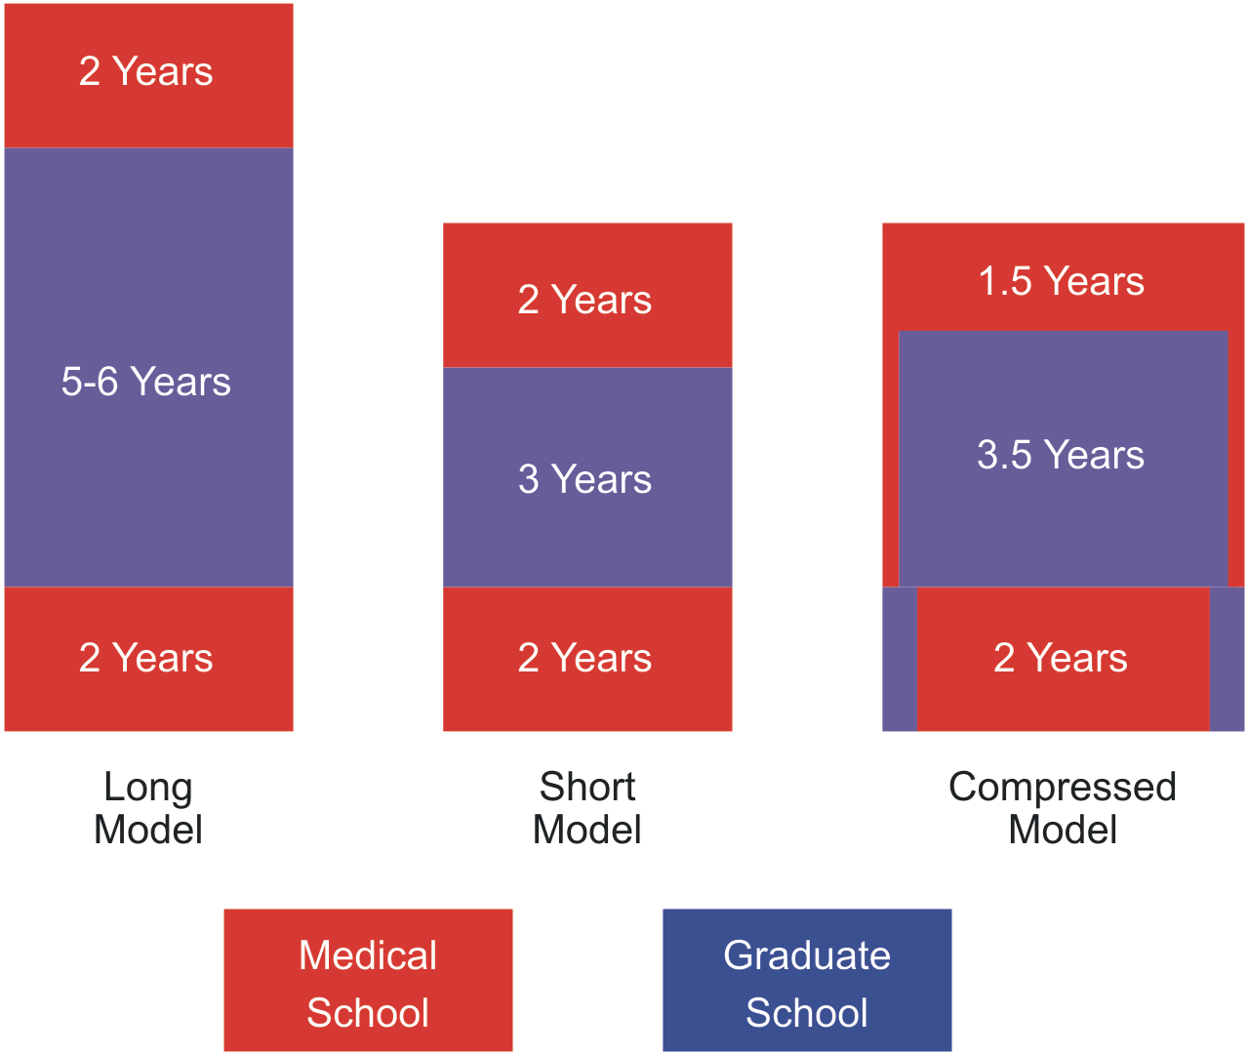
MD-PhD Training
Models for MD-PhD Programs

Slide 18
MD-PhD Training
Principles Guiding the Development of MD-PhD Training Programs
MD-PhD Students are Human
(they should not remain in training forever)
The question is not: what would we like our students to know?
The question is: what MUST they know?

Slide 19
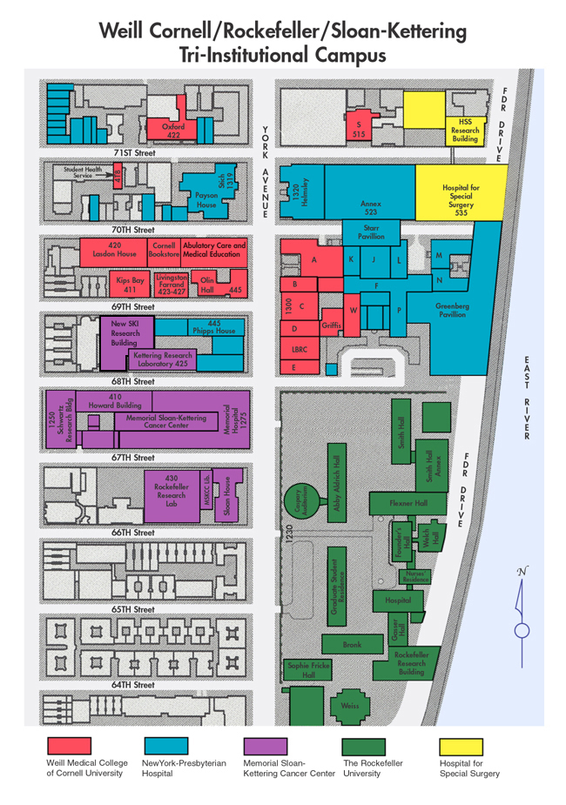
Weill Cornell/Rockefeller/Sloan-Kettering Tri-Institutional MD-PhD Program
☺

Slide 20
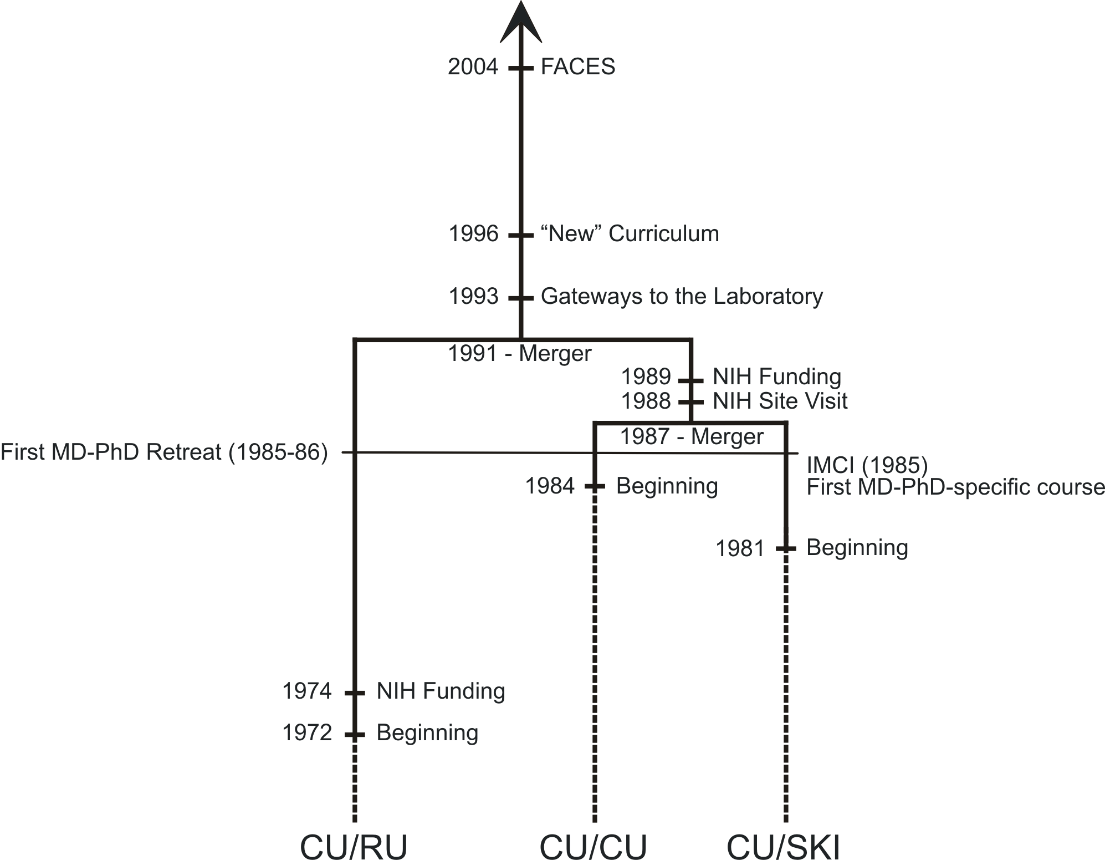
Weill Cornell/Rockefeller/Sloan-Kettering Tri-Institutional MD-PhD Program

Slide 21
Weill Cornell/Rockefeller/Sloan-Kettering Tri-Institutional MD-PhD Program
The New Weill Cornell Curriculum I
An integrated design spanning four years, where:
Science is the foundation of modern medicine
The patient is the center of everything we do
Physicianship is the essence of professionalism and clinical skills
Basic sciences will be presented and learned in a clinical context.
Normal and abnormal biology will be integrated and learned concurrently.
Multiple learning formats, including both traditional and innovative approaches: e-learning, flipped classrooms, skill sessions, clinical reasoning, problem-based learning seminars, laboratories, journal club, lectures, service learning, and others.

Slide 22
Weill Cornell/Rockefeller/Sloan-Kettering Tri-Institutional MD-PhD Program
The New Weill Cornell Curriculum II
First Course (August-December of M1): Fundamental Principles of Medicine
Core concepts in basic science, patient care, and physicianship
Emphasis on the three themes of Science, Patient and Physician; patient experiences as Disease Paradigms
Second Course (January of M1 – December of M2): Health and Disease
Normal and abnormal biology, organized by organ system
Continued emphasis on the three themes
Clinical Clerkships
Deep and active immersion in patient care
Continued emphasis on the basic sciences and pathophysiology

Slide 23
Weill Cornell/Rockefeller/Sloan-Kettering Tri-Institutional MD-PhD Program
Medical School I
Basic Science Curriculum, MD-PhD-specific Graduate Courses, Laboratory Rotations, Clinical Rotations
1.5 Yrs WCMC
4-5 Yrs
RU,
SKI, or
WCMC
Graduate School
Advanced Graduate Course Work, Thesis Research, Clinical Electives
Medical School II
Clinical Studies in Inpatient and Outpatient Settings
1.5 Yrs WCMC

Slide 24
Weill Cornell/Rockefeller/Sloan-Kettering Tri-Institutional MD-PhD Program
MEDICAL SCHOOL I
1.5 Years of Medical College Education
Careers in Biomedicine Discussion Series
3 Research Rotations
(3 different laboratories in at least 2 different institutions)
Frontiers in Biomedical Science I Critical Reading of Scientific Literature
Frontiers in Biomedical Science II Introduction to Molecular Medicine
Introduction to Clinical and Translational Research
Tri-Institutional Research Lunches
Introduction to Medicine for Clinical Investigators

Slide 25
Weill Cornell/Rockefeller/Sloan-Kettering Tri-Institutional MD-PhD Program
GRADUATE SCHOOL
Three graduate schools: WGS, RU and GSK
Comparable graduate school requirements
Modest course requirements (usually advanced courses only)
Thesis lab Chosen by September of Year 3
Qualifying exam (Thesis proposal) by December of Year 4
Teaching opportunities (elective)
Clinical opportunities (elective)
Thesis defense by December of Year 6
☺
Tri-Institutional housing First four years at WCMC, fifth year at WGS (SKI & WCMC), the rest at RU
☺ ☺
Research supplement: $1,500/year
☺ ☺ ☺
Stipend supplement: $5,000/year (if you apply for and receive your own fellowship)

Slide 26
MD-PhD Training
BIOMEDICAL RESEARCH IN THE 21st CENTURY
Biology & Medicine
Chemistry and Chemical Biology
Physics and Physical Biology
Mathematics and Mathematical Modeling
Bioengineering
Economics, Epidemiology, Policy and Statistics
Computer Science and Information Technology
Ethics and Philosophy
Not every program offers every possible PhD, you have to explore the options at programs you plan to apply to

Slide 27
MD-PhD Training
What is special about MD-PhD education and training?
MD-PhD vs MD: Structured research training
MD-PhD vs PhD: Understanding of human biology
(how normal and abnormal function result from complex interactions at many levels of specialization)

Slide 28
MD-PhD Training
MD-PhD TRAINING
ADVANTAGES:
DISADVANTAGES:
FULL FINANCIAL SUPPORT:
Broad education in human biology
Broad range of career choices
Very long education and training
Difficult to manage conflicting pressures from laboratory, clinical responsibilities and family
Enables careers in academic medicine
(but this is not a free lunch)

Slide 29
MD-PhD Training
OVERVIEW
HISTORY OF MD-PhD TRAINING
MD-PhD TRAINING
OUTCOMES
APPLICATION PROCESS

Slide 30
MD-PhD Training
Differing perceptions of MD-PhD training and training outcomes
Clinicians’ perception of MD-PhD graduates?
They all become basic scientists!
Basic scientists’ perception of MD-PhD graduates?
They all become clinicians!
Conclusion?
We must be doing something right!

Slide 31
Post-Graduate Training Pathways
About 95% of graduates pursue clinical residencies followed by fellowship training.
3 to 7+ years of additional training, varies with specialty
fellowship offers opportunity to return to research
75% of graduates become medical school faculty
50% continue to do significant research
Many fill academic leadership roles
Alternate pathways include industry and research institutions (NIH, HHMI, etc).

Slide 32
Training Physician-Scientists
The Importance of Post-Graduate Training
The MD does not make a physician,
it prepares you to become one
The PhD does not make you a scientist,
it prepares you to become one

Slide 33
MD-PhD Training
Duration of Post-Graduate Training in Different Specialties

Slide 34
MD-PhD Training
Duration of Post-Graduate Training in Different Subspecialties

Slide 35
MD-PhD Training
Duration of Post-Graduate Training for a Research Career
And then the Postdoctoral Research Training

Slide 36
MD-PhD Training
Brevity is not just a virtue, it is a necessity
MD-PhD Training ≠ MD + PhD Training

Slide 37
MD-PhD Training
Basic Research
Translational Research
Clinical Research
Epidemiological Research
Industrial Research & Development
RESEARCH
Student
CLINICAL MEDICINE
ADMINISTRATION
Academic
Industry
Public Policy

Slide 38
MD-PhD Training
OVERVIEW
HISTORY OF MD-PhD TRAINING
MD-PhD TRAINING
OUTCOMES
APPLICATION PROCESS

Slide 39
Whom do MD-PhD Programs seek?
Applicants with integrity and maturity who show:
Passion for research
Concern for others
An aptitude for working with others
Leadership potential
A diverse student body

Slide 40
How do MD-PhD programs evaluate their applicants?
Research experiences
Academic records – including MCAT scores
Personal statements – why MD-PhD?
Letters of recommendation from research mentors
Experience in caring for others
Extracurricular activities and Life experiences

Slide 41
What constitutes a substantive research experience?
Sufficient research experience to understand what you are getting into:
Multiple summer projects
Senior thesis research
One or more years pursuing research activities after undergraduate degree
Familiar with the idea of testing a hypothesis
Ability to recover from failure

Slide 42
Statistics
Nationally, there are about 5,100 MD-PhD trainees
In the 2012 entering MD-PhD class
36% were women
11% were students of diversity
34% of MD-PhD applicants entered an MD-PhD Program

Slide 43
MD-PhD Applicant Statistics – 2011-12
Total Applicant Pool (n= 1,853) 100%
Average Range
MCATS 31.2 4 - 43
GPA 3.6 2.2 - 4
Matriculants (n= 635) 34%
Average Range
MCATS 34.5 23 - 43
GPA 3.8 2.9 - 4

Slide 44
MD-PhD Applicant Statistics
Distribution of MCAT Scores
Applicants
Matriculants
27%
9%
Students
MCAT
Notes:
2011 data

Slide 45
MD-PhD Applicant Statistics
Distribution of GPA
Students
GPA
Notes:
2011 data

Slide 46
Application Timeline
Application to AMCAS – Summer before entry year
Secondary applications
Letters of recommendation
Interviews – October to February
Final decisions – November to March
Revisit programs – March and April
Process complete – April 30
Program start – June to August
Notes:
It may take up to 8 weeks for AMCAS to verify your application

Slide 47
Weill Cornell/Rockefeller/Sloan-Kettering Tri-Institutional MD-PhD Program
2012-13 ADMISSIONS
508
Applicants
488
Complete Applications
68
Interviewed Applicants
44
Acceptance Letters
18 Matriculating Students

Slide 48
What should applicants look for in a MD-PhD program?
Research environment research opportunities, faculty, students, programs and support
Academic environment science and clinical curricula, program integration
Program organization, community involvement, alumni achievements who do you go to for advice?
Location (the training lasts 7+ years)
A sense of belonging or “good fit”
Students who are smarter than you are

Slide 49
Finally
As an MD-PhD you can become anything you want to be;
but someday you have got to make a decision!
Biomedical research is changing at a rapid pace;
you have got to adapt − and be ready to make new decisions!
NOBODY remembers what your thesis research was about;
it is the training and mentoring that is important!

Slide 50
For more information: http://www.aamc.org/mdphd or Google: AAMC MD-PhD

Slide 52
Reasonable people adapt themselves to the world. Unreasonable people attempt to adapt the world to themselves. All progress, therefore, depends on unreasonable people.
(George Bernard Shaw)

Slide 53
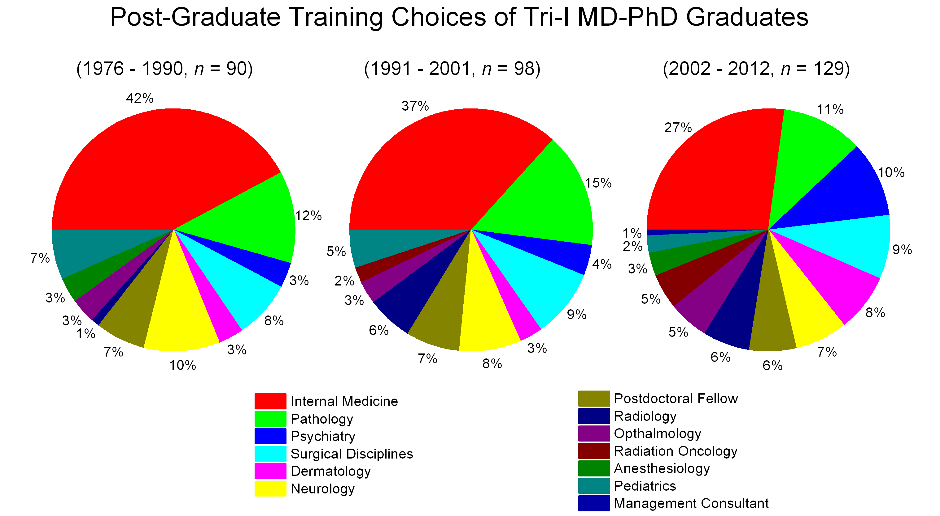
Weill Cornell/Rockefeller/Sloan-Kettering Tri-Institutional MD-PhD Program

Slide 54
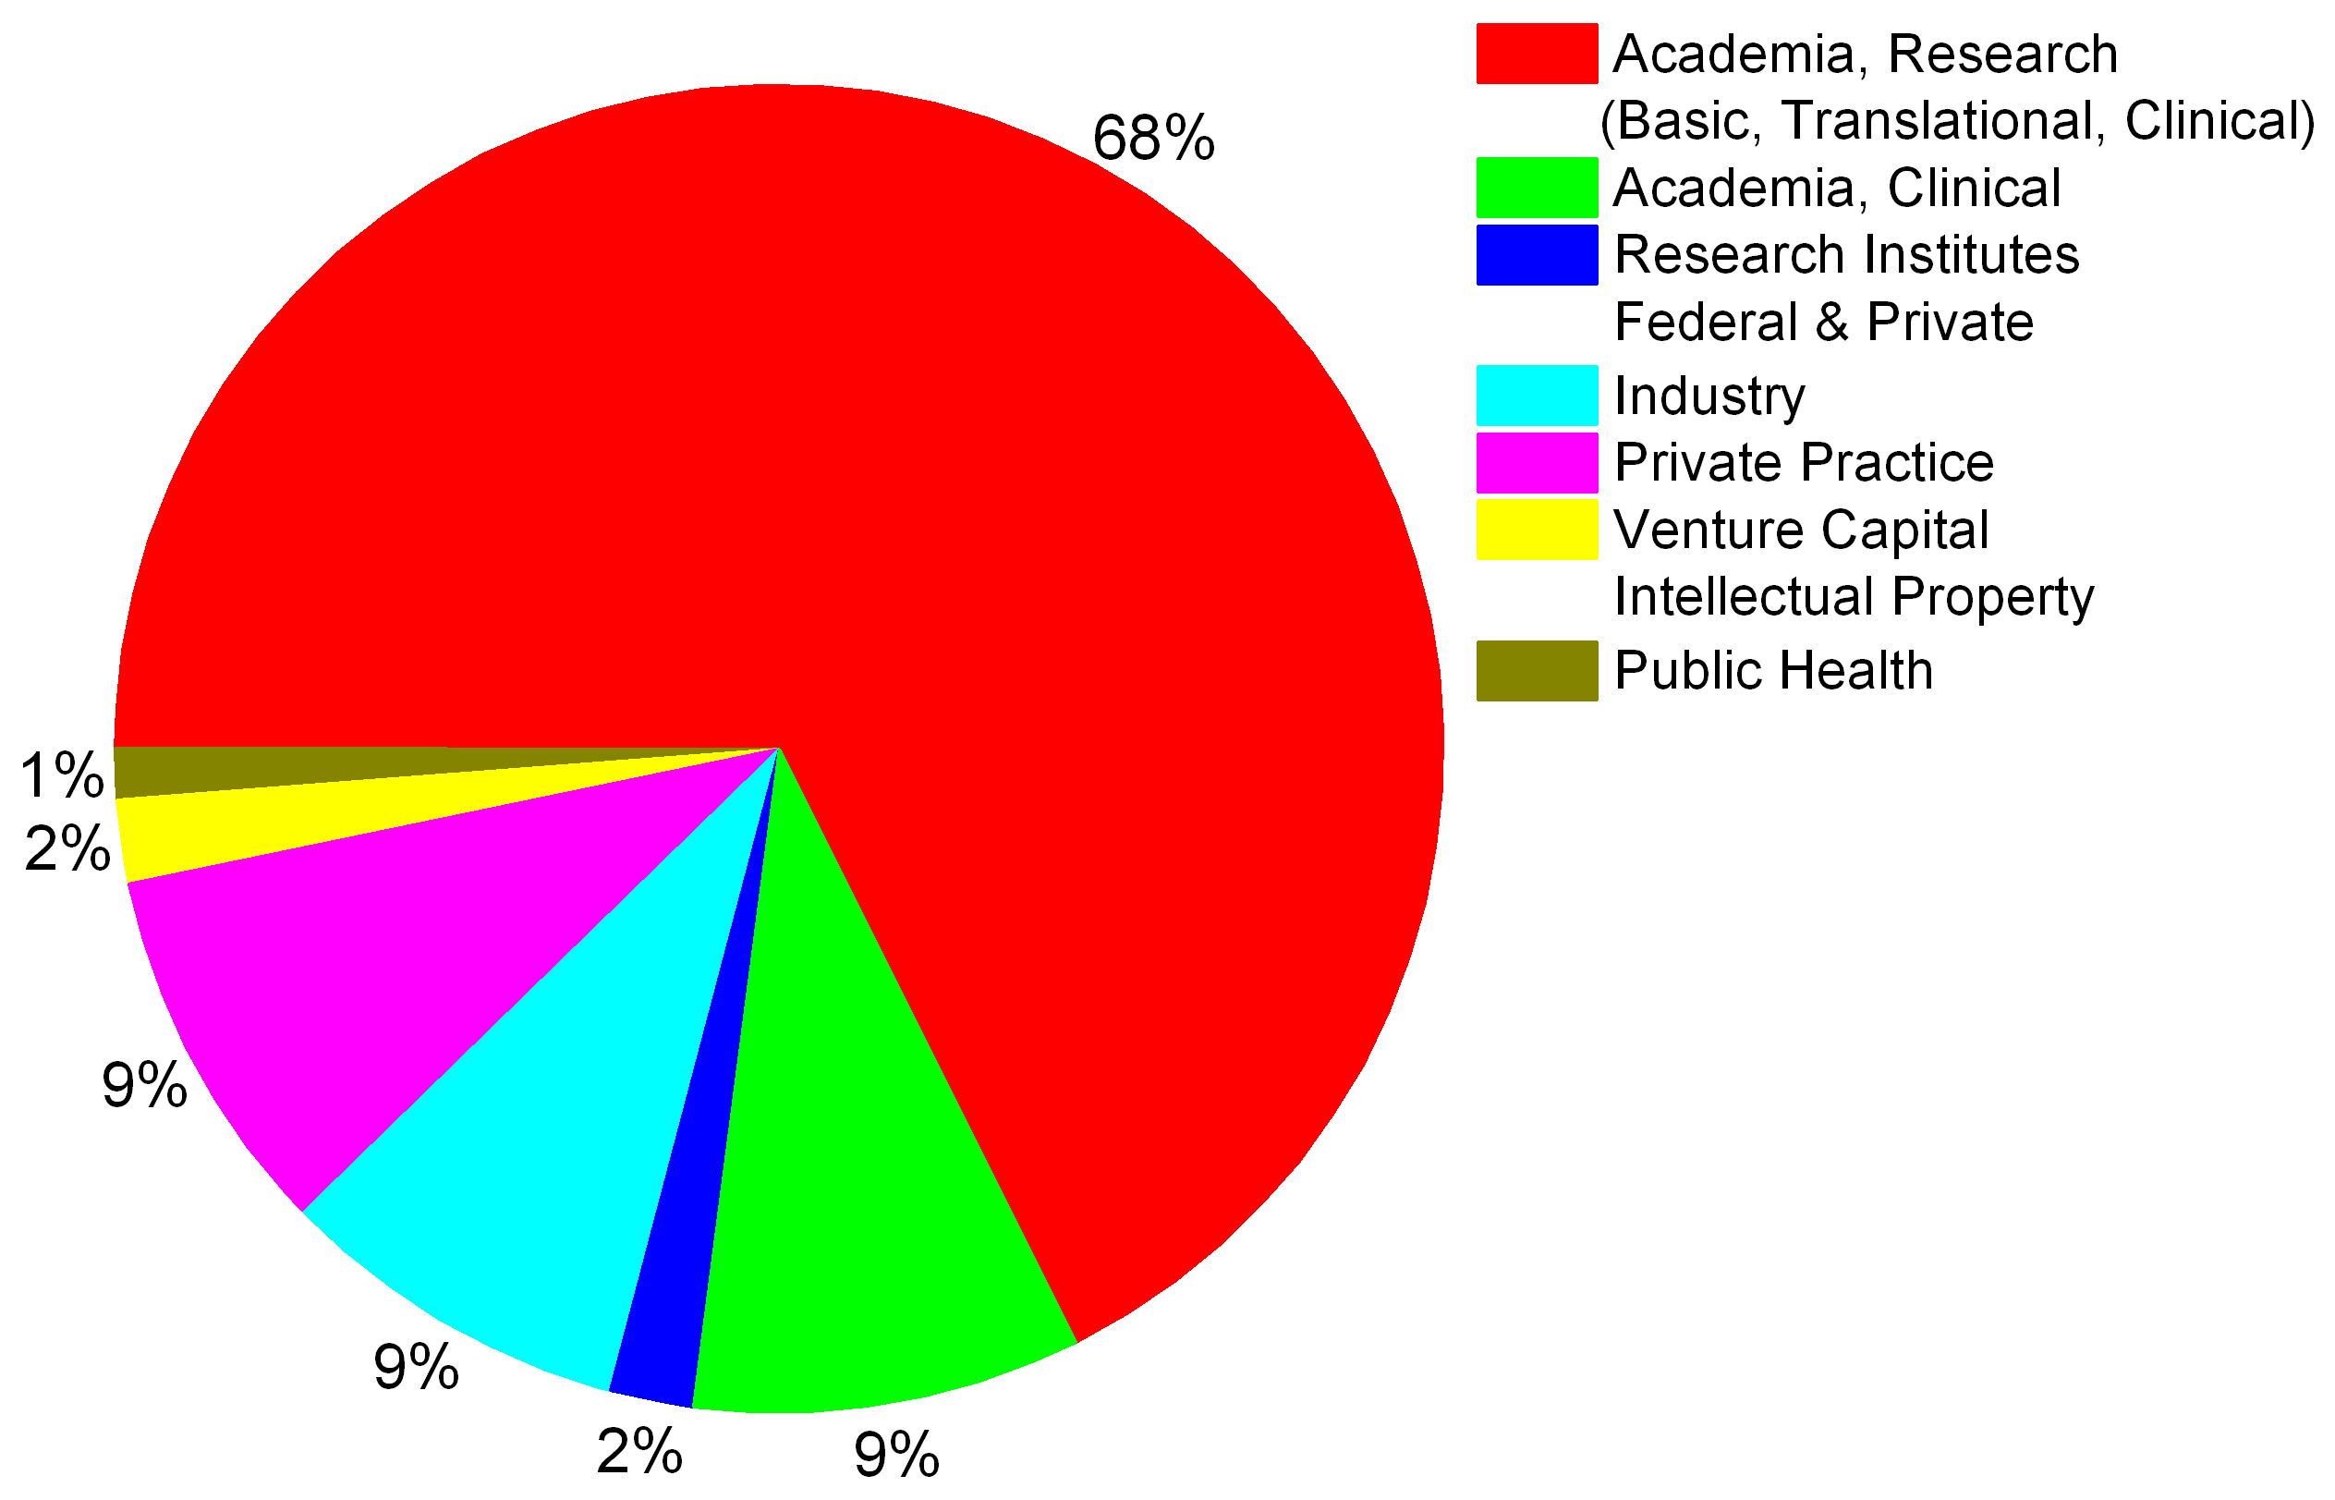
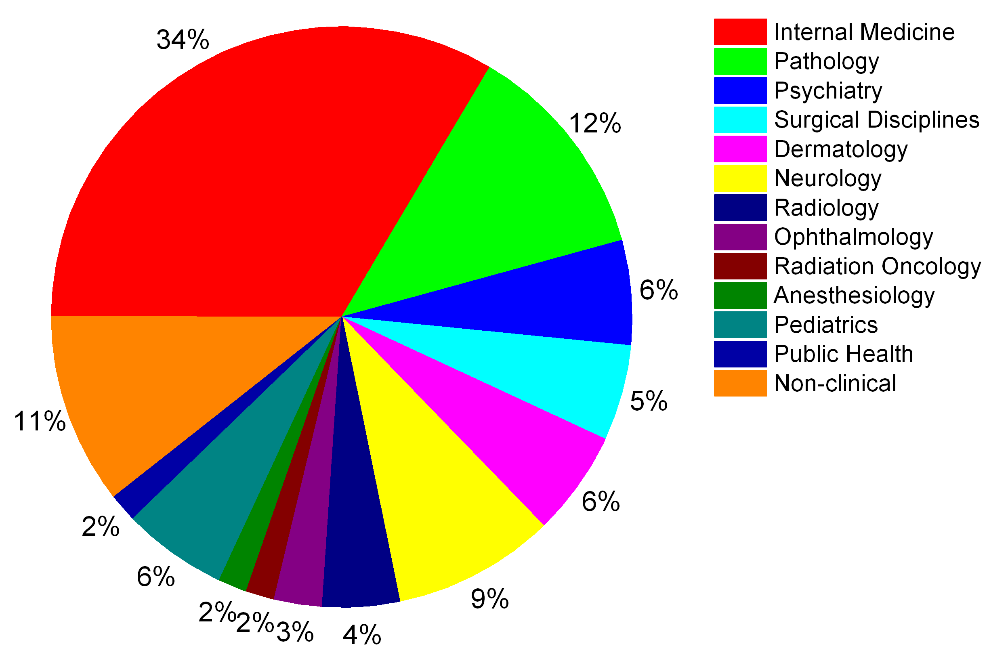
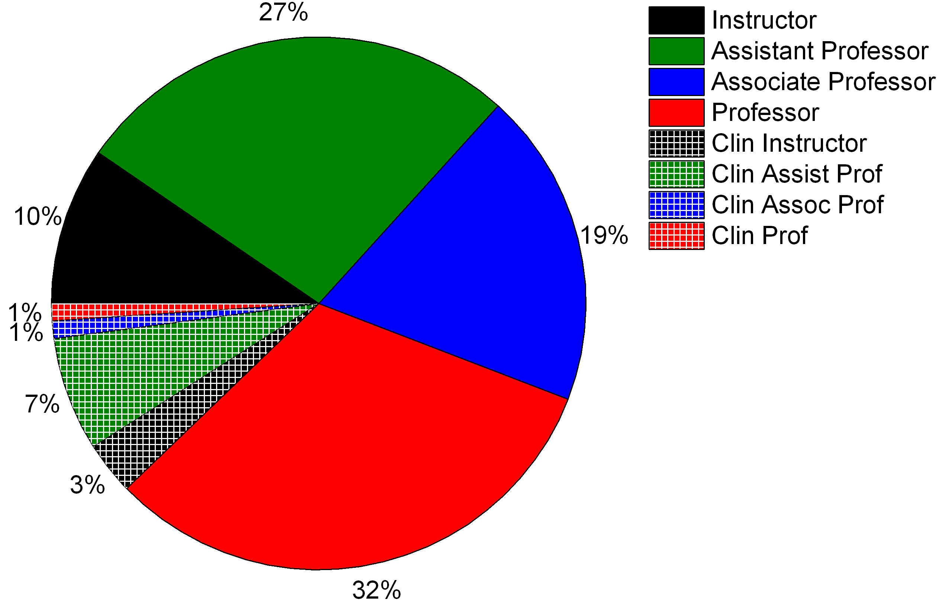
Weill Cornell/Rockefeller/Sloan-Kettering Tri-Institutional MD-PhD Program
Career Choices of Tri-I MD-PhD Graduates (who have completed their training)

Slide 55
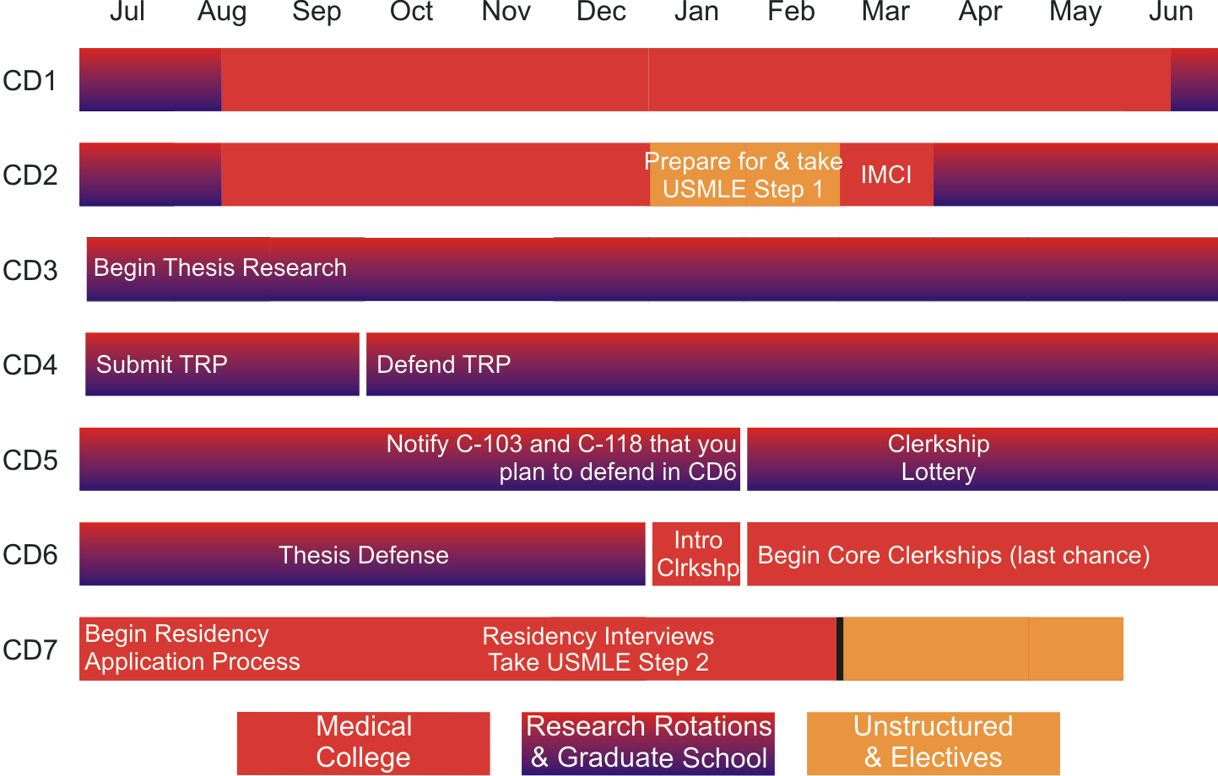
Weill Cornell/Rockefeller/Sloan-Kettering Tri-Institutional MD-PhD Program
Course of Study (Seven-Year Plan)
Graduation

Slide 56
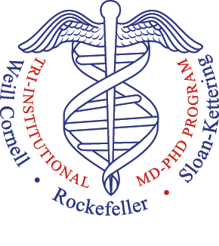
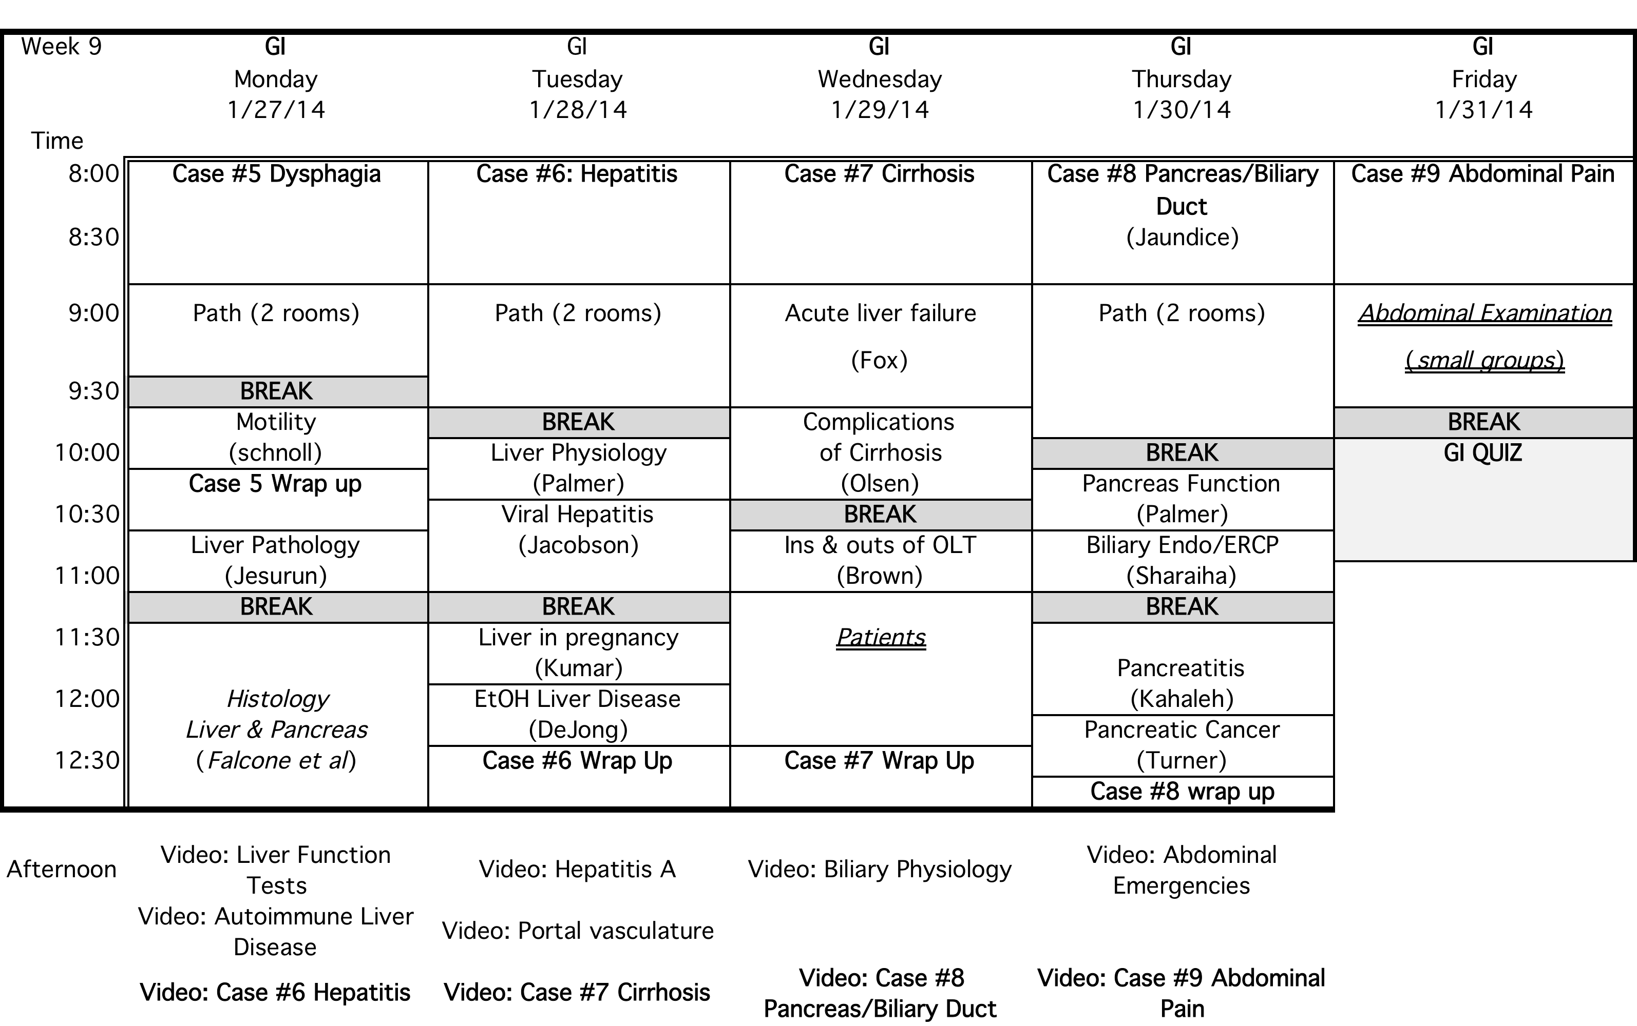
Weill Cornell/Rockefeller/Sloan-Kettering Tri-Institutional MD-PhD Program
Gastro-Intestinal Pilot Unit

