Slide 1


MD-PhD: Is it Right for Me?
Training & Career Paths
Dr. Terry B. Rogers
Senior Advisor for MD-PhD Programs
MD-PhD Student Panel
Johns Hopkins School of Medicine

Slide 2

Advising Activities for Fall 2013
MD-PhD Is it Right for Me? – Student Panel, Oct 7
Recruitment Visit – Oct 22, Brian Sullivan, Administrative
Director Washington Univ. MSTP, 6:00PM, Maryland 110
Recruitment Visit – Nov. 4, Dr. Olaf Anderson, Director, Cornell
Rockefeller, Sloane Kettering MSTP, 5:00PM, Shaffer 101
Small Group Meetings with Dr. Rogers
Oct 16th , 5:00-6:00PM, 6:30-7:30 PM
Oct 23rd, 5:00-6:00PM, 6:30-7:30 PM

Slide 3
Who are physician-scientists?
Men and women who are physicians and investigators (mentors, teachers and inventors and….)
Spend most of their professional careers doing research and applying research. Many also see patients.
Many (not all) do research that is tied to human biology and human disease.
Work at academic medical centers, research institutes, industry and government.

Slide 4
Most MD-PhD’s are chimeras who blend clinical medicine with the discovery and application of new knowledge at the intersection of science and medicine
Science
Medicine

Slide 5
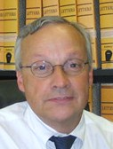
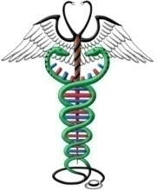
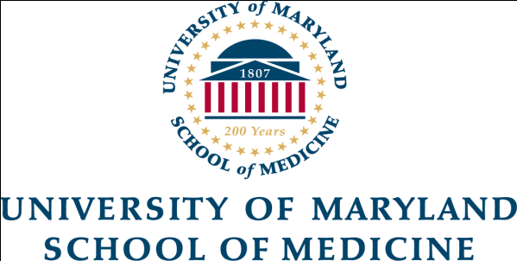
University of Maryland School of Medicine
J. Marc Simard, M.D., PhD.
Professor – Department of Neurosurgery
150 cases per year
Principal Investigator of Lab funded by NIH, DOD
Discovered and developed a novel brain K+ channel blocker that limits brain swelling from trauma and hemorrhaging from strokes. He identified a drug (R001) that blocks this channel, now in development for spinal cord and head injuries.
Founder of biotechnology company to bring this drug to clinic

Slide 6
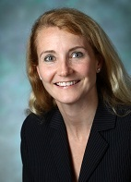

Johns Hopkins University School of Medicine
Andrea Cox, M.D., PhD.
Associate Professor – Dept. of Medicine and Oncology
Co-director, Johns Hopkins MSTP
200 patients per year (clinic twice per month)
Principal Investigator of Lab funded by NIH
Redefining our understanding of the immune system response for patients with Hepatitis C viral infections and currently trying to create novel vaccines for HCV using models of viral evolution.

Slide 7
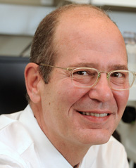
Johns Hopkins University School of Medicine
Harry (Hal) Dietz, M.D.
Victor A. McKusick Professor of Genetics and Medicine –
Dept. of Medicine, Pediatrics, and Molecular Biology and Genetics
Investigator, Howard Hughes Medical Institute
1,500 patients per year (clinic once per week)
Principal Investigator of Lab funded by Howard Hughes and NIH
Revolutionized the understanding and treatment of Marfan’s Syndrome and Loeys-Dietz Syndrome. Discovered that these connective-tissue disorders are caused by mutations in TGF-beta signaling pathway and treatment with a blood-pressure drug can significantly improve the lifespan of afflicted individuals.

Slide 8
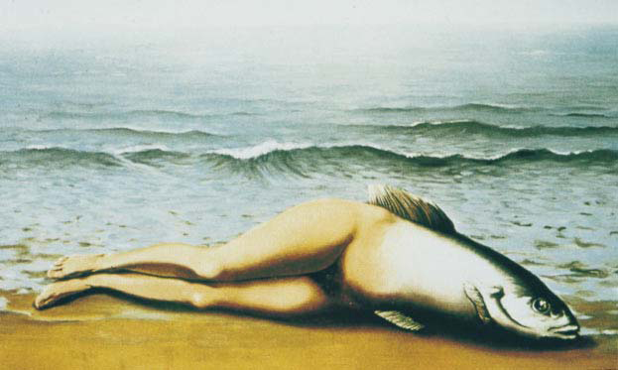
“L’Inventive Collective” Rene Magritte,
1930
MYTH: You can’t be both a physician and a scientist and be happy and successful at both.
Science
Medicine

Slide 9
Who should do MD-PhD training?
Women and men who:
are fascinated by biology and disease and have an aptitude for science
are passionate about understanding how things work
enjoy helping people and are willing to make personal sacrifices

Slide 10
How is MD-PhD training done?
Nationwide, there are over 100 MD-PhD programs affiliated with medical schools.
To promote physician-scientist career paths, most MD-PhD Programs offer students financial support, including stipends and tuition waivers.
Curricula creatively mix MD and PhD phases to complete both in about 8 years.
Programs promote interactions with like-minded students and faculty.

Slide 11
How is MD-PhD training done?
Nationally, 45 programs are partially supported by training grants from NIGMS known as Medical Scientist Training Programs or MSTPs.
This national institutionalization of programs (starting in the 1970s) set a standard for how MD-PhD Programs are organized.
Each program offers unique opportunities and educational environments.
PhD can be awarded in a wide variety of disciplines.

Slide 12
MD-PhD curriculum is a continuum
Years 1-2
Years 3-6
Years 7-8
Integrating medicine and science
Mostly Med School
Some clinical
Mostly Med School
Some Grad School
Mostly Grad School
Some Grad School
Preclinical (years 1 - 2)
Medical sciences
Explore research opportunities (lab rotations)
Initiate clinical exposure
Research (years 3 - 6) Complete PhD degree
Develop and conduct thesis research
Opportunity for clinical experiences
Clinical (5 - 7 or 6 - 8) Complete MD degree
Clinical clerkships and rotations
Opportunity for further research experiences

Slide 13
18
22
30
34
36
College
MD-PhD
Residency
Fellowship
4 years
2
Med
4-6 years
Research
2
Med
3-5 years
Medicine
2-3 years
Med/Res
AND/OR
AND/OR
RESEARCH CLINICAL MEDICINE
PostDoc
PostDoc
2-3 years
Research
2-3 years
Research
Notes:
Remember to mention that MD-PhD is paid for, less debt, but less income overall

Slide 14
How to get there…
Physician- Scientist
Only Get an MD No formal research training
Steep learning curve But start your career MUCH earlier
Combined MD/PhD Program A bit faster than separate degrees
Formal training in medicine AND science
Get Degrees Separately
Not the best option if you know RIGHT NOW you want to do both, BUT…
An MD can run a laboratory, but a PhD can’t treat patients.
Notes:
Mention that, of course, as a PhD you can still do research that affects how patients are treated, Reza Shademehr
Also add that the biggest controversy is whether you need the PhD

Slide 15
Who do MD-PhD Programs seek?
Applicants with integrity and maturity who show:
Concern for others
Leadership potential
An aptitude for working with others

Slide 16
What do MD-PhD programs look for?
Research experiences
Academic records including MCAT scores
Personal statements – why MD-PhD?
Letters of recommendation from research mentors
Experience in caring for others
Extracurricular activities
Life experiences

Slide 17
What constitutes a substantive research experience?
Sufficient research experience to understand what you are getting into:
Multiple summer projects
Senior thesis research
One or more years pursuing research activities after undergraduate degree
Familiar with the idea of testing a hypothesis

Slide 18
Statistics – MD-PhD Applicants 2011
Total Applicant Pool (n= 1,813) 100%
Mean Range
MCATS 31.1 6 - 44
GPA 3.6 1.7 - 4.0
Matriculants (n= 633) 35%
Mean Range
MCATS 34.4 22 - 44
GPA 3.8 2.8 - 4.0

Slide 19
MD-PhD Applicant Statistics 2011-GPA
Students
GPA

Slide 20
MD-PhD: Is it Right for Me?
Training & Career Paths
MD-PhD Student Panel
Johns Hopkins School of Medicine
Neil Neumann, G2 (Johns Hopkins Univ.)
James Beckett, M2 (Kenyon College)
Hannah Edelman, M2 (Swarthmore College)

