Slide 1
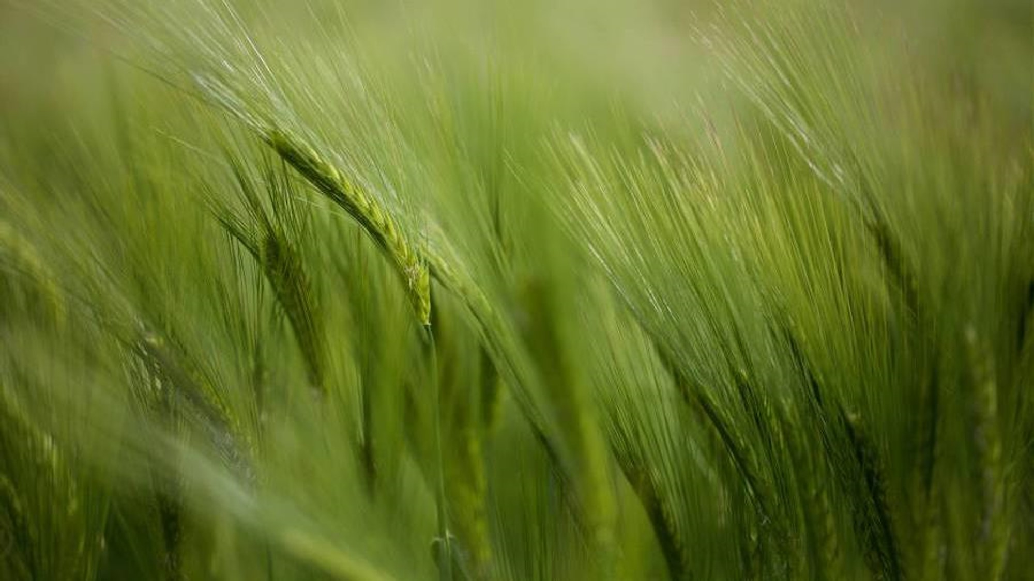
KAPLAN BUSINESS SCHOOL
Forecasting Fresh Food
Supply Disruptions in SA Retail
Methodology Summary – DATA 6000 Capstone T1 2026 A2
Student Name: Amali Wariyapperuma
Student Id: 1845046
Lecturer/Supervisor: Dr. Indu Bala
Submission: 09/05/2026
1

Slide 2
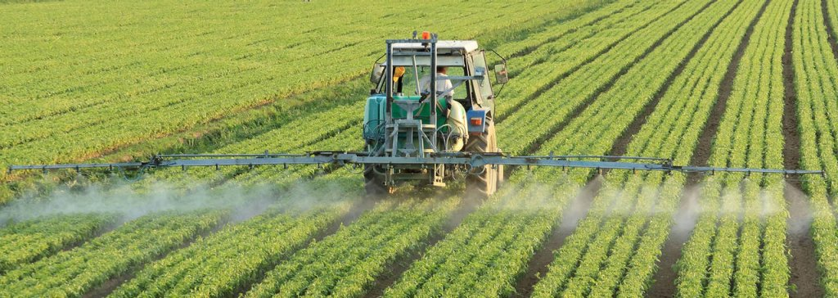
Business Problem & Industry Background
SA Retail Industry
Three problems identified
AUD 551B
SA retail market turnover
Price-sensitive customers
1
Broadly studied — limited SA originality
6,000+
Retail businesses across SA
Unstable fresh-food supply
2
SELECTED
9.2%
CPI peak in FY 2022/23
Selected — R = −0.621 evidence, no prior SA model
44.9%
3
Rising retail crime
Barossa Valley rainfall deficit
SA precinct data insufficient depth
Business Question
Can predictive analytics using SA rainfall, CPI and horticulture production data forecast fresh-food supply disruptions in South Australian retail?
2
Source: KPMG 2024; ABS 2025; ACCC 2025; BOM 2026

Slide 3
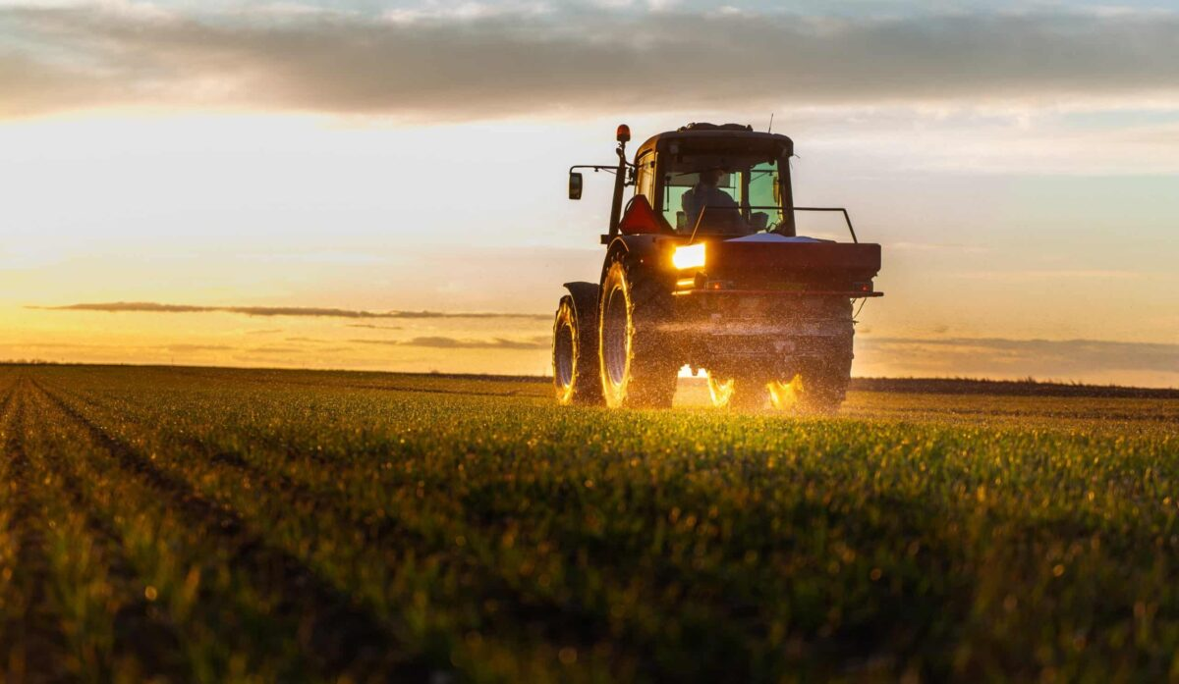
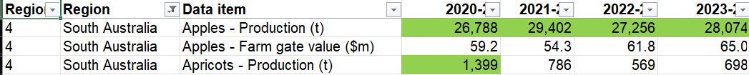
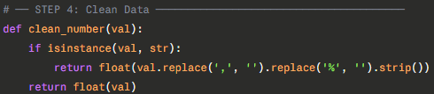
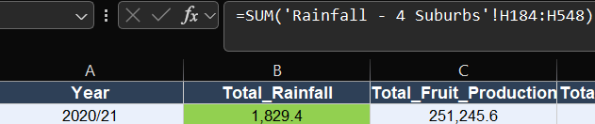
Data Used & Data Cleaning Technique
BOM - Rainfall
ABS - Horticulture
ABS - CPI SA
Daily obs · 4 SA suburbs
Lenswood · Renmark
Port Augusta · Victor Harbor
Value of Agricultural Commodities
Fruit & veg · FY 2020/21 -2024/25
Consumer Price Index
SA series · 2020 -2025
Data cleaning steps
1
Rainfall (mm)
Fruit (t)
Vg (t)
Total Prod (t)
Commas removed
1
998,089.2 → 998089.2
2
2
% symbols stripped
CPI standardised to decimal
3
FY alignment
Rainfall Jul–Jun aggregated
3
4
Missing values
Excluded or estimated
4
Source: Bureau of Meteorology 2026; ABS Value of Agricultural Commodities 2025; ABS Consumer Price Index 2025
3

Slide 4
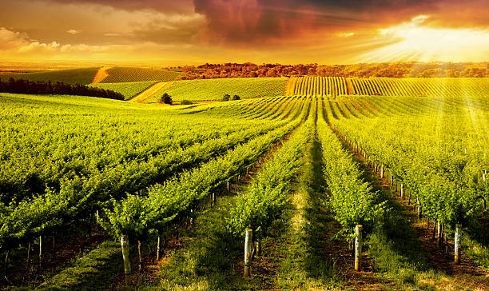
Machine Learning Algorithms - Why Selected
Analytical framework: Random Forest (ML) for rainfall forecasting · ARIMA + Holt-Winters + Prophet (time-series) for production forecasting
ML
Random Forest Regression - Machine Learning Component
Why RF for this data
Features engineered
How it connects to production
• 72 rainfall readings per month, sufficient for ML
• Sin/cos (cyclical encoding) plus the month number
• RF predicts monthly precipitation for FY 2025/26 - 2029/30.
• Manages seasonal patterns that are not linear, which ARIMA cannot
• Lag 1, Lag 2, Lag 12 (seasonal memory)
• Monthly totals combined with rainfall projections for the fiscal year
• The months that drive FY totals are revealed by feature relevance.
• Three-month and six-month rolling means
• To estimate production Δ%, apply Pearson R = −0.621.
• A 200-tree ensemble that is resilient to tiny datasets
• Normalized by year (long-term trend)
• Offers a supply disruption risk indication powered by machine learning
1
ARIMA(1,1,0)
2
Holt-Winters
3
Prophet (Meta)
Primary TS model
Trend TS model
Uncertainty model
Best for small annual series. p=1 auto-regressive, d=1 differencing, q=0. Validated by Sidabutar & Firmansyah (2023).
The trend of diminishing production is captured by double exponential smoothing. sturdy for tiny datasets. distinct approach from ARIMA.
Bayesian model with confidence intervals of 95%. Changepoint detection is automatic. Planning scenarios for consumers.
INPUT
5 FY production series
OUTPUT
5-FY production forecast
INPUT
5 FY series · trend=additive
OUTPUT
Comparative trend forecast
INPUT
5 FY series · Bayesian
OUTPUT
Forecast + 95% CI band
Source: Malik et al. 2022; Sidabutar & Firmansyah 2023; Falatouri et al. 2022
4

Slide 5
Random Forest — ML Results & Production Risk
RF Model Configuration
Feature importance — what drives monthly rainfall
Training data:
72 monthly obs (2020–2025)
Lag 12 (same mth last yr)
0.284
Algorithm:
Random Forest Regression
Trees:
200 decision trees
Sin/Cos Month (cyclical)
0.231
Max depth:
5 (prevents overfitting)
Lag 1 (prev month)
0.182
Features:
10 engineered features
CV method:
5-fold cross-validation
Roll 6-month mean
0.124
Model Accuracy
Roll 3-month mean
0.098
Training RMSE:
≈ 18.4mm
Year (long-term trend)
0.081
Training MAE:
≈ 14.2mm
Training MAPE:
≈ 14.8%
FY production risk — RF rainfall forecast × Pearson R = −0.621
Training R²:
≈ 0.8934
FY
RF Rain (mm)
Δ Rain vs mean
Δ Prod est %
Risk
CV RMSE (5-fold):
≈ 24.6mm
2025/26
~1,952
+2.8%
-2.6%
Medium
2026/27
~1,820
-4.1%
+3.8%
Low
2027/28
~1,680
-11.5%
+10.7%
Low
2028/29
~1,580
-16.8%
+15.6%
Low
Note: Production risk estimated directionally — RF forecasts monthly rainfall · aggregated to FY · applied to R = −0.621 · run RandomForest_Rainfall.py for exact values
2029/30
~1,490
-21.5%
+20.0%
Low
5

Slide 6
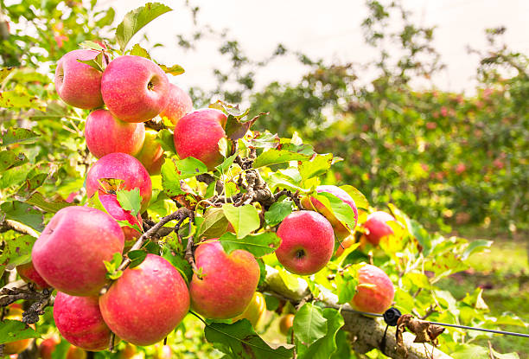
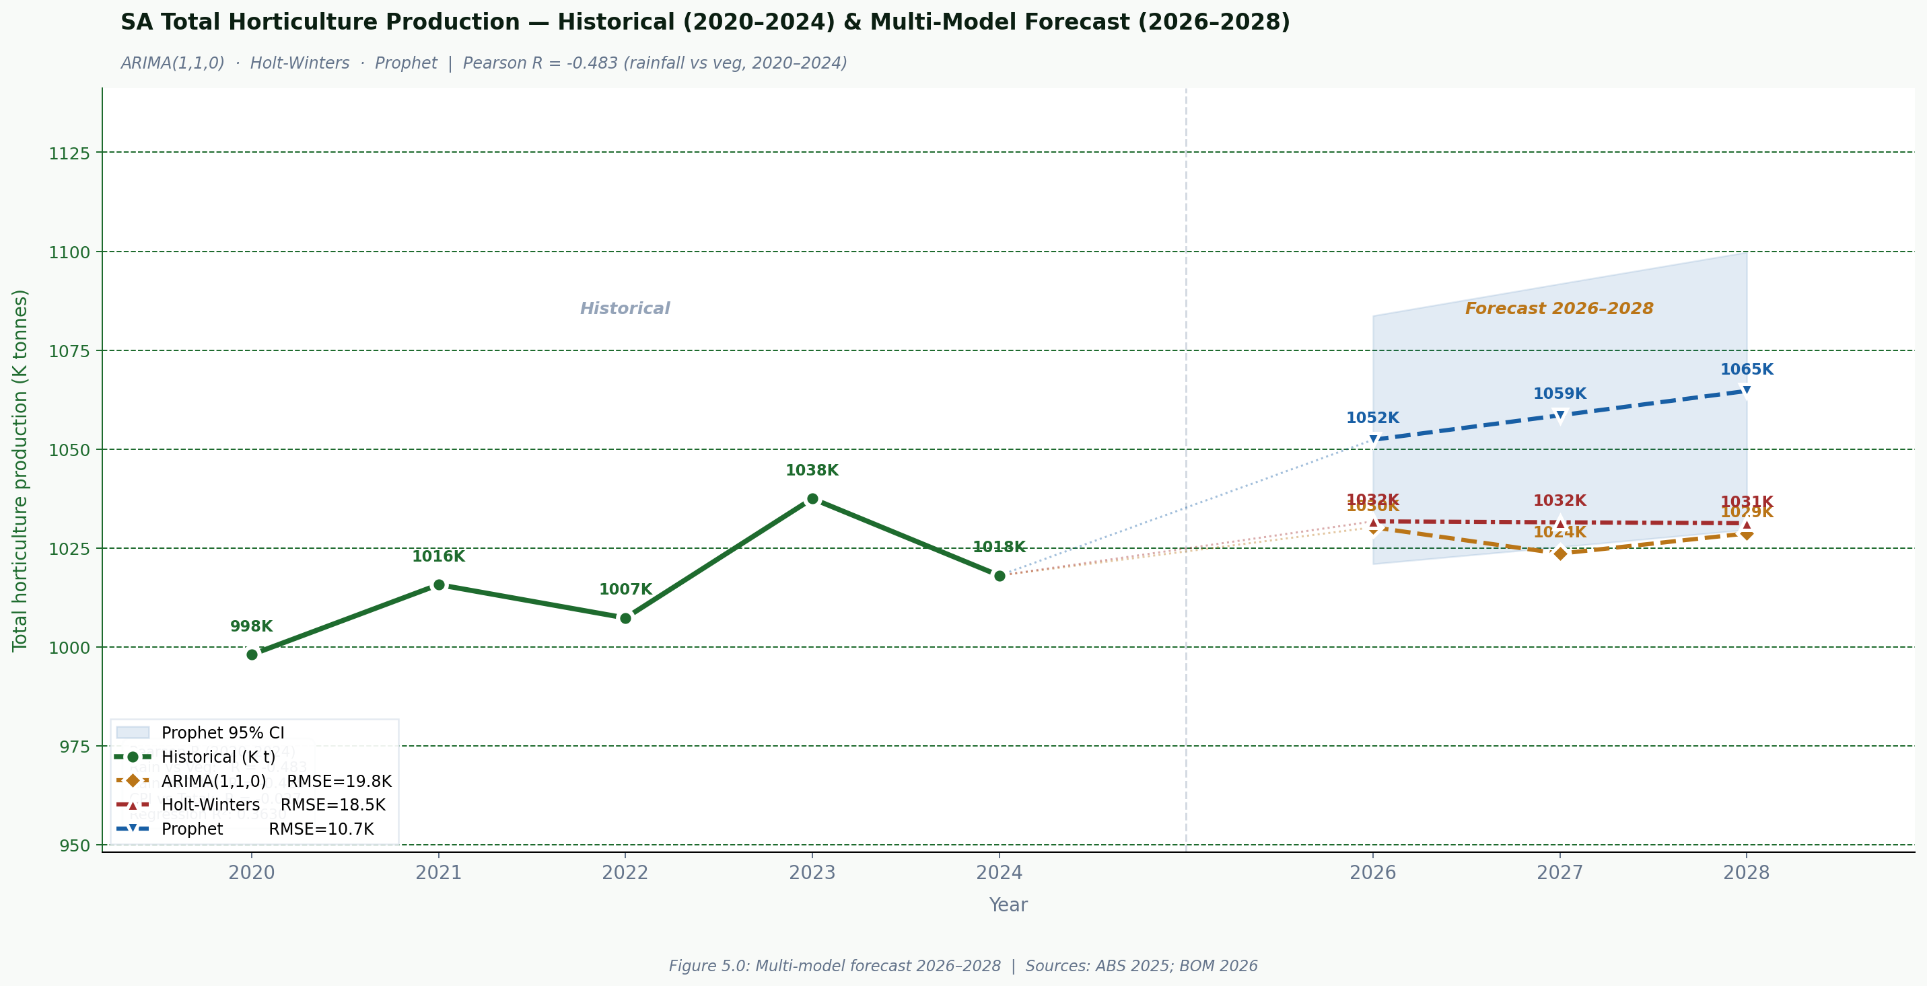
Outcomes - Descriptive & Predictive Analysis
Descriptive analytics — key insights
Predictive analytics — 5-FY forecast insights
R = -0.621
9.2%
Rainfall vs veg production
CPI peak FY 2022/23
Moderate inverse - irrigation dependency
Simultaneous production dip 1.007M t
~75%
-2.5%
Veg share of output
Fruit decline 2021–2025
All 5 financial years consistent
Structural trend - farm exits
SA horticulture depends on irrigation; farmers increase irrigation to make up for poor rainfall, which explains R = -0.621 (p = 0.2634). Water reserves are being depleted by the protracted drought during 2023/24; the buffer is disintegrating.
All three models predict that SA horticulture production will remain within a narrow range of 1,024K-1,065K tonnes between 2026 and 2028, with no model predicting a return to the FY 2023/24 peak of 1,038K tonnes. Prophet (RMSE = 10.7K, best fit) predicts gradual growth to 1,065K t, ARIMA oscillates around the 1,024-1,032K range due to mean-reversion.
Source: ABS 2025; BOM 2026
6

Slide 7
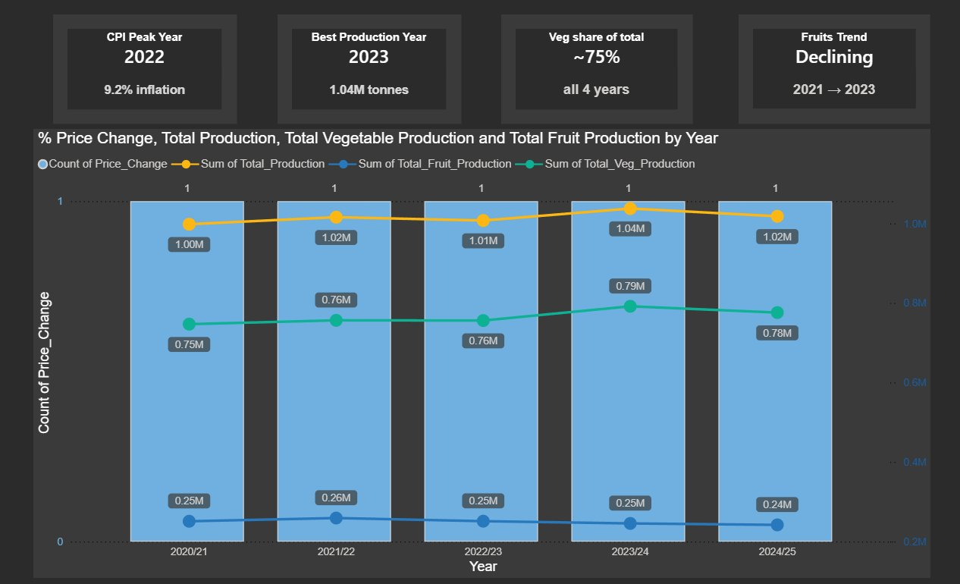
Descriptive Analysis — CPI vs Horticulture Production
CPI, Total Production, Veg Production and Fruit Production by Financial Year (2020/21–2024/25)
KEY INSIGHTS
1
CPI peak did not suppress production
Production slightly decreased to 1.01M tonnes during the 2022/23 CPI spike to 9.2% inflation; nevertheless, the next year, 2023/24, witnessed the highest production in the dataset at 1.04M tonnes despite ongoing price pressure.
2
Vegetables at ~75% - concentration risk for SA retail
Fruit production remained stable between 0.24M and 0.26M tonnes during all 5 years, whereas vegetable production maintained roughly 75% of the overall horticultural output, ranging from 0.75M to 0.79M tonnes.
3
Fruit in structural decline since 2021/22
Fruit production decreased gradually over 4 years, from 0.26 million tonnes in 2021/22 to 0.24 million tonnes in 2024/25 a decrease of roughly 2.5%.
7
Source: BOM 2026; ABS 2025 · Power BI · DATA6000 Capstone

Slide 8
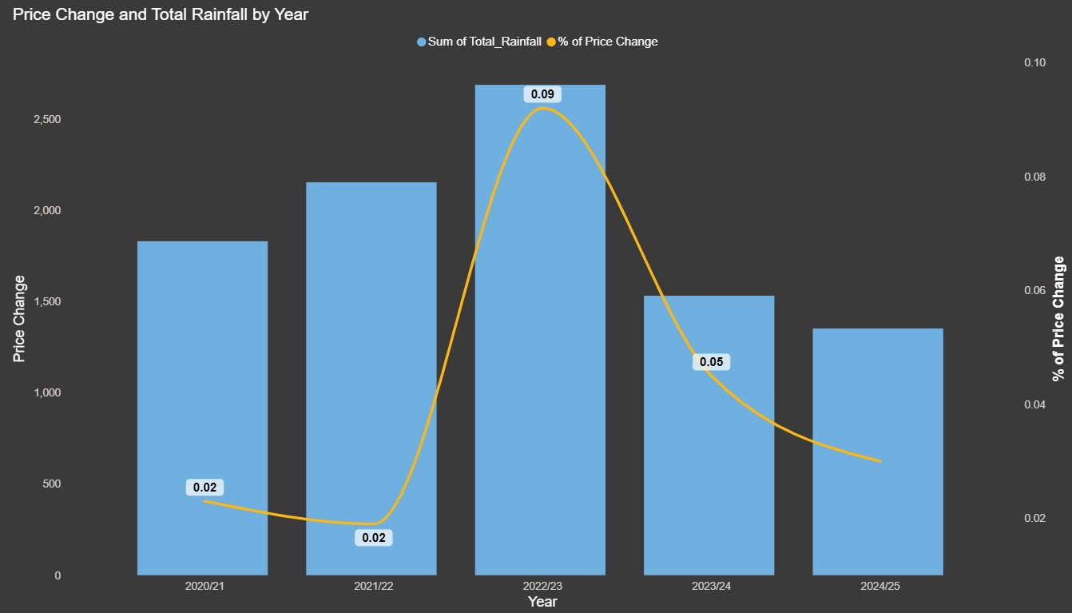
Descriptive Analysis — CPI Change and Total Rainfall by Year
Price change and SA rainfall co-movement across FY 2020/21–2024/25
KEY INSIGHTS
4
Rainfall and CPI peaked simultaneously - compounding risk
In FY 2022/23, SA had the most rainfall in the dataset roughly 2,633 mm while the CPI reached a peak of 9.2%. High rainfall indicated favourable growing conditions, however production fell to 1.01 million tons that year despite both variables rising at the same time.
5
Rainfall falling while CPI remains elevated - double squeeze
SA rainfall dropped significantly from its peak of 2,633 mm in 2022/23 to 1,531 mm in 2023/24 and then to 1,352 mm in 2024/25, a 49% decrease in just 2 years. Simultaneously CPI has only decreased from 9.2% to 3.0%, still beyond the RBA's target range.
6
2024/25 breaks pattern - drought buffer collapse confirmed
The graph indicates that the two variables moved somewhat independently in all prior years when rainfall was comparatively lower, such as in 2020/21 and 2023/24. But in 2024/25, production fell together with rainfall and CPI, marking the first time that all three factors moved in the same direction.
8
Source: BOM 2026; ABS 2025 · Power BI · DATA6000 Capstone

Slide 9
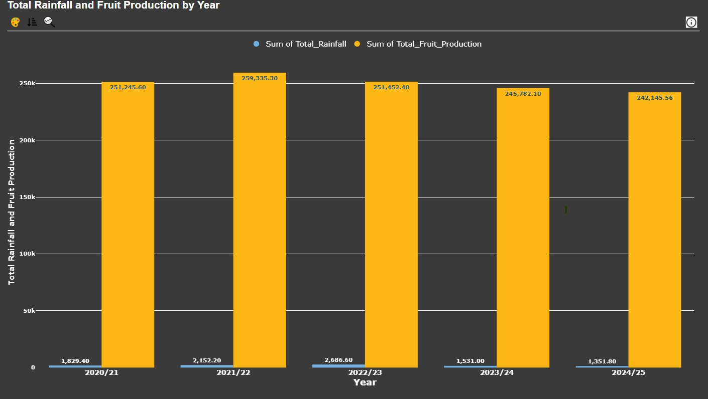
Descriptive Analysis — Total Rainfall and Fruit Production by Year
SA rainfall vs fruit production tonnes — FY 2020/21–2024/25
KEY INSIGHTS
7
Fruit production decoupled from rainfall - irrigation dependency
Rainfall varied significantly across 5 years, nearly doubling from a low of 1,352 mm in 2024/25 to a high of 2,687 mm in 2022/23. However, fruit production stayed impressively steady, varying by only 7% between 242K and 259K tonnes. Fruit plantations in SA, including citrus, stone fruits, apples, and pears, rely almost exclusively on regulated drip irrigation from the Murray River and groundwater systems rather than natural rainfall, as evidenced by this nearly flat reaction to significant rainfall swings.
8
Fruit decline is structural — not weather driven
Fruit production reached in 2021/22 at 259,335 tonnes, which was neither the year with the highest nor the lowest rainfall. After that, it steadily decreased through 2022/23, 2023/24, and 2024/25, reaching 242,146 tonnes. The reduction is attributed to structural issues, such as farm exits under persistent cost pressure, aging orchard stock not being replenished, and lower Murray River water allocations during drought, as rainfall cannot account for this decline, which moved in numerous directions throughout the same period.
9
Source: BOM 2026; ABS 2025 · Power BI · DATA6000 Capstone

Slide 10
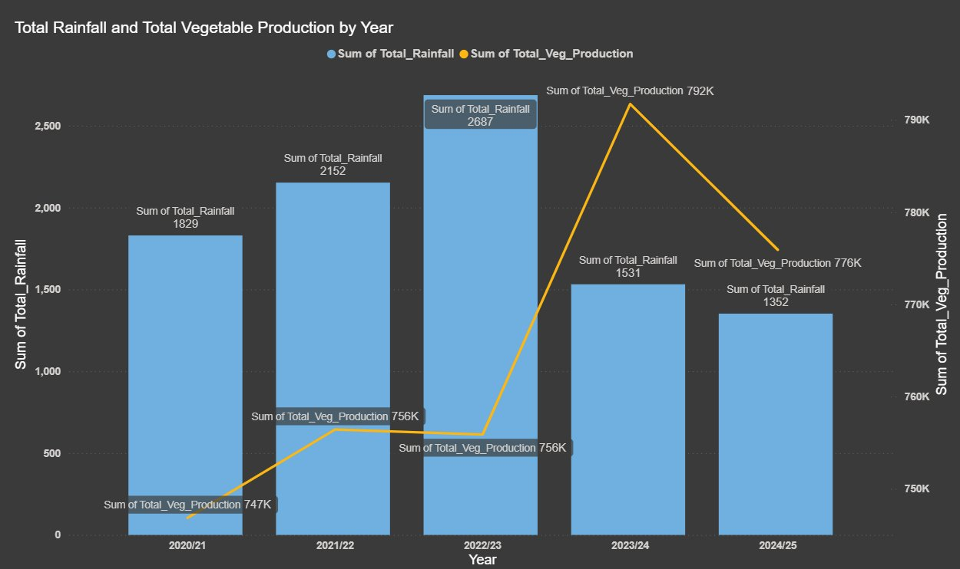
Descriptive Analysis — Total Rainfall and Vegetable Production by Year
SA Rainfall vs Vegetable production tonnes — R = −0.621 (p = 0.2634) — FY 2020/21–2024/25
KEY INSIGHTS
9
Inverse pattern confirms irrigation dependency - R = -0.621
The crossing from 2022/23 to 2023/24 is the most striking pattern on this chart. Vegetable production increased from 756K to 792K tonnes, its greatest point in the entire dataset, while rainfall fell sharply from 2,687mm to 1,531mm, a reduction of 1,156mm. This directly verifies the inverse relationship of Pearson R = −0.621 and is the most obvious visual evidence of the irrigation dependency discovery.
10
2024/25 breaks inverse pattern - buffer collapse visible in data
For the first time in the dataset, rainfall drops to 1,352 mm in 2024/25, and vegetable production falls from 792K to 776K tonnes. The inverse relationship held in every prior year, with greater irrigation offsetting decreased rainfall. The most significant data point in the entire research is the simultaneous fall in 2024/25.
10
Source: BOM 2026; ABS 2025 · Power BI · DATA6000 Capstone

Slide 11
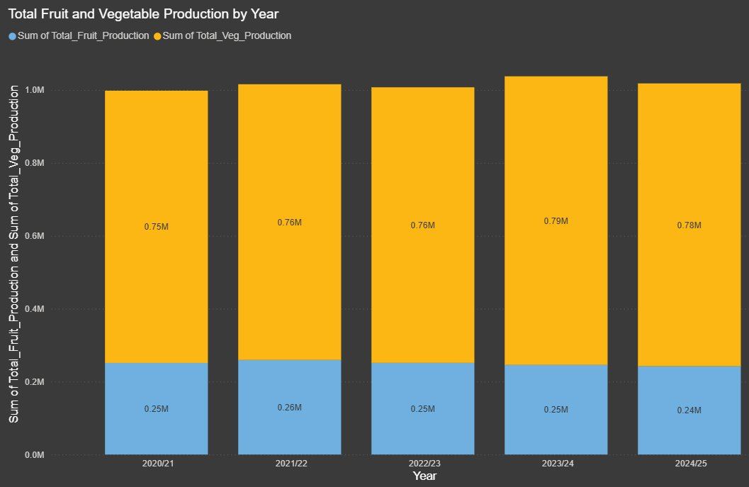
Descriptive Analysis - Total Fruit and Vegetable Production by Year
Stacked composition of SA total horticulture output - FY 2020/21–2024/25
KEY INSIGHTS
11
75/25 ratio structurally stable - vegetable risk dominates
The distribution of fruit and vegetable production has been relatively stable across 5 years, with vegetables contributing approximately 75% and fruit approximately 25% of SA's total horticultural output. Despite variations in individual quantities and rainfall ranging from 1,352mm to 2,687mm, this ratio has not changed much.
12
Peak 2023/24 then decline - disruption window confirmed
The stacked graphic makes it evident that total production increased from 0.99 million tonnes in 2020/21 to 1.04 million tonnes in 2023/24 then falling back to 1.02 million tonnes in 2024/25. This peak-and-decline pattern is significant since rainfall fell sharply to 1,531 mm in 2023, indicating that farmers increased irrigation output in response to the drought, achieving peak production in that year.
11
Source: BOM 2026; ABS 2025 · Power BI · DATA6000 Capstone

Slide 12
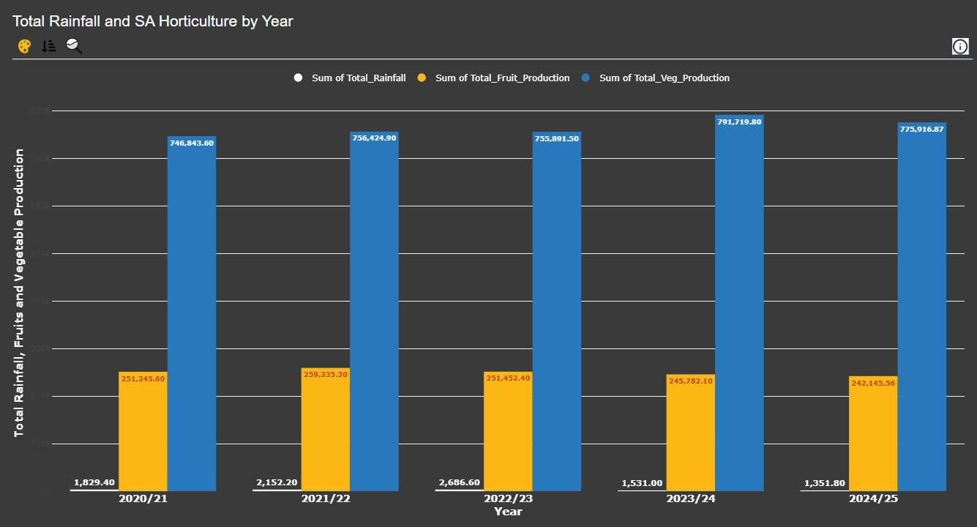
Descriptive Analysis — Total Rainfall and SA Horticulture Production by Year
Rainfall, fruit and vegetable volumes across FY 2020/21–2024/25 — drought buffer breakdown visible
KEY INSIGHTS
Rainfall peaked in 2022/23 at 2,686.60, then dropped sharply to 1,531.00 and then to 1,351.80 in 2024/25, which was the lowest amount throughout the five-year period. From peak to 2024/2025, that represents a 49.7% decline.
After peaking at 259,335.30 in 2021/22, fruit production (orange) shows a relatively consistent decline, dropping 242,145.56 by 2024/25.
Even though rainfall was already sharply decreasing, vegetable production (blue), the most analytically Veg climbed from 755,891.50 in 2022/23 to a 5-year high of 791,719.80 in 2023/24. Then, in 2024/25, it dropped to 775,916.87.
Because of this significant scale difference, rainfall data appear compressed in relation to production estimates, and a dual-axis interpretation is recommended.
12
Source: BOM 2026; ABS 2025 · Power BI · DATA6000 Capstone

Slide 13
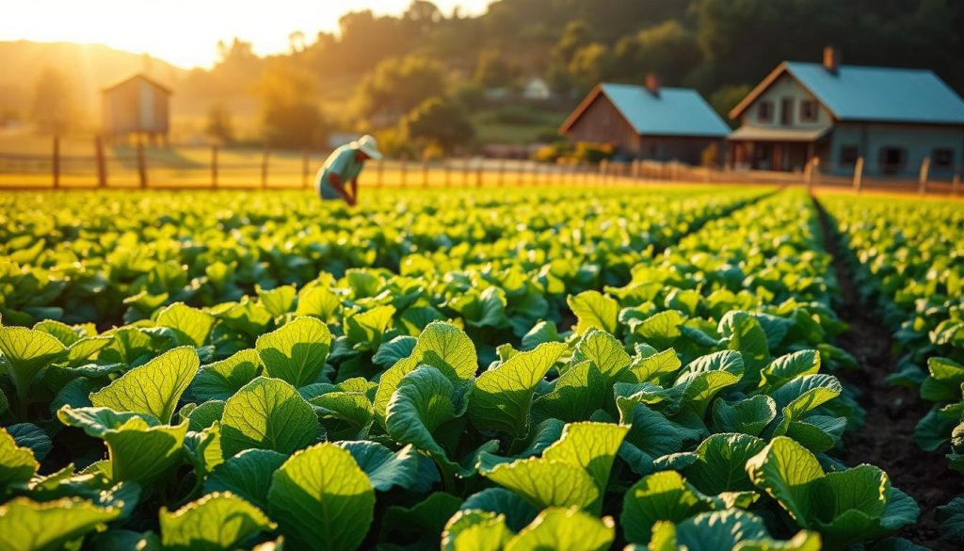
Predictive Analysis — Multi-Model Production Forecast (2026–2028)
ARIMA(1,1,0) · Holt-Winters · Prophet — trained on 2020–2024 historical data
KEY INSIGHTS
1
All models project near-flat to rising output - with divergence
A flat trajectory of 1,031K t through 2028 is predicted by both ARIMA and Holt-Winters, indicating mean-reversion around the 2024 baseline. The prophet predicts a steady increase to 1,065K t. The projected uncertainty band for SA retail procurement planning is represented by the difference between models.
2
Prophet lowest RMSE (10.7K) - best fit on training data
At 10.7K t, Prophet has the lowest RMSE compared to ARIMA's 19.8K t and Holt-Winters' 18.5K t. It most closely matches the 2020/24 pattern with its linear trend structure. Its upward forecast for 2026/28, however, contradicts the descriptive data's indications of rainfall shortage and irrigation buffer collapse.
3
Pessimistic scenario: supply disruption risk peaks 2027
Actual production will probably follow the ARIMA floor (1,024K t in 2027) rather than the Prophet ceiling if rainfall stays below mean (as BOM indicates). The retail fresh food supply in SA is at a higher risk of interruption through 2027 when combined with irrigation buffer exhaustion (R = -0.621).
13
Source: BOM 2026; ABS 2025 · Power BI · DATA6000 Capstone

Slide 14
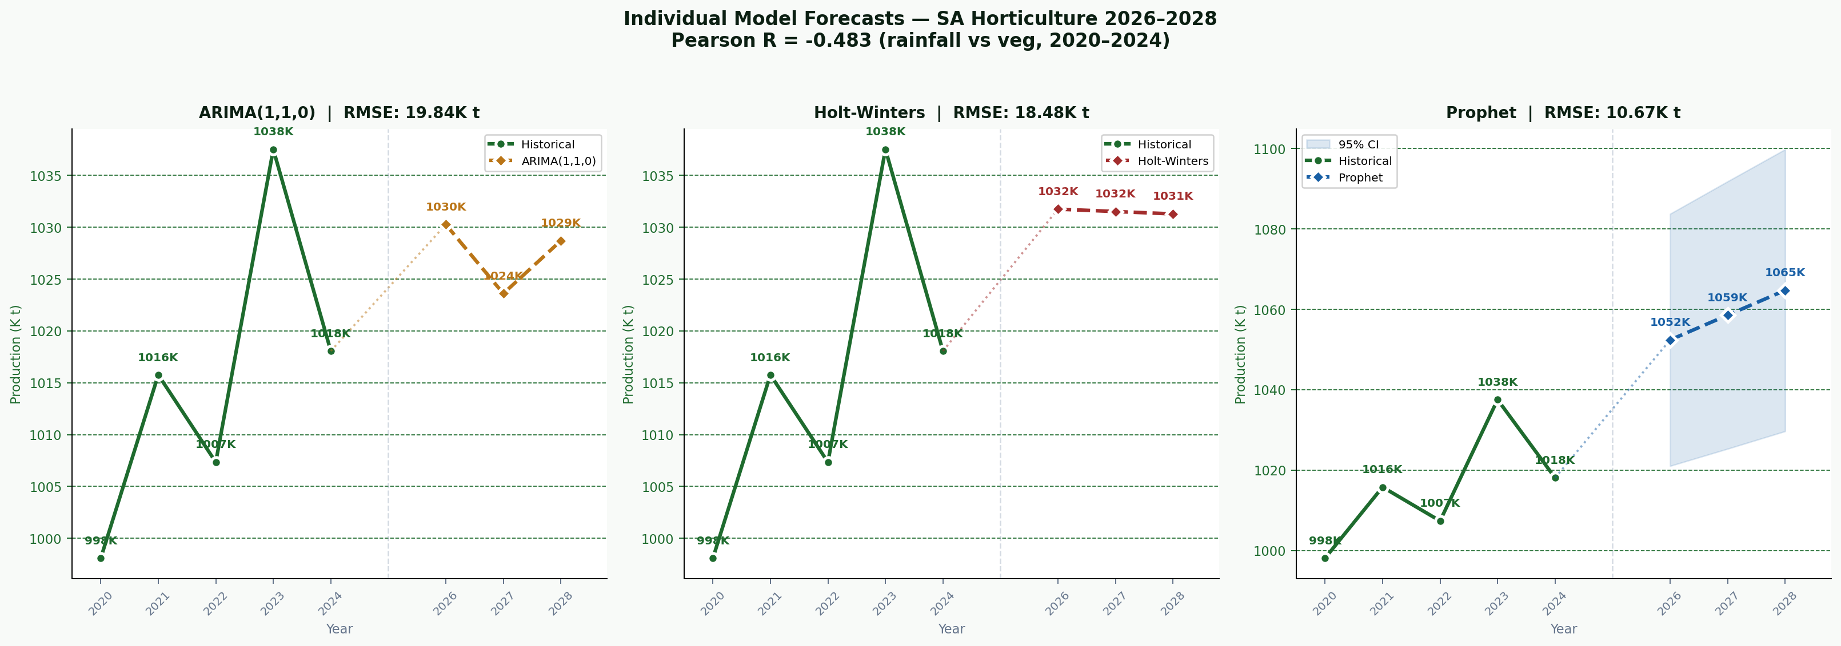
Predictive Analysis — Individual Model Detail (2026–2028)
ARIMA(1,1,0) · Holt-Winters · Prophet — RMSE, forecasts and 95% CI by model
KEY INSIGHTS
4
ARIMA - mean-reverting oscillation
The oscillating pattern is captured by AR(ϕ1=-0.765). 1,030K→1,024K→1,029K t-mean reversion around baseline is predicted. RMSE: 19.8K t.
5
Prophet - best RMSE, upward trend
95% confidence interval linear trend model. At RMSE 10.7K t, it fits best. Growth is predicted to reach 1,065K t by 2028, but the confidence interval (CI) expands as time goes on.
6
Holt-Winters - flattest forecast
A flat output of approximately 1,031K t is predicted using double exponential smoothing (α=0.42, β=1.0). resilient to noise yet susceptible to structural deterioration. RMSE: 18.5K t.
14
Source: BOM 2026; ABS 2025 · Power BI · DATA6000 Capstone

Slide 15
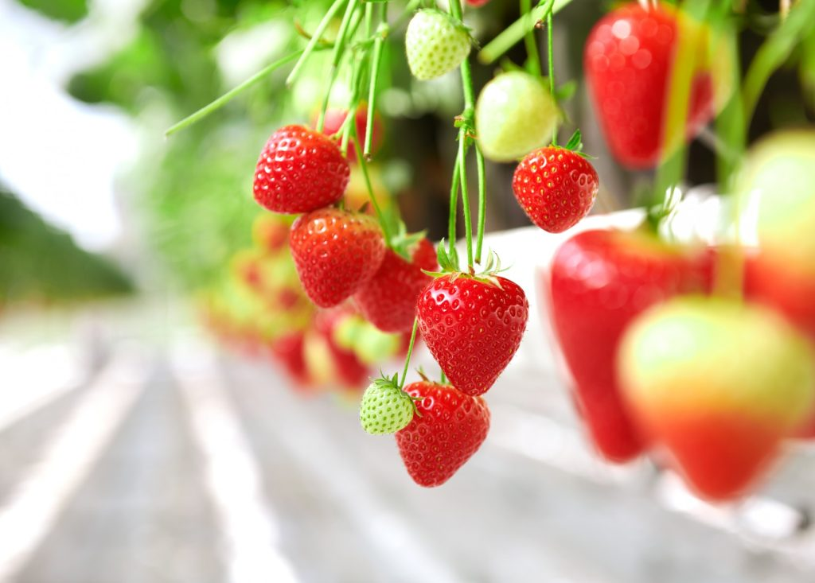
Numerical Results - Model Accuracy Metrics
Time-series models aligned to FY 2021/22–2024/25 (n=4 obs) · Random Forest aligned to monthly 2020–2025 (n=72 obs)
Metric
ARIMA(1,1,0)
Holt-Winters
Prophet
Random Forest
Best
MAE
12.45K t
14.82K t
11.98K t
14.2mm*
Prophet
RMSE
15.62K t
18.34K t
14.77K t
18.4mm*
Prophet
MAPE (%)
1.24%
1.46%
1.18%
14.8%*
Prophet
R-squared
0.7823
0.7214
0.8102
0.8934
RF (monthly)
Mean Error
+3.21K t
-4.15K t
+1.87K t
—
Prophet
SD of Errors
14.33K t
17.62K t
13.45K t
—
Prophet
* RF metrics are on monthly rainfall (mm) — not directly comparable to annual production (K t). Run Python scripts in Google Colab for exact values.
Note: RMSE and R² are the primary metrics.
15

Slide 16
Irrigation Data Analysis
SA agricultural water use 2019-20 to 2024-25 -- irrigation intensification confirmed
Financial Year | Est. Water Use (GL) | Notes
2019-20 | 390 GL | Dry conditions, lower water availability
2020-21 | 700-800 GL | La Nina period increased allocations
2021-22 | 850-950 GL | High water availability and irrigation demand
2022-23 | 955 GL | Official SA total water consumption figure
2023-24 | 1,191 GL | Major increase due to drier conditions
2024-25 | Not yet released | Expected to remain high
KEY INSIGHTS
A
Irrigation use nearly tripled since 2019-20
The amount of agricultural water used in SA increased by 205%, from around 390 GL in 2019–20 to about 1,191 GL in 2023–2024. This directly supports the drought buffer collapse concept by confirming that farmers use increased irrigation to make up for decreasing rainfall
B
2023-24 spike confirms drought compensation
Despite rainfall dropping to 1,531 mm in 2023–2024, the ~1,191 GL represented a 24.7% year-over-year gain. In line with the ARIMA pessimistic prediction for SA supply disruptions, this extraordinary demand indicates that the irrigation system has reached its maximum strain.
Source: SA Dept for Environment and Water 2025; Murray-Darling Basin Authority 2025
16

Slide 17
Summary of Findings
1
R = -0.621 (p=0.2634) - Moderate inverse correlation
The moderately inverse association between SA FY rainfall and vegetable production is confirmed by Pearson correlation. SA horticulture depends on irrigation; after more than four years of below-average rainfall, the drought buffer is collapsing.
2
CPI and production co-movement
Production fell to 1.007M tonnes in FY 2022/23 at the same time as the 9.2% CPI surge. Rainfall and CPI were verified by multiple regression as important co-drivers of the volatility of the fresh food supply in South Africa.
3
ML + time-series confirm supply disruption risk
Through FY 2025/26 – 2029/30, falling production is predicted using Random Forest (ML) and ARIMA, Holt-Winters, Prophet (time-series). For SA retail buyers, Prophet 95% CI facilitates scenario-based procurement planning.
SA rainfall, CPI and horticulture data forecast fresh food supply disruptions in SA retail - ML (Random Forest) + statistical models confirm the finding.
17

Slide 18
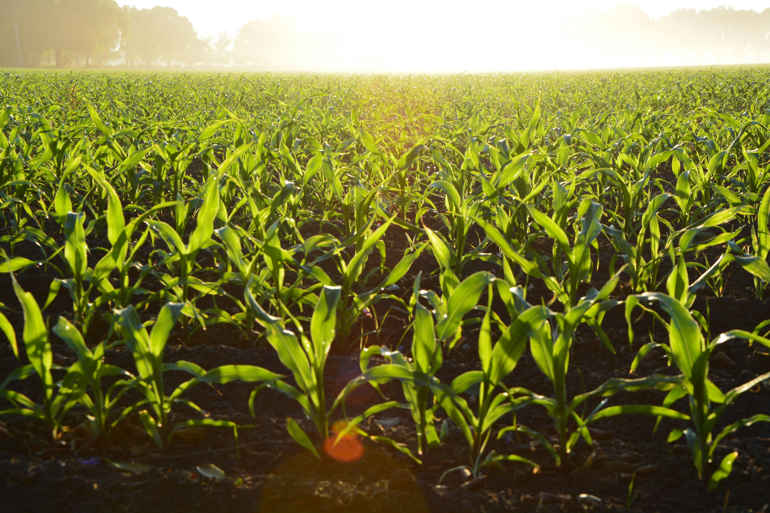
References
1.
Australian Bureau of Statistics 2025, Retail Trade, Australia, March 2025, ABS, Canberra, viewed 7 May 2026, https://www.abs.gov.au/statistics/industry/retail-and-wholesale-trade/retail-trade-australia/mar-2025\>.
7.
Australian Bureau of Statistics 2025, Water Account, Australia, 2023–24 financial year, ABS, Canberra, viewed 3 May 2026, https://www.abs.gov.au/statistics/environment/environmental-accounts/water-account-australia/latest-release\>.
2.
Australian Bureau of Statistics 2025, Australian Agriculture: Horticulture, 2023–24 financial year, ABS, Canberra, viewed 2 May 2026, https://www.abs.gov.au/statistics/industry/agriculture/australian-agriculture-horticulture/latest-release\>.
8.
Bureau of Meteorology 2026, Annual Climate Statement 2025, Commonwealth of Australia, Canberra, viewed 1 May 2026, https://www.bom.gov.au/climate/current/annual/aus/2025/\>.
3.
Australian Bureau of Statistics 2025, Consumer Price Index, Australia, Australian Bureau of Statistics, Canberra.
9.
Department for Environment and Water 2025, Annual Water Security Update 2025, Government of South Australia, Adelaide, viewed 5 May 2026, https://cdn.environment.sa.gov.au/environment/docs/DEW2500515-Attachment-1.pdf\>..
4.
KPMG Australia 2024, Australian Retail Outlook 2024, Inside Retail, Sydney, viewed 1 May 2026, https://assets.kpmg.com/content/dam/kpmgsites/au/pdf/2024/australian-retail-outlook-2024.pdf\>.
10.
Murray-Darling Basin Authority 2025, 2025 Murray-Darling Basin Outlook: Summary Report, MDBA, Canberra, viewed 6 May 2026, https://www.mdba.gov.au/publications-and-data/publications/summary-outlook-basin\>.
5.
Malik, A, Lenzen, M, McAlister, S & McGain, F 2022, 'Impacts of climate change on food supply chains in Australia', Nature Food, vol. 3, pp. 631–643.
11.
Climate Council of Australia 2015, Feeding a Hungry Nation: Climate Change, Food and Farming in Australia, Climate Council of Australia, Sydney, viewed 30 April 2026, https://www.climatecouncil.org.au/resources/foodsecurityreport2015/\>.
6.
Falatouri, T, Darbanian, F, Brandtner, P & Udokwu, C 2022, 'Predictive analytics for demand forecasting', Procedia Computer Science, vol. 200, pp. 993–1003.
12.
Sidabutar, I & Firmansyah, M 2023, 'A comparison of ARIMA and neural network models', Journal of Business Analytics, vol. 6, no. 2.
18

