Slide 1
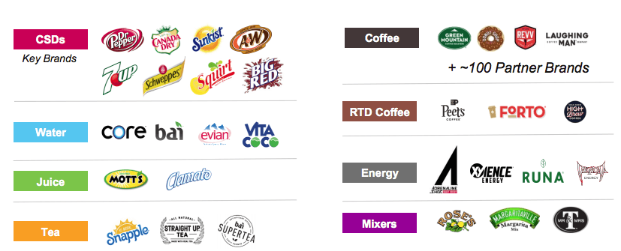
Company Overview
Overview
Key People/Management
An American conglomerate selling beverages such as coffee, hot cocoa, tea, water, fruit juice, and mixers
Diverse product range to cater to a large audience in North America
Popular products include: RC Cola, Schweppes, 7 Up, Snapple, and Dr Pepper
Formed in 2018 with the merger of Keurig Green Mountain and Dr Pepper Snapple Group
Chairman & CEO | Robert Gamgort
CSCO | Fernando Cortes
CFO | Ozan Dokmecioglu
President, Cold Bev | Derek Hopkins
President, Coffee | Mauricio Levya
CSO | Tony Milikin
Family of Brands
Revenue Breakdown (in USD millions)

Slide 2

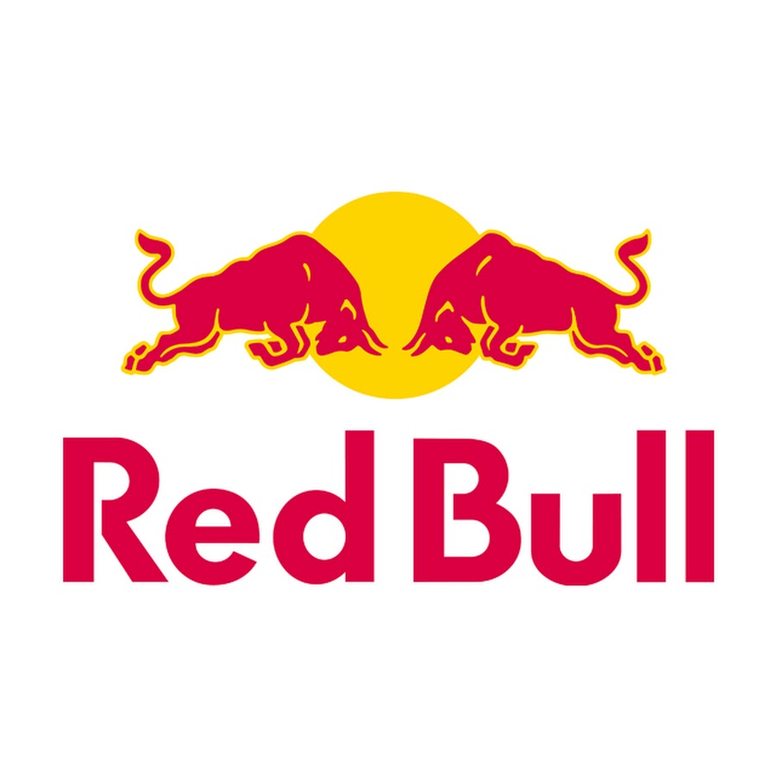

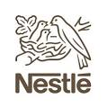
Competitors in Beverage Industry
Company
Description
Market Capitalization
An American multinational beverage corporation incorporated under Delaware's General Corporation Law, headquartered in Atlanta, Georgia
264.46B
Formed in 2018 with the merger of Keurig Green Mountain and Dr Pepper Snapple Group, provide a diverse range of soft beverages to cater to a large audience.
51.4B
A private energy drink brand founded in Austria and is today the largest shareholder of the industry, worldwide as of 2019.
Private
Known for the classic Pepsi drink, PepsiCo encompasses all aspects of the food and beverage market, owning subsidiaries including Gatorade, Frito-Lay and more.
230.47B
A Swiss multinational food and drink conglomerate and the largest food company in the world measured by revenue.
330.99B

