Slide 1
Spark Machine Learning Pipeline with Finance Data Set
Using machine learning to become a millionaire
Rui Wang (ruiw1)
Notes:
Here is the goal to become

Slide 2
Project Purpose
Problem: Having currencies trade records, how to find the pattern from records and help make decisions on future currencies trades.
Value proposition: if such solution could be found, it would be really easy to be a millionaire with a little principle – using discovered pattern to buy and sell concurrencies at the right time!

Slide 3
Analytic Approach Overview
The basic approach is to use general machine learning to learn the pattern. Basically machine learning involves data preparing and feature extraction, platform selection, model selection, model training and testing. My approach exactly obey above steps.

Slide 4
Overall Pipeline
Splitter
Extractor
Random Forest
Transformer Transformer estimator
Splitter splits a row read from CSV file to elements.
Extractor extracts feature vector from elements vector.
Random Forest learns the model.
Notes:
Splitter is a transformer, which splits a row read from CSV file to elements.
Extractor is a transformer, which extracts feature vector from elements vector.
Random Forest is a estimator, which learns the model.

Slide 5
Data and Features
The first step is preparing data and feature extraction.
The initial data saves into CSV format, and provides detail of trades. Spark reads data from CVS file, two transformers compute three different features, that is min, max, and average of bid prices in a period of time, and label data based on if making money.

Slide 6
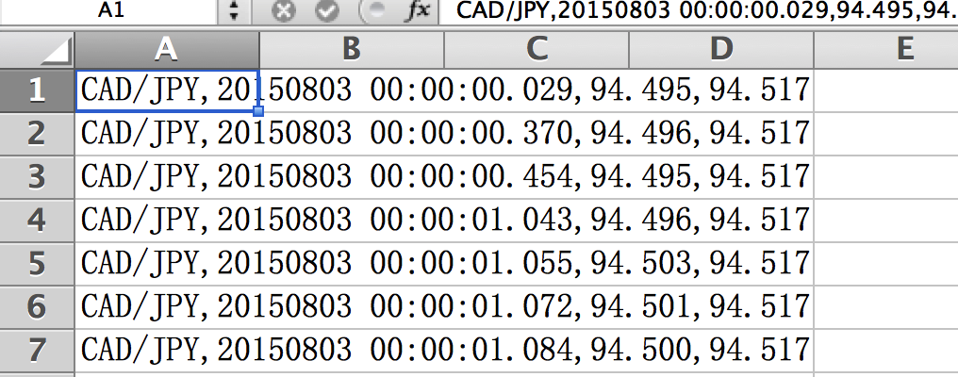
Sample of Data

Slide 7
Platform Selection
Because everyone use computers rather than themselves to train model, we have to use some kind of platforms.
The platform I use is spark, and the reason is speed. Spark is really fast because it puts all data into memory. Access memory is fast than accessing disks or SSDs.(https://en.wikipedia.org/wiki/Apache_Spark)

Slide 8
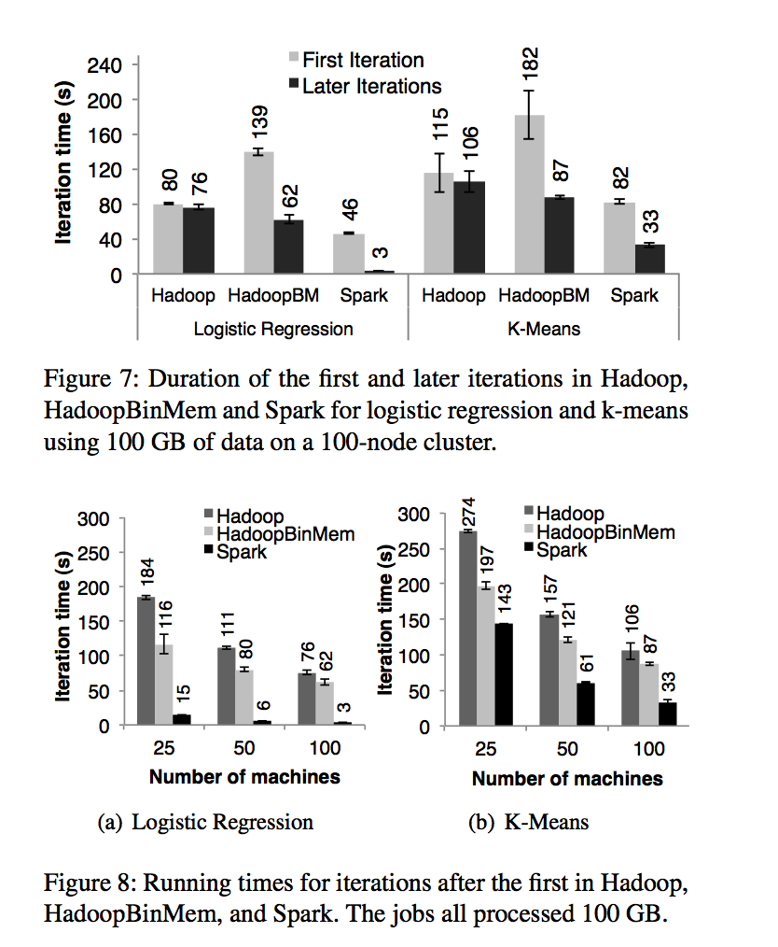
Comparison between common platforms
(Zaharia et al., 2012)

Slide 9
Model Selection
There are plenty of machine learning models that could be used to finish my task. I choose random forest.
Fandom forest is actually an aggregation of decision tree. One disadvantage of decision tree is overfitting, and fandom forest is pretty robust and correct the overfitting problem of single tree. (https://en.wikipedia.org/wiki/Random_forest)

Slide 10
Training and Testing
The next step is training and testing data.
I have 10000 instances. 80% is categorized as training set, and 20% is test set.
Since I have three features, I train the forest with 3 trees and each one use two features for tree splitting.

Slide 11
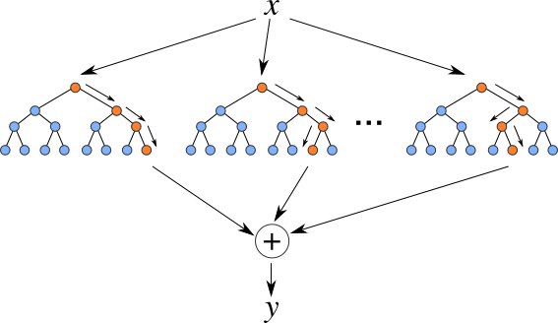
Forest Example
http://en.likefm.org/artists/images/Random+Forest

Slide 12
Results
The metric I use is accuracy, which is computed by (number of correct prediction) / total test instances.
My accuracy is about 0.28, which is less than the 50% (flip coin approach). 566 out of 2000 instances were classified correctly.

Slide 13
Error Analysis
I guess The first reason of the bad result, is features. I only have three features, and these features couldn’t give me enough information of trades.
There are definitely some features related to time that could show the essence of currency trades, like the data classified into weekdays.

Slide 14
Error Analysis
The second reason of the bad result, is trends. Is there really patterns exist in the data, which can be mined by me? I just cannot prove it.
So if I can know about the trends, maybe I can improve my solution to get a better result.

Slide 15
Actionable Information or Insights
There should be an independent project that focuses on Finance feature engineering. Without good understanding on Finance data, it is hard to extract good features and definitely leading to inaccurate result.

Slide 16
Future Work
The first thing is to learn Finance knowledge and to understand the data, the trends.
The second thing is to put more time on feature engineering and extract better features.

