Slide 1
Vaccines
Amily Luo
María Ten
Elizabeth Allum
AIMS:
Store details of patients, hospitals and staff
Store information about the vaccines
Log vaccinations
Notes:
Log the vaccinations that are administered, including critical information such as which vaccines were given to who, when, where, and who administered them.

Slide 2
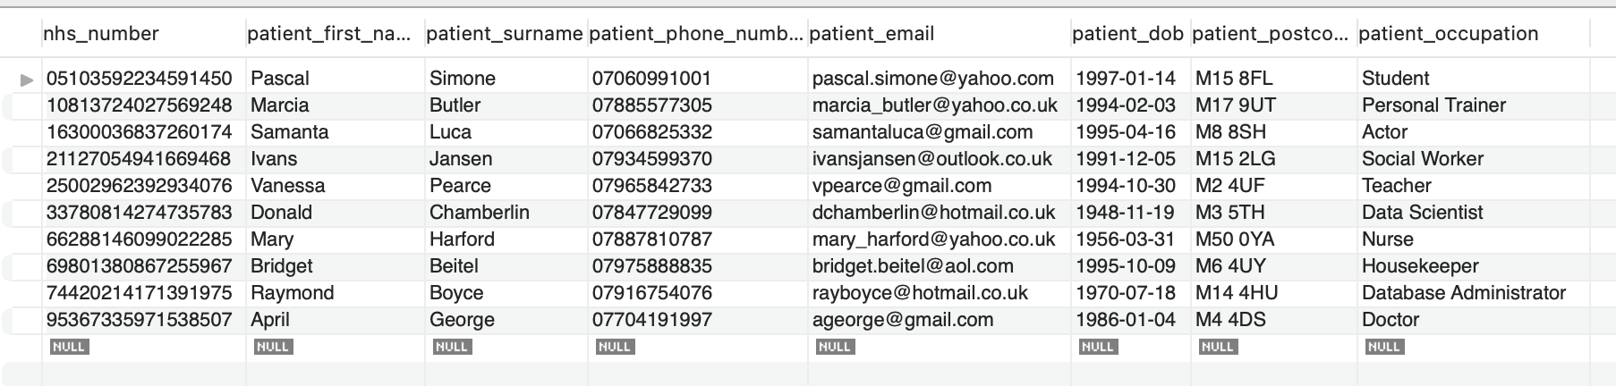
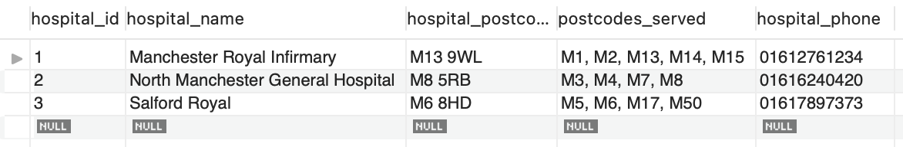
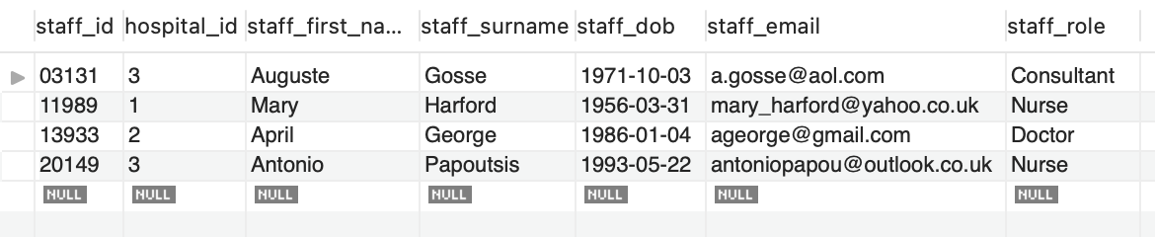
Patient Details
Hospital Details
Staff Details

Slide 3
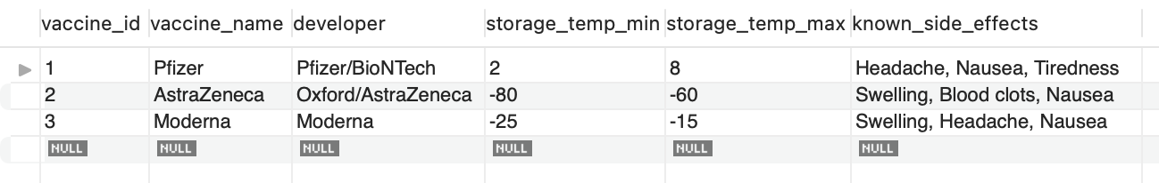
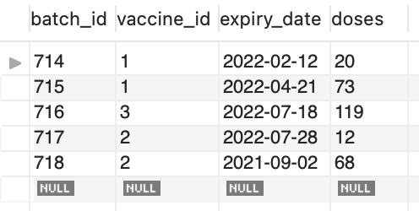
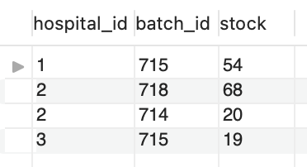
Vaccine Info
Batch Info
Batch Distribution

Slide 4
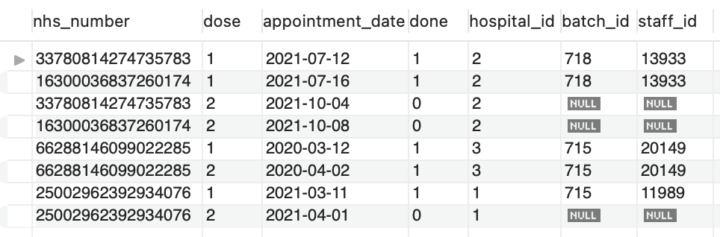
Patient Vaccine History

Slide 5
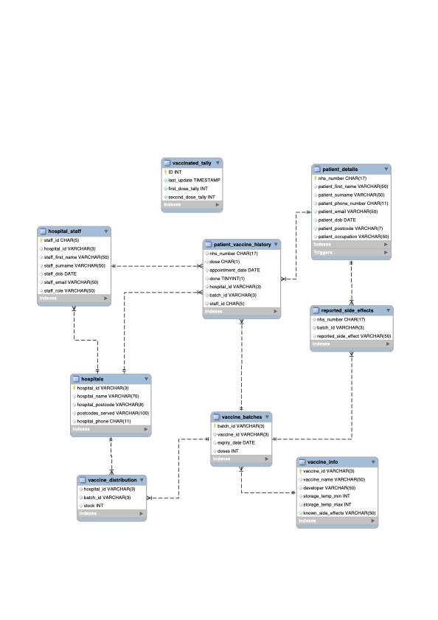
ER Diagram

Slide 6
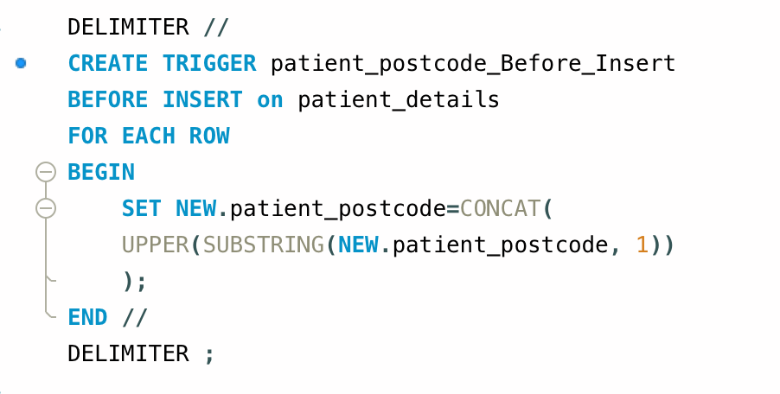
Ensuring consistent formatting
Trigger
M14 9ig M14 9IG

Slide 7
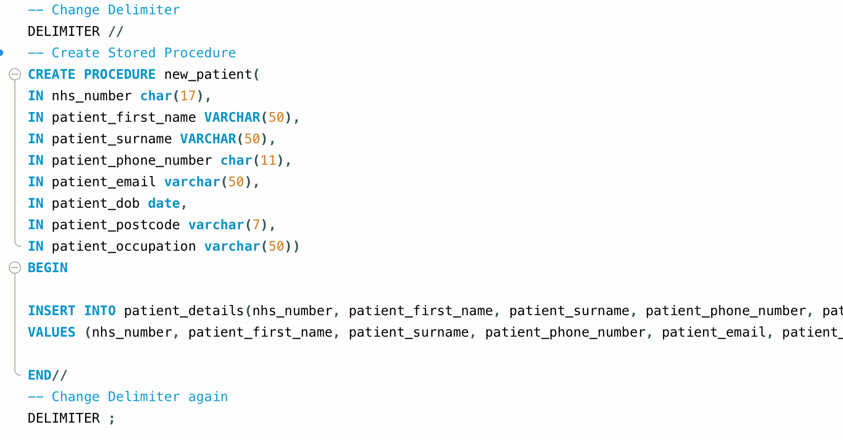
Adding a new patient
Stored Procedure

Slide 8
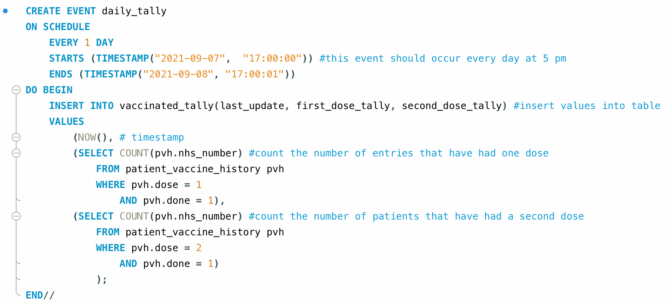
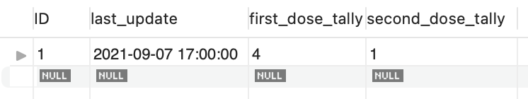
Logging the progress of the vaccine rollout
Event

Slide 9
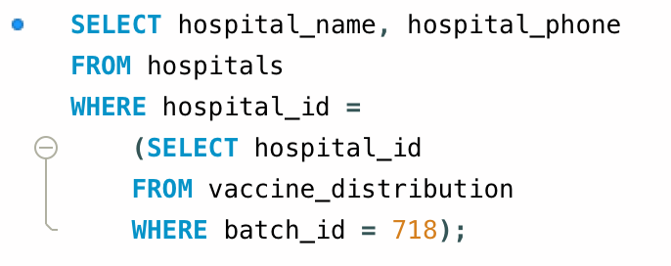
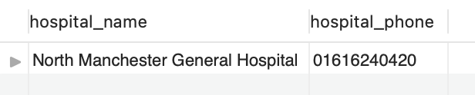
There was a problem with batch 718!!!
Subquery

Slide 10

Thank you for your attention ☺

