Slide 1
Pixel Props
Steven Keyes and Becca Greene

Slide 2
Overview
Pixel Poi and Pixel Staff
Videos

Slide 3
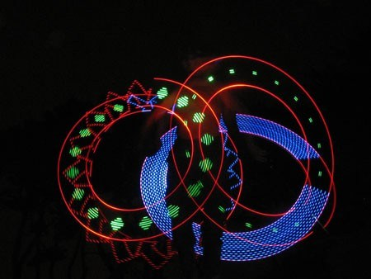
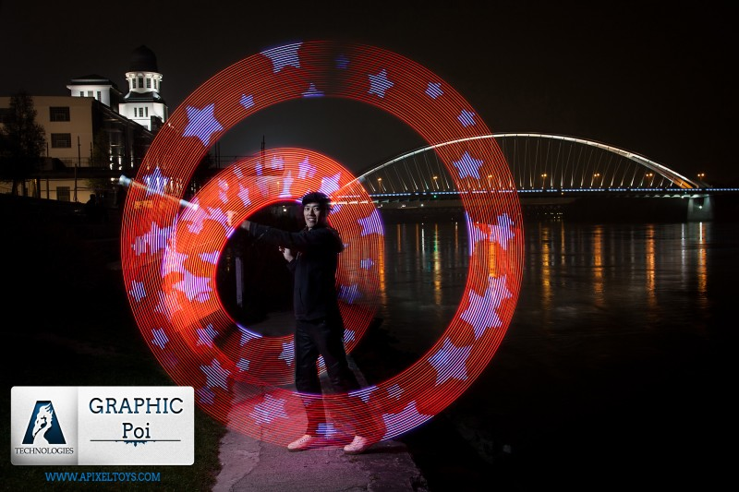
Notes:
From: http://hackadaycom.files.wordpress.com/2008/08/poiplay.jpg?w=450&h=338
And apixeltoys.com

Slide 4
Design – board
Wireless dude
Microcontroller
LEDs
(individually addressable)
Gyro
(digital, 3 axis)
Accelerometer
(digital, 3 axis)

Slide 5
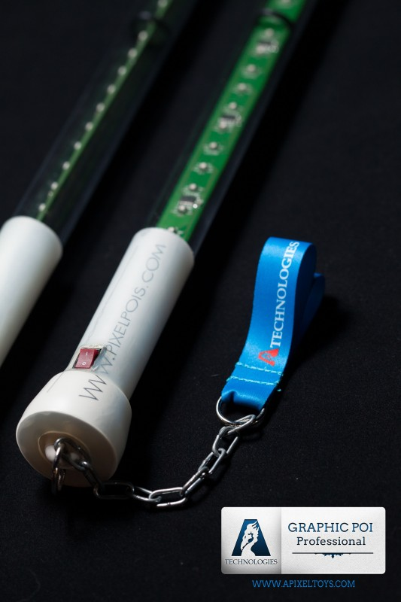
Design – casing
Board and LED strip inside plastic tube
Leashes for poi
Extended tube for staff
Notes:
From http://www.apixeltoys.com/p/154/pixelpois-profesional

Slide 6
Measurable events and values
Angular velocity
Angular acceleration
Angular position
Radius of rotation
Radial acceleration
Poi phase
Stalls
Tosses
Floats
Flowers
Events from outside computer (like music cues) over wireless

Slide 7
Budget
Category | Item | Cost ($)
 | Prototype components | 50
Poi | LEDs | 90
 | ICs | 40
 | Batteries | 15
 | Casing | 15
Staff | LEDs | 90
 | ICs | 20
 | Batteries | 10
 | Casing | 20
Wireless stuff |  | 100
Board manufacturing |  | 500

Slide 8
Budget – details
Item | Cost ($)
Accelerometer | 5
Gyro | 7
Microcontroller | 6
LED strips (per meter) | 25

Slide 9
Timeline
November
Spec and choose parts
Order parts for testing
December
Test circuitry on breadboard and write code that implements the following
Communication with with gyro, accelerometer, and LEDs
Basic dynamics calculations
cursedlight library – Zach Banks
Lay out and order board and other final hardware

Slide 10
Timeline
January
Manufacture case
Assemble circuitry
Write code that uses sensor input to drive LEDs in certain patterns
Extra time
Board revisions
Wireless communication

Slide 11
Questions?

