Slide 1






Hackathon 2022 Applying sentiment analysis on Alternate/ Social Media data (Twitter) to predict cryptocurrency trends
Team Data Pirates:
Amal Joseph (Forward Deployed)
Bhanu Yeragani (Technology)
Puneet Mittal (Technology / CCG)
Rahul Bighane (Product)
Vipul Agarwal (Technology)

Slide 2
Agenda
Background
Problem Statement
Prototype Solution Demo Walkthrough
Visualization & steps towards a product feature
Learnings

Slide 3
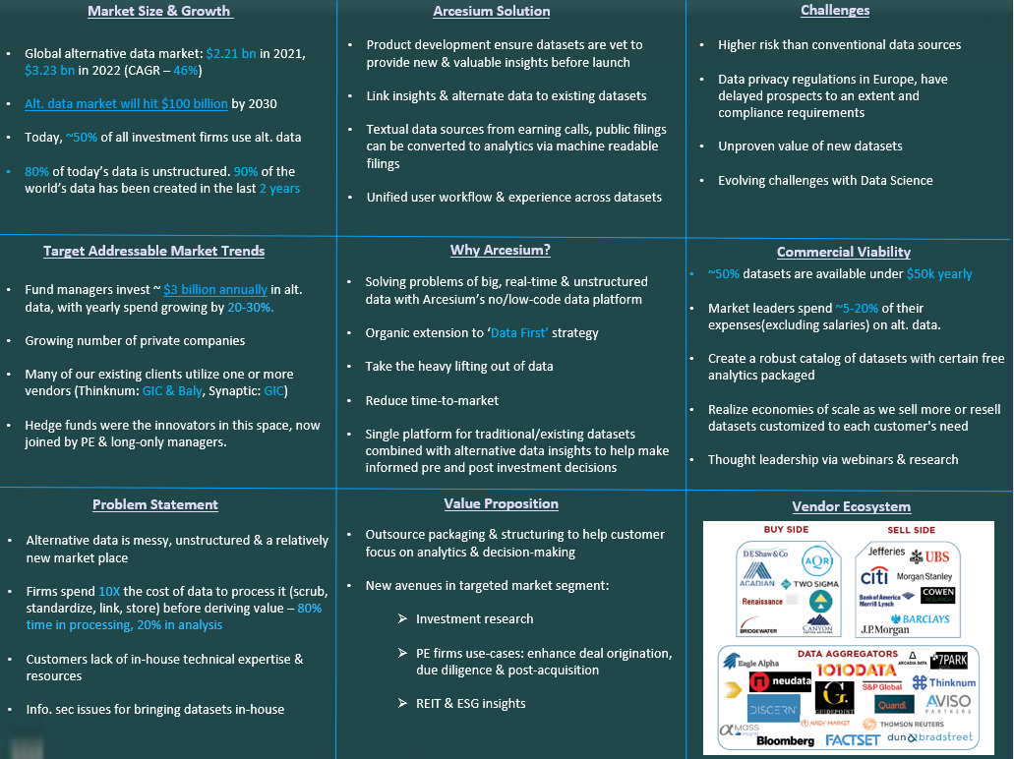
Background (From Power Pitch 2022 Competition) – Overall Winning Pitch

Slide 4
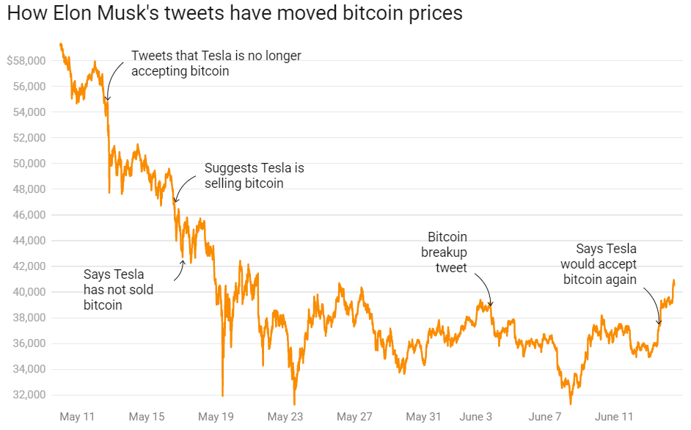
Problem Statement
The market capitalization of cryptocurrencies increased from $17 bn in 2017 to $2.25 tn in 2021. (Over a 13,000% ROI in 5 years)
Even with this growth, cryptocurrencies remain incredibly volatile, with their value being impacted by a multitude of factors: Market trends, politics, technology….and social media Twitter!! Yes, that's right.
There have been instances where their prices were impacted on account of tweets by famous personalities.
Analyze correlation between social media (Twitter Data) sentiment on the price change of a crypto asset (Bitcoin) by using Machine Learning (ML) and Natural Language Processing (NLP) models
With over 500 million tweets generated daily, Twitter is full of opinions, jokes, mentions, & more from people all over the world.
This unstructured data (tweets) can be analyzed as sentiment data which analyze the feelings of the users sending those tweets

Slide 5
Why Bitcoin and what affects crypto prices?
In 2017, Bitcoin accounted for more than 80% of the overall market capitalization in cryptocurrency markets. Though by 2022, that share has reduced to less than 50%
Cryptocurrency for investors is that it is traded 24x7 and the market data is available round the clock. This makes it easier to analyze the correlation between the Tweets and crypto prices.
The reality of currencies like Big Eyes and Ethereum is becoming more probable.
TRG datacenters’ research team discovered that attitudes about cryptocurrencies on Twitter were inextricably tied to how they were priced in actual terms at the moment.
How cryptocurrencies are using social channels
Educating buyers
Creating communities like Medium
Exchange using social media – customer support & alerts, news, updates, recruitment, news, addressing rumors, geo-political news

Slide 6
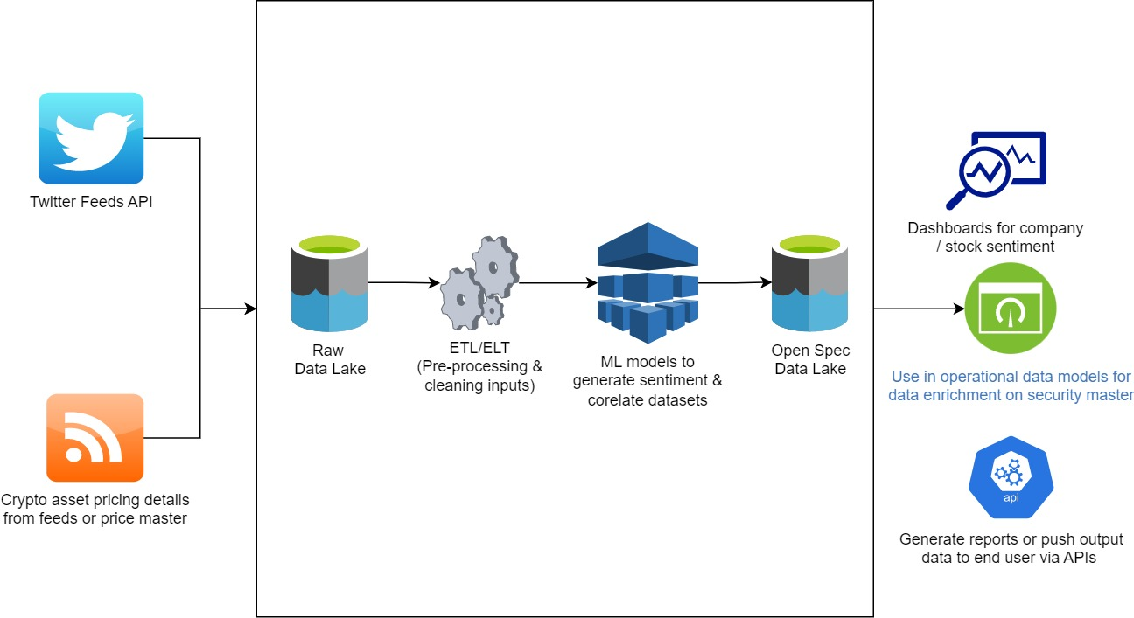
Visualizing a Product Solution (Future State)

Slide 7
Prototyping Solution (Steps)
Connect to Twitter via Tweepy API using elevated access role
Fetch data (role limits real time data sourcing for limited feeds per call)
Rely on Kaggle to fetch historical data for Tweets associated to Bitcoin (16M records across a wide date range) – (2012-2019)
Extracted area of interest data for (1.5M records for 1.5yrs of data) and pre-processed/cleaned data these records for removing noise, tags etc.
Using unsupervised libraries for Text blob and VADER, generate subjectivity, polarity and a sentiment score
Fetched historical data for Bitcoin prices via Kaggle for same date range
Grouping price data by hour and day range for apple to apple comparison with Twitter sentiment data
Segregate data for training and testing in ~ 85:15 ratio
Utilizing LSTM classifier model based on TensorFlow libraries for establishing correlation between Twitter Sentiment and Bitcoin price

Slide 8
Prototyping Solution (ML Models Analyzed)
Sentiment analysis is the task of determining the emotional value of a given expression in natural language.
Text Blob | VADER (Valence aware dictionary for sentiment reasoning) | Flair
It is a simple python library that offers API access to different NLP tasks such as sentiment analysis, spelling correction, etc. Output: Polarity - float that lies between [-1,1], -1 indicates negative sentiment and +1 indicates positive sentiment. Subjectivity is also a float which lies in the range of [0,1]. Subjective sentences generally refer to personal opinion, emotion, or judgment. Model ignores words that it doesn’t know, it will consider words and phrases that it can assign polarity to and averages to get the final score. | Popular rule-based sentiment analyzer. It uses a list of lexical features (e.g. word) which are labeled as positive or negative according to their semantic orientation to calculate the text sentiment. Vader sentiment returns the probability of a given input sentence to be positive, negative, & neutral. These 3 probabilities will add up to 100%. Vader is optimized for social media data and can yield good results when used with data from Twitter, Facebook, etc. This method only cares about individual words and completely ignores the context in which it is used. | Simple to use framework for state of the art NLP. Supports functionalities such as: Pre-trained sentiment analysis models, text embeddings, NER, and more. Useful for custom sentiment analyzer for domain specific models, it is possible to train a classifier using flair using input dataset(s). The drawback of using a flair pre-trained model for sentiment analysis is that it is trained on IMDB data and this model might not generalize well on data from other domains like twitter.

Slide 9
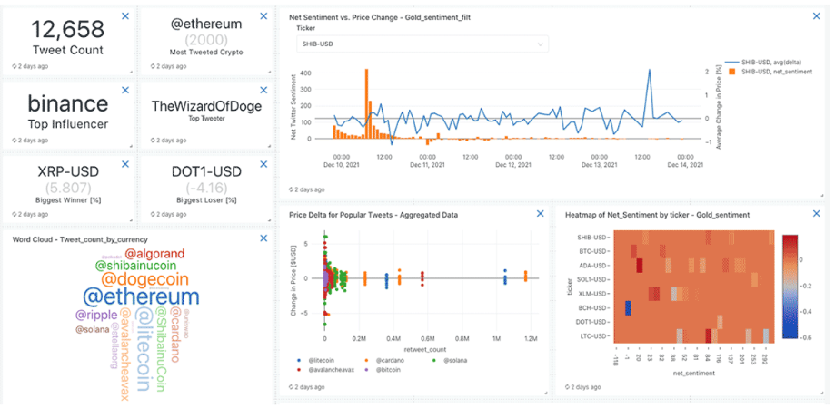
Dashboards (Future State)
Generate visual dashboards / graphs /maps similar to the above (Source: Databricks)

Slide 10
Learnings/Outcomes from Hackathon Implementation
Major time was spent on:
Data gathering from Tweepy APIs considering there are multiple versions of the API and limited data can be pulled based on the role available
Data cleanup and pre-processing for Twitter data is a time consuming activity for the dataset we were interested in
Analysis of various ML models for NLP and correlation analysis was time consuming as research papers indicated no single model that can be uniformly used for ML/NLP analysis
Using generic tools for web scraping and Data Platform tools for real-time or big data for loading datasets into data lake for cleansing and analysis would simplify this approach for generic implementation and scale across other crypto currencies & asset classes
Libraries primarily utilized :
Pandas, Tweepy, TensorFlow, LangDetect, NLTK, VADER
Spend more time on final data analysis by implementing more models for correlation & data visualization

Slide 11
Thank you!

