Slide 1
DORY
Your Personal Health Companion App

Slide 2
INDEX
Introduction
How it Works
Problems that we Overcame
The App Design
Home Page
Connect with Doctor
Book an Appointment
Dory
Dashboard
Advantages
Security
Conclusion

Slide 3
Introduction
Dory is the one app that you will ever need to live a healthy life. On registration every user is given a unique id by which they can be identified at hospitals. Doctors can upload the patients' conditions and the medicines to be consumed directly to the patient's profile.The inbuilt assistant in the app can then go through the prescription and remind the user when they need to take the medicines. The assistant also tracks your physical and mental health by collecting data across all your smart devices including Fitness Bands.

Slide 4
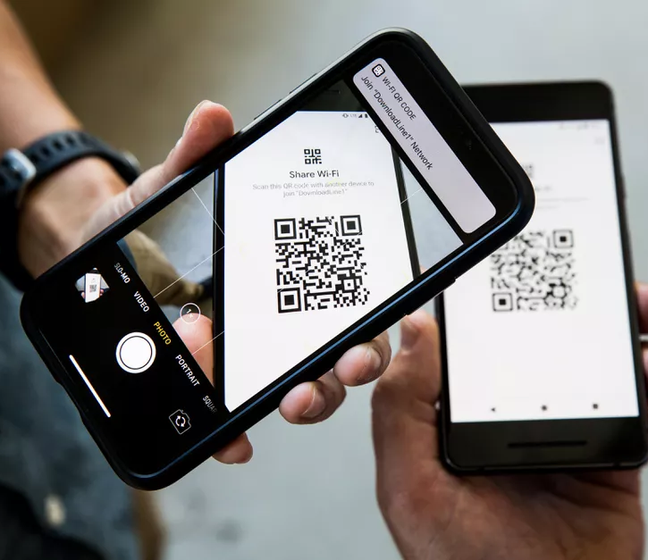
How it works
The User visits the hospital and shares his unique id from the app in the means of a QR Code
The Doctor can scan the qr and then the patient's entire medical history will be shown at his screen
He then conducts the rest of the check-up and edits the prescription and uploads it back to the App’s server and then tells him to take a Test from a lab
The user can go to any lab and show the QR code, once the tests are done the lab can upload the same back to the app where the doctor can access it right away and connect back with the user through the app. Thus, reducing the need to visit the hospital again
The Assistant inbuilt in the app will send a notification when it's time to consume a medicine.

Slide 5
Problems that we Overcame
Enabling a patient-centered information exchange system
An easily accessible system for the patients
Designed to support patient participation in health care decision making and treatment activities.
Provide patients with an electronic copy of their health information
Provide clinical summaries for patients for each office visit
All the past records of the patient can be accessed easily
Users can review and access their documents so that they don't need to constantly rely on a doctor

Slide 6
2. Personal Medical Assistant
Management of appointments and schedules with ease
Reminds the user about the daily intake of their medicines timely and the required doses
Notifies the doctor or guardian in case of emergencies
Chat bot constantly checks upon the user and keeps track of their daily activities, unusual records will be reported
Provides list of diets and exercises created by medical experts
Data Management at its finest ,to manage all your administrative and documentation work.

Slide 7
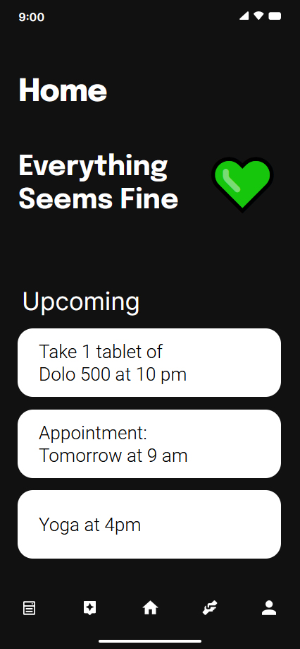
HOME
This is the main page which is shown when the app is opened.
It mainly indicates the status of the user's conditions which is processed from the data the app gets from the smart fitness accessories...
The bottom section shows upcoming events or notifications like appointed time to visit the doctor and reminders to take the next medicine

Slide 8
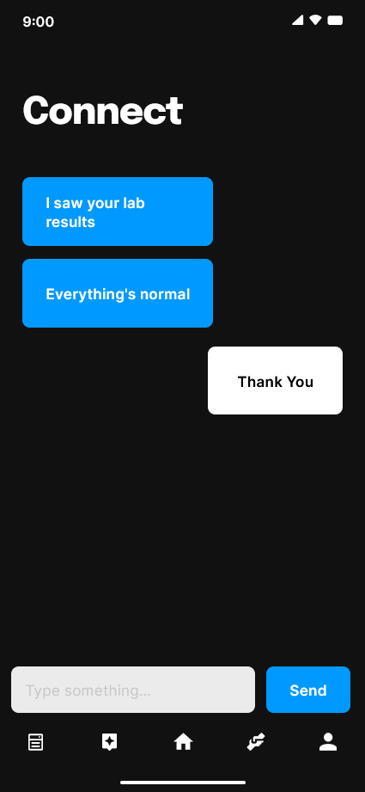
Connect with doctor
From this page, users can directly contact their doctors in case there's a sudden emergency or to clear their doubts
This is also where doctors can reply to the lab results or give further instructions once the user has left the hospital
This can reduce the number of hospital visits a person should make

Slide 9
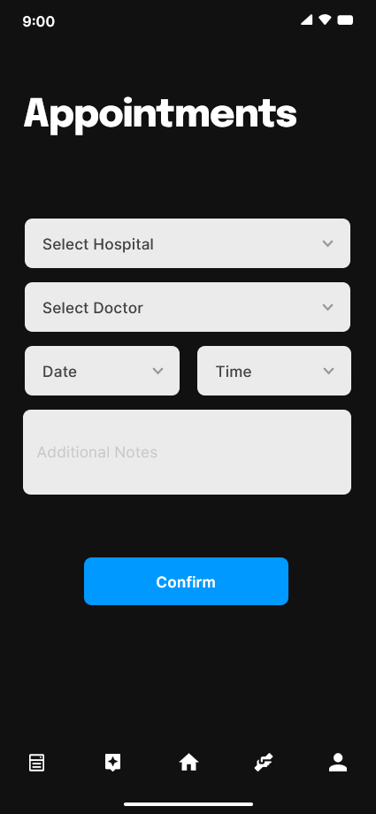
Book an appointment
This tab is for booking appointments to visit the hospital
Its as easy as selecting which hospital or the nearest one, then choosing from the doctor's available and then choosing the date and timeslot

Slide 10
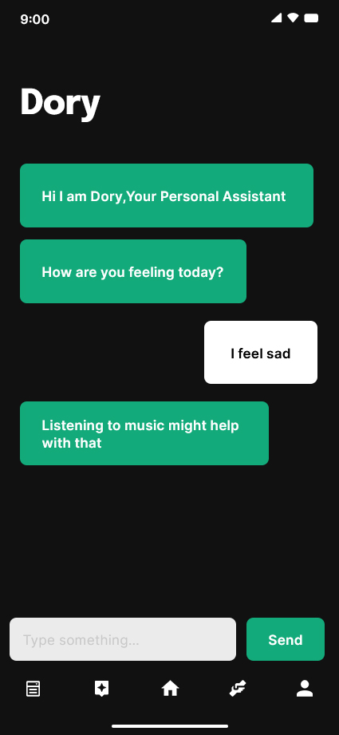
Dory-Your Personal Chat bot
Dory is like the google assistant of the medical world
The more you talk with it the more it understands your mental health
It keep tracks of your daily activities and can provide comprehensive list of diets and exercises
It can act as your Digital Therapist
It will regularly assess and responds to the user's lived experiences

Slide 11
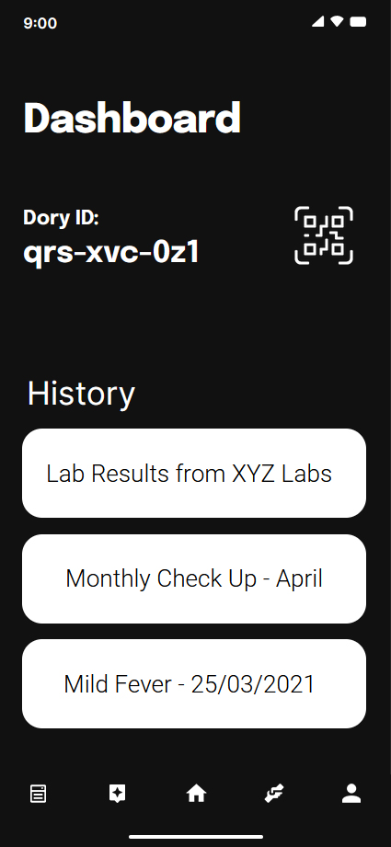
Dashboard
This is like the main profile page of the user
The Unique Id along with its QR code can be accessed from this page
All the previous medical prescriptions can be found here
The entire details and the medicines given can be seen by opening the required one from the history

Slide 12
Advantages
Easy access
Cost efficient
Easy to use for elderly people
Can always rely on
Improved patient- physician communication
24x7 availability
Higher accountability and greater flexibility
Less time consuming

Slide 13
Security – Embracing the Openness in Open Source Software
Medical Data is something that needs to be securely stored
Fully Encrypted Data Storing
Fully Open Source so anyone can go through the app's code and check for malicious code
Security flaws can be instantly found and the fix can be suggested by anyone in the community

Slide 14
Conclusion
Dory can be universally applied, and it is very practical for the use of ordinary people, especially the elderly. This app can improve our health sector up to an extent. Dory makes it easier for users to directly contact the doctor in case of an emergency or to clear doubts. Users can also make appointments from the nearest hospital.
Moreover, the inbuilt assistant can help people improve their mental health and suggest them ways to improve their physical health.
All the Data stored are fully encrypted and the app is fully open source.

