Slide 1


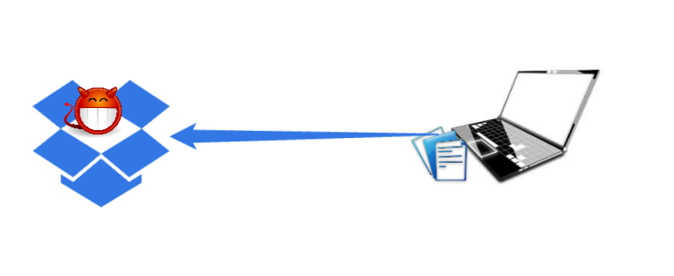


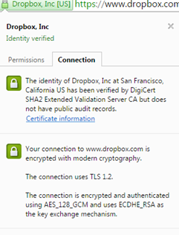
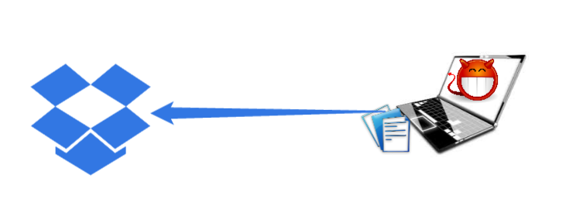
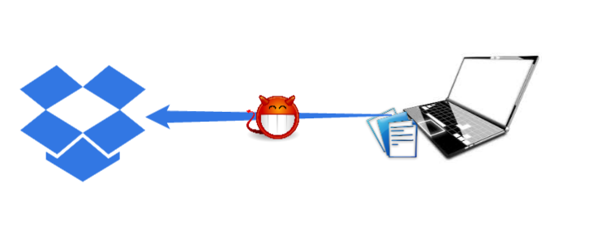
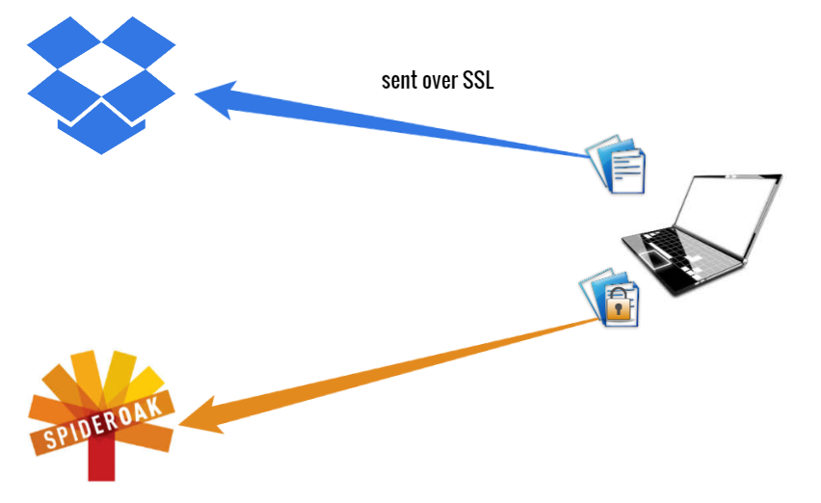
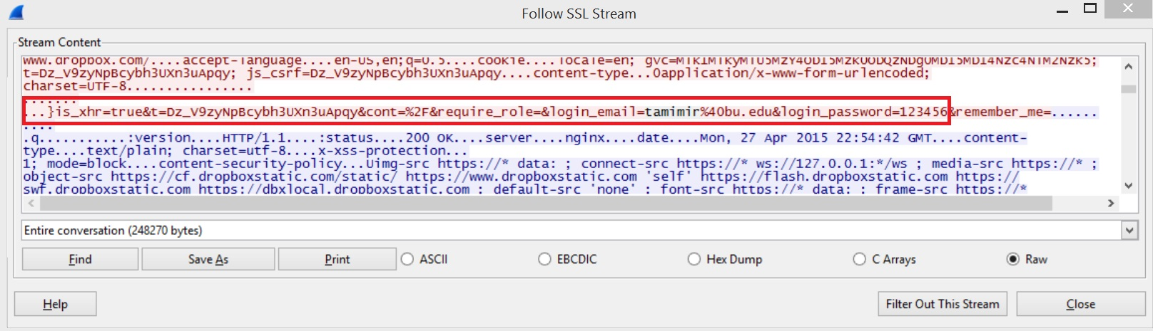
Dropbox is a file hosting
services that enables
uploading and sharing
files.
SSL connection to Dropbox:
Security of Dropbox’s website:
No mixed http/https content.
All cookies are secure & httponly.
No cross-user deduplication visible.
No ads or offsite sources.
Two-step verification.
Are users’ files really private?
Actually, no!
Dropbox employees can access your decrypted files.
Other storage services like SpiderOak encrypt data on user’s computer while Dropbox doesn’t.
- Attacker can get all files on Dropbox server, decrypt them.
- Learn usernames and passwords of everyone who communicates with Dropbox.
- Attacker can get all files on user’s machine.
- Attacker can learn all communication between user and server. - Download files user is uploading to Dropbox.
1.
2.
3.
References: www.dropbox.com
Tools: - Wireshark
- Chrome developer tools
Rasha Altamimi, Amal Kadi

