Slide 1


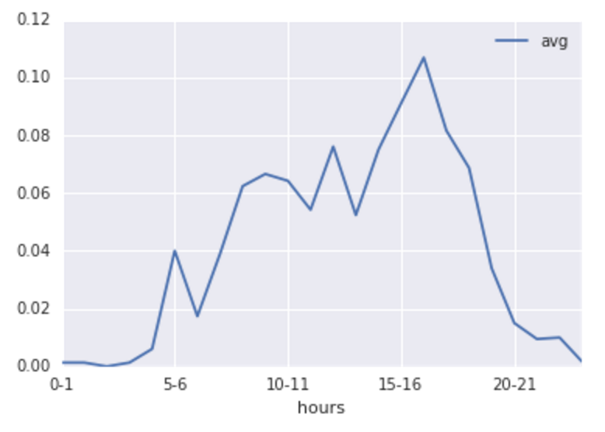
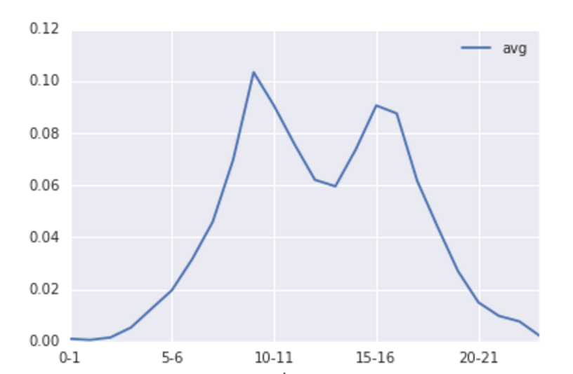
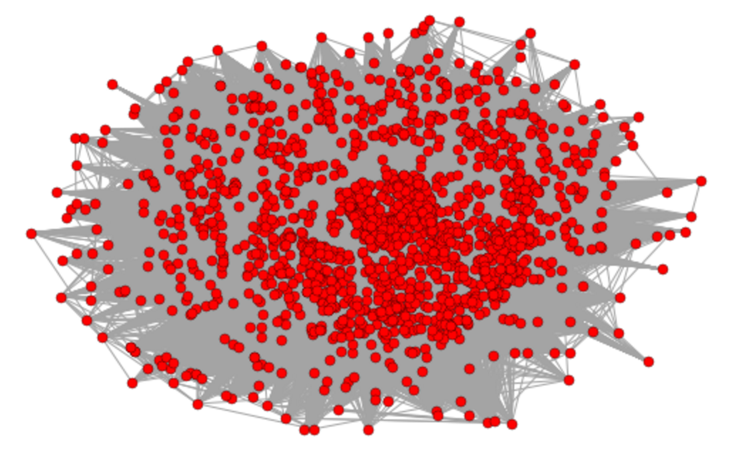
Introduction
Yelp has been a popular website for people to review businesses, and get suggestions from other users on new businesses to discover.
Goals
Cluster businesses based on similarity
Build a network graph of related users
Build a recommendation system to suggest businesses to a given user & suggest users who can be potential friends.
The dataset
A large dataset of multiple cities was provided by Yelp as part of a challenge, we only gathered the information we felt are necessary for our project, these were:
Business related: business_id, name, address, attributes, check-in times
User related: User_id, current friends user_ids.
Review related: User_id, business_id, rating.
Techniques & results
I – Clustering businesses based on Check-in times:
II – Creating a network of users:
III – Recommending businesses:
Conclusion
The conclusion
Future Work
With more computing resources we could build a larger network of more users
Optimize the recommending model
A graph network of 1664 users in Waterloo with 600K edges between them
Renqing Gao, Amal Kadi

