Slide 1


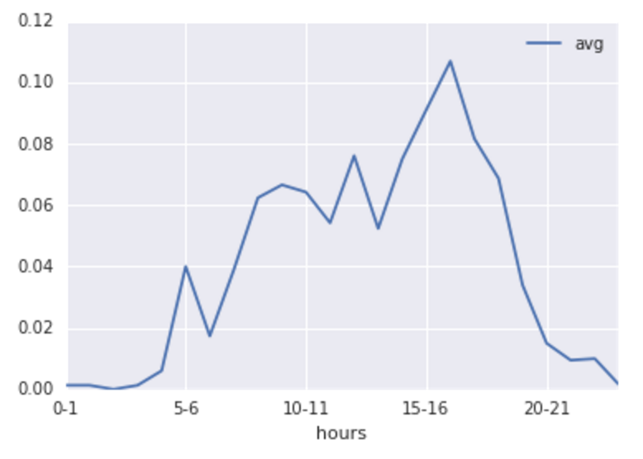
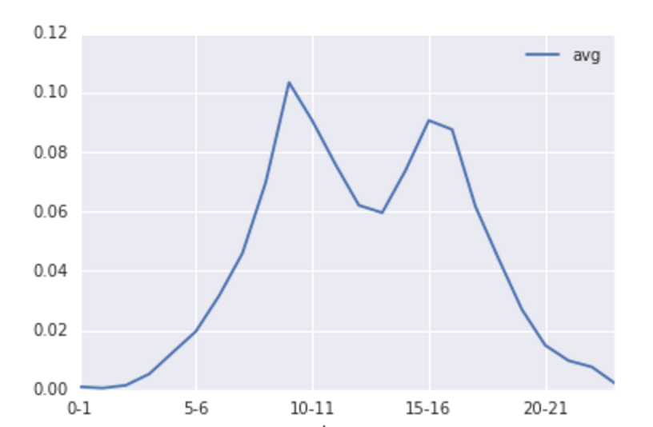
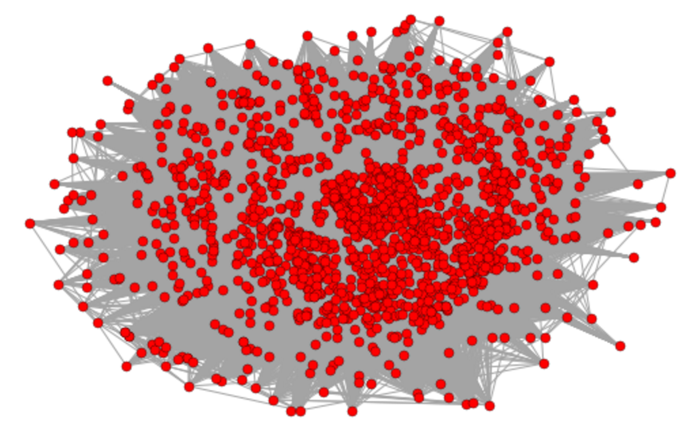
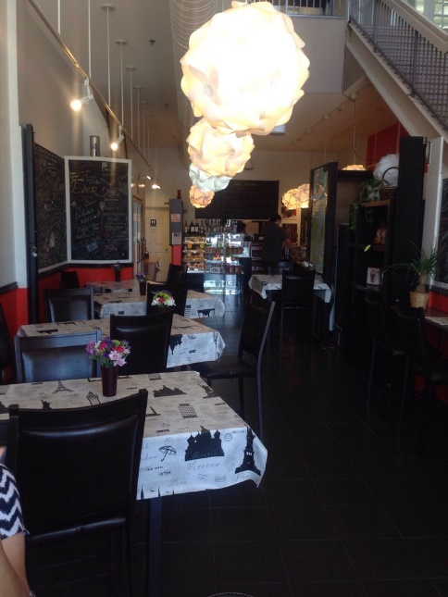
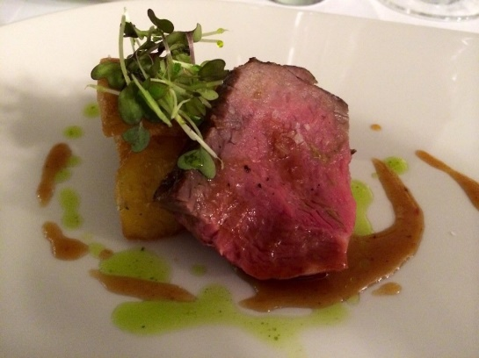
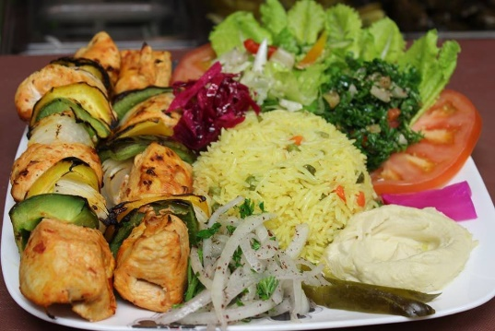
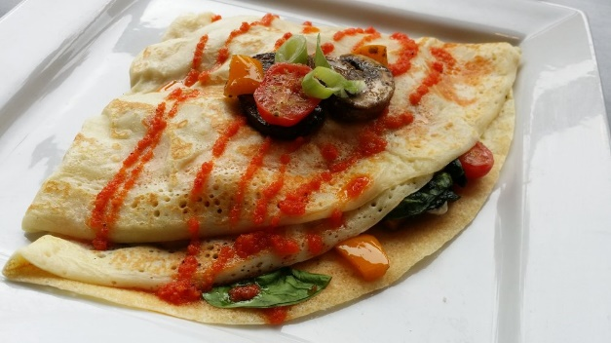
Introduction
Yelp has been a popular website for people to review businesses, and get suggestions from other users on new businesses to discover.
Goals
Cluster businesses based on similarity
Build a network graph of related users
Build a recommendation system to suggest businesses to a given user & suggest users who can be potential friends
The dataset
A large dataset of multiple cities was provided by Yelp as part of a challenge, we only gathered the information we felt are necessary for our project, these were:
Business related: business_id, name, address, attributes, check-in times
User related: User_id, current friends user_ids.
Review related: User_id, business_id, rating.
Techniques & results
I – Clustering businesses based on Check-in times:
II – Creating a network of users:
III – Recommending businesses:
We got user-based
recommendation
according to review
history (in any given
city).
Evaluation
To evaluate the recommendations we gave, we evaluated our rating prediction algorithm against the existing rating in our dataset. We used root-mean-square error (RMSE) to compute the error and it was 1.2 which is pretty good.
Conclusion
We implemented the recommending system according to the user’s review and their connection to other users. We also evaluated our recommending according to existed data using root-mean-square error. Our system could be used to recommend restaurants in different city and it could be used in travel website like TripAdvisor.
Future Work
With more computing resources we could build a larger network of more users
Optimize the recommending model
2 different clusters of average check-in time series
A graph network of 1664 users in Waterloo with 600K edges between them
Renqing Gao, Amal Kadi

