Slide 1
TEAM
Abiya John
Department of CSE
DIGITAL LEGAL AID PLATFORM • REVIEW 1
Devdath A R
Themis
Department of CSE
Amal K R
Department of CSE
An Integrated Digital Platform for Legal Aid, Document Automation,
and Case Management in India
Academic Year 2025–2026
Stack: Node.js · Hono · tRPC · Drizzle ORM · PostgreSQL · React · TypeScript

Slide 2
Abstract
Access to justice in the Indian legal ecosystem remains a significant challenge due to increasing case backlogs, procedural complexity, and limited access to reliable legal information. Citizens are frequently unable to navigate the system alone, while legal aid organizations lack a unified digital infrastructure to manage cases and reach those who need help most.
Themis is a full-stack legal-technology platform that simplifies legal processes and improves digital legal literacy through an integrated environment for legal knowledge discovery, guided legal assessments, automated document generation, secure document management, and case tracking. A citizen can search relevant legal information, complete a guided assessment, and generate editable complaints or RTI applications — without drafting them from scratch or consulting an advocate for routine paperwork.
A verification mechanism connects eligible citizens with verified legal aid advocates, while an interactive case timeline gives visibility into an otherwise opaque legal process — improving transparency, accessibility, and efficiency of legal-service delivery.
Themis — Review 1
2

Slide 3
System Study
Problem domain and platform objectives
1
Systemic Backlogs
2
Information Asymmetry
Indian courts face large case backlogs and slow procedural throughput, delaying justice for citizens.
Citizens with limited legal literacy struggle to interpret statutes and identify the correct remedy.
3
Fragmented Aid Access
4
Manual Paperwork
No unified channel connects eligible citizens to verified, credentialed legal aid advocates.
Drafting complaints and RTI applications from scratch is a major barrier to timely grievance redressal.
Objective
Build a production-ready platform that unifies legal search, guided assessment, automated document generation, secure storage, advocate matching, and case-timeline tracking into a single, accessible system.
Themis — Review 1
3

Slide 4
Functional Requirements
Core capabilities derived from requirement collection
Legal Knowledge Search
Advocate Matching
Natural-language search over statutes & rights, returned as simplified explanations.
Verification engine matches citizens to verified advocates by case type & jurisdiction.
Guided Legal Assessment
Case & Hearing Timeline
Question-based flow identifying the issue and recommending next steps or forms.
Tracks milestones and hearing dates with reminders to citizens and advocates.
Automated Document Generation
Role-Based Access
Editable complaints & RTI applications pre-filled from assessment responses.
Distinct roles — Citizen, Attorney, Coordinator, Administrator — with scoped permissions.
Secure Document Repository
Asynchronous Processing
Signed uploads, versioning, OCR processing, and complete audit trails.
OCR, generation and notifications handled off the request path for responsiveness.
Themis — Review 1
4

Slide 5
User Stories
Representative stories across platform roles
Citizen
Attorney
Coordinator
Administrator
“As a citizen, I want the platform to auto-generate a complaint or RTI application from my answers, so I don't have to draft legal documents myself.”
“As an attorney, I want to view case files and update hearing dates, so my clients stay informed about their case progress.”
“As a coordinator, I want to review attorney verification requests, so only credentialed professionals are onboarded.”
“As an administrator, I want complete audit logs of document access, so I can investigate compliance or security concerns.”
Themis — Review 1
5

Slide 6
Modules & Team Ownership
1
2
3
Frontend Experience
Backend API
Document, OCR & Case Engine
Abiya John
Devdath A R
Amal K R
Citizen & attorney interfaces, guided-assessment flow, document upload UI, case-timeline views, responsive layouts, and state management.
tRPC / Hono services, JWT authentication, database schema, Drizzle migrations, and core business logic.
Secure document repository, OCR processing, RTI/complaint generation, advocate-matching engine, and case/hearing timeline automation.
Shared Responsibilities: Docker Compose configuration • CI/CD pipeline • System integration • Migration review • Testing & deployment
Themis — Review 1
6

Slide 7
UML Diagram — Use Case
Actor interactions across the Themis platform
Themis Platform
Search Legal
Knowledge Base
Find & Match
Advocate
Take Guided
Assessment
Manage Case
Status
Citizen
Generate RTI /
Complaint Document
Coordinator
Verify Advocate
Credentials
Upload & OCR
Documents
View Audit
Logs
Track Case
Timeline
Attorney
Administrator
Themis — Review 1
7

Slide 8
UML Diagram — Class Diagram
Core domain entities and relationships
User
Case
Assessment
Document
• id, name, email
• password_hash
• role, created_at
• id, citizen_id
• attorney_id, case_type
• status, jurisdiction
• id, user_id, case_id
• responses_json
• recommended_action
• id, case_id
• uploaded_by, file_key
• file_type, ocr_status
1..*
1..*
1..*
1..*
1..1
1..*
1..*
GeneratedDocument
AttorneyVerification
Hearing
AuditLog
• id, case_id
• document_type
• content, status
• id, attorney_id
• bar_council_id
• verification_status
• id, case_id
• hearing_date, location
• status, notes
• id, user_id
• document_id, action
• timestamp
Themis — Review 1
8

Slide 9
Database & Table Design
PostgreSQL schema (Drizzle ORM) — 8 core tables
Users
id · name · email · password_hash · role · created_at
Cases
id · citizen_id · attorney_id · case_type · status · jurisdiction · created_at
Assessments
id · user_id · case_id · responses_json · recommended_action · created_at
Documents
id · case_id · uploaded_by · file_key · file_type · ocr_status · uploaded_at
Generated Documents
id · case_id · document_type · content · status · generated_at
Attorney Verifications
id · attorney_id · bar_council_id · verification_status · verified_at
Hearings
id · case_id · hearing_date · location · status · notes
Audit Logs
id · user_id · document_id · action · timestamp
Themis — Review 1
9

Slide 10
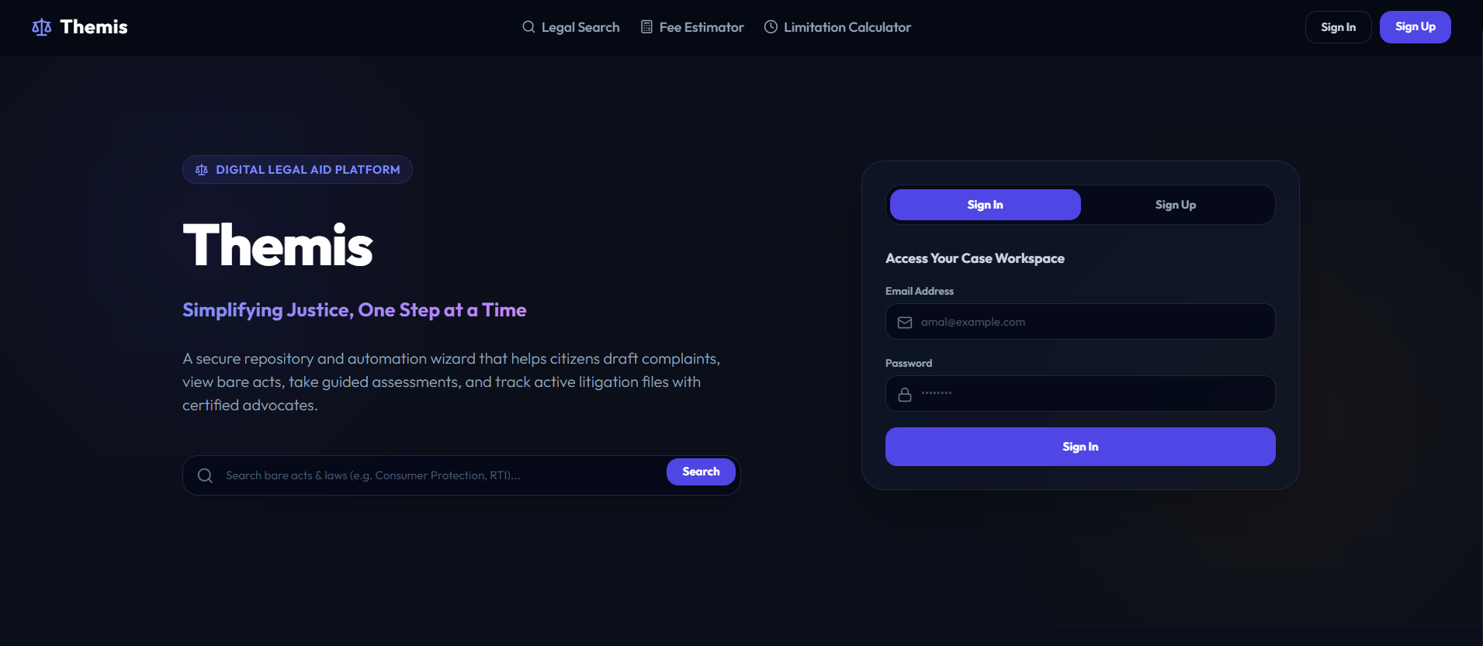
UI Design — Landing & Authentication
Themis — Review 1
10

Slide 11
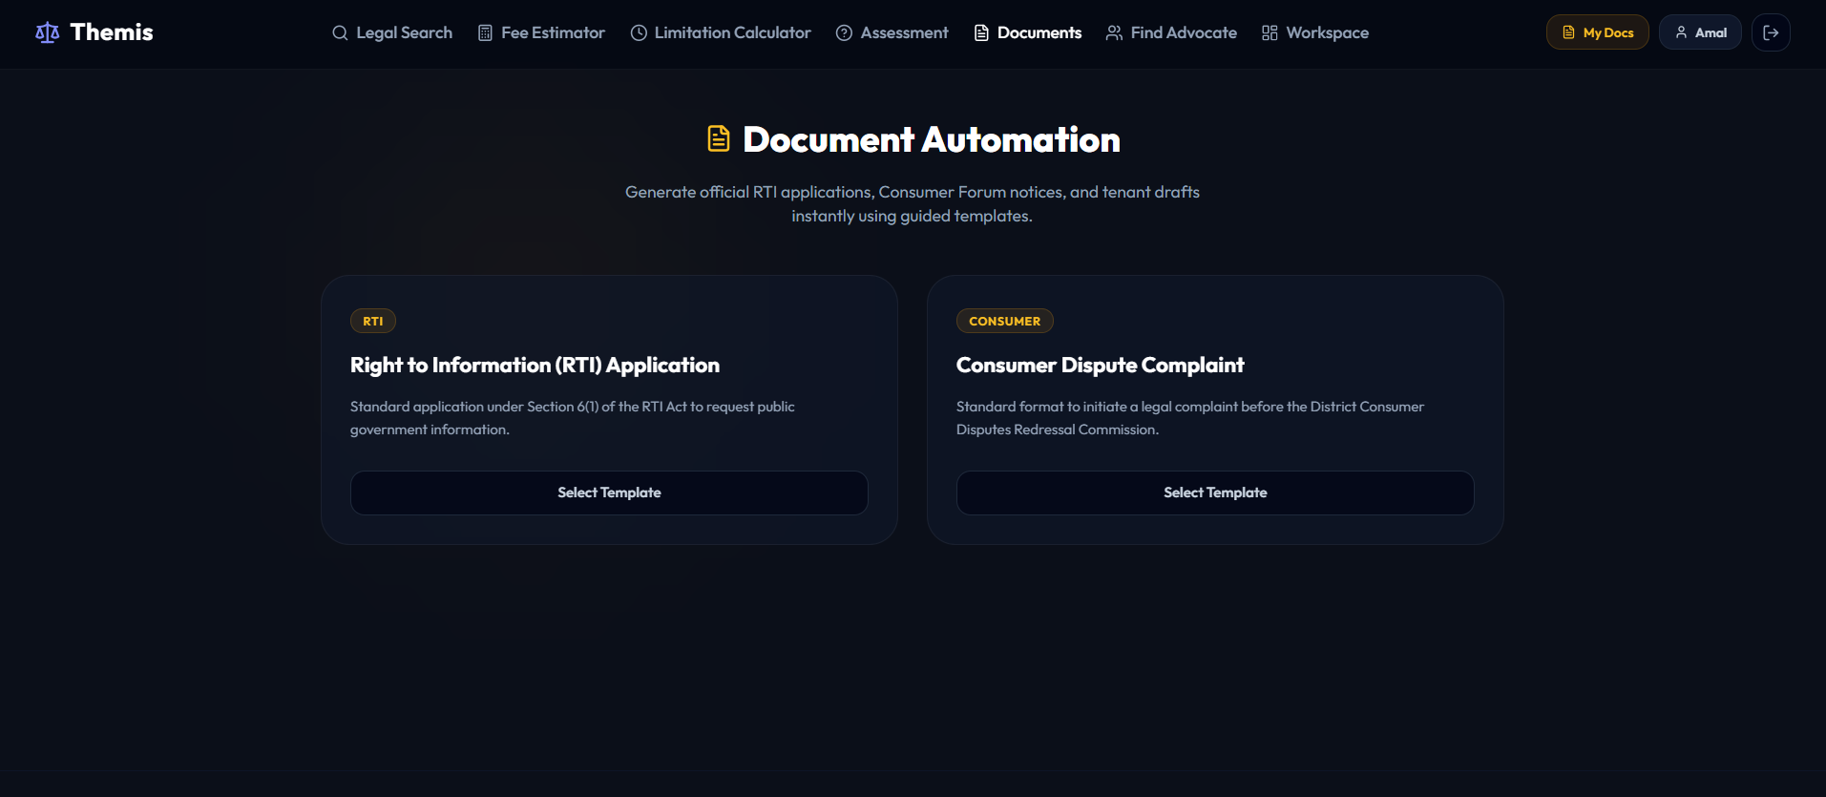
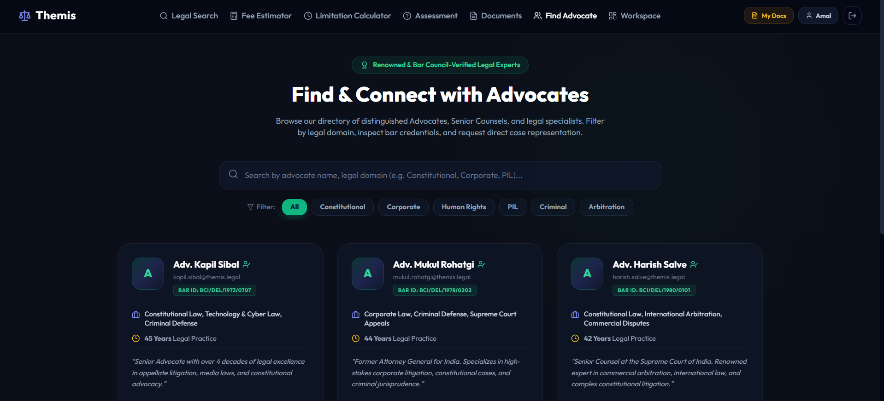
UI Design — Core Workflows
Document Automation — RTI & Consumer Complaint generation
Find Advocate — verified attorney directory & matching
Themis — Review 1
11

Slide 12
Technology Stack
Frontend
Backend
React
Node.js
TypeScript
TypeScript
Vite
Hono
Tailwind CSS
tRPC
shadcn/ui
Drizzle ORM
Radix UI
PostgreSQL
Lucide React
Zod
JWT Auth
Themis — Review 1
12

Slide 13
Project Completion Status
Review 1 — implementation snapshot
Repository & Infra Setup (Docker, CI, monorepo)
55%
~18%
Authentication (Sign Up / Sign In, JWT)
45%
Landing Page & Core Navigation
COMPLETE
50%
Document Automation (RTI / Consumer templates)
30%
Find Advocate Directory (UI, sample data)
Within the expected 10–20% range for Review 1.
25%
OCR, Case Timeline & Advocate Matching Engine
5%
Themis — Review 1
13

Slide 14
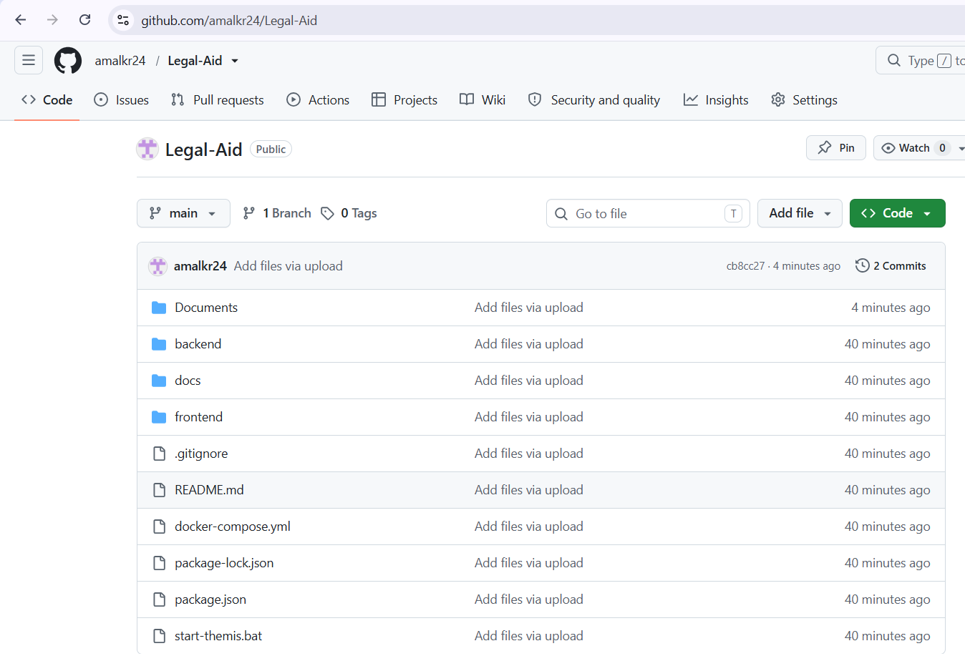
Version Control & Repository
github.com/amalkr24/Legal-Aid
Themis — Review 1
14

