Slide 1

Summer Engineering Technology (SET) Program

Slide 2
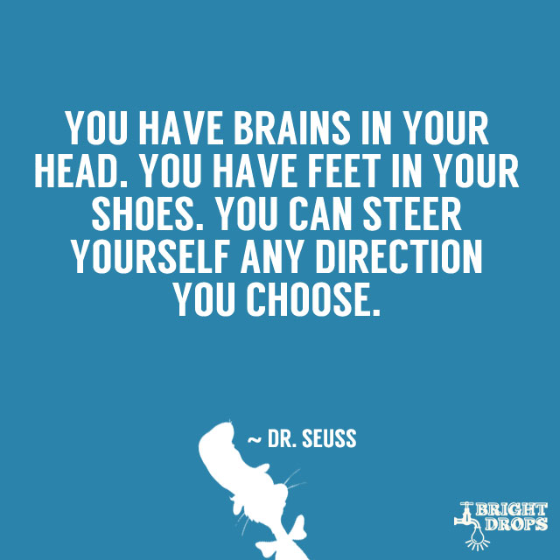
Expectations:
Be Respectful
Be Responsible
Be Safe
Be a Learner
“Think B4 you act!”
Notes:
Consequences for not following expectations

Slide 3

Be Respectful
Respect each other and the instructor
Respect the campus and classroom property
Respect individual space
Respect learning time
Notes:
Be polite; refrain from using profane or abusive language; listen to the speaker; treat other they way you want to be treated; work quietly; do not disturb or interrupt the work of others; BULLYING will not tolerated

Slide 4

Be Responsible
Be responsible for your work and your learning
Listen to and follow directions from your instructor
Return any materials to the original location
If you see something, say something

Slide 5

Be Safe
Keep hand, feet and objects to yourself
Remain with your instructor at all time * escort only to/from restrooms and lunch
Be aware of your surroundings
Follow all procedures & expectations in labs

Slide 6

Be a Learner
Be an active learner
Try your best… It’s okay to ask for help!
BElieve in yourself
Have FUN!
Notes:
Ask and answer questions;

Slide 7

Now it’s your turn…
Reflection Questions
What will you do to ensure you are successful at camp?
How will you demonstrate respect, responsibility, and safety?
What are you most excited to learn?
Questions
Comments
Concerns?

