Slide 1
CAP6673 – Data Mining and Machine Learning
Review of Network Traffic Prediction Models for Near- and Long-Term Predictions
Christopher Foley

Slide 2
Network Traffic Prediction Models
Overview
Kyoto Datasets
Related Work
Approach To Problem
Results
Conclusions

Slide 3
Overview
Network Intrusion
Detect without looking at user data
Can traffic characteristics be used to determine if connection is malicious or benign.
Use Machine Learning!
Datasets required

Slide 4
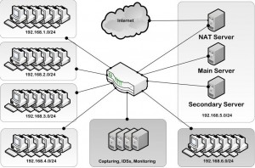
Overview - Datasets
DARPA investigations
USAF – KDD
Developed for USAF
Created LAN with simulated USAF traffic
Attacked by different types of intruders
ISCX – 2012
University Of New Brunswick
LAN with profile of normal use
Attacked by different types of intruders

Slide 5
Overview - Datasets
Excellent datasets
Large amounts of data to analyze
Permits researchers to analyze networks
What do they have in common?
Created in lab
How to address that issue.
Kyoto Dataset

Slide 6
Kyoto Datasets
Kyoto University Approach
Honeypot
Create a network that does nothing and monitor traffic into the netword
Datasets strength
Connection requests from outside the network may be assumed to be routine routing requests or malicious
Brief summary of results
42 617 536 known attacks
4 420 971 unique source IP addresses

Slide 7

Kyoto Datasets
Kyoto University Approach
Honeypot
Create a network that does nothing and monitor traffic into the network
Datasets strength
Connection requests from outside the network may be assumed to be routine routing requests or malicious
Brief summary of results
42 617 536 known attacks
4 420 971 unique source IP addresses

Slide 8
Kyoto Datasets
Data accumulated over large span of time
Initially 2006-2009
Additional data through December 2015
Network wiped and reset after each intrusion
Network appeared to be realistic
Intrusion based on actual intrusions not simulated

Slide 9
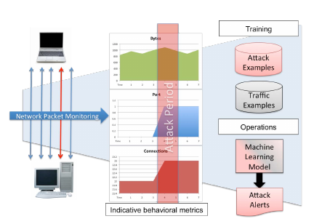
Related Work
Beaver et al. - Oak Ridge National Labs
Hybrid Approach
Use Machine Learning to filter normal traffic from statuses
Allow managers to see alerts

Slide 10
Approach To Problem
Wald – no new solution to NIDS
Importance – Lifespan of Model
Classification Algorithms chosen
Feature Selection
Features not used

Slide 11
Approach To Problem
Wald – no new solution to NIDS
Others studying model
Not integrating Machine Learning directly with models
Importance – Lifespan of Model
How long is a model reasonably valid once created
Kyoto Dataset key since it has data over 3 year period
Developed Near-Term results (6-12 months)
Developed Long-Term results (18-19 months)

Slide 12
Approach To Problem
Classification Algorithms chosen
Ease of Calculation
Not similar
Nearest Neighbor, C4.5D, C4.5N, Naive Bayes Chosen
Feature Selection
Chi Squared
ROC – allows feature to be used as predictor
Signal To Noise Ratio

Slide 13
Approach To Problem
Features not used
Features that would lead to immediate classification
Security analysis
Destination IP address – internal traffic used different addresses than external traffic
Class label generated as a result of analysis

Slide 14
Results
Published in paper „Network Traffic Prediction Models for Near- and Long-Term Predcitions“
Tables indicating AUC (Area Under Curve) for Near/Long Term predictions
All learners were reliable with data close to training set
5-Nearest Neighbor generally returned 0.99 AUC
Not viable for live system due to computation requirements

Slide 15
Results
C4.5D did not produce best results when paired with features, however
Best second place was C4.5 learners paired with Signal To Noise feature selection
Naive Bayes usually worst
Best performance in 2 of 182 tests.
Worst performance in 171 of 182 tests

Slide 16
Results
Both Near- and Long-Term datasets performed similarly
Similar learner / feature combinations performed similarly
Long-Term effectiveness 0.99
Model generated with 2008-01-01 data performed equally well up to 19 months after creation.

Slide 17
Conclusions
Machine learning can be used to generate models which may filter traffic and help unmask intrusions
Model data indicated that traffic did not change
Traffic similar over entire 3 years
Initial incursion has not significantly changed over time
Models Viable over longer periods

Slide 18
Further Investigation
Additional Models
Different calcuations and impact
Longer periods of data
Kyoto until 2015
Can this be integrated to provide filter
Network defense that learns

