Slide 1
User Story, Use Case and Use Case Diagrams

Slide 2
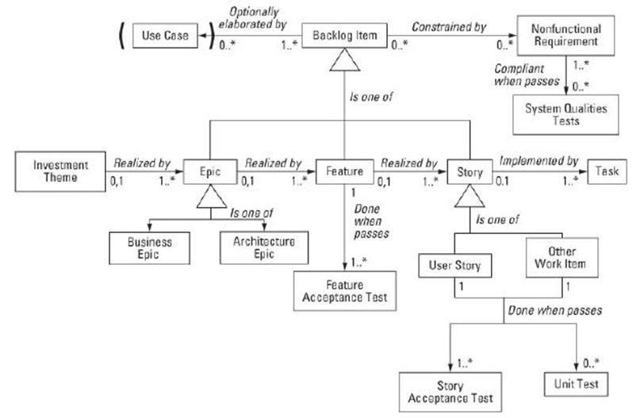
Backlog metamodel

Slide 3
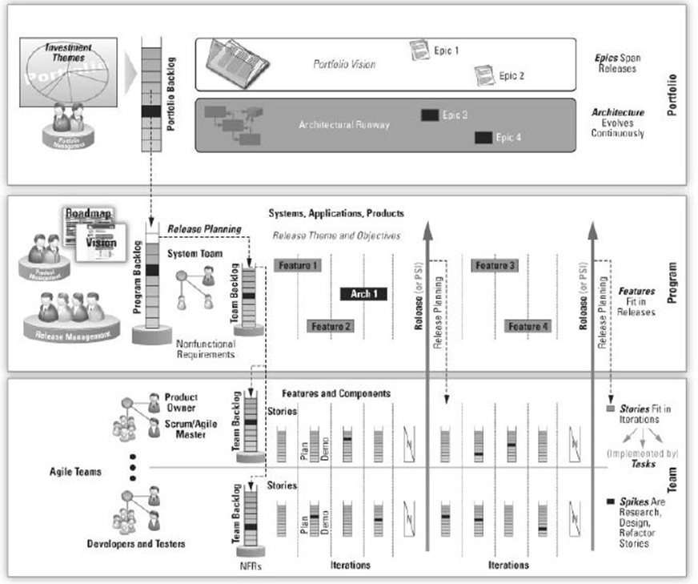

Slide 4
I <in the role of XX> needs functionality <zzz> to achieve the goal of <YYY>
User Story Template

Slide 5
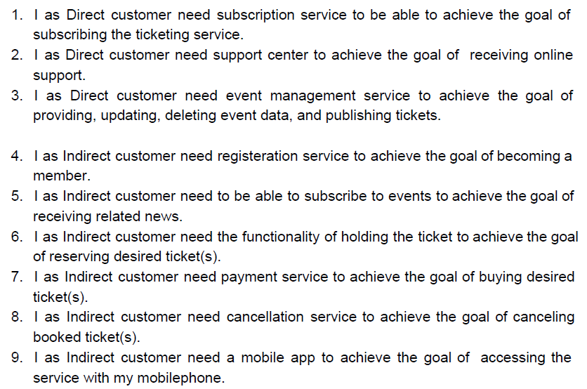
User Stories

Slide 6
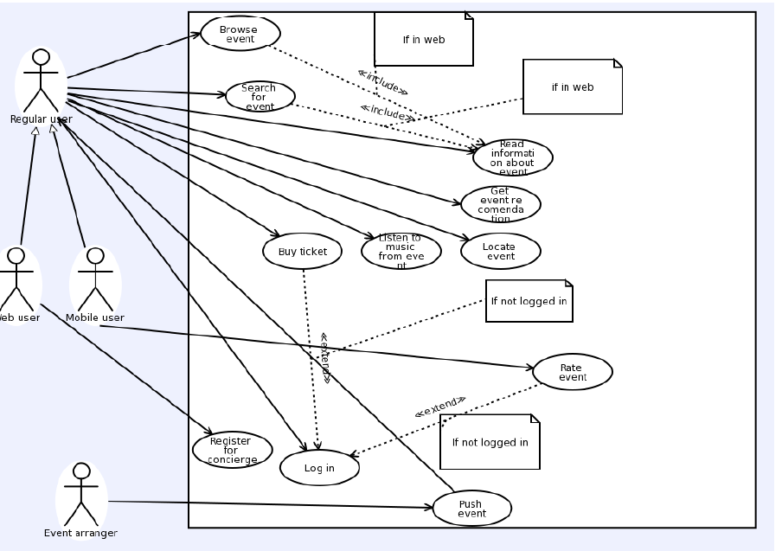
Use Cases

Slide 7
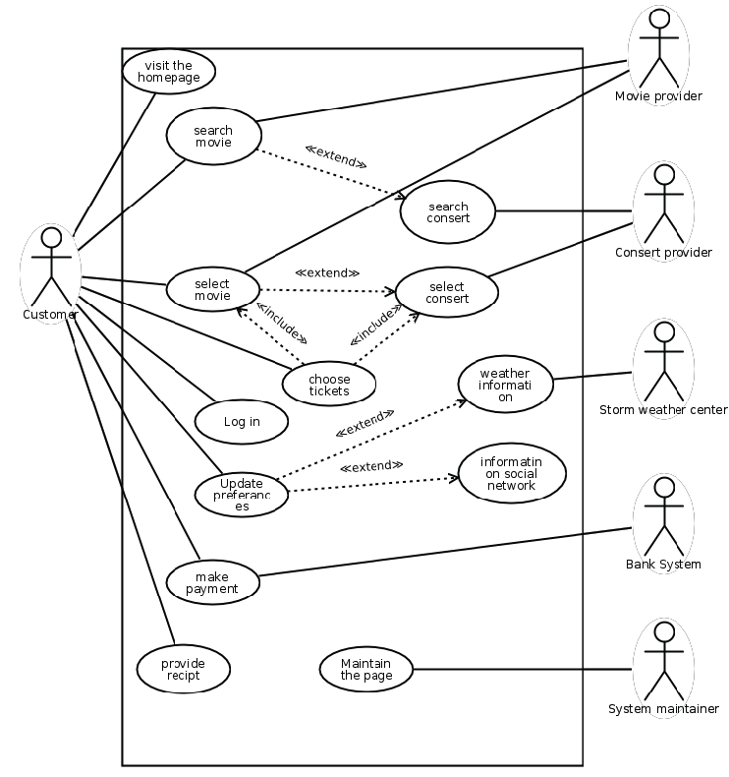
Use Cases

