Slide 1
Software Development
Chapter 1

Slide 2
Chapter Contents
1.1 Problem Analysis and Specification
1.2 Design
1.3 Coding
1.4 Testing, Execution, and Debugging
1.5 Maintenance

Slide 3
Chapter Objectives
Introduce software development approaches
Contrast software development in programming course with real world
Study top-down, objected oriented approaches
Introduce design aspects
  Select or build data types
  Develop algorithms for operations on data
Investigate error types
Emphasize importance of testing
Note time and effort devoted to maintenance

Slide 4
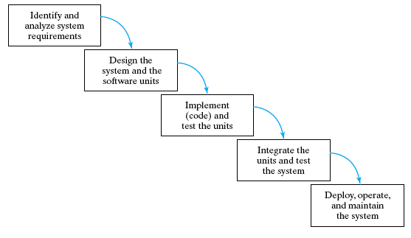
5 Phases of Software Life Cycle
Waterfall Model

Slide 5
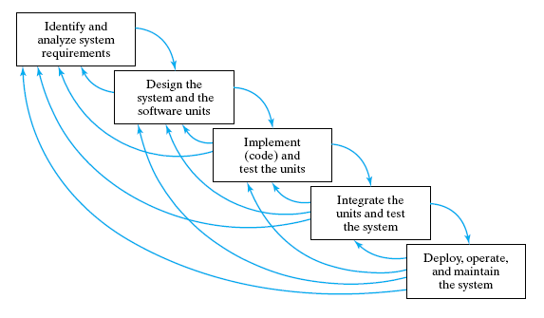
5 Phases of Software Life Cycle
Realistic Waterfall Model

Slide 6
Problem Analysis and Specification
CS courses
  small systems
    few hundred lines of code
    simple, straightforward
    self-contained
“Real” world
  large systems
    thousands of lines of code
    complex
    many components
    problem initially poorly defined

Slide 7
Problem Analysis and Specification
The specification or "contract" will include
  Purpose
  Precondition
  Postcondition
Real world contracts
  Must be precise
  May be required to prove end product meets these precise specifications

Slide 8
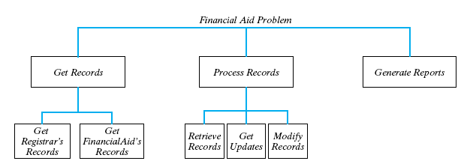
Top Down Design
Original problem partitioned into simpler subproblems
  Each of these subproblems likewise subdivided

Slide 9
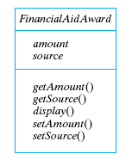
OOD: Object-Oriented Design
Identify the objects in the problem's specification and their types.
Identify the operations or tasks to manipulate the objects

Slide 10
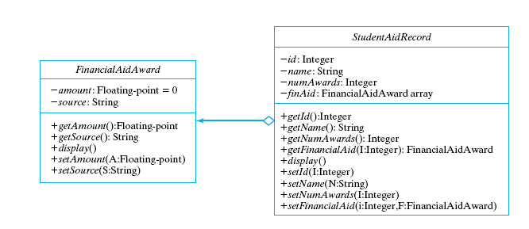
OOD: Object-Oriented Design
UML class diagram

Slide 11
Data Types of the Objects
Simple
Structured
  arrays
  structures
  class objects
Think of them as Containers

Slide 12
Algorithms
Pseudo code
Must be
  Definite, unambiguous
  Simple
  Finite
  correct and efficient
  well structured
Cannot separate data structures from algorithms

Slide 13
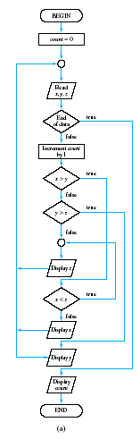
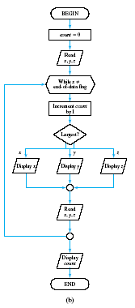
Algorithms
Structured
while loop
switch stmt
Unstructured
goto's
if-else's

Slide 14
Coding
Select language of implementation
Encode the design
Example
  Figure 1.9 Financial-aid update function
  Figure 1.10 Test-driver for Financial-aid update function
  Figure 1.11 Header file for FinancialAidAward class
  Figure 1.12 Implementation file for FinancialAidAward class

Slide 15
Coding
Verify integration
  combining program units into a complete software system.
Insure quality
  programs must be correct, readable, and understandable
  well-structured, documented, formatted for readability

Slide 16
Testing, Execution, and Debugging
Validation:
"Are we building the right product?"
  check that documents, program modules, etc. match the customer's requirements.
Verification:
"Are we building the product right?"
  check that products are correct,
  complete,
  consistent with each other and with those of the preceding phases.

Slide 17
Different Kinds Of Tests Required
Unit tests:
  Each individual program unit works?
  Program components tested in isolation
Integration tests :
  Units combined correctly?
  Component interface and information flow tested
System tests:
  Overall system works correctly?

Slide 18
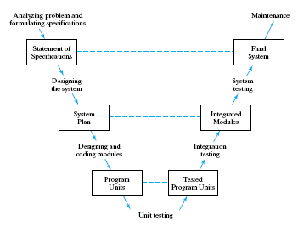
The "V" Life Cycle Model

Slide 19
Types of Errors
Syntax errors
  errors in the grammar of the programming language
Run-time errors
  happen during program execution
Logic errors
  errors in algorithm design

Slide 20
Black Box or Functional Test
Outputs produced for various inputs
  Checked for correctness
  Do not consider structure of program component itself.
Program unit is viewed as a black box
  Accepts inputs and produces outputs,
  Inner workings of the box are not visible.

Slide 21
White Box or Structural Test
Performance is tested
  examine code’s internal structure.
Test data is carefully selected
  specific parts of the program unit are exercised.

Slide 22
Maintenance
Large % of
  Computer center budgets
  Programmer's time
  Software development cost
Because …
  Includes modifications and enhancements
  Poor structure, poor documentation, poor style
    Bug finding and fixing is tougher
    Impedes implementation of enhancements

