Slide 1
Introduction to Abstract Data Types
Chapter 2

Slide 2
Chapter Contents
2.1 A first look at ADTs and Implementations
2.2 C++'s Simple Data Types
2.3 Programmer-Defined Data Types
2.4 Pointers

Slide 3
Chapter Objectives
Distinguish between ADTs and implementations of ADTs
Review C++'s simple data types & ADTs they model
See examples of how implementations of ADTs are sometimes insufficient
Look at simple mechanisms to define new data types
Take a first look at pointers and pointer operations

Slide 4
First Look at ADTs & Implementations
For a programming task we must identify
  The collection of data items
  Basic operations to be performed on them
Taken together (data items & operations)
  are called an Abstract Data Type (ADT)
Implementation
  Storage structures for the data items
  Algorithms for the operations

Slide 5
C++ Simple Data Types
Integers
Unsigned integers
  unsigned short, unsigned, unsigned long
  Sometimes called whole numbers
  Represented in 2, 4, or 8 bytes
Signed integers
  short, int, long
  represented in two's complement

Slide 6
Two's Complement Representation
For nonnegative n:
  Use ordinary base-two representation with leading (sign) bit 0
For n < 0
  Find w-bit base-2 representation of |n|
  Complement each bit.
  Add 1

Slide 7
Two's Complement Representation
Example: –88
  88 as a 16-bit base-two number
  0000000001011000
  Complement this bit string
  1111111110100111
  Add 1
  1111111110101000
WHY?

Slide 8
Two's Complement Representation
Works well for arithmetic computations
    5 + –6:
0000000000000101
+1111111111111010
1111111111111111
What gets done to the bits to give this answer?

Slide 9
Problems with Integer Representation
Limited Capacity — a finite number of bits
An operation can produce a value that requires more bits than maximum number allowed.
This is called overflow .
None of these is a perfect representation of (mathematical) integers
Can only store a finite (sub)range of them.
See Demonstrations Fig. 2.1, Fig. 2.2

Slide 10
C++ Simple Data Types
Real Data
Types float and double in C++
Use single precision (IEEE Floating-Point)
Store:
  sign of mantissa in leftmost bit (0 = +, 1 = – )
  represent exponent in next 8 bits
  (exponent + 127)
  bits b₂b₃ . . .b₂₄ mantissa in rightmost 23 bits.
  Need not store b₁ — (we know it's 1)

Slide 11
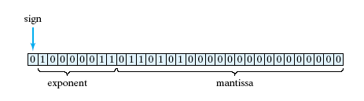
Real Data
Example: 22.625 = 10110.101₂
Floating point form:
1.0110101₂ * 2₄

Slide 12

Problems with Real Representation
Exponent overflow and underflow
Round off error
  Most reals do not have terminating binary representations.
Example:
0.7 = (0.10110011001100110011001100. . .)₂

Slide 13
Problems with Real Representation
Round off error may be compounded in a sequence of operations.
  Real-world example – Gulf War Patriot missile guidance affected by accumulated round off
Be careful in comparing reals
  with == and !=.
  Instead use comparison for closeness
  if (abs (x – 12.34) < 0.001) …

Slide 14


C++ Simple Data Types
Character Data
1 byte for ASCII, EBCDIC
2 bytes for Unicode (java)
or C++ wide character type
Operations ==, <, >, etc. Using numeric code

Slide 15
C++ Simple Data Types
Boolean Data
Values { false, true }
Could be stored in bits, usually use a byte
Operations &&, ||
In C++
  bool type
  int (boolVal) evaluates to
    0 if false
    1 if true

Slide 16
Programmer-Defined Data Types
Typedefs
  Mechanism usable to create a new type
  Give new name to existing type
Example:
typedef double real;
  Now either double or real can be used.

Slide 17

Programmer-Defined Data Types
Enumerations
  Mechanism for creating types whose literals are identifiers
  Each identifier associated with unique integer

Slide 18
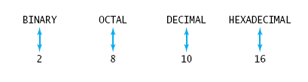
Programmer-Defined Data Types
Also possible to specify explicit values to give the enumerators
enum NumberBase { BINARY = 2,
OCTAL = 8,
DECIMAL = 10,
HEXADECIMAL = 16};

Slide 19
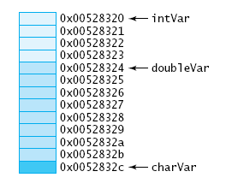
Pointers
When regular variables are declared
  Memory allocated for value of specified type
  Variable name associated with that memory location
  Memory initialized with values provided (if any)
27

Slide 20
Pointers
Pointer Variables
  value stored is a memory address
Note sample program, Fig. 2.4
  Declares variables that can store int addresses and double variables
  Displays the addresses

Slide 21

Basic Pointer Operations
Dereferencing and indirection
  Pointer variable stores address of a location
  Accessing contents of that location requires dereferencing operator *
Note program example
Fig 2.5_x000b_

Slide 22
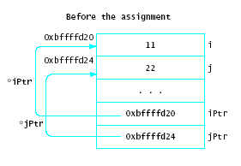
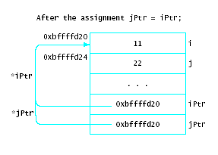
Basic Pointer Operations
Assignment
  Pointer variables can be assigned the values of other pointer variables bound to same type

Slide 23
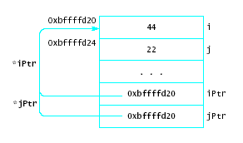
Basic Pointer Operations
Consider *jPtr = 44;
  Changes value that both pointers reference
  Not good programming practice, hard to debug
  Known as aliasing problem

Slide 24
Basic Pointer Operations
Comparison
  Relational operators used to compare two pointers
  Must be bound to same type
  Most common = = and !=
  The null address may be compared with any pointer variable

Slide 25

Dynamic Memory Allocation
The new operation
Example
int * intPtr;
intPtr = new int;
  An anonymous variable
  Cannot be accessed directly

Slide 26
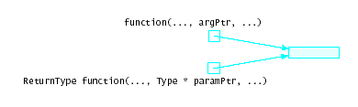
Pointer Arguments
Pointers can be passed as arguments to functions
This is logically equivalent to reference parameters
  In fact, this is how early C++ compilers accomplished reference parameters

