Slide 1
Data Structures and Abstract Data Types
Chapter 3

Slide 2
Chapter Contents
3.1 Data Structures, Abstract Data Types and Implementations
3.2 Static Arrays
3.3 Multidimensional Arrays (optional)
3.4 Dynamic Arrays
3.5 C-Style Structs (optional)
3.6 Procedural Programming

Slide 3
Chapter Objectives
Look at ADTs, implementations in detail
Introduce arrays as ADTs
See arrays implemented as C++ static arrays
(Optional) Describe multidimensional arrays
Extend pointers to use in dynamic arrays
(Optional) Show use of C++ structs to model objects with multiple attributes
Show example of procedural programming paradigm

Slide 4

Data Structures, Abstract Data Types, and Implementations
Consider example of an airplane flight with 10 seats to be assigned
Tasks
  List available seats
  Reserve a seat
How to store, access data?
  10 individual variables
  An array of variables

Slide 5
Data Structures, Abstract Data Types, and Implementations
Implementation consists of
  Storage (data) structures
  Algorithms for basic operations
Note following figure
  C++ provides large collection of data types and structures

Slide 6
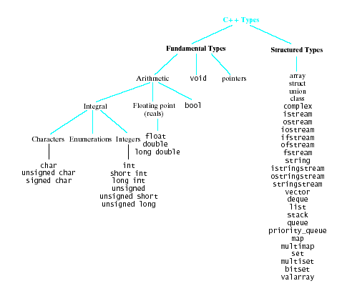
C++ Types

Slide 7
Arrays
Collection of data elements
  All of same type
  Each accessed by specifying position
Static array
  Compiler determines how memory allocated
Dynamic array
  Allocation takes place at run time

Slide 8

Single Dimension Arrays
Syntax:
ElementType arrayName [CAPACITY];
ElementType arrayName [CAPACITY] =
{ initializer_list };
Example:
int b [10];
Elements accessed by
  name and [ ] operation b[5]

Slide 9

Character Arrays
Elements of an array may be of any type
  Including characters
Example:
char name [NAME_CAPACITY] =
"John Doe";
If array initialized shorter than specs
  extra locations filled with null character

Slide 10
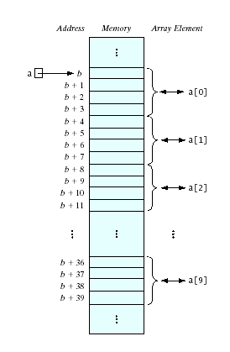
Subscript Operation
We have said elements accessed by name and [ ] numList[5]
Consider the [ ] to be an operator
  The subscript operator
  Performs address translation
Name of the array is a pointer constant
  The base address

Slide 11
Using Arrays
Accessing array for output
  See Fig. 3.3
Accessing array for input from keyboard
  See Fig. 3.4
Note use of arrays as parameters
  Must specify number of elements of array being used

Slide 12
Out of Range Errors
Most C++ compilers do not by default check indices for out of range
Results of out of range array access
  Program can exceed allowed memory area
  Program can give puzzling results
Note example, Fig. 3.5

Slide 13
Problems with C-Style Arrays
Capacity cannot change.
An array is not an object
  (in the OOP sense)
Virtually no predefined operations
for non-char arrays.
The Deeper Problem:
  C-style arrays aren't self-contained
  Data, functions, and size not encapsulated

Slide 14
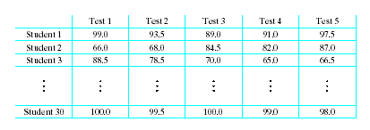
Multidimensional Arrays
Consider a table of test scores for several different students
Two-dimensional array
  Syntax
  ElementType arrayName [numRows][numCols]

Slide 15
Multidimensional Arrays
Consider multiple pages of the student grade book
const int NUM_ROWS = 10, NUM_COLS = 5,
NUM_RANKS = 10;
typedef double
ThreeDimArray[NUM_ROWS][NUM_COLS][NUM_RANKS];
. . .

Slide 16
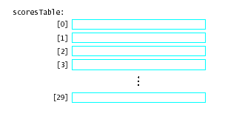
Array of Array Declarations
An array of arrays
  An array whose elements are other arrays

Slide 17
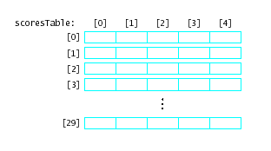
Array of Array Declarations
Each of the rows is itself a one dimensional array of values
scoresTable [1][3]
scoresTable[2]
is the whole row numbered 2

Slide 18
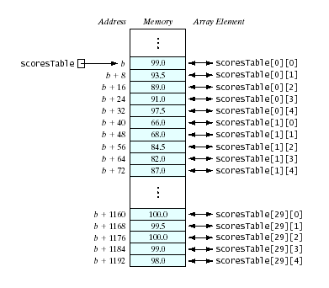
Memory Allocation in
2-Dimensional Arrays
Elements stored in rowwise order
Also called column major order
location [0][4] is followed in memory by location [1][0]

Slide 19
Multidimensional Arrays as Parameters
Must specify
  The type and name of the array (a pointer to the base address)
  The number of rows
  The number of columns (or the length of each row)
Note example program

Slide 20
Dynamic Arrays
Recall earlier mention of arrays being fixed size at compile time
  Space wasted by unused elements
  Program cannot adjust if size set too small
Dynamic (run time) allocation mechanism provided
  Acquire memory as needed
  Release memory when no longer needed
C++ commands
  new and delete

Slide 21
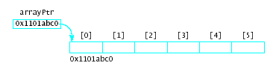
The new Operator
Syntax for arrays
new Type [capacity]
This command issues a run-time request for a block of memory
  Asks for enough memory for the specified number of elements of the stated type
Example
int *arrayPtr;
arrayPtr = new int[6];

Slide 22
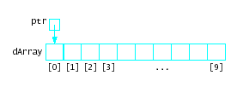

Pointer Arithmetic
Possible to alter pointer contents
  The pointer is a variable
  It is not a pointer constant like an array name
Example
Given:
Then
ptr++;

Slide 23
Failures of new
When new execute
  Requests memory from heap or free store
  Allocates that block to executing program
Possible to use up available heap memory
  If not enough memory for request, new throws an exception … bad_alloc
Note sample program, Fig. 3.8
Possible to use try and catch mechanism to take appropriate action, Fig 3.9

Slide 24
The delete Operation
Counterpart to the new operation
Requests memory be returned to the heap
  Can then be reused by later allocations
Syntax
delete pointerVariable;
delete [ ] arrayPointerVariable;
Frees the dynamically memory whose address is stored in the variable
  Does not delete the variable

Slide 25
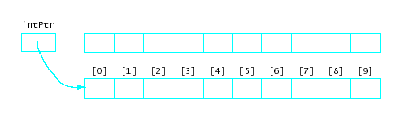
Memory Leaks
Important for programmer to make sure to deallocate memory originally allocated by new
What if new is called again for intPtr?
Originally allocated memory now cannot be accessed, nor is it available for reallocation

Slide 26
Other Uses of Pointers
Command-line arguments
  argc is the counter – how many arguments are found
  argv is a pointer to the array of pointers to char (the arguments)
Functions as arguments
  The name of a function is a pointer to code
  Can be passed to another function

Slide 27
Aggregate Data Types
Predefined types not always adequate to model the problem
  When objects have multiple attributes
  When objects have collections of heterogeneous elements
C++ provides structs and classes
  Create new types with multiple attributes

Slide 28
Structures
Characteristics
  has a fixed size
  is ordered
  elements may be of different size
  direct access of elements by name (not index)
  struct Date {
  int month, day, year;
  char dayOfWeek [12];
  };

Slide 29
FAQs about Structures
structs can be nested (can contain struct objects)
Access members with
  name of struct object
  dot (member selector operator) .
  name of struct member
  Date today = { 3, 4, 2005, "Tuesday");
  cout << today.month;

Slide 30
Pointers to Structs
Pointers can be bound to any type
Date today = { 3, 4, 2005, "Tuesday");
Date *datePtr = &today;
Use for accessing the original location
cout << (*datePtr).day;
cin >> datePtr->year;
Note use of arrow -> operator

Slide 31
Description of Procedural Programming
Typical languages : C, FORTRAN, and Pascal
Action-oriented — concentrates on the verbs
Programmers:
  Identify basic tasks to solve problem
  Implement actions to do tasks as subprograms (procedures/functions/
  subroutines)
  Group subprograms into programs/modules/libraries,
  together make up a complete system for solving the problem

Slide 32
Example of Procedural Programming
Consider a type for processing times
  In hh:mm AM/PM format
  In military format (24 hr clock)
We must determine
  Data attributes
  Operations on the data
  How to implement
Note sample header, Fig. 3-11A
Implementation, Fig. 3-11B
Test program, Fig. 3-11C

