Slide 1
Standard C++ Input/Output and String Classes
Chapter 5

Slide 2
Chapter Contents
5.1 The C++ Standard I/O Classes
5.2 The C++ String Types
5.3 Case Study: Text Editing
5.4 Introduction to Pattern Matching (optional)
5.5 Introduction to Data Encryption (optional)

Slide 3
Chapter Objectives
Study in detail C++ classes for I/O
Look at C++ hierarchy for I/O classes
  In particular for file I/O
Study in detail the C++ string class
Illustrate with use of string operators used in text editors
(Optional) Introduce basic ideas of pattern matching
(Optional) Introduce basic methods of data encryption

Slide 4
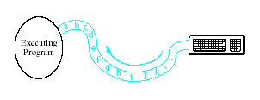
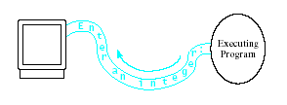
The C++ Standard I/O Classes
Input viewed as a stream of characters
  Flowing from some source into an executing program
Input viewed as a stream of characters
  Flowing from program to output device

Slide 5

The C++ Standard I/O Classes
C++ has <iostream> library
  istream for input
  ostream for output

Slide 6
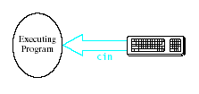
The istream Class
Models flow of characters from input device to program
  Characters enter an istream object
  Object transmits characters
  from device to program
Input operator >>
  Extraction operator
  istreamObject >> variable;
Stream states accessed with functions
  .good(), .bad(), .fail(), .eof()

Slide 7
The istream Class
Input manipulators
  Specify whether or not to skip white space
  noskipws or skipws
Note Table 5-2 in text for Input Stream Operations and Methods

Slide 8
The ostream Class
Models flow of characters from executing program to output device
  Characters enter ostream object
  Transmitted to specified output device
Output operator <<
  Insertion operator
  ostreamObject << expression;
Note Table 5-3 in text for Output Stream Operations and Methods

Slide 9

The ostream Class
Standard ostream
objects
  cout for normal output
  cerr and clog for error
  and diagnostic messages
Buffered streams (cout and clog)
  Held in the stream until it is flushed
Contrast cerr which is sent to the output device immediately
  Can cause confusion when debugging

Slide 10
The ostream Class
Format control
  Format manipulators used to specify various format features
Examples
  endl to send a newline
  showpoint to specify that decimal points be used in output of reals
Note Table 5-4 in text, Format Manipulators

Slide 11
File I/O: ifstream, ofstream Classes
Stream object must be constructed for purpose of receiving/sending I/O
  Called opening a stream to the file
Stream activities
  Declaring
  ifstream inStream;
  Opening
  ifStream.open(file_name);
  Closing
  ifStream.close();

Slide 12
File I/O: ifstream, ofstream Classes
File opening modes
  specify various properties of file being opened
Examples
  input, output, append.
Note Table 5-5 in text, File-Opening Modes

Slide 13
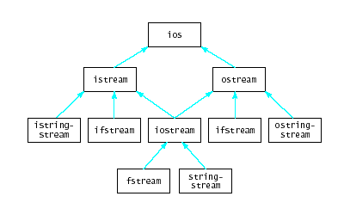
The I/O Class Hierarchy
Characteristics of OOP hold
  Encapsulation
  Inheritance
  Polymorphism
Note demo of file I/O, Fig 5-1

Slide 14
The C++ String Class
Variety of constructors provided for defining strings
  Define an empty string
  String s;
  Define a string initialized with another string
  String s("some other string);
Note further options in text, Table 5-7
String Constructors

Slide 15
The C++ String Class
Storage differs by implementation
  May use char arrays
  May use dynamic storage
Note Table 5-8 in text, String Storage Information Methods
Input and output
  Use insertion << and extraction >> operators
  getline () for reading a string and including white spaces

Slide 16
The C++ String Class
Editing operations provided such as
  appending
  inserting
  erasing
  replacing
  swapping
Note table 5-10 in text, String Editing Operations

Slide 17
The C++ String Class
Copiers – make copies of part or all of a string
  Operators = and +=
  Function assign()
Accessing Individual Characters
  Use overloaded subscript operator [ ]
String element accessors
  Functions such as find(), find_first_of()
  See Table 5-12 in text

Slide 18
The C++ String Class
Comparisons
  Overloaded operators for <, >, ==, etc.
  Also compare() function which returns a negative, 0, or positive value for <, ==, or >
String conversions
  When C-style string needed instead of a string object
  Converts to an array of char

Slide 19
String Streams
Possible to connect a stream to a string
  Read input from the string
  istringstream
  Write output to the string
  ostringstream
  stringstream (both input, output)
Also known as in-memory I/O
String stream library <sstream>
Note Table 5-14 in text, String Stream Operations
Demonstration program, Fig. 5-2

Slide 20
Case Study: Text Editing
Operations provided
Construct text editor
  given names of input, output file
Run editor – accept, carry out user commands
Display menu of editing commands
Insert string into current line of text
Delete string from current line of text
Replace string in current line of text with different text
Get next line of text
Wrap up editing process

Slide 21
Case Study: Text Editing
Source code provided to study OOP principles incorporated
  Data members
  Operations
Declaration file, TextEditor.h, Fig. 5-3A
Definition file, TextEditor.cpp, Fig 5-3B
Driver program, driver.cpp, Fig 5-3C

Slide 22


Intro to Pattern Matching
Uses
  Text editing
  Searching file with Unix's grep
One method … "brute force"
  Look for pattern starting at each successive character

Slide 23
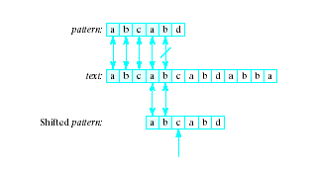
Pattern Matching
A better way
  Instead of shifting to the right in text each time
  Shift until we know there will be at least a match in the first character of pattern

Slide 24
Intro to Data Encryption
Definition: Encryption is the coding of information to keep it secret
Accomplished by transforming
  From a string of characters with information
  To a new string that is the coded message or the ciphertext
The ciphertext may be safely transmitted
At a later time the ciphertext is deciphered into plaintext

Slide 25

Data Encryption
Simplest encryption schemes use substitution
  Each letter replaced by some other letter according to a fixed rule

Slide 26
Data Encryption
Improved substitution method is to use a keyword
  Specifies several different displacements
Vignère cipher
  Keyword added character by character to plane text string
  Each character represented by position in the string
  Addition carried out modulo 26

Slide 27
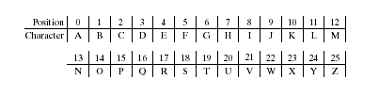
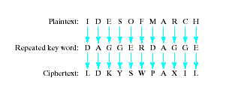
Vignère Cipher
Example
Character set,
positions given by
Keyword is DAGGER
Plane text IDESOFMARCH thus encrypted

Slide 28
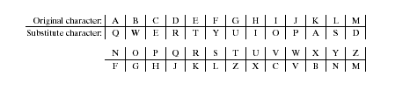

Substitution Table
Table of substitutions given
Resulting cipher text is

Slide 29


Permutation Cipher
Characters in plaintext or blocks rearranged by specified pattern
Ciphertext thus produced

Slide 30
Data Encryption Standard (DES)
Developed by federal government and IBM corporation in 1970s
  Input is a 64 bit string representing a block of characters
  Output string also 64 bit string of cipher text for the block
  Encryption done with series of permutations and substitutions
Was proven to be breakable
Replaced in 1999 by Advanced Encryption Standard (AES)

Slide 31
Public-Key Encryption
Both sender and receiver must know key
  Must be transmitted in some secure manner
Public-key encryption uses two keys
  One for encryption, exactly one corresponding key for decryption
  Many such pairs of keys exist, easily computed
  Nearly impossible to determine decryption key knowing only encryption key
  Encryption key made public, only receiver knows decryption key

