Slide 1
Lists
Chapter 6

Slide 2
Chapter Contents
6.1 List as an ADT
6.2 An Array-Based Implementation of Lists
6.3 An array Based Implementation of Lists with Dynamic Allocation
6.4 Introduction to Linked Lists
6.5 A Pointer-Based Implementation of Linked Lists in C++
6.6 An Array-Based Implementation of Linked Lists optional)

Slide 3
Chapter Objectives
To study list as an ADT
Build a static-array-based implementation of lists and note strengths, weaknesses
Build a dynamic-array-based implementation of lists, noting strengths and weaknesses
  See need for destructor, copy constructor, assignment methods
Take first look at linked lists, note strengths, weaknesses
Study pointer-based implementation of linked lists
(Optional) Study array-based implementation of linked lists

Slide 4

Consider Every Day Lists
Groceries to be purchased
Job to-do list
List of assignments for a course
Dean's list
Can you name some others??

Slide 5
Properties of Lists
Can have a single element
Can have no elements
There can be lists of lists
We will look at the list as an abstract data type
  Homogeneous
  Finite length
  Sequential elements

Slide 6
Basic Operations
Construct an empty list
Determine whether or not empty
Insert an element into the list
Delete an element from the list
Traverse (iterate through) the list to
  Modify
  Output
  Search for a specific value
  Copy or save
  Rearrange

Slide 7
Designing a List Class
Should contain at least the following function members
  Constructor
  empty()
  insert()
  delete()
  display()
Implementation involves
  Defining data members
  Defining function members from design phase

Slide 8
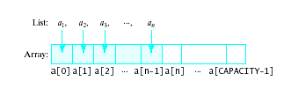
Array-Based Implementation of Lists
An array is a viable choice for storing list elements
  Element are sequential
  It is a commonly available data type
  Algorithm development is easy
Normally sequential orderings of list elements match with array elements

Slide 9


Implementing Operations
Constructor
  Static array allocated at compile time
Empty
  Check if size == 1
Traverse
  Use a loop from 0th element to size – 1
Insert
  Shift elements to
  right of insertion point
Delete
  Shift elements back
Also adjust size up or down

Slide 10
List Class with Static Array
Must deal with issue of declaration of CAPACITY
Use typedef mechanism
typedef Some_Specific_Type ElementType
ElementType array[CAPACITY];
For specific implementation of our class we simply fill in desired type for Some_Specific_Type

Slide 11
List Class with Static Array
Can put typedef declaration inside or outside of class
  Inside: must specify List::ElementType for reference to the type outside the class
  Outside: now able to use the template mechanism (this will be our choice)
Also specify the CAPACITY as a const
  Also choose to declare outside class

Slide 12
List Class Example
Declaration file, Fig. 6.1A
  Note use of typedef mechanism outside the class
  This example good for a list of int
Definition, implementation Fig. 6.1B
  Note considerable steps required for insert() and erase() functions
Program to test the class, Fig 6.1C

Slide 13
List Class with Static Array - Problems
Stuck with "one size fits all"
  Could be wasting space
  Could run out of space
Better to have instantiation of specific list specify what the capacity should be
Thus we consider creating a List class with dynamically-allocated array

Slide 14
Dynamic-Allocation for List Class
Changes required in data members
  Eliminate const declaration for CAPACITY
  Add variable data member to store capacity specified by client program
  Change array data member to a pointer
  Constructor requires considerable change
Little or no changes required for
  empty()
  display()
  erase()
  insert()

Slide 15
Dynamic-Allocation for List Class
Note data changes in Fig. 6.2A, List.h
Note implementation file Fig. 6.2B, List.cpp
  Changes to constructor
  Addition of other functions to deal with dynamically allocated memory
Note testing of various features in Fig. 6.2C, the demo program

Slide 16
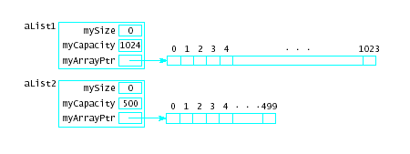
Dynamic-Allocation for List Class
Now possible to specify different sized lists
cin >> maxListSize;
List aList1 (maxListSize);
List aList2 (500);

Slide 17
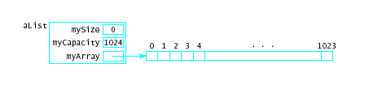
New Functions Needed
Destructor
  When class object goes out of scope the pointer to the dynamically allocated memory is reclaimed automatically
  The dynamically allocated memory is not
  The destructor reclaims dynamically allocated memory

Slide 18
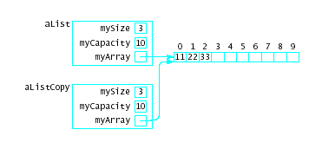
New Functions Needed
Copy Constructor – makes a "deep copy" of an object
  When argument passed as value parameter
  When function returns a local object
  When temporary storage of object needed
  When object initialized by another in a declaration
If copy is not made,
observe results
(aliasing problem,
"shallow" copy)

Slide 19
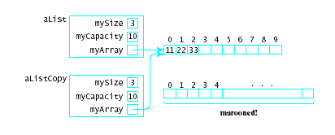
New Functions Needed
Assignment operator
  Default assignment operator makes shallow copy
  Can cause memory leak, dynamically-allocated memory has nothing pointing to it

Slide 20
Notes on Class Design
If a class allocates memory at run time using the new, then a it should provide …
A destructor
A copy constructor
An assignment operator
Note Fig. 6.3 which exercises constructors and destructor

Slide 21
Future Improvements to Our
List Class
Problem 1: Array used has fixed capacity
Solution:
  If larger array needed during program execution
  Allocate, copy smaller array to the new one
Problem 2: Class bound to one type at a time
Solution:
  Create multiple List classes with differing names
  Use class template

Slide 22
Recall Inefficiency of
Array-Implemented List
insert() and erase() functions inefficient for dynamic lists
  Those that change frequently
  Those with many insertions and deletions
So …
We look for an alternative implementation.

Slide 23
Linked List
For the array-based implementation:
First element is at location 0
Successor of item at location i is at location
i + 1
End is at location size – 1
Fix:
Remove requirement that list elements be stored in consecutive location.
But then need a "link" that connects each element to its successor
Linked Lists !!

Slide 24

Linked List
Linked list nodes contain
  Data part – stores an element of the list
  Next part – stores link/pointer to next element
  (when no next element, null value)

Slide 25
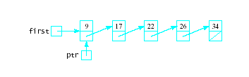
Linked Lists Operations
Construction: first = null_value;
Empty: first == null_value?
Traverse
  Initialize a variable ptr to point to first node
  Process data where ptr points

Slide 26
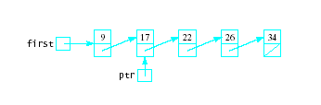
Linked Lists Operations
Traverse (ctd)
  set ptr = ptr->next, process ptr->data
  Continue until ptr == null

Slide 27

Operations: Insertion
predptr
Insertion
  To insert 20 after 17
  Need address of item before point of insertion
  predptr points to the node containing 17
  Get a new node pointed to by newptr and store 20 in it
  Set the next pointer of this new node equal to the next pointer in its predecessor, thus making it point to its successor.
  Reset the next pointer of its predecessor to point to this new node
20
newptr

Slide 28
Operations: Insertion
Note: insertion also works at end of list
  pointer member of new node set to null
Insertion at the beginning of the list
  predptr must be set to first
  pointer member of newptr set to that value
  first set to value of newptr
 Note: In all cases, no shifting of list elements is required !

Slide 29
Operations: Deletion
predptr
ptr
To free space
Delete node containing 22 from list.
  Suppose ptr points to the node to be deleted
  predptr points to its predecessor (the 20)
Do a bypass operation:
  Set the next pointer in the predecessor to
  point to the successor of the node to be deleted
  Deallocate the node being deleted.

Slide 30
Linked Lists - Advantages
Access any item as long as external link to first item maintained
Insert new item without shifting
Delete existing item without shifting
Can expand/contract as necessary

Slide 31
Linked Lists - Disadvantages
Overhead of links:
  used only internally, pure overhead
If dynamic, must provide
  destructor
  copy constructor
No longer have direct access to each element of the list
  Many sorting algorithms need direct access
  Binary search needs direct access
Access of n^{th} item now less efficient
  must go through first element, and then second, and then third, etc.

Slide 32
Linked Lists - Disadvantages
List-processing algorithms that require fast access to each element cannot be done as efficiently with linked lists.
Consider adding an element at the end of the list
Array | Linked List
a[size++] = value; | Get a new node; set data part = value next part = null_value If list is empty Set first to point to new node. Else Traverse list to find last node Set next part of last node to point to new node.
This is the inefficient part

Slide 33
Using C++ Pointers and Classes
To Implement Nodes
class Node
{
public:
DataType data;
Node * next;
};
Note: The definition of a Node is recursive
  (or self-referential)
It uses the name Node in its definition
The next member is defined as a pointer to a Node

Slide 34
Working with Nodes
Declaring pointers
Node * ptr; or
typedef Node * NodePointer;
NodePointer ptr;
Allocate and deallocate
ptr = new Node; delete ptr;
Access the data and next part of node
(*ptr).data and (*ptr).next
or
ptr->data and ptr->next

Slide 35
Working with Nodes
Note data members
are public
This class declaration will be placed inside another class declaration for List
The data members data and next of struct Node will be public inside the class
  will accessible to the member and friend functions
  will be private outside the class
class Node
{ public:
DataType data;
Node * next; };

Slide 36
Class List
typedef int ElementType;
class List
{
private:
class Node
{
public:
ElementType data;
Node * next;
};
typedef Node * NodePointer;
. . .
data is public inside class Node
class Node is private inside List

Slide 37


Data Members for Linked-List Implementation
A linked list will be characterized by:
  A pointer to the first node in the list.
  Each node contains a pointer to the next node in the list
  The last node contains a null pointer
As a variation first may
  be a structure
  also contain a count of the elements in the list

Slide 38
Function Members for Linked-List Implementation
Constructor
  Make first a null pointer and
  set mySize to 0
Destructor
  Nodes are dynamically allocated by new
  Default destructor will not specify the delete
  All the nodes from that point on would be "marooned memory"
  A destructor must be explicitly implemented to do the delete
0

Slide 39
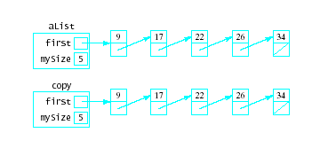
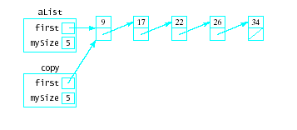
Function Members for Linked-List Implementation
Shallow Copy
Copy constructor for deep copy
  By default, when a copy is made of a List object, it only gets the head pointer
  Copy constructor will make a new linked list of nodes to which copy will point

Slide 40
Array-Based Implementation of Linked Lists
Node structure
struct NodeType
{
DataType data;
int next;
};
const int NULL_VALUE = -1;
// Storage Pool
const int NUMNODES = 2048;
NodeType node [NUMNODES];
int free;

Slide 41

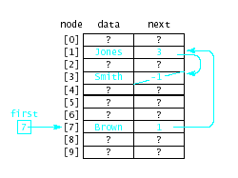
Array-Based Implementation of Linked Lists
Given a list with names
Implementation would
look like this

Slide 42
Array-Based Implementation of Linked Lists
To traverse
ptr = first;
while (ptr != NULL_VALUE)
{
// process data at node[ptr].data
ptr = node[ptr].next;
}

Slide 43
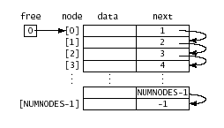
Organizing Storage Pool
In the array
  Some locations are storing nodes of the list
  Others are free nodes, available for new data
Could initially link all nodes as free

Slide 44
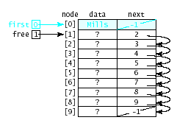
Organizing Storage Pool
Then use nodes as required for adds and inserts
  Variable free points to beginning of linked nodes of storage pool

Slide 45
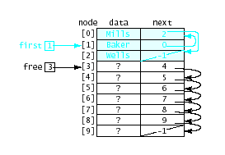
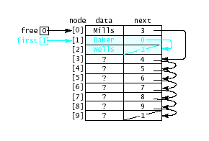
Organizing Storage Pool
Links to actual list and storage pool maintained as new data nodes are added and deleted

