Slide 1

Stacks
Chapter 7

Slide 2
Chapter Contents
7.1 Introduction to Stacks
7.2 Designing and Building a Stack Class – Array-Based
7.3 Linked Stacks
7.4 Use of Stacks in Function Calls
7.5 Case Study: Postfix (RPN) Notation

Slide 3
Chapter Objectives
Study a stack as an ADT
Build a static-array-based implementation of stacks
Build a dynamic-array-based implementation of stacks
Build a linked-implementation of stacks
Show how a run-time stack is used to store information during function calls
(Optional) Study postfix notation and see how stacks are used to convert expressions from infix to postfix and how to evaluate postfix expressions

Slide 4
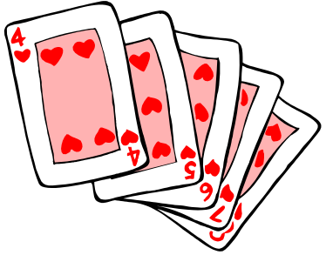
Introduction to Stacks
Consider a card game with a discard pile
  Discards always placed on the top of the pile
  Players may retrieve a card only from the top
We seek a way to represent and manipulate this in a computer program
This is a stack
What other examples can you think of that are modeled by a stack?

Slide 5
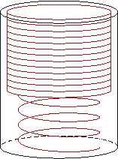
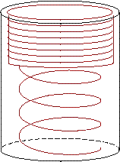
Introduction to Stacks
A stack is a last-in-first-out (LIFO) data structure
Adding an item
  Referred to as pushing it onto the stack
Removing an item
  Referred to as
  popping it from
  the stack

Slide 6
A Stack
Definition:
  An ordered collection of data items
  Can be accessed at only one end (the top)
Operations:
  construct a stack (usually empty)
  check if it is empty
  Push: add an element to the top
  Top: retrieve the top element
  Pop: remove the top element

Slide 7
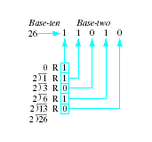
Example Program
Consider a program to
do base conversion of
a number (ten to two)
Note program which assumes existence of a Stack class to accomplish this, Fig 7.2
  Demonstrates push, pop, and top

Slide 8
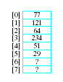
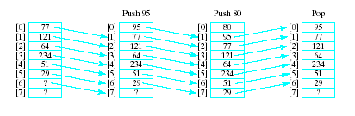
Selecting Storage Structure
Model with an array
  Let position 0 be top of stack
Problem … consider pushing and popping
  Requires much shifting

Slide 9
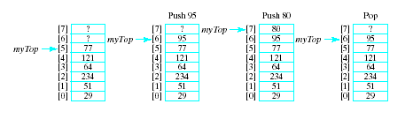
Selecting Storage Structure
A better approach is to let position 0 be the bottom of the stack
Thus our design will include
  An array to hold the stack elements
  An integer to indicate the top of the stack
Note beginning of Stack.h file, Fig. 7.3

Slide 10
Implementing Operations
Constructor
  Compiler will handle allocation of memory
Empty
  Check if value of myTop == -1
Push (if myArray not full)
  Increment myTop by 1
  Store value in myArray [myTop]
Top
  If stack not empty, return myArray[myTop]
Pop
  If array not empty, decrement myTop
Output routine added for testing

Slide 11

The Stack Class
The completed Stack.h file, Fig. 7.4A
  All functions defined
  Note use of typedef mechanism
Implementation file, Stack.cpp, Fig 7.4B
Driver program to test the class, Fig 7.5
  Creates stack of 4 elements
  Demonstrates error checking for stack full, empty

Slide 12
Dynamic Array to Store Stack Elements
Same issues regarding static arrays for stacks as for lists
  Can run out of space if stack set too small
  Can waste space if stack set too large
As before, we demonstrate a dynamic array implementation to solve the problems
Note additional data members required
  DStack Data Members

Slide 13
Dynamic Array to Store Stack Elements
Constructor must
  Check that specified numElements > 0
  Set capacity to numElements
  Allocate an array pointed to by myArray with capacity = myCapacity
  Set myTop to -1 if allocation goes OK
Note implementation of constructor for DStack
Fig 7.6A DStack.h, Fig. 7.6B DStack.cpp

Slide 14

Dynamic Array to Store Stack Elements
Class Destructor needed
  Avoids memory leak
  Deallocates array allocated by constructor
Note destructor definition

Slide 15
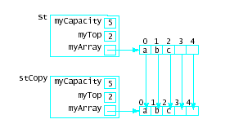
Dynamic Array to Store Stack Elements
Copy Constructor needed for
  Initializations
  Passing value parameter
  Returning a function value
  Creating a temporary storage value
Provides for
deep copy
Note definition

Slide 16
Dynamic Array to Store Stack Elements
Assignment operator
  Again, deep copy needed
  copies member-by-member, not just address
Note implementation of algorithm in operator= definition
View driver program to test DStack class,
Fig. 7.10

Slide 17
Further Considerations
What if dynamic array initially allocated for stack is too small?
  Terminate execution?
  Replace with larger array!
Creating a larger array
  Allocate larger array
  Use loop to copy elements into new array
  Delete old array
  Point myArray variable at this new array

Slide 18
Further Considerations
Another weakness – the type must be set with typedef mechanism
This means we can only have one type of stack in a program
  Would require completely different stack declarations and implementations
Solution coming in Chapter 9
  class templates

Slide 19
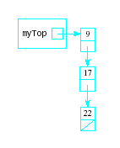
Linked Stacks
Another alternative to allowing stacks to grow as needed
Linked list stack needs only one data member
  Pointer myTop
  Nodes allocated (but not
  part of stack class)
Note declaration, Fig. 7-11

Slide 20
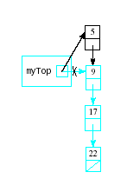
Implementing Linked Stack Operations
Constructor
  Simply assign null pointer to myTop
Empty
  Check for myTop == null
Push
  Insertion at beginning of list
Top
  Return data to which myTop
  points
View definitions in Fig. 7.12

Slide 21
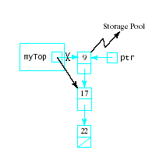
Implementing Linked Stack Operations
Pop
  Delete first node in the
  linked list
  ptr = myTop;
  myTop = myTop->next;
  delete ptr;
Output
  Traverse the list
  for (ptr = myTop;
  ptr != 0; ptr = ptr->next)
  out << ptr->data << endl;
View definitions in Fig. 7.12

Slide 22
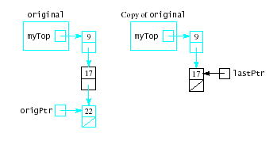
Implementing Linked Stack Operations
Destructor
  Must traverse list and deallocate nodes
  Note need to keep track of ptr->next before calling delete ptr;
Copy Constructor
  Traverse linked list,
  copying each into
  new node
  Attach new node
  to copy
View definitions in Fig. 7.12

Slide 23
Implementing Linked Stack Operations
Assignment operator
  Similar to copy constructor
  Must first rule out self assignment
  Must destroy list in stack being assigned a new value
View completed linked list version of stack class, Fig 7.12
Note driver program, Fig. 7.12C

Slide 24
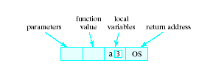
Application of Stacks
Consider events when a function begins execution
Activation record (or stack frame) is created
Stores the current environment for that function.
Contents:

Slide 25
Run-time Stack
Functions may call other functions
  interrupt their own execution
Must store the activation records to be recovered
  system then reset when first function resumes execution
This algorithm must have LIFO behavior
Structure used is the run-time stack

Slide 26
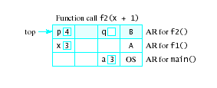
Use of Run-time Stack
When a function is called …
Copy of activation record pushed onto run-time stack
Arguments copied into parameter spaces
Control transferred to starting address of body of function

Slide 27
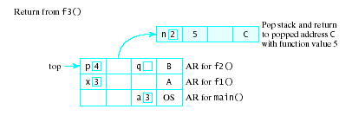
Use of Run-time Stack
When function terminates
Run-time stack popped
  Removes activation record of terminated function
  exposes activation record of previously executing function
Activation record used to restore environment of interrupted function
Interrupted function resumes execution

Slide 28
Application of Stacks
Consider the arithmetic statement in the assignment statement:
x = a * b + c
Compiler must generate
machine instructions
LOAD a
MULT b
ADD c
STORE x
Note: this is "infix" notation
The operators are between the operands

Slide 29
RPN or Postfix Notation
Most compilers convert an expression in infix notation to postfix
  the operators are written after the operands
So a * b + c becomes a b * c +
Advantage:
  expressions can be written without parentheses

Slide 30
Postfix and Prefix Examples
INFIX RPN (POSTFIX) PREFIX
A + B
A * B + C
A * (B + C)
A - (B - (C - D))
A - B - C - D
A B +
+ A B
A B * C +
+ * A B C
A B C + *
* A + B C
A B C D---
-A-B-C D
A B-C-D-
---A B C D
Prefix : Operators come before the operands

Slide 31
Evaluating RPN Expressions
"By hand" (Underlining technique):
1. Scan the expression from left to right to find an operator.
2. Locate ("underline") the last two preceding operands
and combine them using this operator.
3. Repeat until the end of the expression is reached.
Example:
2 3 4 + 5 6 - - *
→ 2 3 4 + 5 6 - - *
→ 2 7 5 6 - - *
→ 2 7 5 6 - - *
→ 2 7 -1 - *
→ 2 7 -1 - * →
2 8 * →
2 8 * →
16

Slide 32
Evaluating RPN Expressions
By using a stack algorithm
Initialize an empty stack
Repeat the following until the end of the expression is encountered
  Get the next token (const, var, operator) in the expression
  Operand – push onto stack
  Operator – do the following
    Pop 2 values from stack
    Apply operator to the two values
    Push resulting value back onto stack
When end of expression encountered, value of expression is the (only) number left in stack
Note: if only 1 value on stack, this is an invalid RPN expression

Slide 33
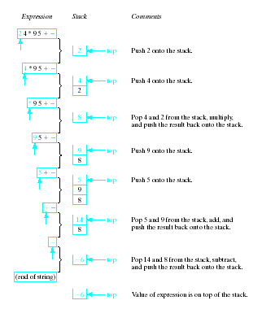
Evaluation of Postfix
Note the
changing
status of the
stack

Slide 34
Converting Infix to RPN
By hand: Represent infix expression as an expression tree:
A * B + C
A * (B + C)
((A + B) * C) / (D - E)
+
*
/
*
A
*
-
C
+
A
B
+
C
D
E
B
C
x Δ y
Δ
A
B
x
y

Slide 35
Traverse the tree in Left-Right-Parent
order (postorder) to get RPN:
/
*
-
A
B
+
C
*
D
E
-
/
+
C
D
E
Traverse tree in Parent-Left-Right
order (preorder) to get prefix:
/
A
B
*
-
/ * + A B
- D E
C
+
C
D
E
Traverse tree in Left-Parent-Right
order (inorder) to get infix:
— must insert ()'s
/
A
B
*
-
+
C
D
E
( )
/
( * C)
(A + B)
(D - E)
A
B

Slide 36
Another RPN Conversion Method
By hand: "Fully parenthesize-move-erase" method:
1. Fully parenthesize the expression.
2. Replace each right parenthesis by the corresponding operator.
3. Erase all left parentheses.
Examples:
A * B + C →
((A * B) + C)
A * (B + C) →
(A * (B + C) )
→ ((A B * C +
→ A B * C +
→ (A (B C + *
→ A B C + *

Slide 37
Stack Algorithm
Initialize an empty stack of operators
While no error && !end of expression
  Get next input "token" from infix expression
  If token is …
    "(" : push onto stack
    ")" : pop and display stack elements until
    "(" occurs, do not display it
const, var, arith operator, left or right paren

Slide 38
Stack Algorithm
Note: Left parenthesis in stack has lower priority
than operators
    operator
    if operator has higher priority than top of stack
    push token onto stack
    else
    pop and display top of stack
    repeat comparison of token with top of stack
    operand display it
When end of infix reached, pop and display stack items until empty

Slide 39
Sample Program
Converts infix expression to postfix
  Uses Stack data type (dynamically allocated version)
  View Fig 7.15
  User enters elements of infix expressions separated by spaces
  Program generates postfix expression
  Also notes invalid infix expressions

