Slide 1
OOP and ADTs
Chapter 14

Slide 2
Chapter Contents
14.1 A Brief History and Overview of OOP and ADTs
14.2 Inheritance and Object-Oriented Design
14.3 Building Derived Classes
14.4 Case Study: Payroll
14.5 Polymorphism, Virtual Functions, and ADTs
14.6 Case Study: A Heterogeneous Data Structure

Slide 3
Chapter Objectives
Study the basic properties of object-oriented programming: encapsulation, inheritance, an polymorphism
Discuss object-oriented design and the role inheritance plays in it
Describe how inheritance is implemented in C++
Look at examples of inheritance and class hierarchies
Describe the need for polymorphism and how it is accomplished in C++ by means of virtual functions and late-binding

Slide 4
History, Overview
Languages such as Pascal and C facilitated development of structured programs
Need for ability to extend and reuse software became evident
These lead to object-oriented programming
  First used in Smalltalk
  More widely available in C++ and Java

Slide 5
Encapsulation
Data and basic operations for processing this data are encapsulated into a single entity
Made possible with introduction of
  Units
  Modules
  Libraries
  Packages
Implementation details separated from definition
  Client code must use only public operations
  Implementation may be changed without affecting client code

Slide 6

Inheritance
A class can be derived from another class
  New class inherits data and function members from original class
  Reusable for the new class
Example:
  Consider need to add max() and min() functions to capability of a stack
  Could simply add these functions to the class
  But … alters already proven code

Slide 7
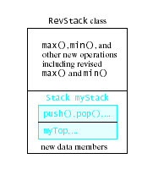
Inheritance
Adapter approach
  Build a new RevStack class
  Contains Stack object as
  its member
But …
  We cannot say a RevStack is a Stack
  It only contains a Stack

Slide 8
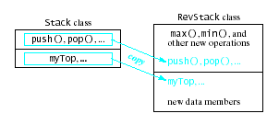
Inheritance
Copy-&-paste approach
  Build a RevStack class
  Copy, paste all Stack data
  members and function members in
  Add the max() and min()
Problem
  RevStack and Stack are still separate and independent classes
  If we update Stack, we must change RevStack versions

Slide 9
Inheritance
Object-oriented approach
  Derive a new class, RevStack from Stack
  Stack is the base class or superclass
  RevStack is derived class or subclass
Derived class inherits all members of base class
Modifying Stack class automatically updates Revstack class

Slide 10
Polymorphism and Dynamic Binding
Previous observation of polymorphic behavior in functions and classes
  Function name can be overloaded
  Function template a pattern for multiple functions
  Class template a pattern for multiple classes
In these cases the compiler determines which version of the function or class to use
  Called static or early binding

Slide 11
Polymorphism and Dynamic Binding
Consider the declaration of a stack pointer
Stack * sptr;
  It can point to either a Stack or a RevStack
If we give the command
sptr->display(cout);
  Which code to use (for Stack or RevStack) cannot be determined until runtime
  This is dynamic or late binding

Slide 12
Inheritance and Object-Oriented Design
Simplified approach
Identify objects in problem specs, their types
Identify operations needed to solve the problem
Arrange problem's objects, operations in sequence of steps – algorithm – to solve the problem

Slide 13
Inheritance and Object-Oriented Design
Problems with simplified approach
  Operations not readily found,
  must create functions to accomplish
  Object types not available,
  must design new object types using classes
In designing classes
  Identify all objects
  Group common objects into a base or general class
  Derive less-general classes from base class

Slide 14
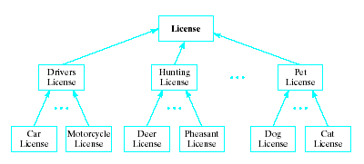
Example: Licenses
We need to model various licenses for a state bureau
We study the variety and note groupings and subgroupings

Slide 15
Base Class
Begin at tree root, License class
class License
{
public:
/*** Function members ***/
void display (ostream & out) const;
void read (istream & in);
// … and other operations
private:
long myNumber;
string myLastName,
myFirstName;
char myMiddleInitial;
int myAge;
Date myBirthDay;
...
};

Slide 16
Derived Classes
class DriversLicense : public License
{
public:
...
private:
int myVehicleType;
string myRestrictionsCode;
...
};
All derived from the License class
class HuntingLicense : public License
{
public:
...
private:
string thePrey;
Date seasonBegin,
seasonEnd;
...
};
class PetLicense : public License
{
protected:
...
private:
string myAnimalType;
...
};

Slide 17
Declaration of a Derived Class
Syntax
DerivedClassName : kind BaseClassName
{
public:
// new data members and
private: // or protected
// functions for derived class
...
}
kind is one of:
- public
- private
- protected

Slide 18
Fundamental Property of Derived Class
Derive class inherits all members of base class
  And members of ancestor classes
Cannot access private members of base class
The kind of access it has to public and protected members depends on kind of inheritance
Kind of inheritance | Kind of access in derived class to public, protected members of base class
public private protected | public & protected, respectively private protected

Slide 19
Relationships Between Classes
When class C2 is derived from class C1
  Class C2 is-a C1
  A HuntingLicense is-a License
Use public inheritance only for is-a relationships

Slide 20
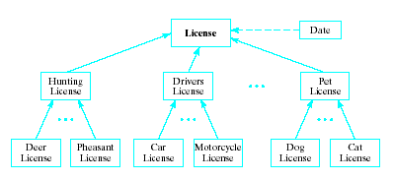
Relationships Between Classes
When class D1 contains a class D2 object as an element
  Then D1 has-a D2
  A License has-a Date
Public inheritance should not be used for has-a relationships

Slide 21
Relationships Between Classes
If class D1 needs information from class D2
  Then D1 uses-a D2
  An AutoInsurance class needs the name from a DriversLicense class
AutoInsurance

Slide 22
Building Derived Classes
Derived class constructors
  Use parent class's constructors to initialize base class members
  Is actually a call to the base class constructor
  Called the member-initializer list
Accessing inherited data members
  If base class data public, derived class can access, even alter it
  If base class data private, must use accessor functions
  If base class protected, may also alter it
Author's preference is for private data, accessor functions

Slide 23
Building Derived Classes
Reusing Operations
  Derived class may extend or replace base class function of same name
  Possible to call the base class function with scope resolution operator
  void DerivedClass::whatever()
  { BaseClass::whatever();
  . . . }

Slide 24
Example: Stacks and Bounded Stacks
Consider need for a stack with limit on size
  Design BoundedStack class
We need to ask
  Can we say a BoundedStack is-a Stack?
If so, we can derive it from Stack
May not be
  Needs altered push() method for full stack
  What does that do to inheritance?
Note BoundedStack interface, Fig. 14.1
View use of this for conversion of numbers from base 10 to base 2, Fig. 14.2

Slide 25
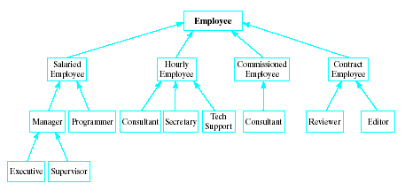
Case Study: Payroll
Problem:
  Firm has variety of types of employees
  Pay calculated differently for each
Design
  Look for commonality for all types of employees
  Define base class for common data members

Slide 26
Case Study: Payroll
View base Employee Class, Fig 14.3A
  Derived class SalariedEmployee, Fig. 14.3B
  Derived Class HourlyEmployee, Fig. 14.3C
  Driver program to test base and derived classes, Fig. 14.3D

Slide 27
Why Polymorphism Needed
Note display() functions and overloaded output operator<<
  Declared, defined only for base class
  This works because of is-a relationship
Note that only the Employee class data is displayed in this context
  We need other data to also be displayed
  The output operator<< function must be made polymorphic … it must know which version to use

Slide 28
Virtual Functions, Dynamic Binding
Which version is called must be deferred to run time
  Dynamic binding
Accomplished with virtual functions
  Compiler creates a virtual function table (vtbl) for each object containing virtual functions
  Table of pointers to actual code for required function
For our example we make display() a virtual function
  Note source code, Fig. 14.4A, driver program Fig. 14.4B

Slide 29
Example 1: Using Handles
A handle is a variable whose value is the address of that object
  It is a pointer variable
  Refers to the object indirectly
Handle for base class object
  Can also refer to any derived class object
  Employee * eptr;
  eptr = new Employee(); or
  eptr = new SaleriedEmployee();
Then eptr->display(cout); will always work

Slide 30
Example 2: Stack, BoundedStack
Consider need for new operation, repeatedPush() to both Stack BoundedStack
Possible solution
  Add function template to base class Stack
    Let BoundedStack inherit
  Note use of this approach, Fig 14.5
Note also (pg 837 of text) invalid output this strategy produces

Slide 31
Example 2: Stack, BoundedStack
Best solution
  Make push() a virtual function in base class
  virtual void push
  (const ElementType & value);
Result is that repeatedPush() for BoundedStack objects now uses correct version of push()

Slide 32
Pure Virtual Functions, Abstract Classes
Abstract class
  Where no definition provided for one or more of function members
  These function members said to be pure virtual functions
View source code for Document class
  Note use of keyword virtual and = 0 at end of declarations
  This makes them pure virtual functions
  Cannot declare instances of base class
View source code of derived class, License

Slide 33

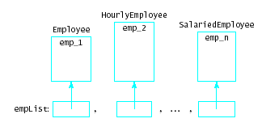
Case Study: Heterogeneous Data Structure
Consider processing of a list empList of employees
If we specify a list
of handles (pointers)
they can point to
different derived types
List<Employee *> empList;

Slide 34
Need for Virtual Functions
Suppose our Employee base class has output member function display()
  Each descendant class also has its own display()
Now when we traverse list and call
empList[x]->display(cout);
  We need polymorphic behavior
  Same function call produces different results in different contexts
Note application
  Header file for derived class Manager, Fig. 14.6A
  Driver program Fig. 14.6b

