Slide 1

Trees
Chapter 15

Slide 2
Chapter Contents
15.1 Case Study: Huffman Codes
15.2 Tree Balancing: AVL Trees
15.3 2-3-4 Trees
Red-Black Trees
B-Trees
Other Trees
15.4 Associative Containers in STL – Maps (optional)

Slide 3
Chapter Objectives
Show how binary trees can be used to develop efficient codes
Study problem of binary search trees becoming unbalanced
  Look at classical AVL approach for solution
Look at other kinds of trees, including 2-3-4 trees, red-black trees, and B-trees
Introduce the associate containers in STL and see how red-black trees are used in implementation

Slide 4
Case Study: Huffman Codes
Recall that ASCII, EBCDIC, and Unicode use same size data structure for all characters
Contrast Morse code
  Uses variable-length sequences
Some situations require this variable-length coding scheme

Slide 5


Variable-Length Codes
Each character in such a code
  Has a weight (probability) and a length
The expected length is the sum of the products of the weights and lengths for all
the characters
0.2 x 2 + 0.1 x 4 +
0.1 x 4 + 0.15 x 3 + 0.45 x 1 = 2.1

Slide 6

Immediate Decodability
When no sequence of bits that represents a character is a prefix of a longer sequence for another character
  Can be decoded without waiting for remaining bits
Note how previous scheme is not immediately decodable
And this one is

Slide 7
Huffman Codes
We seek codes that are
  Immediately decodable
  Each character has minimal expected code length
For a set of n characters { C₁ .. C_{n} } with weights { w₁ .. w_{n} }
  We need an algorithm which generates n bit strings representing the codes

Slide 8
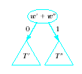
Huffman's Algorithm
Initialize list of n one-node binary trees containing a weight for each character
Do the following n – 1 times
a. Find two trees T' and T" in list with minimal weights w' and w"
b. Replace these two trees with a binary tree whose root is w' + w" and whose
subtrees are T' and T"
and label points to these
subtrees 0 and 1

Slide 9

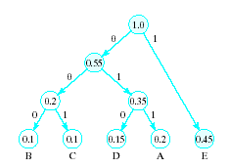
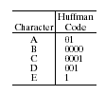
Huffman's Algorithm
The code for character C_{i} is the bit string labeling a path in the final binary tree form from the root to C_{i}
Given characters
The end with codes
result is

Slide 10
Huffman Decoding Algorithm
Initialize pointer p to root of Huffman tree
While end of message string not reached do the following
a. Let x be next bit in string
b. if x = 0 set p equal to left child pointer
else set p to right child pointer
c. If p points to leaf
i. Display character with that leaf
ii. Reset p to root of Huffman tree

Slide 11

Huffman Decoding Algorithm
For message string 010101001010
  Using Hoffman Tree and decoding algorithm
Click for answer

Slide 12
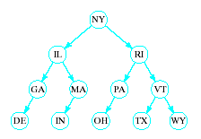
Tree Balancing: AVL Trees
Consider a BST of
state abbreviations
When tree is nicely
balanced, search time is O(log₂n)
If abbreviations entered in order
DE, GA, IL, IN, MA, MI, NY, OH, PA, RI, TX, VT, WY
  BST degenerates into linked list with
  search time O(n)

Slide 13
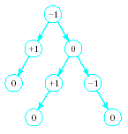
AVL Trees
A height balanced tree
  Named with initials of Russian mathematicians who devised them
Defined as
  Binary search tree
  Balance factor of
  each node is
  0, 1, or -1
(Balance factor of a node = left height of sub tree minus right height of subtree)

Slide 14
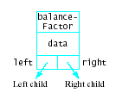
AVL Trees
Consider linked structure to represent AVL tree nodes
  Includes data member for the balance factor
Note source code for AVLTree class template

Slide 15
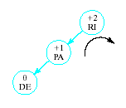

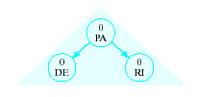
AVL Trees
Insertions may require adjustment of the tree to maintain balance
  Given tree
  Becomes unbalanced
  Requires right rotation on subtree of RI
  Producing balanced tree
Insert DE

Slide 16
Basic Rebalancing Rotations
Simple right rotation
When inserted item in left subtree of left child of nearest ancestor with factor +2
Simple left rotation
When inserted item in right subtree of right child of nearest ancestor with factor -2
Left-right rotation
When inserted item in right subtree of left child of nearest ancestor with factor +2
Right-left rotation
When inserted item in left subtree of right child of nearest ancestor with factor -2

Slide 17
Basic Rebalancing Rotations
Rotations carried out by resetting links
Right rotation with A = nearest ancestor of inserted item with balance factor +2 and
B = left child
  Resent link from parent of A to B
  Set left link of A equal to right link of B
  Set right link of B to point A
Next slide shows this sequence

Slide 18
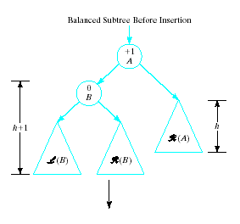
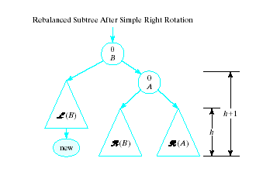
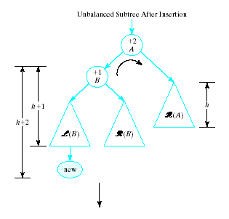
Basic Rebalancing Rotations

Slide 19
Basic Rebalancing Rotations
Right-Left rotation
Item C inserted in right subtree of left child B of nearest ancestor A
Set left link of A to point to root of C
Set right link of B equal to left link of C
Set left link of C to point to B
Now the right rotation
Resent link from parent of A to point to C
Set link of A equal to right link of C
Set right link of C to point to A

Slide 20
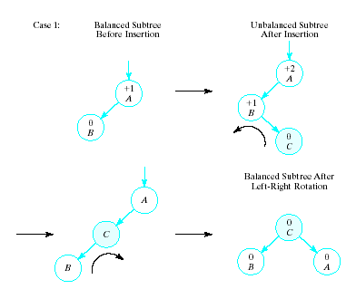
Basic Rebalancing Rotations
When B has no right child before node C insertion

Slide 21
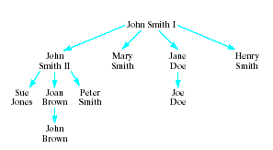
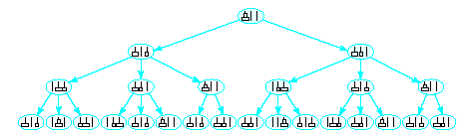
Non Binary Trees
Some applications require more than two children per node
  Genealogical tree
  Game tree

Slide 22
2-3-4 Trees
We extend searching technique for BST
  At a given node we now have multiple paths for a search path may follow
Define m-node in a search tree
  Stores m – 1 data values k₁ < k₂ … < k_{m-1}
  Has links to m subtrees T₁ ..T_{m}
  Where for each i
  all data values in T_{i} < k_{i} ≤ all values in T_{k+1}

Slide 23
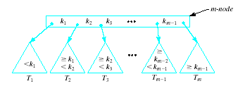
2-3-4 Trees
Example of m-node
Define 2-3-4 tree
  Each node stores at most 3 data values
  Each internode is a 2-node, a 3-node, or a
  4-node
  All the leaves are on the same level

Slide 24
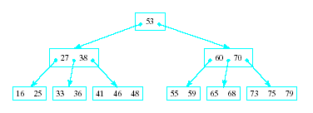
2-3-4 Trees
Example of a 2-3-4
node which stores
integers
To search for 36
  Start at root … 36 < 53, go left
  Next node has 27 < 36 < 38. take middle link
  Find 36 in next lowest node

Slide 25
Building a Balanced 2-3-4 Tree
If tree is empty
  Create a 2-node containing new item, root of tree
Otherwise
  Find leaf node where item should be inserted by repeatedly comparing item with values in node and following appropriate link to child
  If room in leaf node
  Add item
  Otherwise … (ctd)

Slide 26
Building a Balanced 2-3-4 Tree
  Otherwise:
  Split 4-node into 2 nodes, one storing items less than median value, other storing items greater than median. Median value moved to a parent having these 2 nodes as children
  If parent has no room for median, spilt that 4-node in same manner, continuing until either a parent is found with room or reach full root
  If full root 4-node split into two nodes, create new parent 2-node, the new root

Slide 27




Building a Balanced 2-3-4 Tree
Note sequence of building a tree by adding numbers
. . .

Slide 28

Building a Balanced 2-3-4 Tree
Note that last step in algorithm may require multiple splits up the tree
Instead of bottom-up insertion
  Can do top-down insertion
  Do not allow any parent nodes to become 4-nodes
  Split 4-odes along
  search path
  as encountered
Note that 2-3-4 trees stay balanced during insertions and deletions

Slide 29

Implementing 2-3-4 Trees
class Node234
{
public
DataType data[3]; // type of data item in nodes
Node234 * child[4];
// Node234 operations
};
typedef Node234 * Pointer234

Slide 30
Red-Black Trees
Defined as a BST which:
  Has two kinds of links (red and black)
  Every path from root to a leaf node has same number of black links
  No path from root to leaf node has more than two consecutive red links
Data member added to store color of link from parent

Slide 31
Red-Black Trees
enum ColorType {RED, BLACK};
class RedBlackTreeNode
{
public:
DataType data;
ColorType parentColor; // RED or BLACK
RedBlackTreeNode * parent;
RedBlackTreeNode * left;
RedBlackTreeNode * right;
}
Now possible to construct a red-black tree to represent a 2-3-4 tree

Slide 32
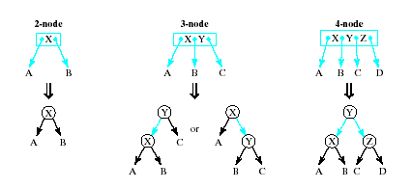
Red-Black Trees
2-3-4 tree represented by red-black trees as follows:
  Make a link black if it is a link in the 2-3-4 tree
  Make a link red if it connects nodes containing values in same node of the 2-3-4 tree

Slide 33
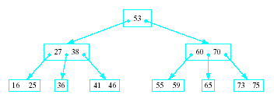
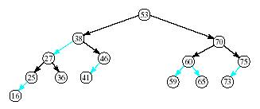
Red-Black Trees
Example: given 2-3-4 tree
Represented by this red-black tree

Slide 34
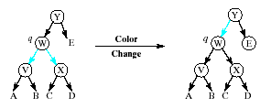
Constructing Red-Black Tree
Do top-down insertion as with 2-3-4 tree
Search for place to insert new node – Keep track of parent, grandparent, great grandparent
When 4-node q encountered, split as follows:
a. Change both links of q to black
b. Change link from parent to red:

Slide 35
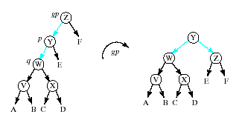
Constructing Red-Black Tree
If now two consecutive red links, (from grandparent gp to parent p to q)
Perform appropriate AVL type rotation determined by direction (left-left, right-right, left-right, right-left) from gp -> p-> q

Slide 36
B-Trees
Previous trees used in internal searching schemes
  Tree sufficiently small to be all in memory
B-tree useful in external searching
  Data stored in 2ndry memory
B-tree has properties
  Each node stores at most m – 1 data values
  Each internal nodes is 2-node, 3-node, …or m-node
  All leaves on same level

Slide 37
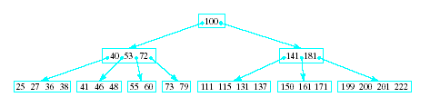
B-Trees
Thus a 2-3-4 tree is a B-tree of order 4
Note example below of order 5 B-tree
Best performance found to be with values for 50 ≤ m ≤ 400

Slide 38
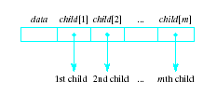
Representing Trees & Forests as Binary Trees
Consider a node
with multiple links
const int MAX_CHILDREN = … ;
class TreeNode
{
public:
DataType data
TreeNode * child[MAX_CHILDREN];
// TreeNode operations
}
typedef TreeNode * TreePointer;
Note problem with wasted space when not all links used

Slide 39
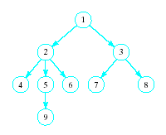
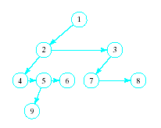
Representing Trees & Forests as Binary Trees
Use binary (two link) tree to represent multiple links
  Use one of the links to connect siblings in order from left to right
  The other link points to first node in this linked list of its children
Note right pointer in root always null

Slide 40
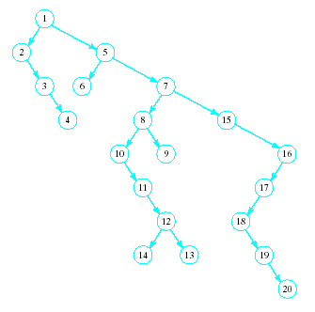
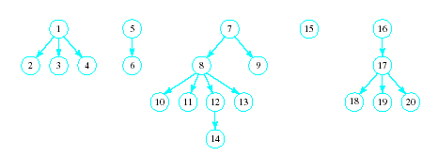
Representing Trees & Forests as Binary Trees
Now possible to represent collection of trees (a forest!)
This collection
becomes

Slide 41
Associative Containers in STL maps (optional)
Contrast to sequential containers
  vector, deque, list, stack, queue
STL also provides associative containers
  set, multiset, map, multimap
Note operations provided
  Table page 896, text
Associative containers implemented with red-black trees
Note that map containers provide subscript operator [ ]

Slide 42
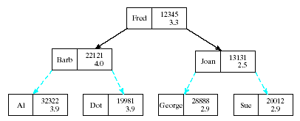
map Containers
Subscript operator allows associative arrays
  The index type may be any type
Declaration
<KeyType, DataType, les<KeyType> > obj;
See example program, Fig 15.1

